Slide 1
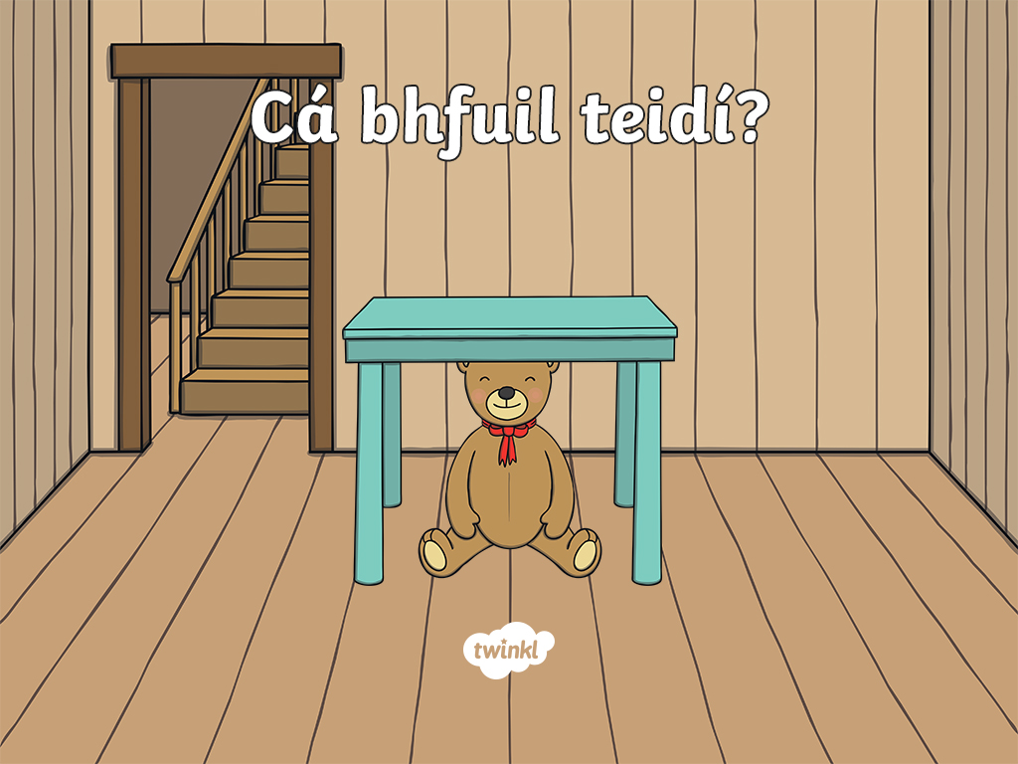

Slide 2
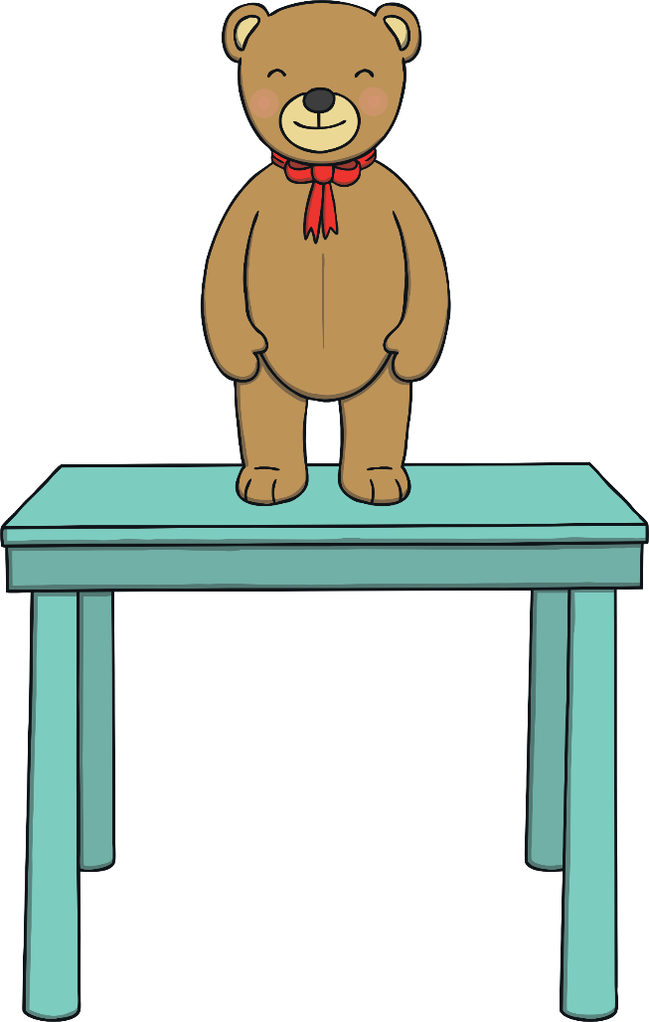
Where is Teddy?

Slide 3
Teddy is on the table.

Slide 4
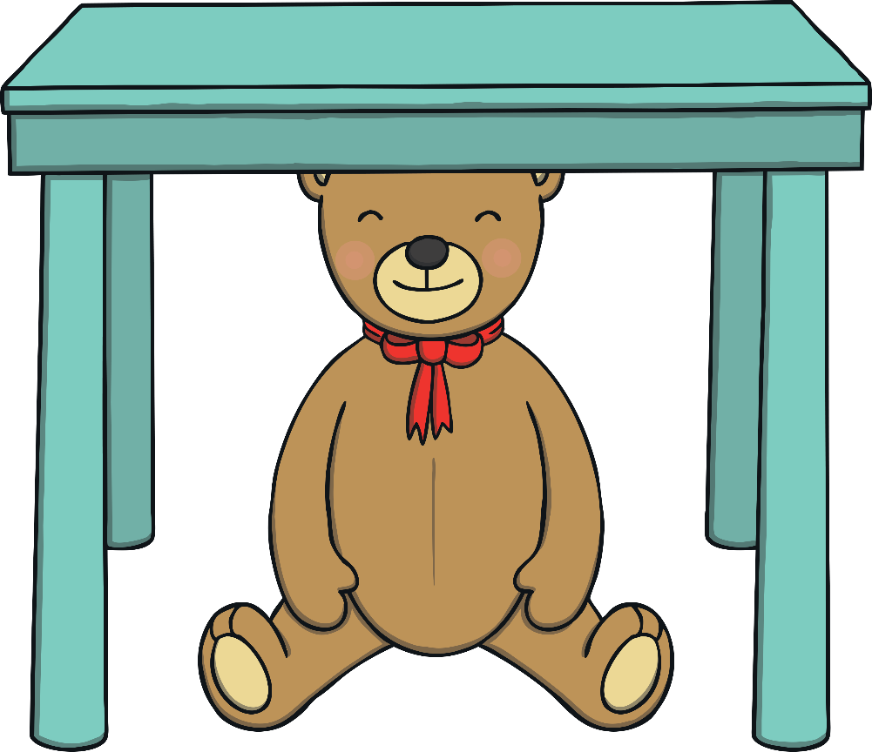
Where is Teddy?

Slide 5
Teddy is under the table.

Slide 6
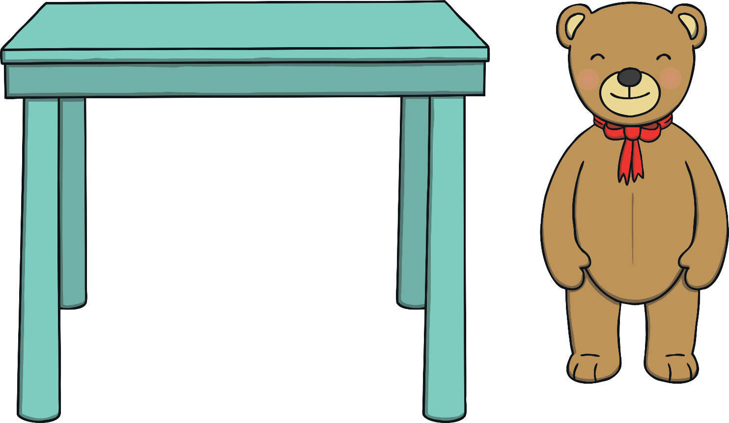
Where is Teddy?

Slide 7
Teddy is beside the table.

Slide 8
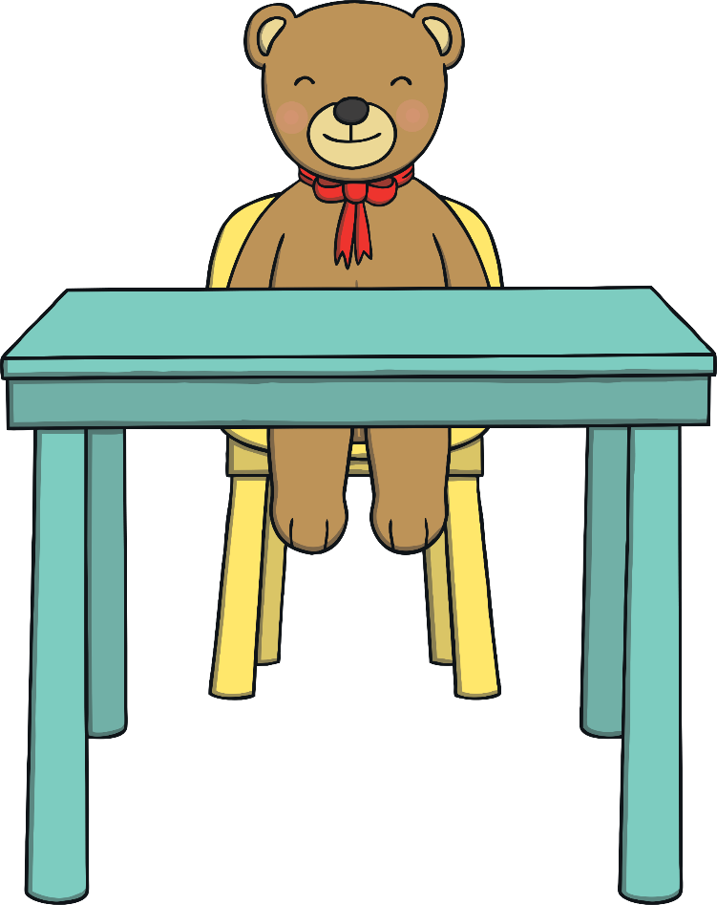
Where is Teddy?

Slide 9
Teddy is at the table.

Slide 10
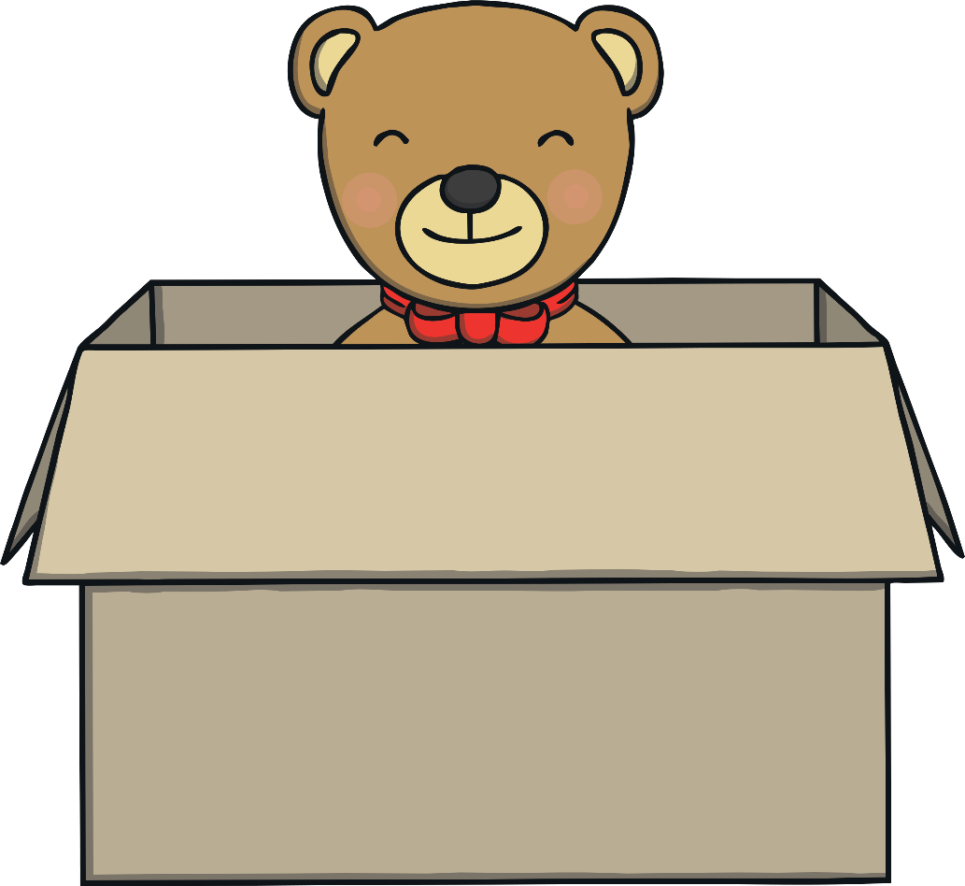
Where is Teddy?

Slide 11
Teddy is in the box.

Slide 12
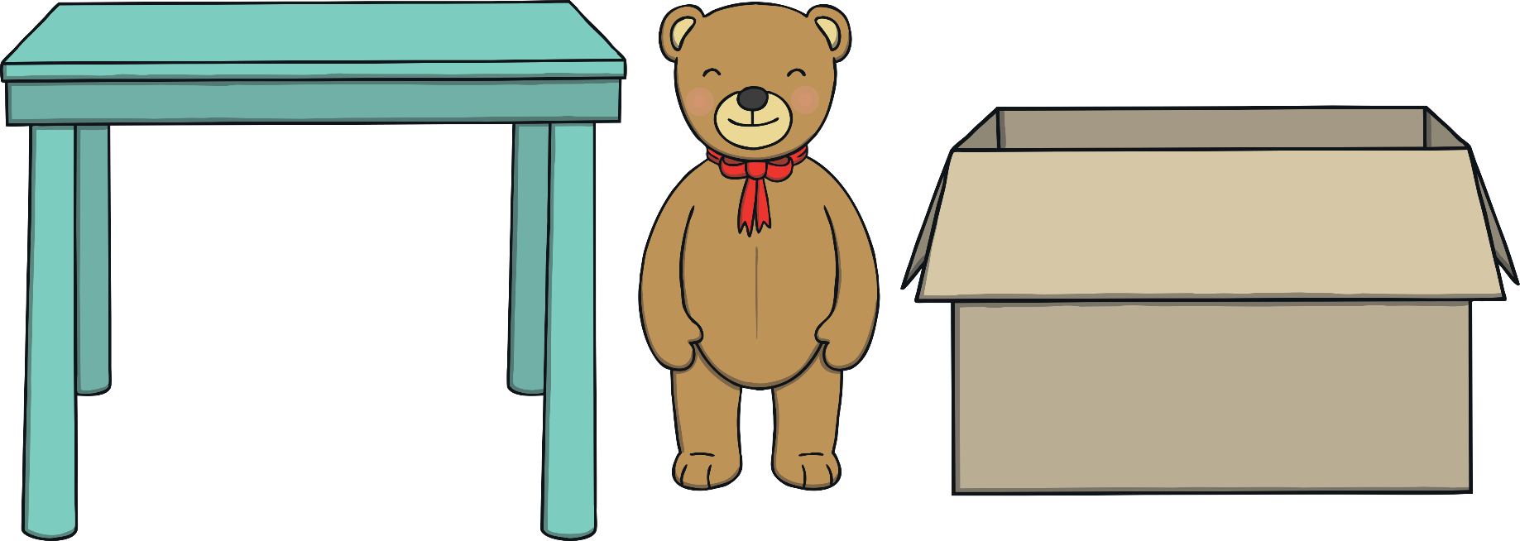
Where is Teddy?

Slide 13
Teddy is between the box and table.

Slide 14


