Slide 1


Science
Animals Including Humans
Science | Animals Including Humans | The Human Body | Lesson 4

Slide 2


Meet Quizby!
I will appear like this, click me to reveal a key question.
Can you spot me in the
Lesson Presentation?
Hi, I’m Quizby!
The questions that appear will help
you to think about the key learning throughout the lesson.

Slide 3
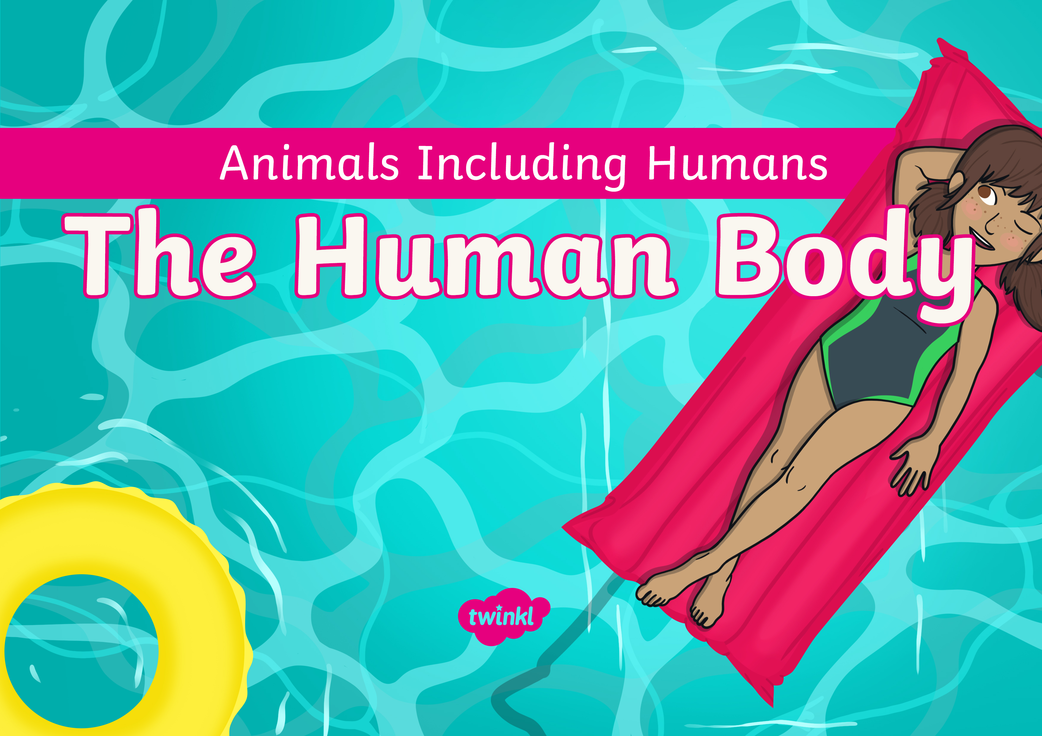

Slide 4
Aim
To name, identify and label the parts of the human body.
Success Criteria
I can name parts of the human body.
I can identify parts of the body.
I can label a diagram to show parts of the body.

Slide 5







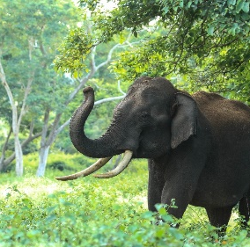
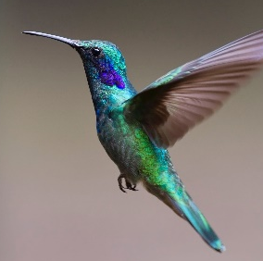
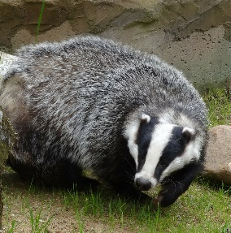
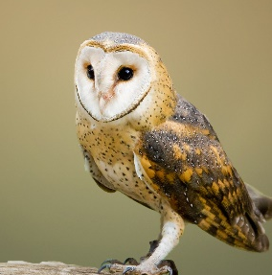
Remember It
Can you sort these animals by the groups they belong to?
Birds | Mammals

Slide 6
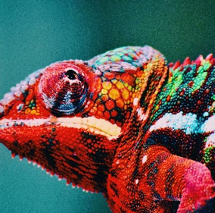
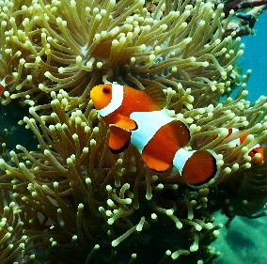
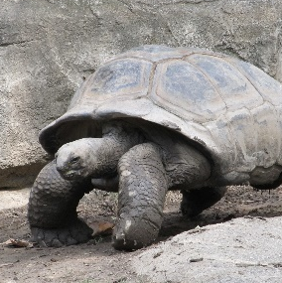
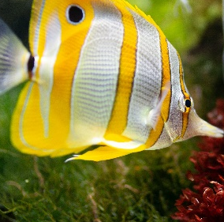
Remember It
Can you sort these animals by the groups they belong to?
Fish | Reptiles

Slide 7
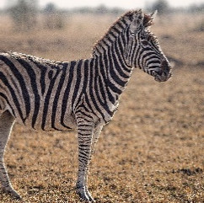

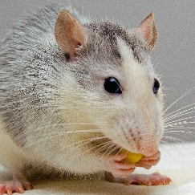
Remember It
Can you sort these animals by the groups they belong to?
Carnivore | Herbivore | Omnivore
I eat grass and
other plants.
I eat other animals such as mice, insects and spiders.
I eat fruit, seeds,
nuts as well as
other animals.

Slide 8
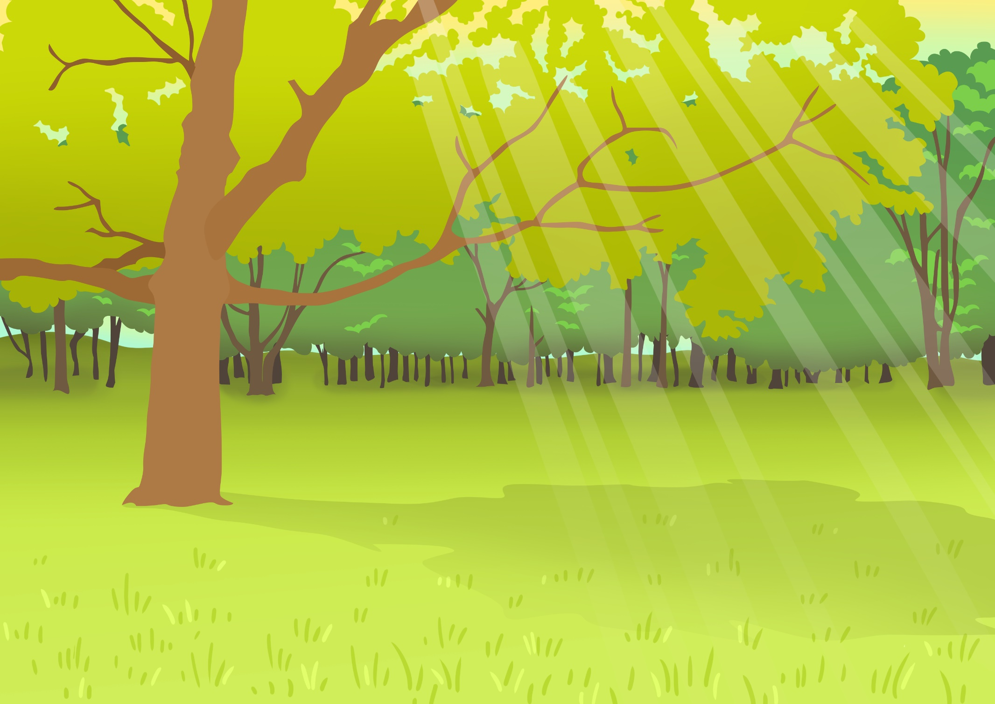

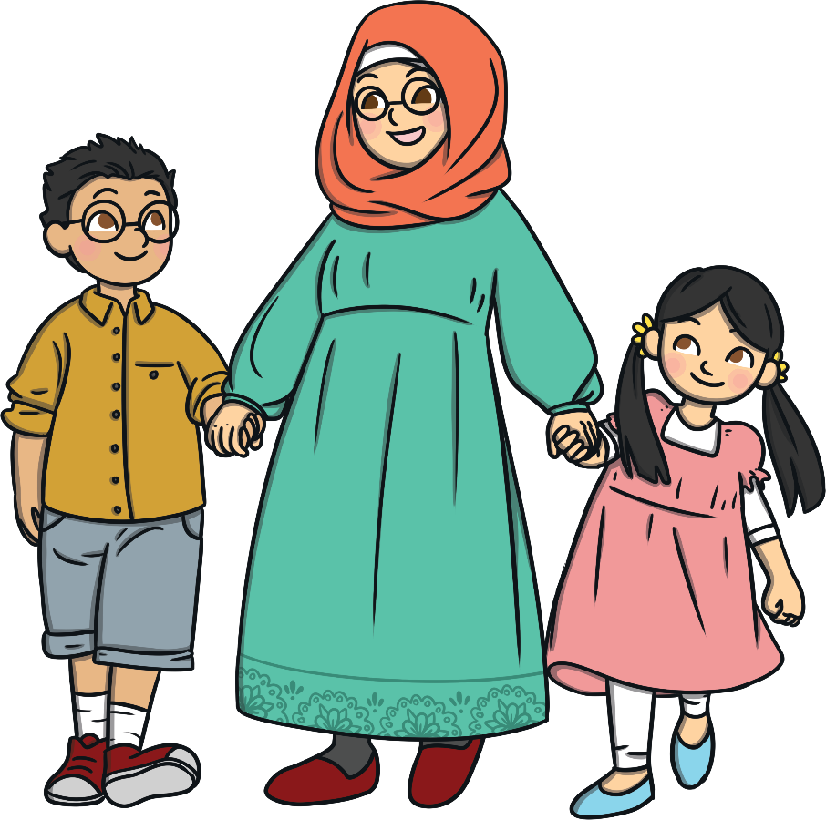
Simon Says
Can you remember what animal group humans belong to?
That’s right – humans are mammals.
We are going to find out about the parts of the human body.

Slide 9
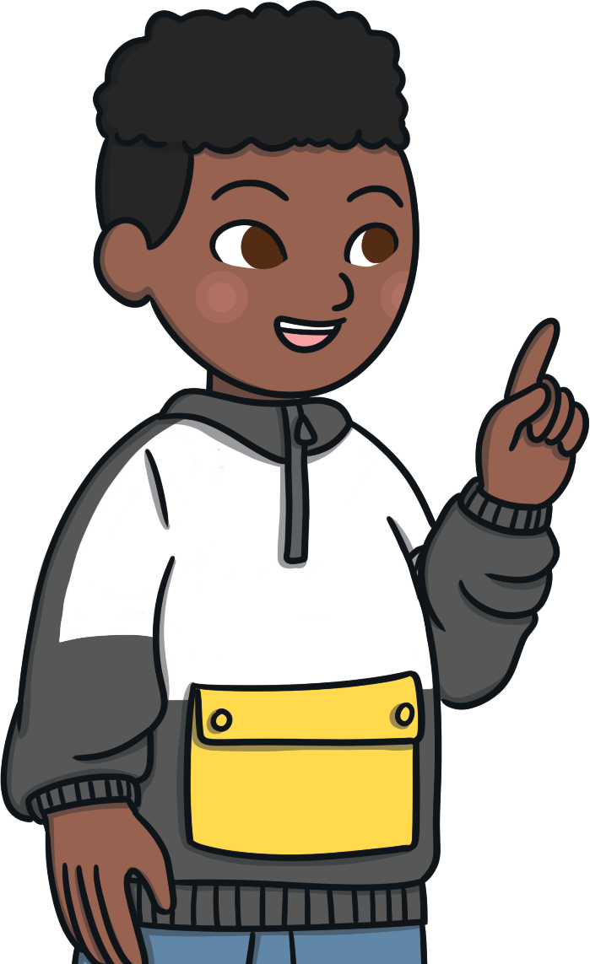
Simon Says
We are going to play Simon Says.
Listen carefully to the instructions.

Slide 10
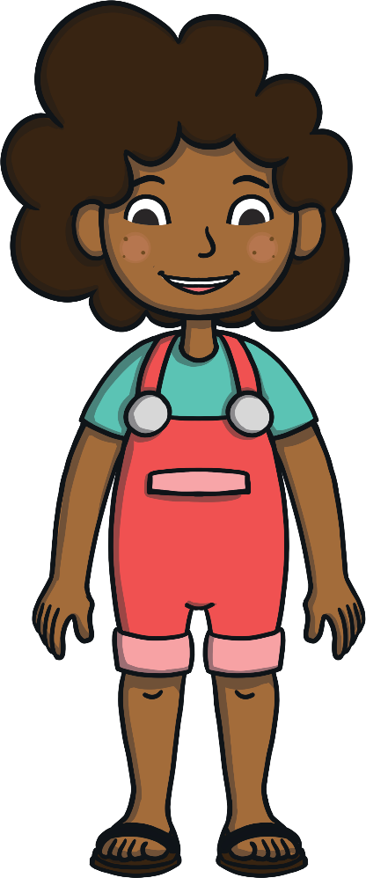

Humans
Our body is made up of lots of different parts.
X
head
hair
Can you help to name the body parts?
ear
eye
teeth
nose
mouth
neck
shoulder
hand
arm
X
Can you name any other parts?
foot
leg

Slide 11
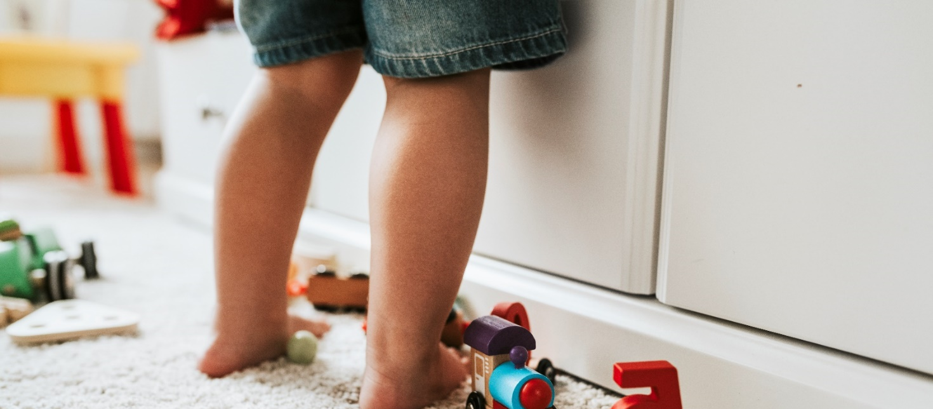
Humans
Each part of your body has its own special job to do.
What do you think the job of each of these body parts is?
These are legs.
What body parts are these?
What is the job of your legs?

Slide 12
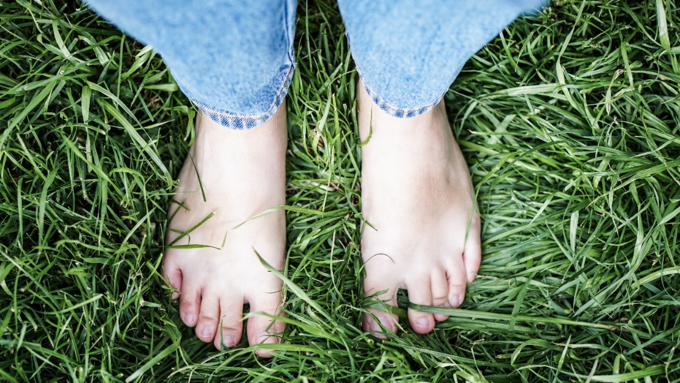
Humans
Each part of your body has its own special job to do.
What do you think the job of each of these body parts is?
These are feet.
What body parts are these?
What is the job of your feet?

Slide 13

Humans
Each part of your body has its own special job to do.
What do you think the job of each of these body parts is?
This is an arm.
What body part is this?
What is the job of your arms?

Slide 14
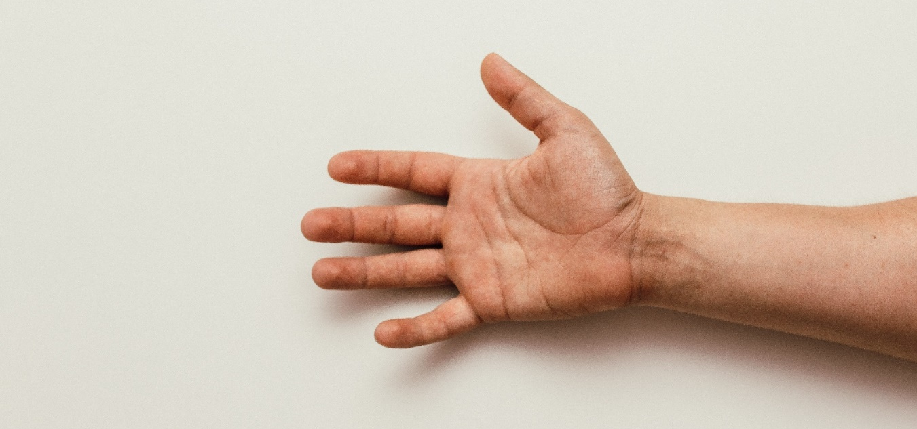
Humans
Each part of your body has its own special job to do.
What do you think the job of each of these body parts is?
This is a hand.
What body part is this?
What is the job of your hands?

Slide 15
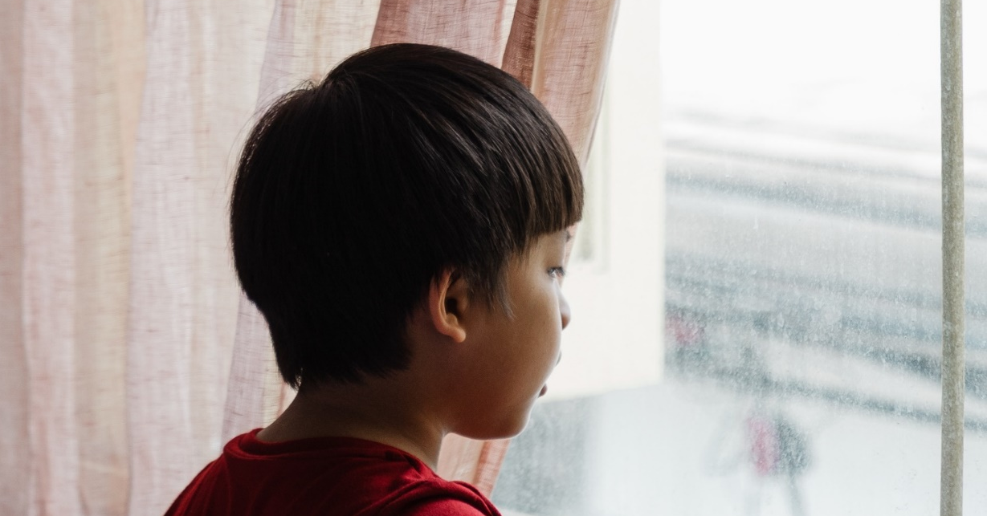
Humans
Each part of your body has its own special job to do.
What do you think the job of each of these body parts is?
This is a head.
What body part is this?
What is the job of your head?

Slide 16

Humans
Each part of your body has its own special job to do.
What do you think the job of each of these body parts is?
This is a neck.
What body part is this?
What is the job of your neck?

Slide 17

Humans
Each part of your body has its own special job to do.
What do you think the job of each of these body parts is?
This is hair.
What body part is this?
What is the job of your hair?

Slide 18
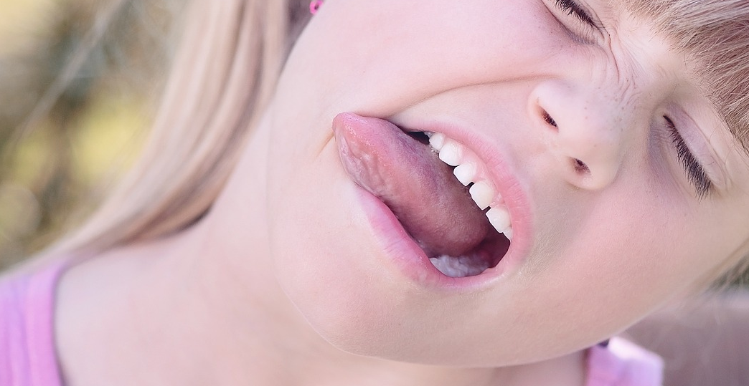
Humans
Each part of your body has its own special job to do.
What do you think the job of each of these body parts is?
This is a mouth.
What body part is this?
What is the job of your mouth?

Slide 19

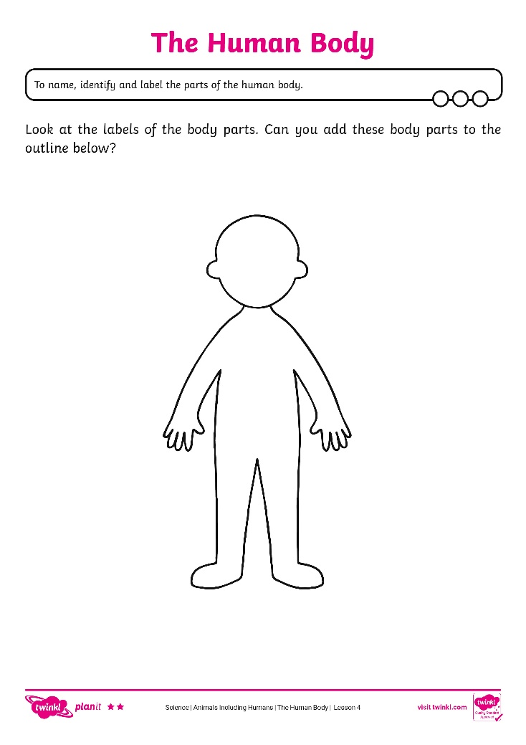
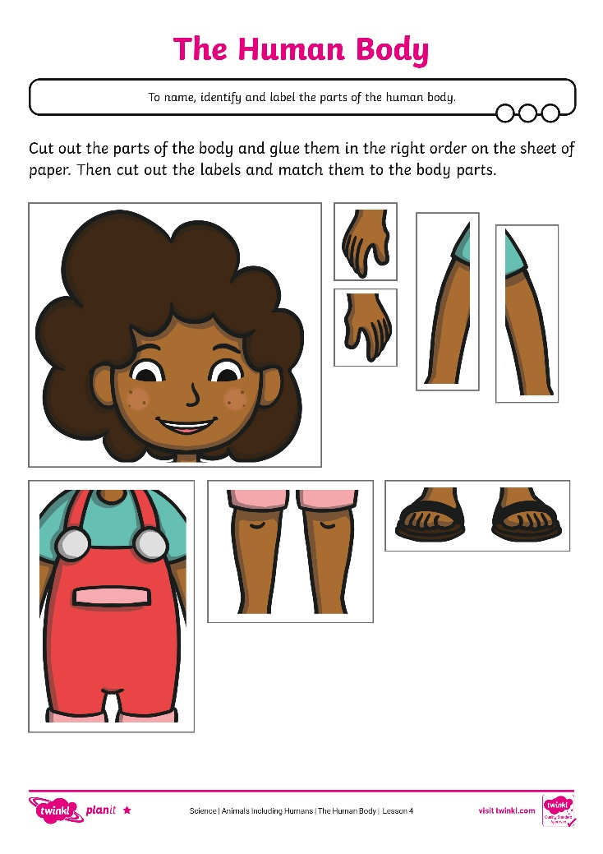
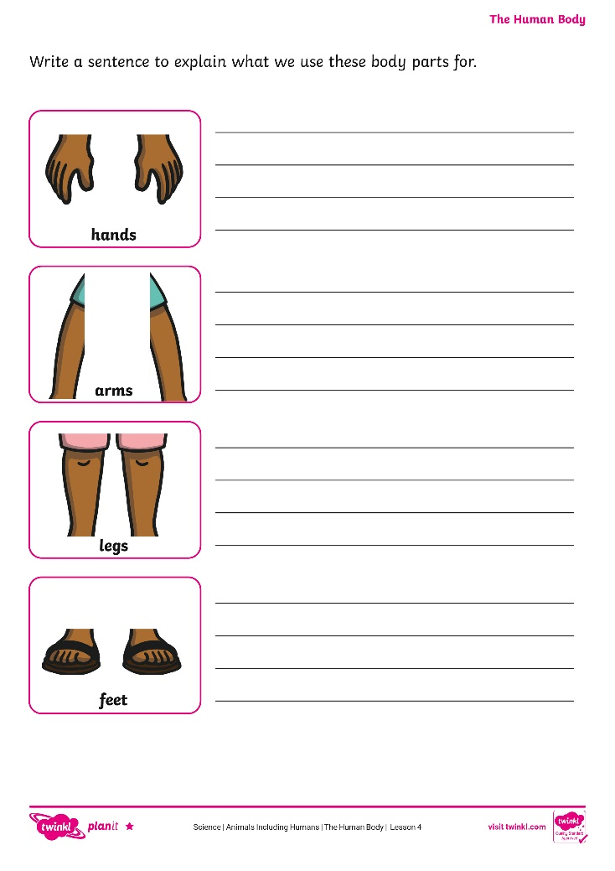

The Human Body
Complete the diagram of the human body by adding the missing body parts in the correct place. When the body is complete, add the labels to your diagram.

Slide 20

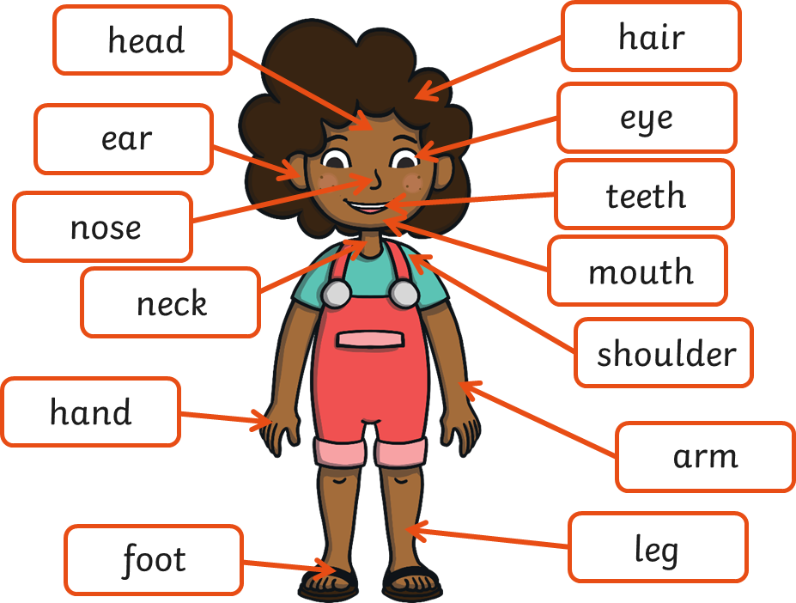
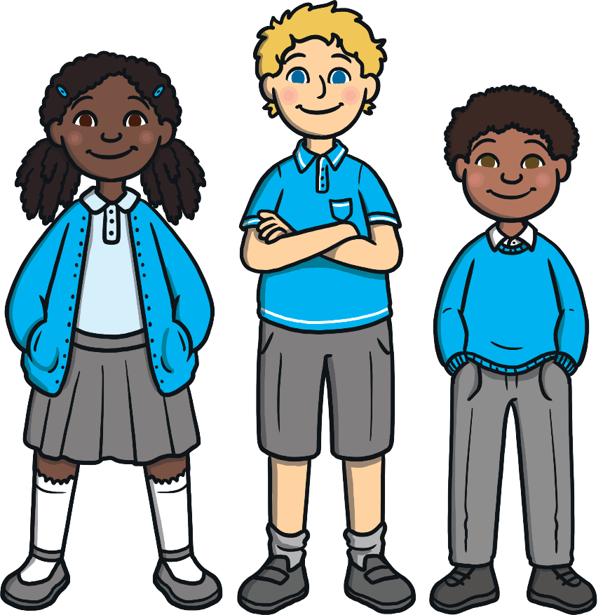
Body Bingo
We are now going to play Body Bingo.

Slide 21
Aim
To name, identify and label the parts of the human body.
Success Criteria
I can name parts of the human body.
I can identify parts of the body.
I can label a diagram to show parts of the body.

