Slide 1
PSHE and Citizenship
Health and Wellbeing | It’s My Body
PSHE and Citizenship | UKS2 | Health and Wellbeing | It’s My Body | Your Body Is Your Own | Lesson 1

Slide 3
We hope you find the information on our website and resources useful. This resource contains potentially sensitive and/or upsetting topics that may emotionally impact on students you use it with due to their experiences in their past. It is your responsibility to consider whether it is appropriate to use this resource with your students. If you do use this resource, it is your responsibility to ensure that appropriate support is available for anyone affected.

Slide 4
Aim
I know that my body belongs to me and that I have control over what happens to it.
Success Criteria
I understand that I can make choices about what happens to my body.
I understand the difference between wanted and unwanted contact.
I know what to do if I am worried about myself or a friend.
This resource is fully in line with the Learning Outcomes and Core Themes outlined in the PSHE Association’s Programme of Study.

Slide 5
The Big Questions

Slide 6

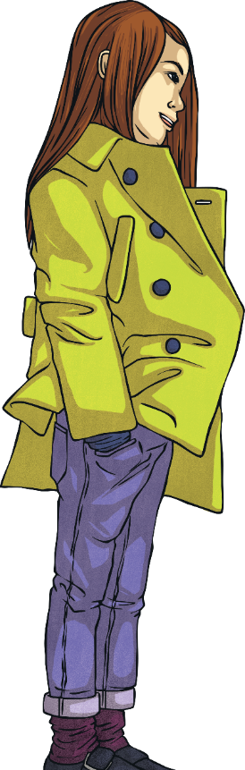
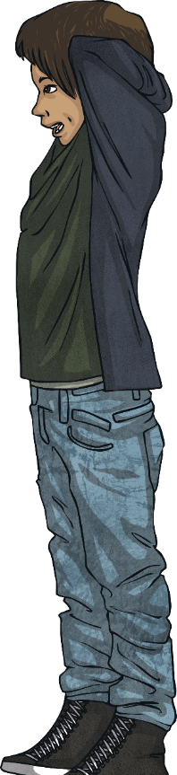
Why is looking after our bodies
so important?
What is autonomy and what
is consent?

Slide 7
Reconnecting

Slide 8

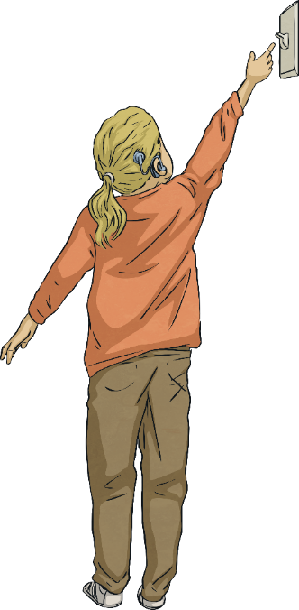
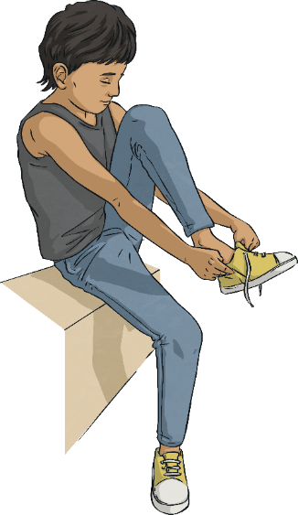
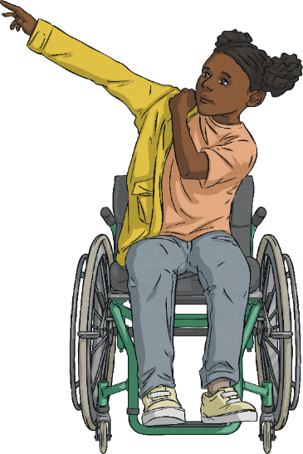
Choice, Control, Consent
The three Cs –
choice,
control
and
consent.
Everyone has choices they can make every day.

Slide 9
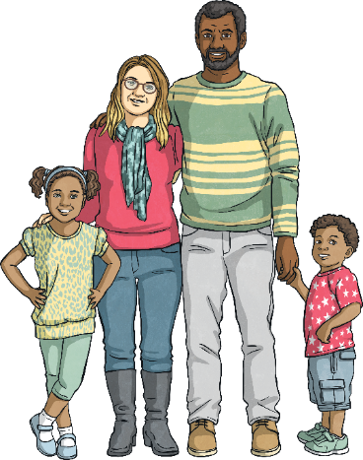
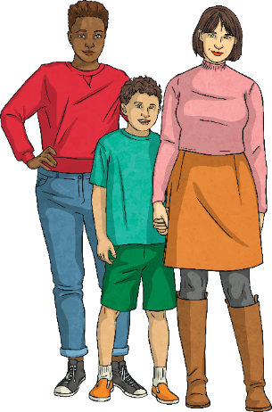
Choice, Control, Consent
We all have control over some aspects of our lives.
However, we are all different and live in different families with different rules. So, you might not be allowed to do something your friend is allowed to do but you have the same right to autonomy as everyone else.

Slide 10

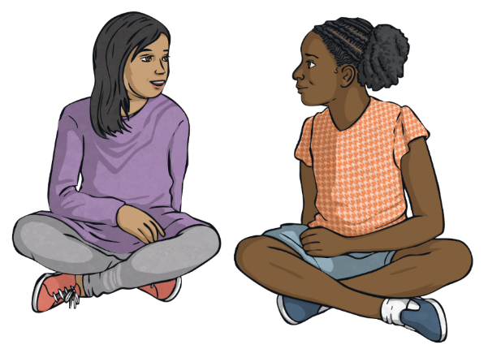
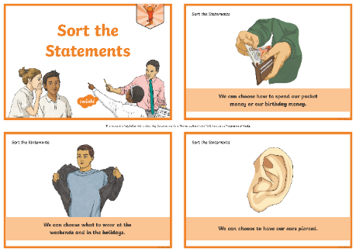
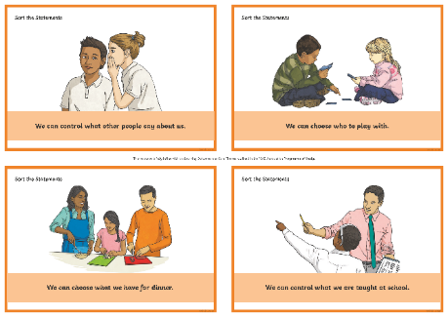
Choice, Control, Consent
The things we have choices about and control over may differ
from person to person.
In your groups, discuss the statements and sort them into two piles:
things which we have choice and control over;
things that we do not have choice and control over.

Slide 11
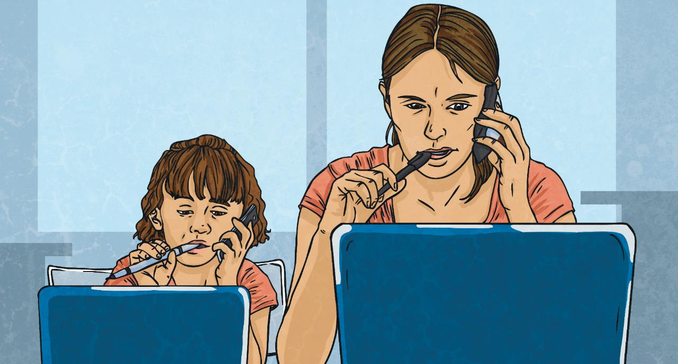
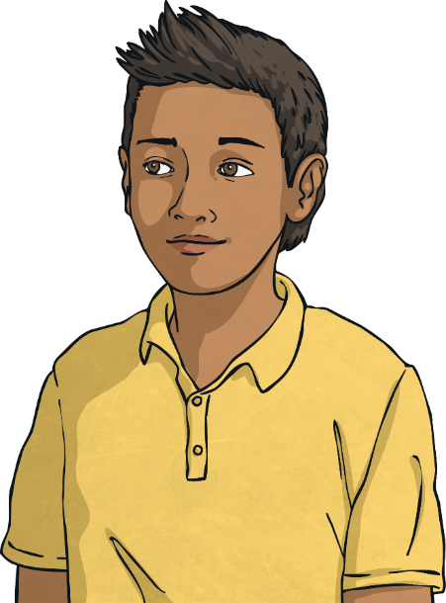
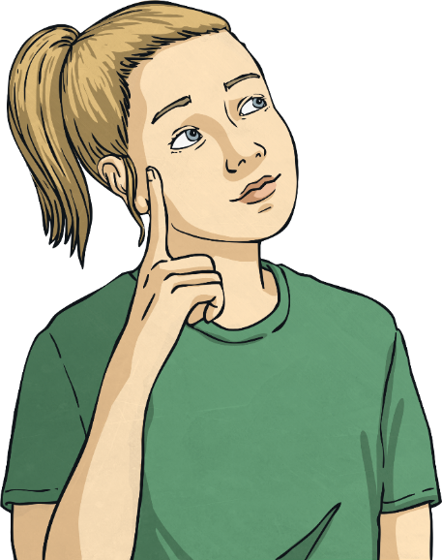
Choice, Control, Consent
Did everyone in the group agree about having choice and control over the same things?
How did you get on?
Sometimes, we have limited choice or control, especially when we are young and our parents or carers make a lot of decisions for us.
Choice and control are two of the three Cs. Let’s take a look at the third – consent.
Is there an area of your life about which you wish you had more choice or more control?

Slide 12
Exploring

Slide 13
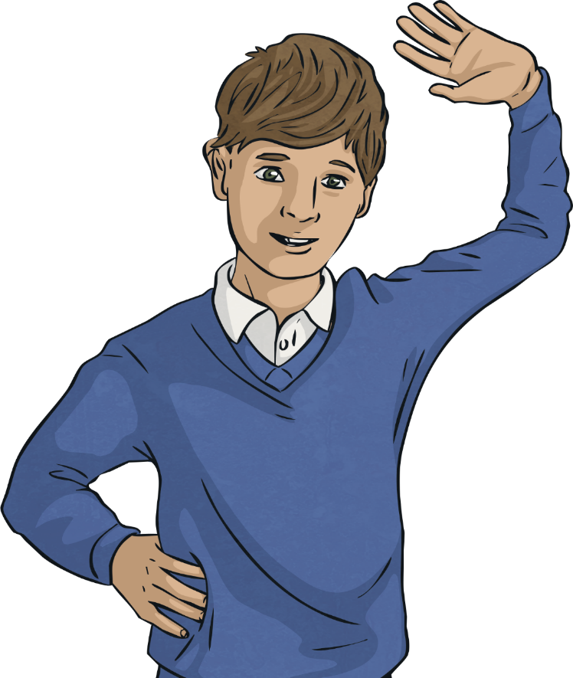
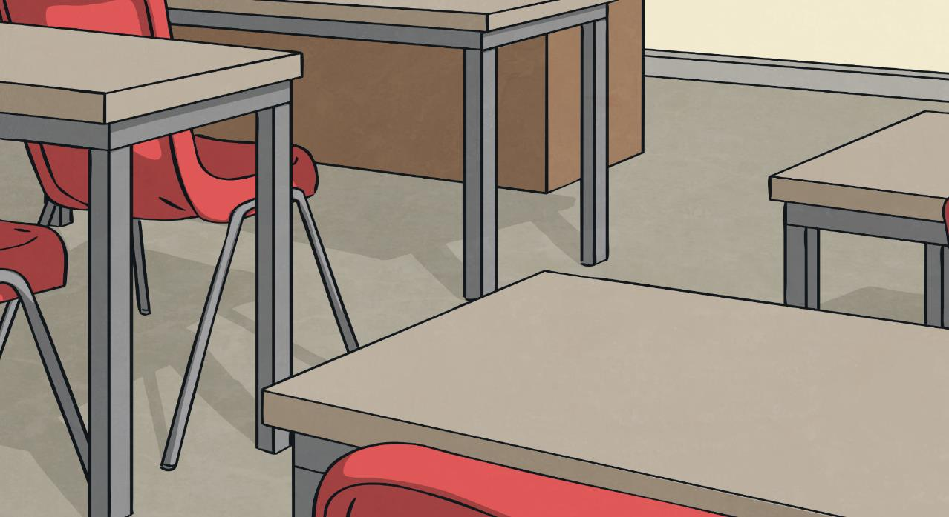

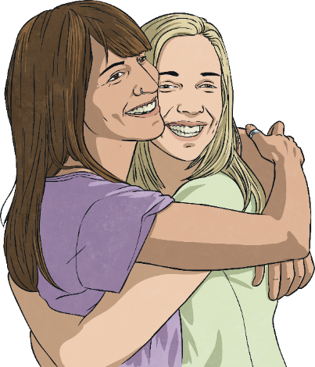

Autonomy – It’s up to Me
What does the word consent mean?
In addition to having choices and control over what happens to our bodies, we have to consent to someone else doing something to our bodies.
The dictionary defines consent as:
This is because your body is your own. It belongs to you and no one else. You can decide what does and does not happen to
your body.
‘permission for something to happen
or agreement to
do something.’

Slide 14
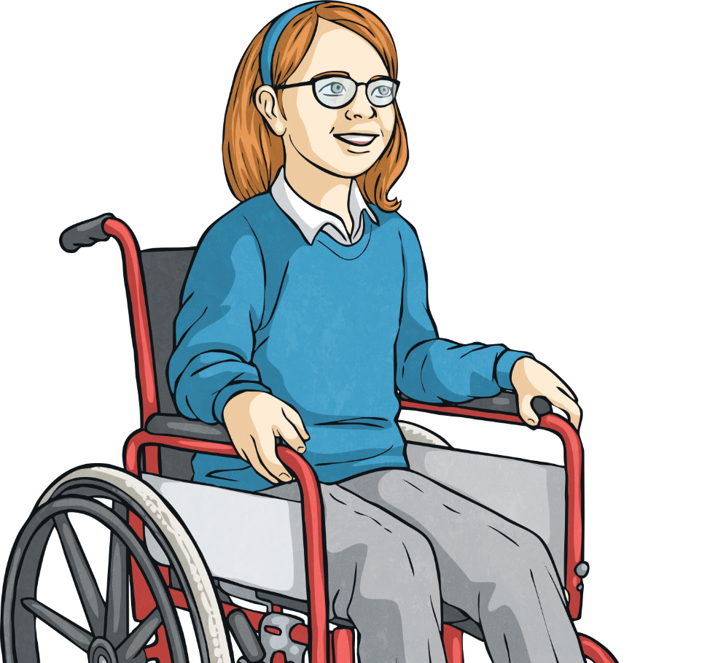
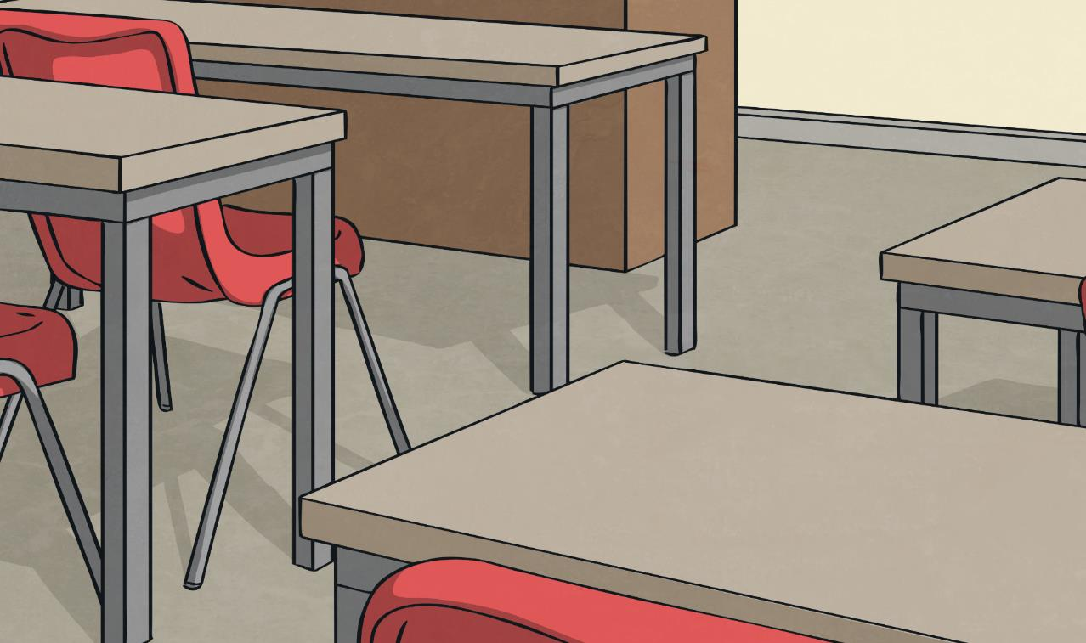
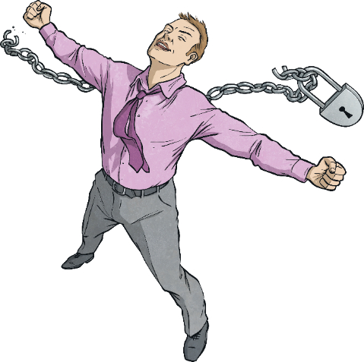
Autonomy – It’s up to Me
No individual should have control over another – we all have the right to be free from the control or influence of others.
The dictionary defines autonomy as:
We do not have to do something that we are not comfortable about, even if others say we have to or if they threaten us in
some way.
‘freedom from external control or influence; independence.’

Slide 15
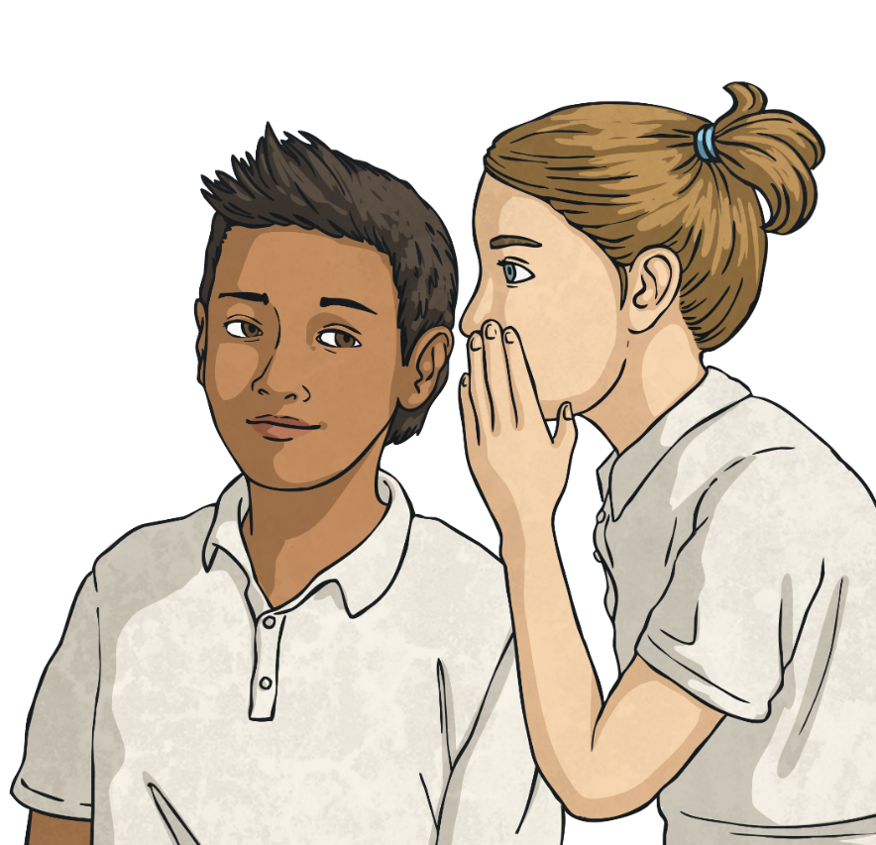
Autonomy – It’s up to Me
We do not have to keep something a secret if we
do not want to.
If something does not feel right, tell someone you trust.
We all have the power of consent and autonomy – we can choose what happens to our own bodies and others need our permission to touch us.

Slide 16

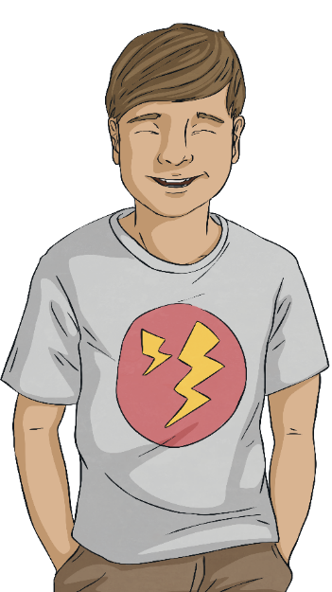
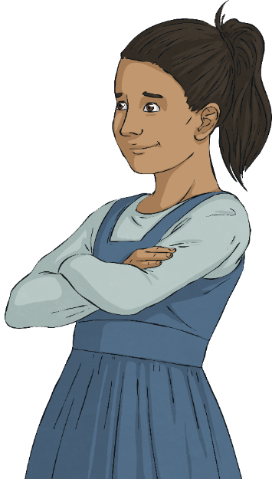
Respect and Protect
Respect and protect – these are two very important words when it comes to looking after our bodies.
We should respect ourselves enough to know that our bodies are precious and deserve to be protected from any harm or unwanted touch.
We should also respect others and know that it is never OK to touch someone else if they do not want to be touched.
Look at the following scenarios and discuss them in your pairs.
It is not OK to make someone do something they are not comfortable doing.

Slide 17

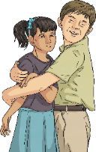
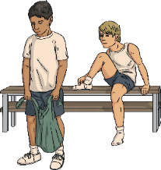
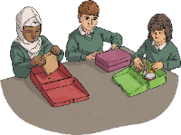
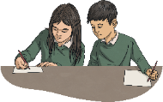
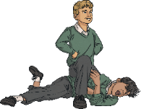
Respect and Protect
Look at these scenarios in pairs and discuss each one.
Try to answer these questions:
Who is not being treated with respect?
Who does not feel safe?
Who is being harmed?
What can be done to protect the person who is being harmed?
What rights does the person have?
Who could help the person who is being harmed?

Slide 18
Respect and Protect
Ruby is feeling uncomfortable around her mum’s boyfriend.
Deana has got a problem with her older cousin.
Bayo has noticed bruises on the back of his friend, Gav.
Sibra’s friends are worried about her getting thinner.
Rebecca has
an issue with the boy she sits next to
in class.
Soam is having friendship problems.
Astur is nervous about a procedure she is going
to have.
Questions

Slide 19
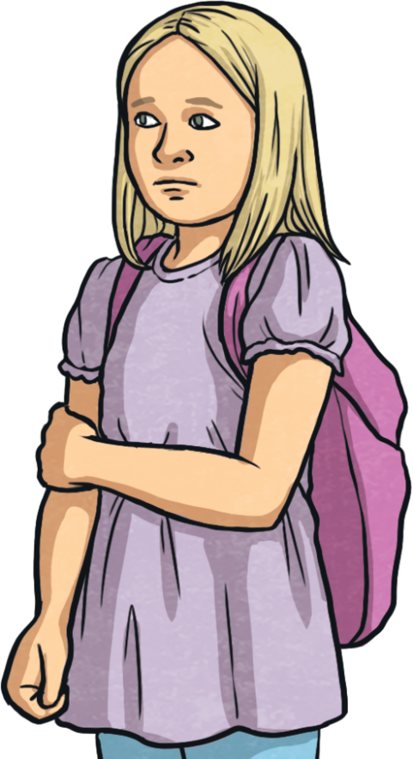
Respect and Protect
Ruby’s mum has a new boyfriend, who has started staying over quite a lot.
Sometimes, when mum is at work he looks after Ruby and her sister, Sapphire.
The girls feel uncomfortable when they are in the house on their own with him because he always makes them have a bath and he wants to help wash them. He says it is their little secret and they should not tell their mum.
00

Slide 20

Respect and Protect
Deana’s older cousin has a learning disability. He is very fond of Deana and sees her often but he doesn’t know his own strength.
Whenever he sees Deana, he gives her a really big, hard squeeze. Deana really hates this because
it hurts.
Deana doesn’t want to upset him by saying anything about this.

Slide 21
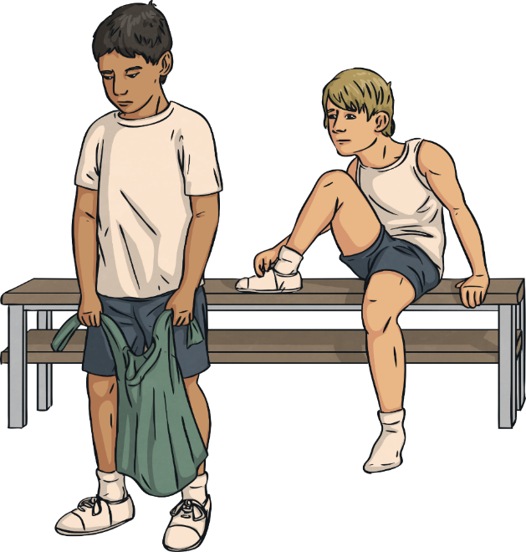
Respect and Protect
Two friends, Bayo and Gav, are getting changed for PE. Bayo notices that Gav has some bruises and marks on his back. He asks Gav how he got them.
Gav says that they are from playing in the garden and he quickly changes the subject.
Bayo is worried about his friend because it looks like someone has been hitting him.

Slide 22
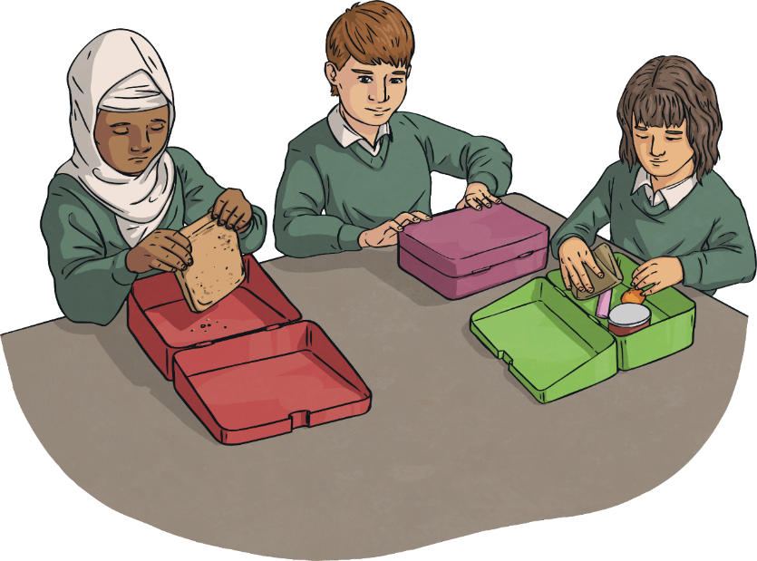
Respect and Protect
Sibra’s friends have noticed that she is getting thinner and thinner. She is always asking them if she can have some of their playtime snacks or their packed lunch at breaktime.
Sibra does bring a packed lunch but her friends have noticed that often all she has is some dry bread or a couple of small crackers.

Slide 23
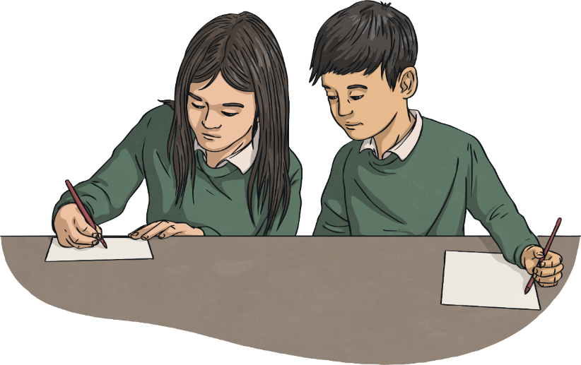
Respect and Protect
Rebecca is sitting next to Tyler at the back of the class.
Tyler keeps touching her thigh and squeezing her knee under the desk. He knows that the teacher can’t see.
He tells Rebecca that if she tells the teacher, he will just deny it.

Slide 24

Respect and Protect
Soam has recently started a new school. He is struggling to make friends. However, there is one boy in his class who really wants to be friends with him.
Every day, at playtime, the other boy wants to play-fight, pretending Soam is the dragon and he is the knight.
The other boy is very rough and Soam always gets hurt. Soam doesn’t like this but he does not want to lose his only friend.

Slide 25
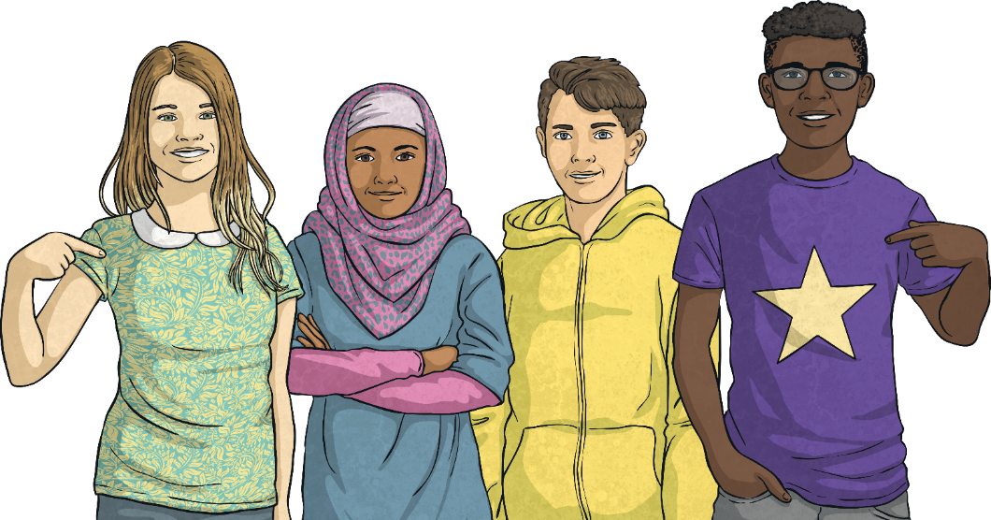
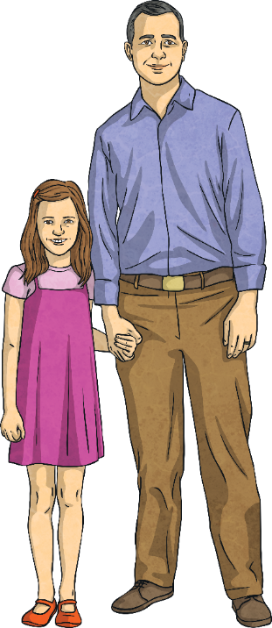
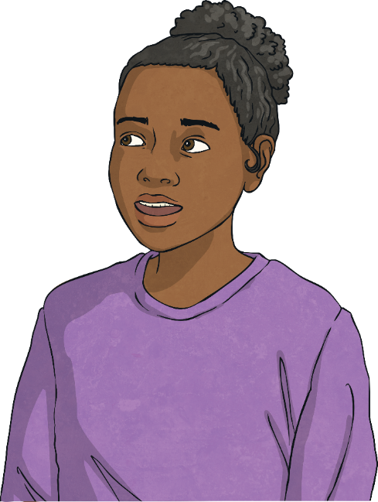
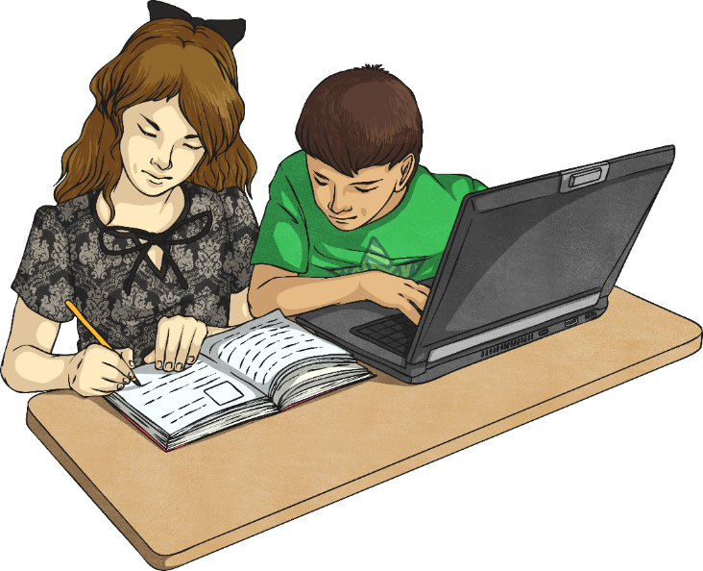
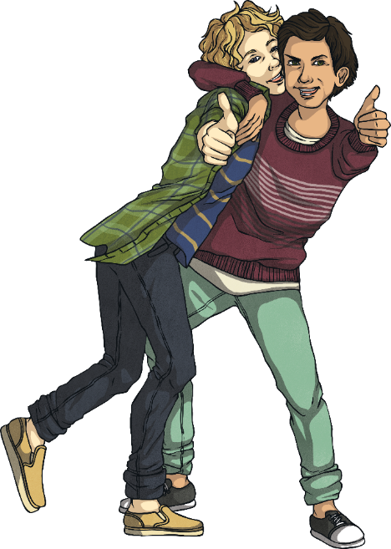
Respect and Protect
It is important to remember that these scenarios are made-up examples.
Most children are safe and happy.
Ruby doesn’t feel comfortable with her mum’s new boyfriend. However, Ruby’s friend Maddie lives with her mum’s new boyfriend and he is really kind. Maddie is really happy and she always feels safe.
Bilan is Astur's cousin. Her parents believe that FGM is wrong and support the laws against it.
Soam is having a tough time finding the right
friends and communicating his feelings to the boy who plays with him. However, his brother has made friends easily in his class in the same school.
Rebecca has problems with the boy who sits next to her in class. However, her friend, Olivia, sits next to a boy who used to keep poking her with a pencil. He stopped when Olivia told him to stop.
Some situations can be resolved if we give them time. However, it’s usually best to speak up and ask for advice or help, sooner rather than later. Knowing when to ask for help is an important skill.

Slide 26
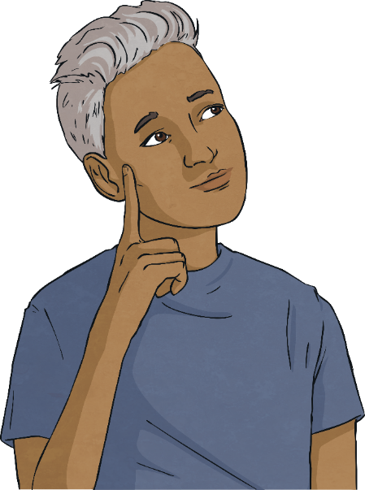
Seeking Support
All the children in the made-up scenarios need support to cope with their own situation and make things better.
Who could the children in our scenarios have turned to?
No child has to keep their concerns and worries to themselves.
No child has to keep a secret about something that makes them uncomfortable or that makes them feel upset or worried.
If something happens that makes someone feel uncomfortable, it is not their fault. A trusted adult will be able to help.
Sometimes people may need to seek support for themselves but sometimes it is for someone else. If a friend tells you something that has happened to that has made them feel worried or uncomfortable, the most helpful thing to do is to talk to a trusted adult about what's been shared, to make sure your friend gets the help they need.
It can sometimes be hard to talk about certain situations but seeking support from a trusted adult is always the best thing to do.

Slide 27
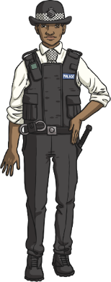
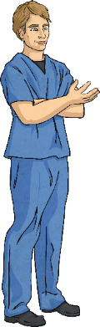
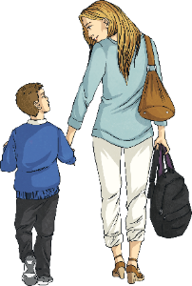
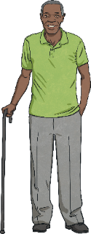
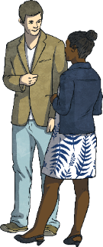
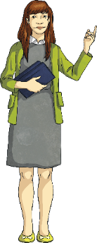
Seeking Support
A trusted adult could be:
a parent or a carer;
another family member, such as a grandparent;
a friend’s parent or carer;
a teacher or another adult in school;
a doctor, nurse or police officer.
Who are your trusted adults?

Slide 28
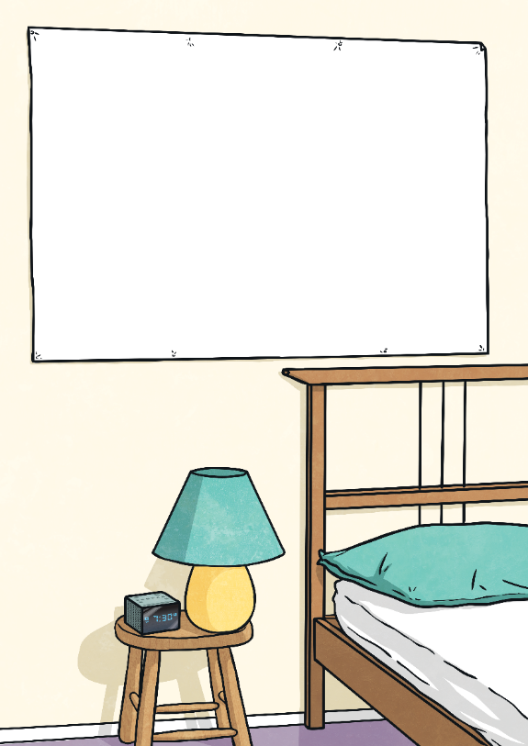
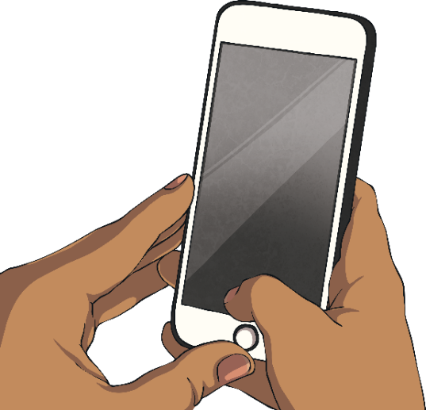
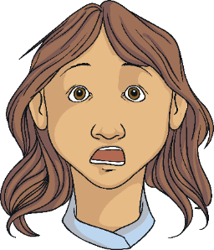
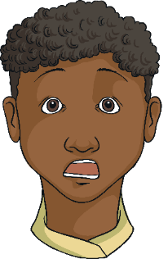
Seeking Support
Sometimes, children might feel that they have no one to talk to. Maybe they are worried or frightened to speak to someone they know. Perhaps they are embarrassed or think that they will not be believed.

Slide 29
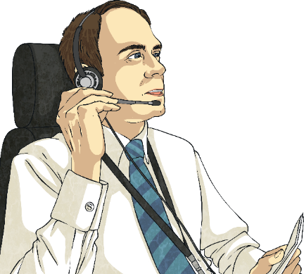
Seeking Support
This is why Childline exists.
Childline is a charity that provides help for children.
Children can speak to a grown-up who will listen to their worry, concern or problem and give them advice about what they can do.

Slide 30

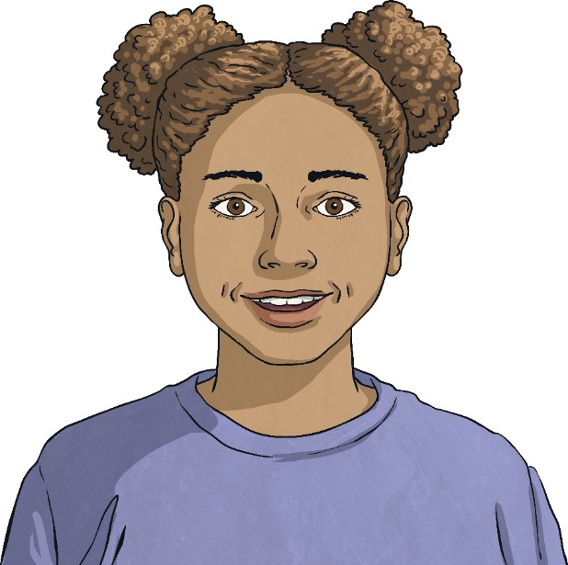

Seeking Support
The number to call is 0800 11 11
0
8
0
0
1
1
1
1
1
2
3
Consolidating
4
5
6
7
8
9
*
0
#
Reflecting

Slide 31
Consolidating

Slide 32

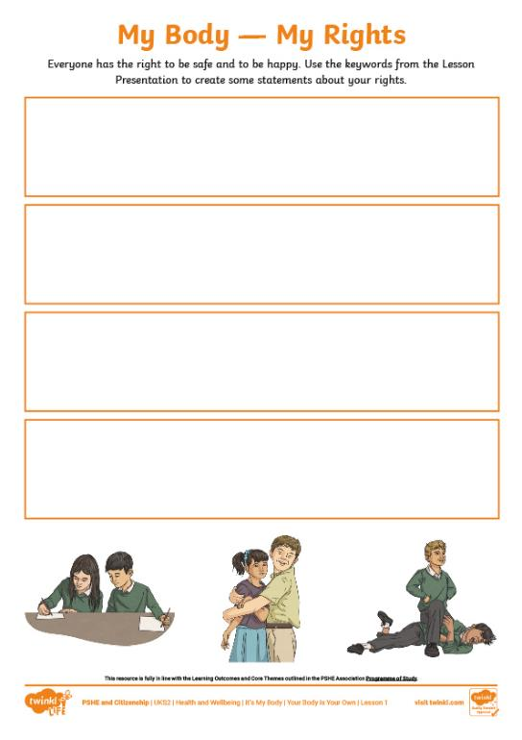
My Body — My Rights
As humans, we all have the right to be safe. This includes keeping our bodies safe from harm and keeping ourselves safe from unwanted touch or contact.
By understanding our rights and the rights of others, we can ensure that everyone is safe and happy.
On your activity sheet, create a set of rights that you have with regard to your own body.
You can use the keywords on the following slide to help.

Slide 33
My Body — My Rights
harm
safe
hurt
tell
Childline
touch
secret
happy
contact
help
adult
upset
call
danger
protect
body
privacy
respect
unwanted

Slide 34
Reflecting

Slide 35

True or False?
Let’s read the following statements. If you think they are true, put your thumbs up. If you think they are false, put your thumbs down.
We all have the right to say no to something being done to our bodies that we do not want.

Slide 36


True or False?
Let’s read the following statements. If you think they are true, put your thumbs up. If you think they are false, put your thumbs down.
We should tell a trusted adult if we are worried about the safety of ourselves or the safety of someone else.

Slide 37

True or False?
Let’s read the following statements. If you think they are true, put your thumbs up. If you think they are false, put your thumbs down.
Unwanted touch means the same thing to everyone.

Slide 38

True or False?
Let’s read the following statements. If you think they are true, put your thumbs up. If you think they are false, put your thumbs down.
Consent means agreeing to something.

Slide 39

True or False?
Let’s read the following statements. If you think they are true, put your thumbs up. If you think they are false, put your thumbs down.
If someone tells you to keep a secret, you must keep it.

Slide 40

True or False?
Let’s read the following statements. If you think they are true, put your thumbs up. If you think they are false, put your thumbs down.
If we like hugs, then it is OK to hug other people without asking.

Slide 41
True or False?
Let’s read the following statements. If you think they are true, put your thumbs up. If you think they are false, put your thumbs down.
The number for Childline is 0800 11 11.
0
8
0
0
1
1
1
1
1
2
3
4
5
6
7
8
9
*
0
#

Slide 42
The Big Questions

Slide 43
Why is looking after our bodies
so important?
What is autonomy and what
is consent?

Slide 44
Aim
I know that my body belongs to me and that I have control over what happens to it.
Success Criteria
I understand that I can make choices about what happens to my body.
I understand the difference between wanted and unwanted contact.
I know what to do if I am worried about myself or a friend.
This resource is fully in line with the Learning Outcomes and Core Themes outlined in the PSHE Association’s Programme of Study.

