Slide 1


RE
Judaism
Year One
RE | Year 3 | Judaism | Main Beliefs | Lesson 2

Slide 2
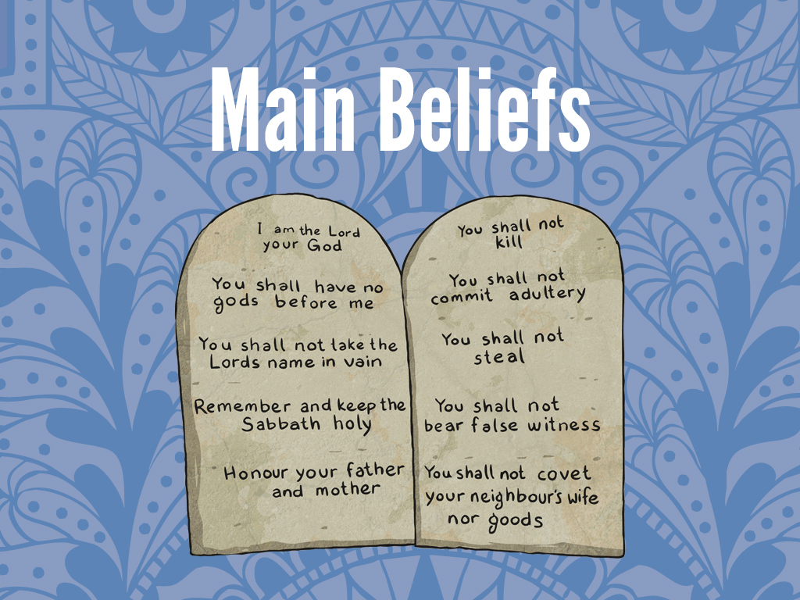


Slide 3
Aim
I can explain the main beliefs in Judaism.
Success Criteria
I can explain that Jews believe there is only one God.
I can illustrate the ten commandments to show the rules Jews believe we should live by.

Slide 4
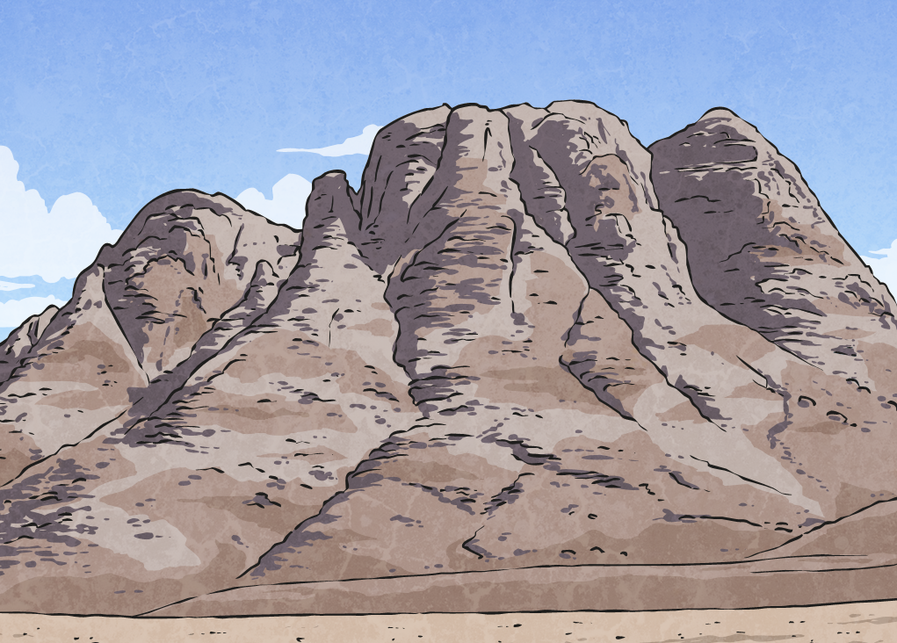

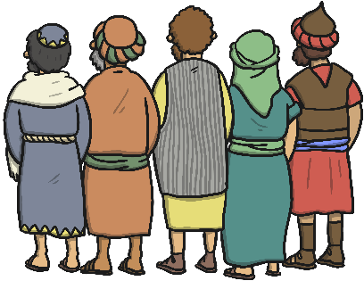
Moses
The Israelites had been travelling in the desert for about 3 months, on their way to Canaan, when they got to Mount Sinai.
Moses was over 80 years old now and he was leading the Israelites. When they got to Mount Sinai, Moses walked up the mountain to talk to God.

Slide 5
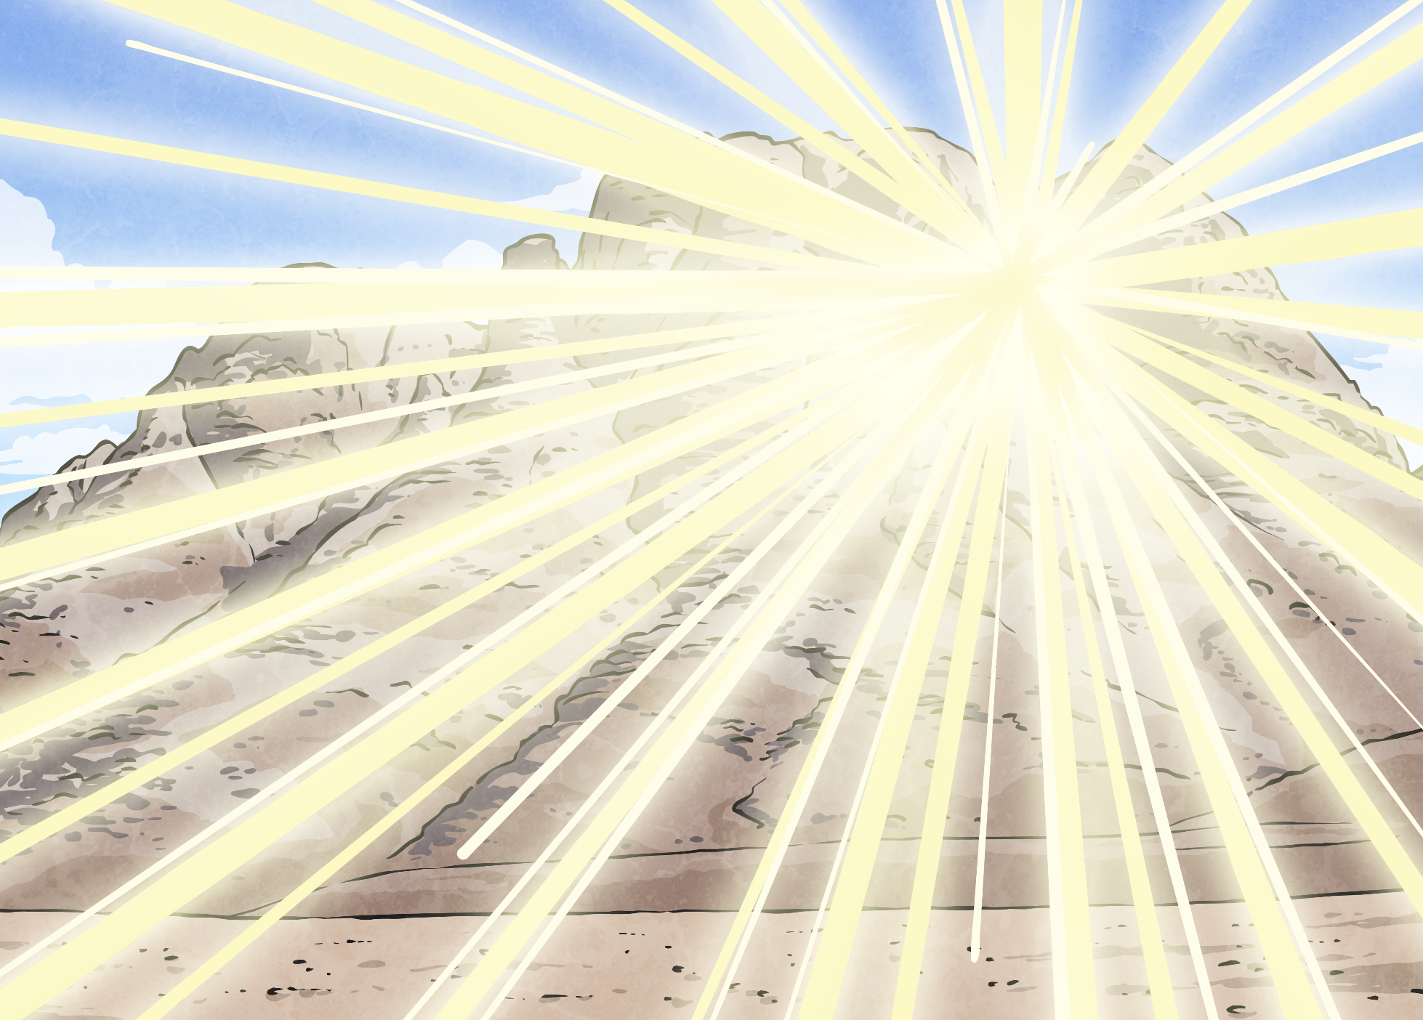
Moses
God told Moses to tell the Israelites to get ready. Moses came down to tell the people to have a wash and to clean all their clothes. This meant they would be ready to hear God’s important words.
On the third morning after Moses had talked to God, the Israelites were having their breakfast when suddenly there was a flash of light over the mountain and a large rumble.

Slide 6
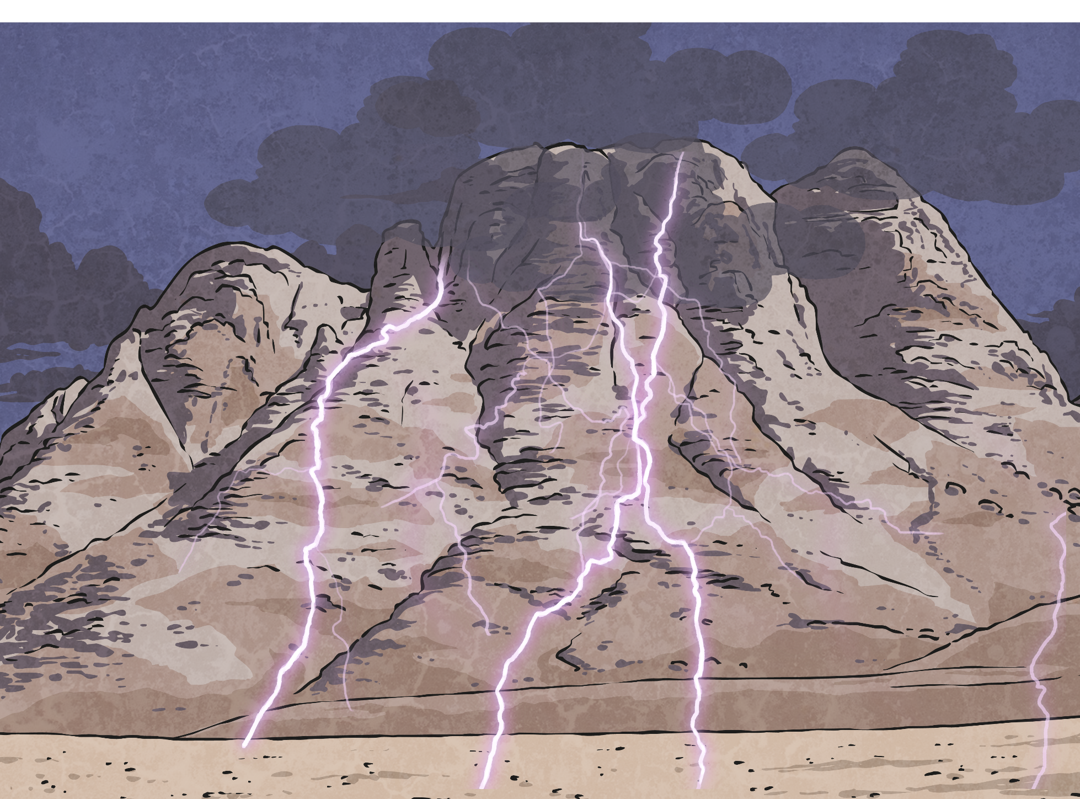
Moses
There was lightning and thunder over the mountain and a thick cloud covering the top of the mountain. The mountain shook and trumpet sounds got louder and louder.
So Moses went up the mountain to listen to God again. This time, God told Moses, “Go down to the people and tell them not to follow you up the mountain, the mountain is a special place because I am here.” So Moses told the people not to go too close to the Mountain and not to touch it.

Slide 7
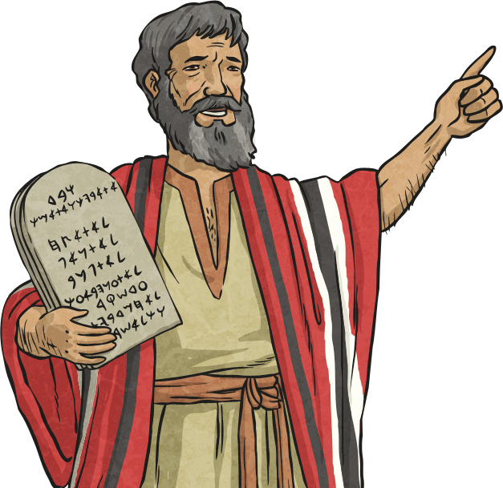
Moses
After passing on the message, Moses went back up the mountain and stayed for a very long time (40 days and 40 nights). God wanted to tell the people how to live and to let them know that by following his rules they would lead happier lives and have less sadness. He gave Moses 10 very important life rules.

Slide 8

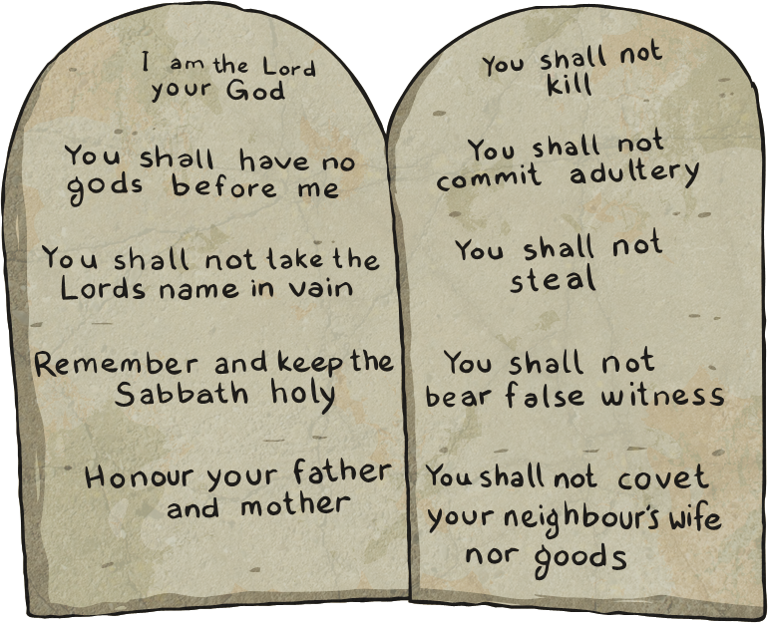
Our Rules
In partners, create a list of ten rules for people to live by. Remember to make sure the rules would make people feel happy.
Write your ten rules down on your whiteboard. When you have finished, we will discuss all our rules together.

Slide 9
The Ten Commandments
The ten rules (commandments) given to Moses are as follows:
The first commandment is to put God first.
The second command is to worship only God.
The third commandment is to use God’s name with respect.
The forth commandment is to remember God's Sabbath.
The fifth commandment is to respect our parents.
The sixth commandment says don't hurt others.
The seventh commandment tells us to be faithful in marriage. He wants us to love our wife or husband and treat them with respect.
The eighth commandment is don't steal.
The ninth commandment is don't lie.
The last commandment is don't be envious of others.

Slide 10

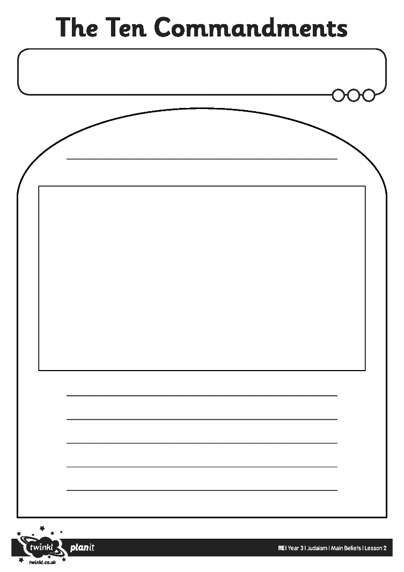
Book
Activity
Your task is to create a page for our class book of the Ten Commandments. You will have one commandment to write on your page and you must then decorate it appropriately for the rule you are writing. You will work in a small group to do this.
Here is a reminder of the Ten Commandments:
Put God first.
Worship only God.
Use God’s name with respect.
Remember God’s Sabbath.
Respect our Parents.
Don’t hurt others.
Be faithful in marriage.
Don’t steal.
Don’t lie.
Don’t be envious of others.

Slide 11

Aim
I can explain the main beliefs in Judaism.
Success Criteria
I can explain that Jews believe there is only one God.
I can illustrate the ten commandments to show the rules Jews believe we should live by.

