Slide 2
Lesson Aims
To be able to say and write my own address.
To be able to say and write an important phone number.

Slide 3


In this lesson, you are going to learn how to say and write your address and a contact phone number.

Slide 4

My Address
In what situations might you need to give your address?
Why might it be important to know your address?

Slide 5

My Address
House number and street name
Town or city
County
Postcode
42 Twinkl Way
Sheffield
South Yorkshire
TW1 7KL

Slide 6
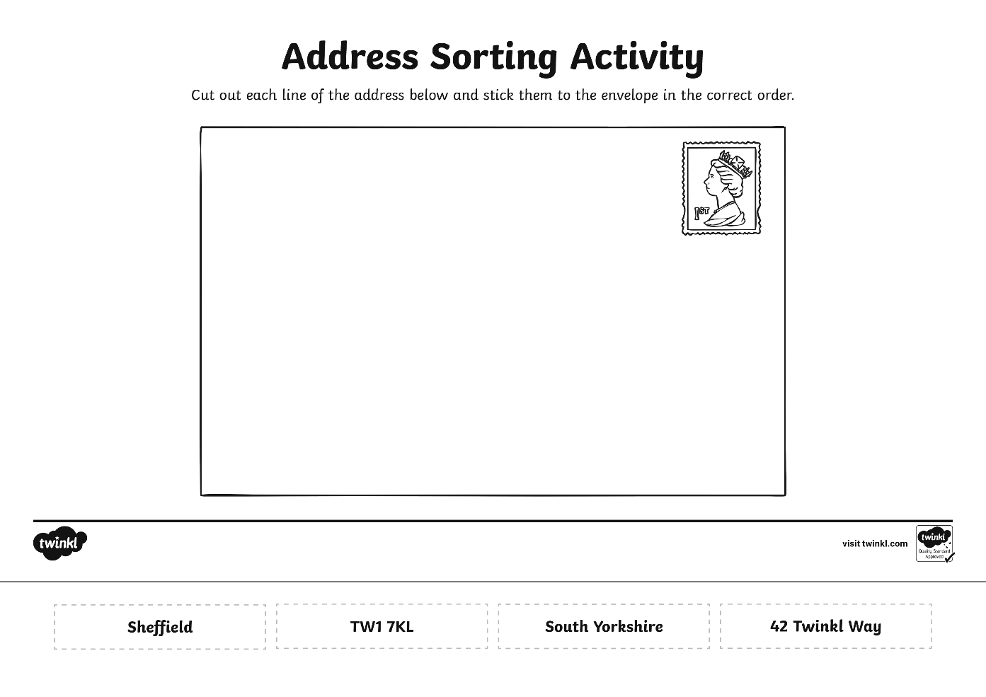
Sorting Activity

Slide 7
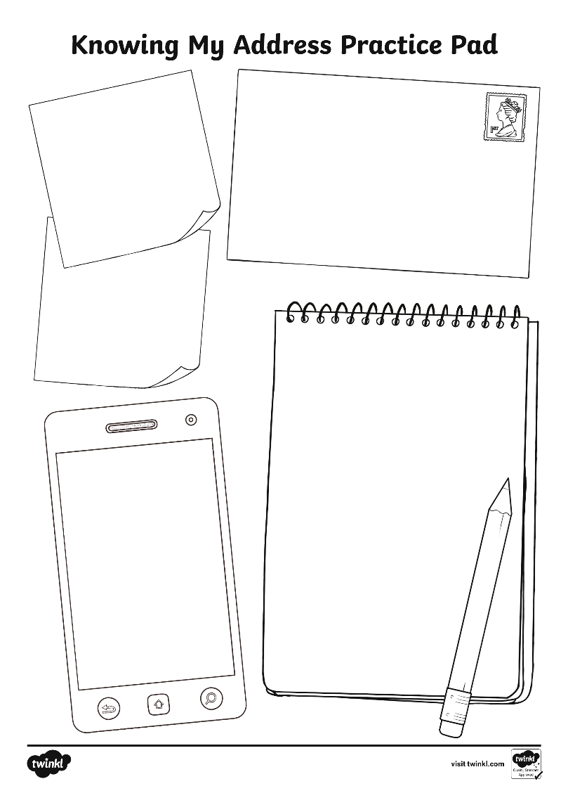
Knowing My Address

Slide 8
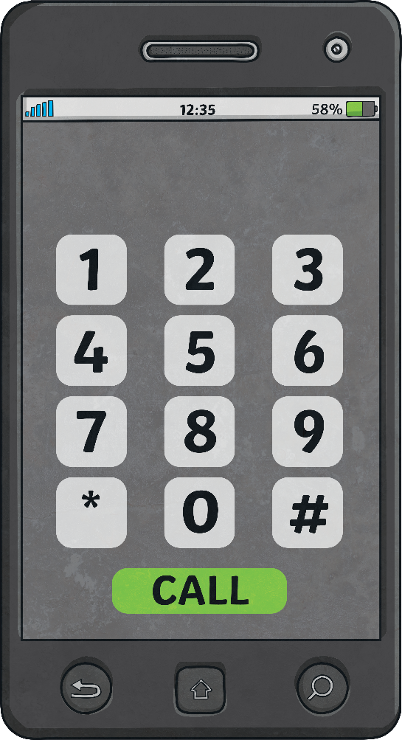
My Phone Number
In what situations might you need to give your phone number?
Why might it be important to know your phone number?

Slide 9
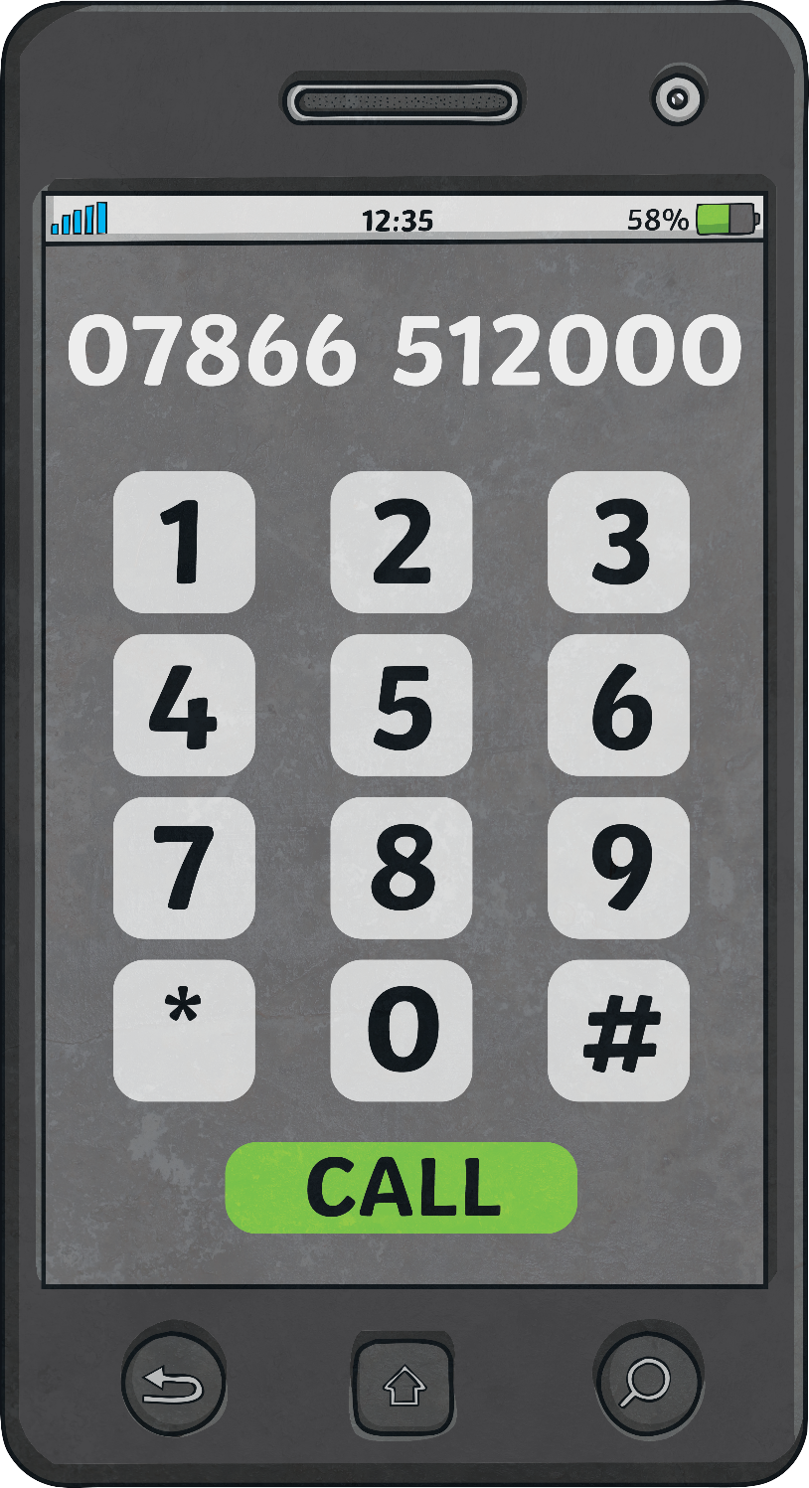
Learning a Phone Number
How could we learn to remember this number?

Slide 10
Learning a Phone Number
Practise giving your address and phone number.

