Slide 1


RE
Judaism
Year One
RE | Year 3 | Judaism | Who and Where? | Lesson 1

Slide 2
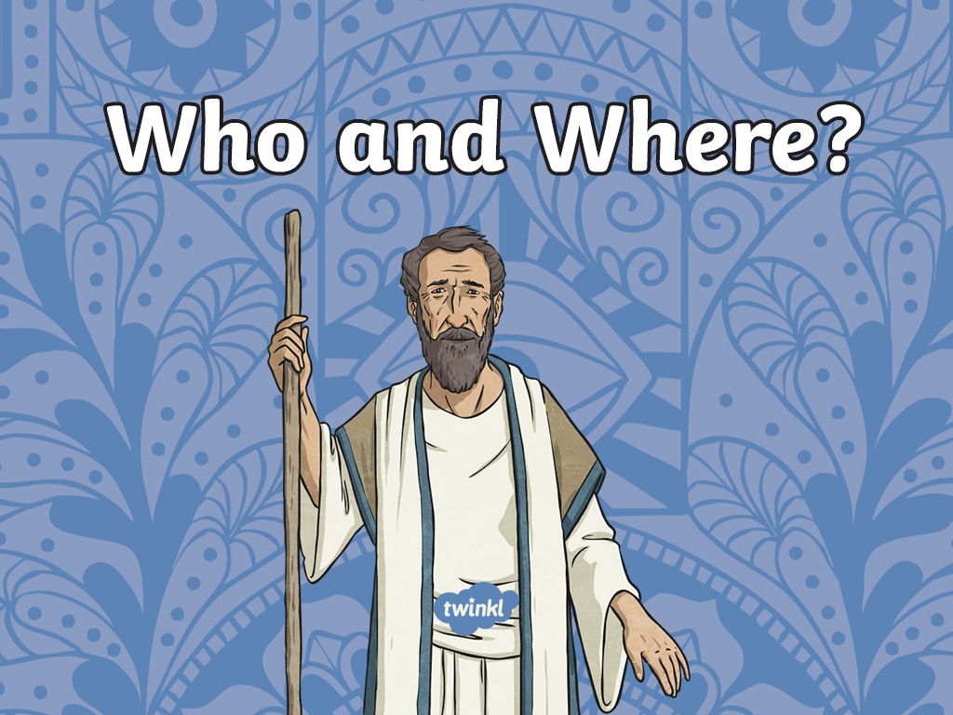

Slide 3
Aim
To understand who founded Judaism and where.
Success Criteria
I can explain how Abraham founded Judaism.
I can locate where Judaism was founded.

Slide 4








Religions of the World
Christianity
Sikhism
Judaism
Humanism
Buddhism
Islam
Hinduism

Slide 5
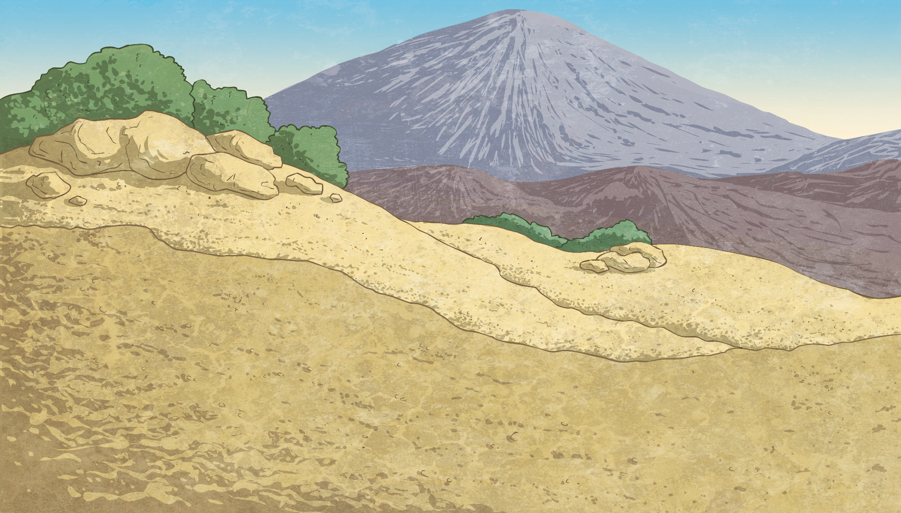
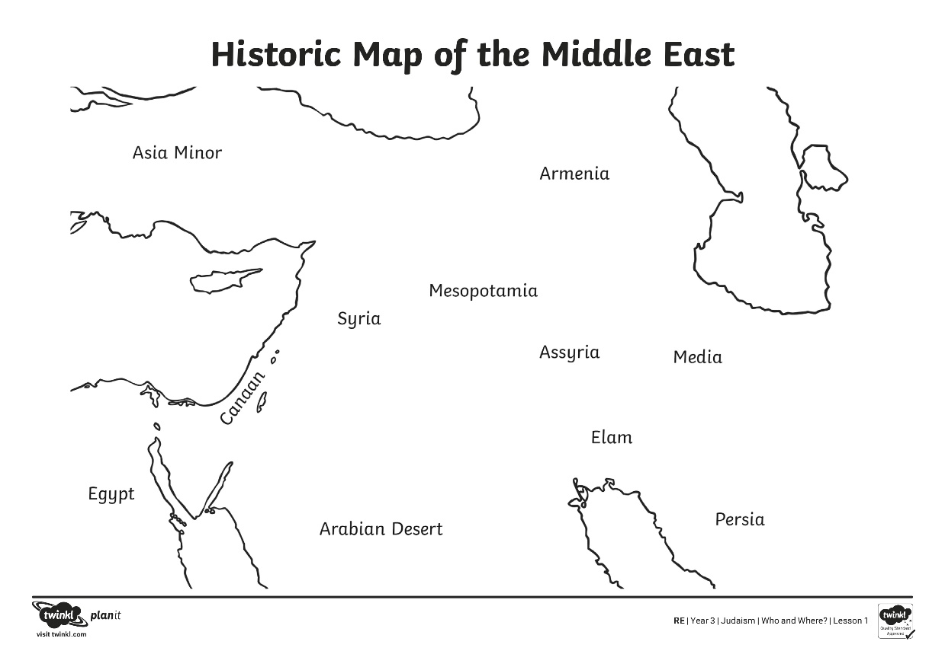
Where Was Judaism Founded?
Judaism was founded in a land called Canaan. This place no longer has
the name Canaan. Can you see Canaan on this historic map?

Slide 6
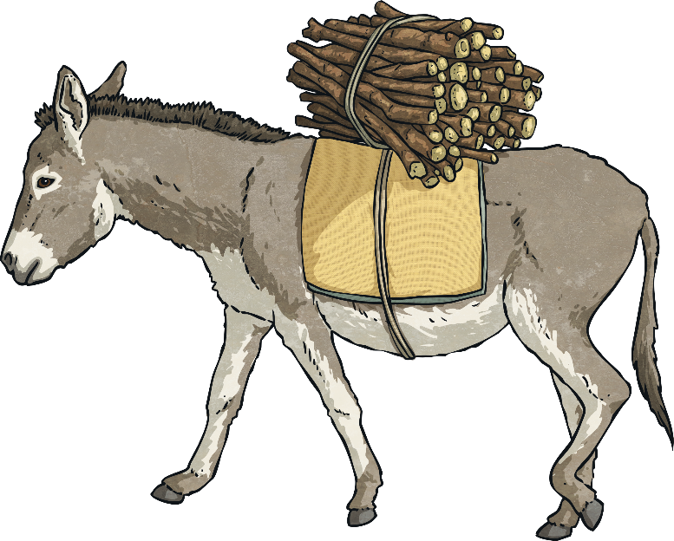
Where Was Judaism Founded?
The land that was in Canaan is now a country called Israel. Canaan also included lands from other countries near to modern Israel.
Judaism was founded 4000 years ago in Israel.

Slide 7
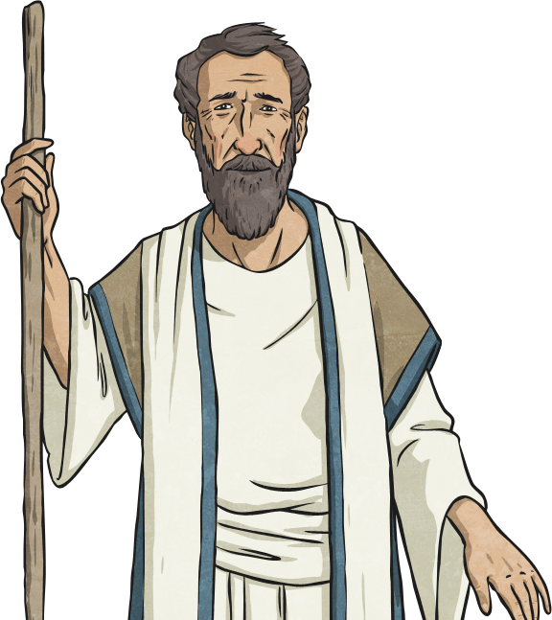
Who Founded Judaism?
Judaism was founded around 1812 BC with the
covenant made between God and Abraham.
At the start of the story, Abraham is known as ‘Abram’.
Even when Abram was a boy growing up, he believed that there was only one God, even though others at the time believed in many gods.
In fact, Abram’s own father sold statues of the different gods (idols). Abram once smashed up the idols, leaving just one unharmed, to show that there is one God.
Let’s read about how Abram
founded Judaism.

Slide 8
Who Founded Judaism?
Long ago, there was a man called Abram who lived in a place called Haran. He had a nice life there and owned many different animals, including sheep and cattle. Abram was a good man who lived with his wife, Sarai, but they had no children.
On one day, God visited Abram to give him a message. “I want you to pack up all of your things, Abram, and leave your home.” He wanted him to go to a new land. He made a promise to Abram. “I promise that I will bless your family.” Abram trusted God and moved to a new land.
Abram, who was now 75, and Sarai packed up all of their belongings and left. With them they took Abram’s nephew, Lot, and any people who wanted to join them.

Slide 9
Who Founded Judaism?
How do you think Abram felt when he was asked to leave
his home, friends and everything he knew in Haran?
What made Abram pack up to leave without hesitation?
Example answers:
Abram might have felt that he didn’t really want to leave and he might feel worried about going to a new place.
Abram trusted God and was loyal to him. He was willing to make sacrifices to follow God’s instructions.

Slide 10
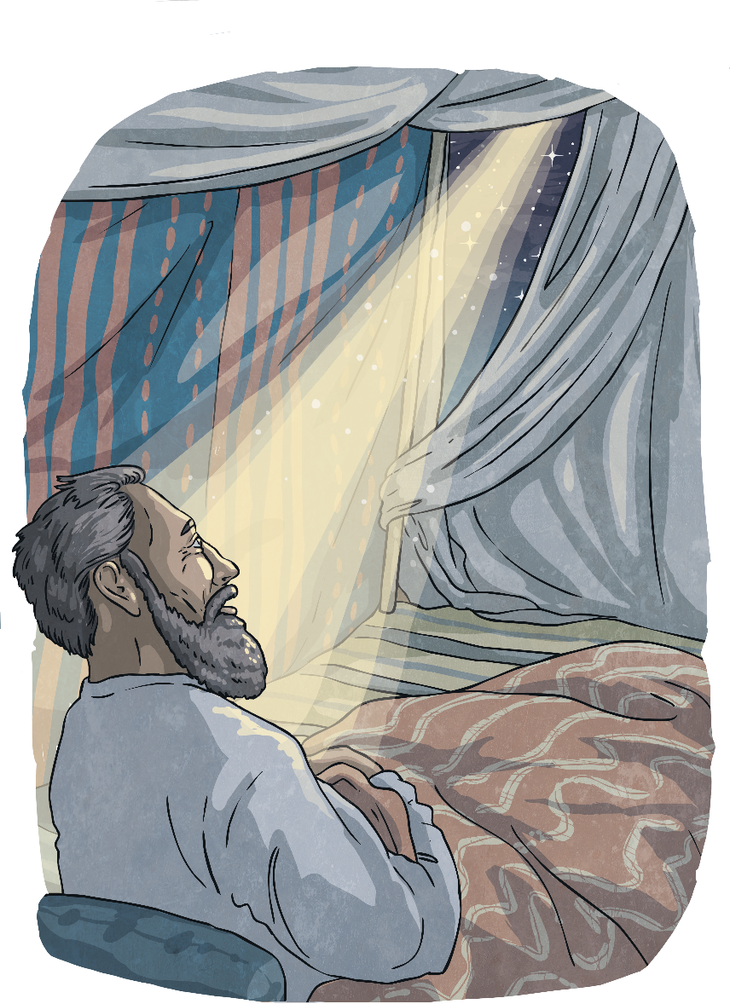

Who Founded Judaism?
One night in Canaan, after a hard day’s work, God appeared to Abram again. He told him to look to the sky and count all of the stars. He explained that the number of stars in the sky would be how many descendants he would have. Abram told his wife about the news and Sarai laughed because she believed they were too old to have children! God reminded Abram of the promise God had made to them.
With this promise in mind, God changed Abram's name to Abraham (meaning 'father of many') and Sarai's name to Sarah (meaning 'princess'). Abraham was 99 years old, but again God said that they would be parents and that they would have a boy.

Slide 11
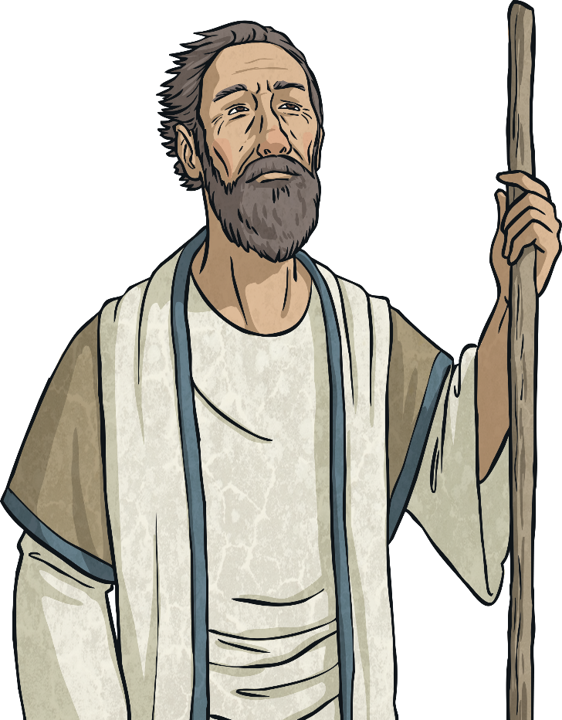
Who Founded Judaism?
God made a covenant with Abraham.
A covenant means an agreement or partnership.
As part of this covenant, Abraham promised to do some things and God promised to do some things.
God promised to give Abraham children and land.
The land God gave to Abraham and his people was called Canaan.
In return, Abram and Sarai agreed to leave their home and travel as God instructed them. They also agreed to change their names.

Slide 12
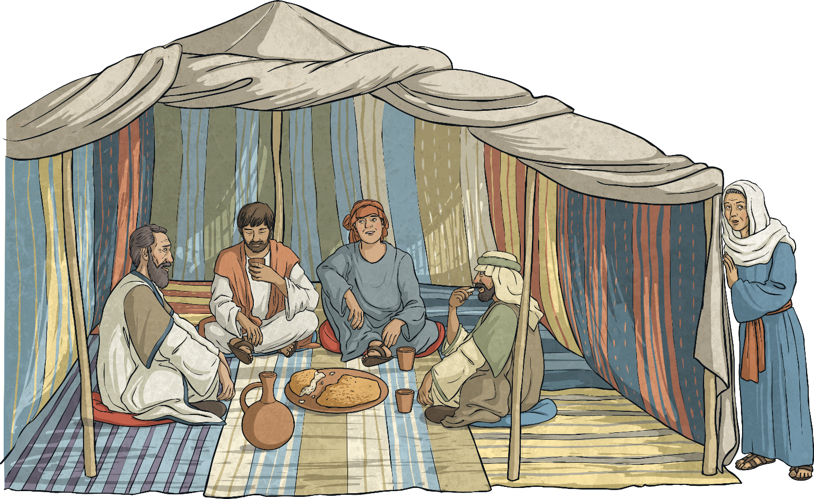
Who Founded Judaism?
One day, three visitors came by. Abraham encouraged them to stop a while and invited them to eat. While the visitors were eating, they asked Abraham where Sarah was and one of them reminded him of God's promise, "I will come back to see you at this time next year, and Sarah will have a son.” Sarah laughed when she overheard this. It was hard to still have faith because of their old age.

Slide 13
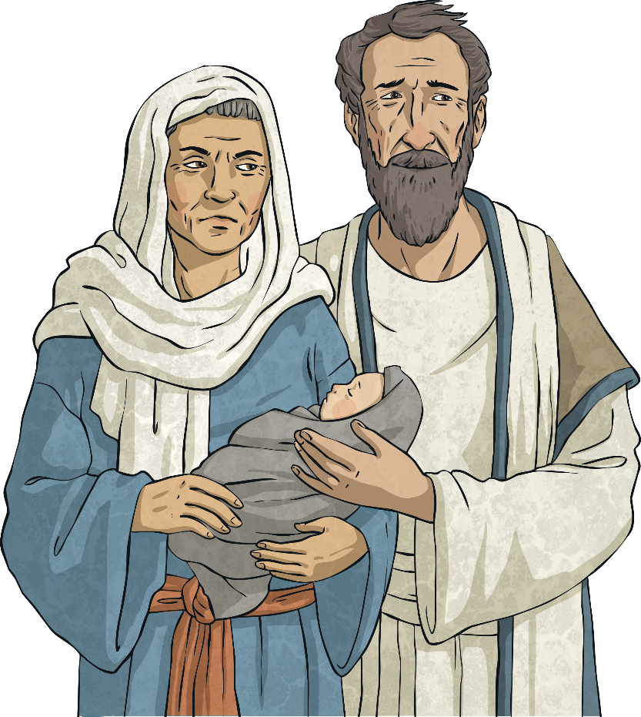
Who Founded Judaism?
Abraham and Sarah realised that the man who had told them this was God. Sure enough, as they had been told, a year later Sarah did have a son.
They named him Isaac, which means 'he laughs'. Abraham was 100 years old at the time of Isaac's birth and they were both full of joy and knew that everyone would rejoice with them. "God has made laughter for me," said Sarah and they thanked God for the birth of their son.

Slide 14
Who Founded Judaism?
Abraham is important to Jewish people.
Through the covenant he made with God, Jews believe that he was chosen to make a partnership between God and the Jewish people. They believe that he was the founder of the Jewish faith. Jewish people call him ‘the father of the people’.
Although some other people before Abraham had talked about there being one God, Jews believe that Abraham was the first significant person to teach about one God.

Slide 15

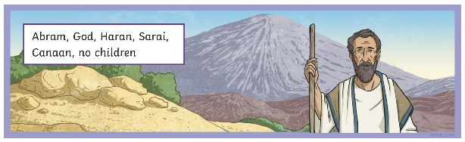
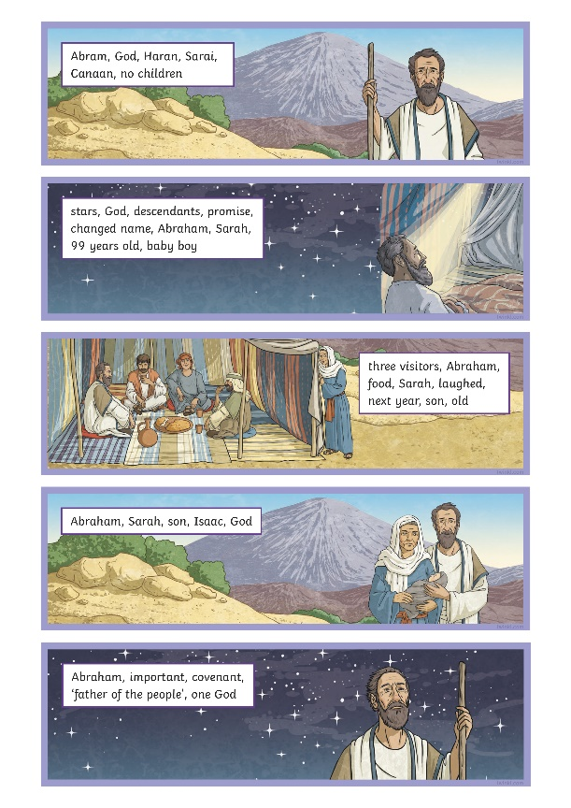


Retell the Story
Work in pairs. Use the Retelling the Story Activity Sheet to work together
to retell the story of the covenant between Abraham and God.

Slide 16
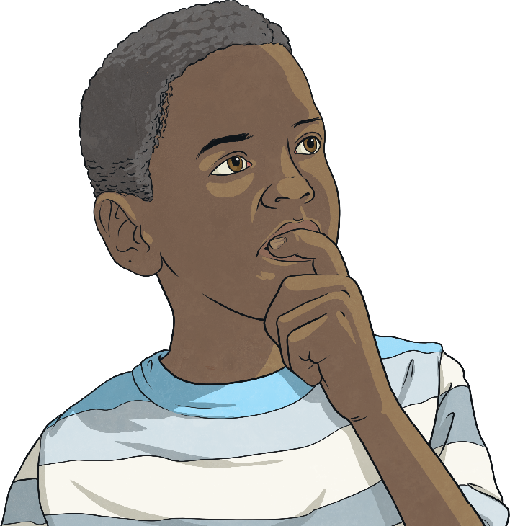
Reflect
What other questions did you think of that you would like to ask Sarah?
Do you have any questions that you would like to ask Abraham?
What qualities do you think Abraham might have had that Jewish people believe made God choose him to be 'the father of the people'?

Slide 17

Aim
To understand who founded Judaism and where.
Success Criteria
I can explain how Abraham founded Judaism.
I can locate where Judaism was founded.

Slide 18


