Slide 1


Maths
Measurement
Year One
Maths | Year 1 | Measurement | Tell the Time to the Hour and Half Past the Hour | Lesson 2 of 3: Half Past Times

Slide 2

Half Past Times

Slide 3
Aim
I can use a clock to tell the time to half past the hour.
Success Criteria
I can describe the parts of a clock face.
I can read a clock showing half past times.

Slide 4

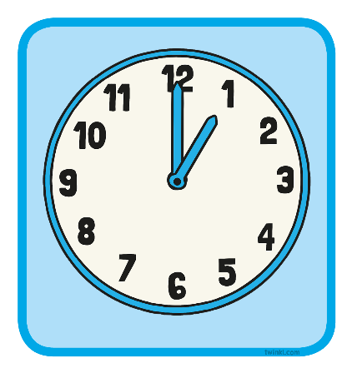
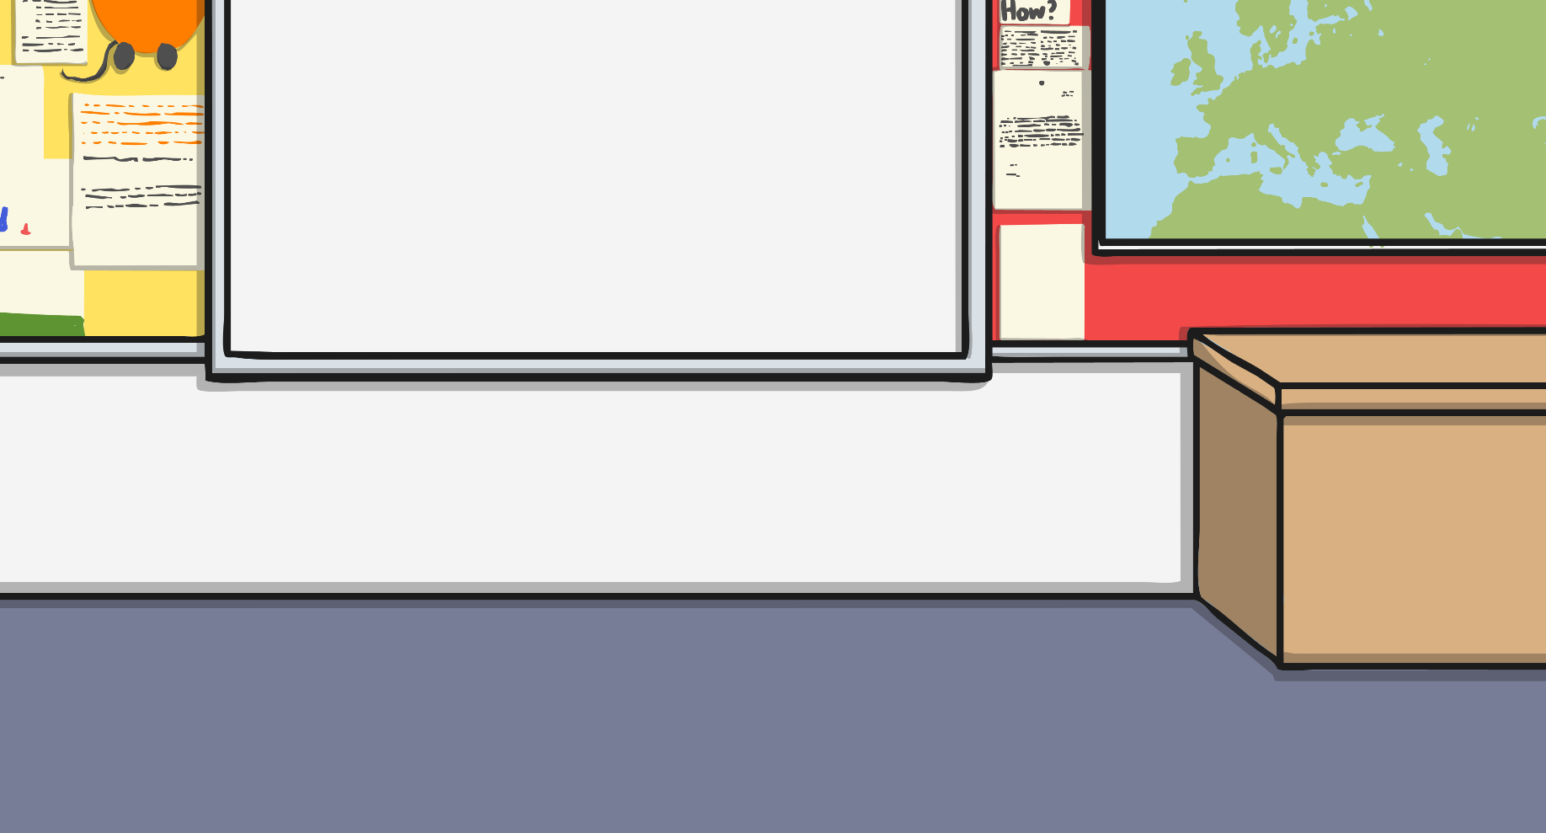
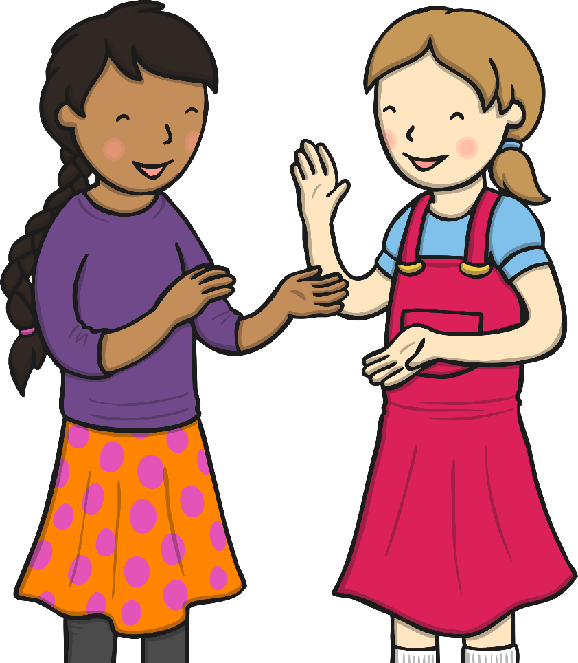
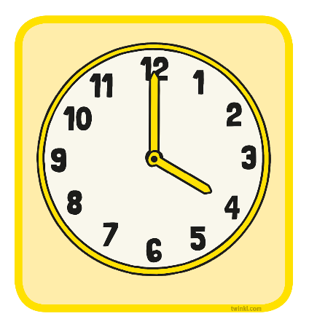
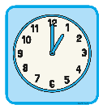
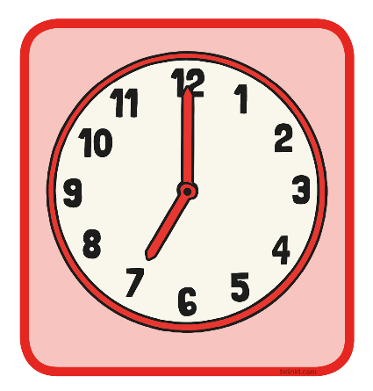
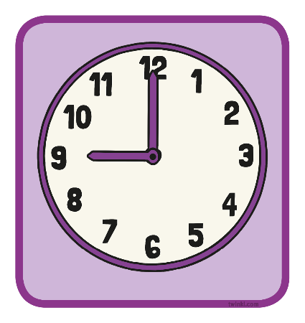
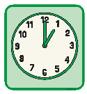
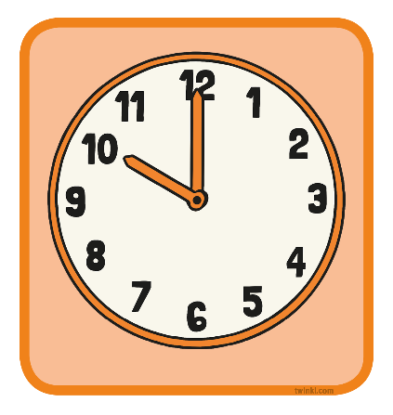
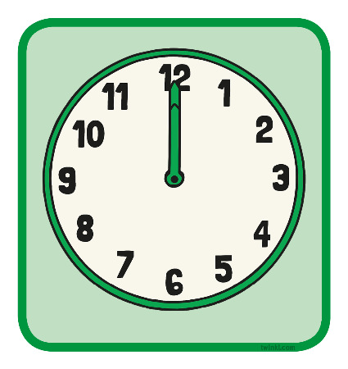
Time Teams
Find the children whose clock face shows the same time as yours.
What time does it say?

Slide 5

Clocks
Time is measured in years, months, weeks, days, hours,
minutes and seconds.
There are 24 hours in a day, which is made up of 2 lots of 12 hours; 12 hours in the morning and 12 hours in the afternoon.
1 hour is made up of 60 minutes.
We use clocks to help us tell the time.

Slide 6

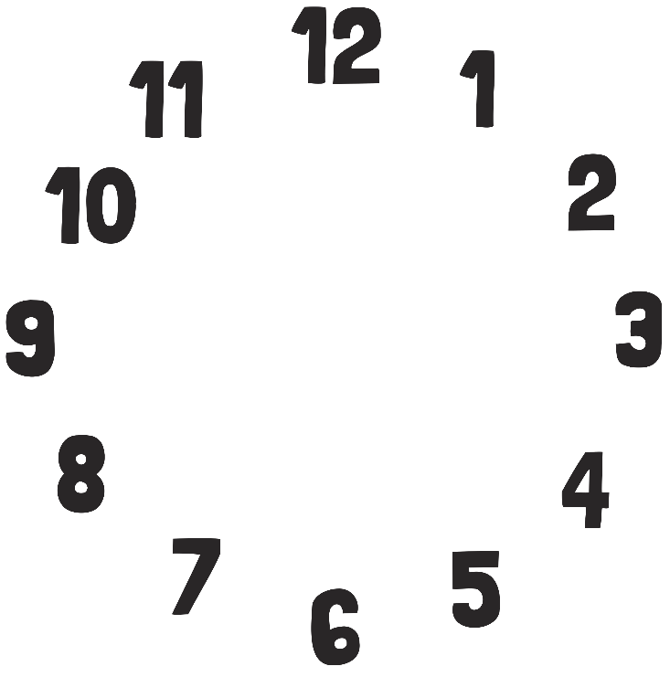


Half Past Times
A clock face is a circle.
In one hour, the minute hand travels all the way around the circle.

Slide 7
Half Past Times
The full circle can be split into 2 halves.
It takes half an hour for the minute hand to travel half way around the circle.

Slide 8
Half Past Times
When half an hour has gone past, we say the time is ‘half past’ the hour.
o’clock
half past

Slide 9
Half Past Times
When the time is ‘half past’ the hour, the minute hand will point to the 6.
The hour hand will be halfway between one number and the next.
The minute hand is pointing to the 6 and the hour hand is halfway between the 7 and the 8. What time is it?
Half past 7.

Slide 10
Half Past Times
Look at this time.
The minute hand is pointing at 6, which is halfway around the clock.
Where is the hour hand pointing? Is it on the number?
It’s halfway between 1 and 2.
It is half past 1.

Slide 11
Half Past Times
Look at this time.
Where is the minute hand pointing?
It is pointing to the 6.
Where is the hour hand pointing?
It’s halfway between 11 and 12.
What is the time?
It is half past 11.

Slide 12
Half Past Times
Look at this time.
Where is the minute hand pointing?
It is pointing to the 6.
Where is the hour hand pointing?
It’s halfway between 8 and 9.
What is the time?
It is half past 8.

Slide 13
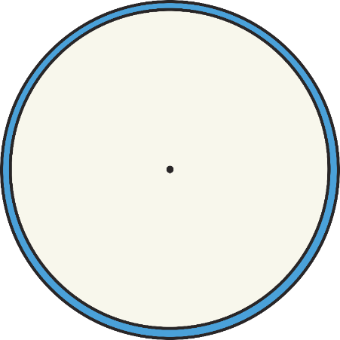
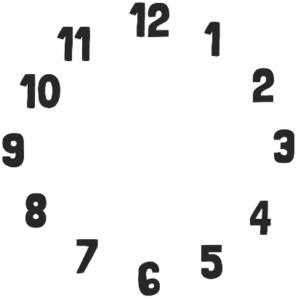


Half Past Times
Click the correct clock face.
Which clock is
showing half past 2?
Which clock is
showing half past 9?
Which clock is
showing half past 7?

Slide 14

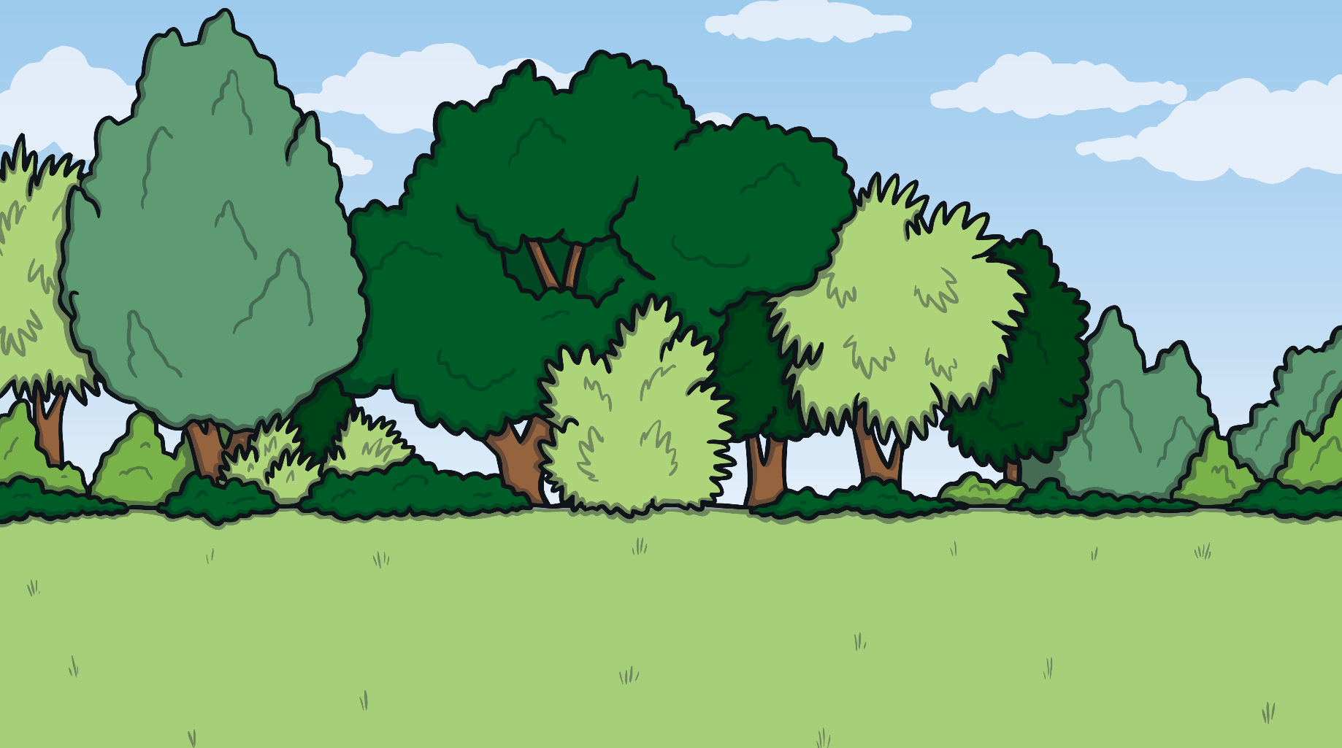
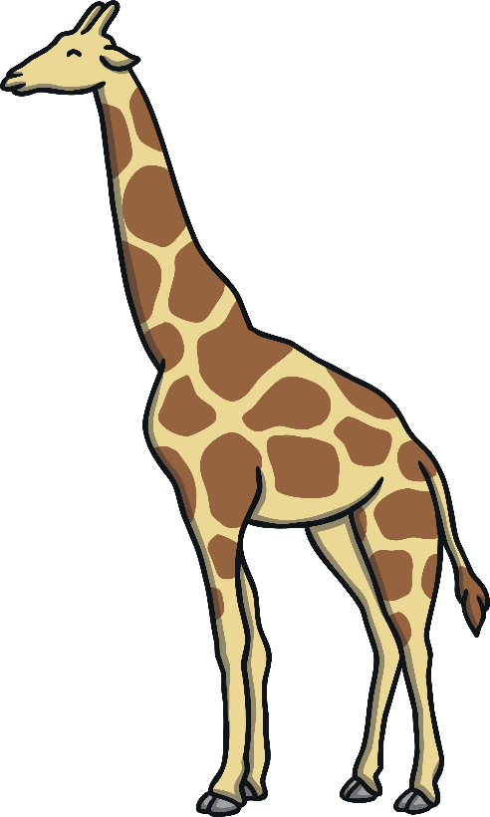

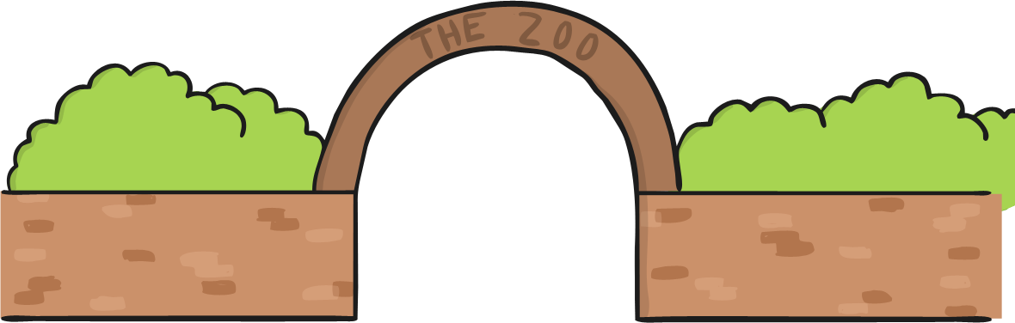
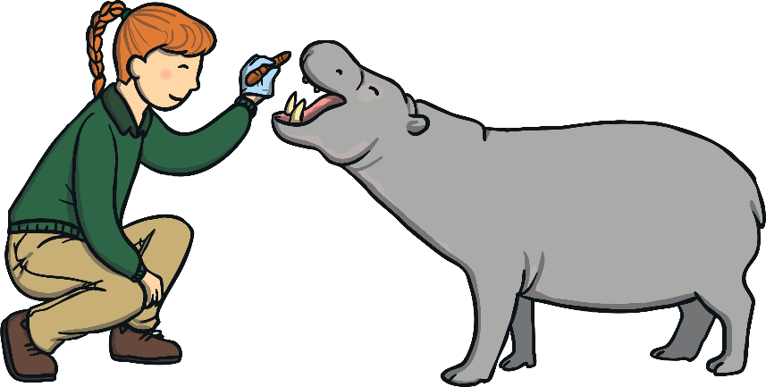
Feeding Time!
It’s feeding time at the zoo.
Can you help Sam work out which animal she needs to feed now?

Slide 15
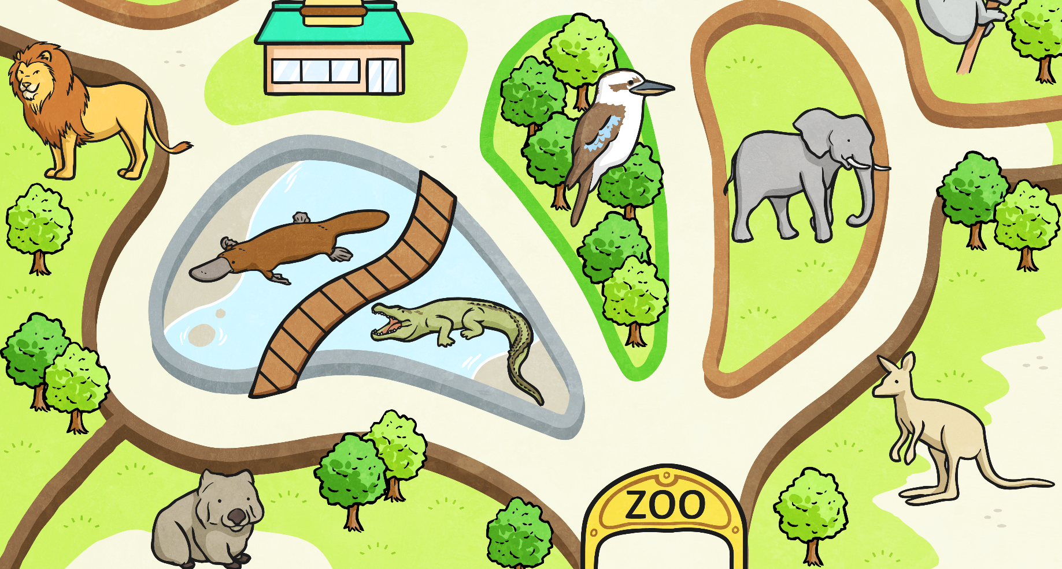
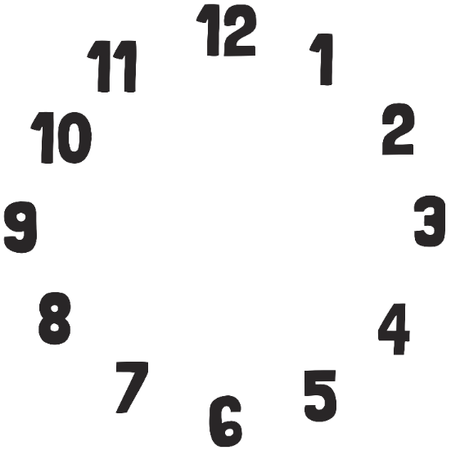


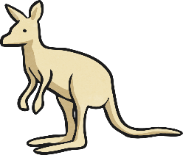


Feeding Time!
Click the correct time.
half past 2
half past 9
6 o’clock

Slide 16
Feeding Time!
Oops!
Try again

Slide 17
Feeding Time!
Well done!

Slide 18
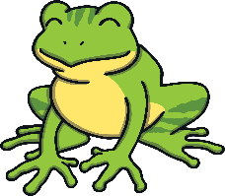
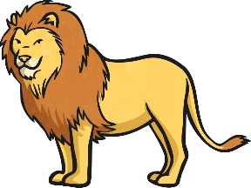
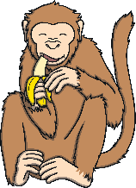
Feeding Time!
Click the correct time.
4 o’clock
half past 2
half past 3

Slide 19
Feeding Time!
Oops!
Try again

Slide 20
Feeding Time!
Well done!

Slide 21



Feeding Time!
Click the correct time.
half past 11
10 o’clock
half past 6

Slide 22
Feeding Time!
Oops!
Try again

Slide 23
Feeding Time!
Well done!

Slide 24

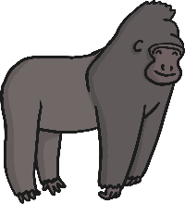

Feeding Time!
Click the correct time.
5 o’clock
half past 3
half past 12

Slide 25
Feeding Time!
Oops!
Try again

Slide 26
Feeding Time!
Well done!

Slide 27
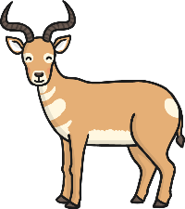
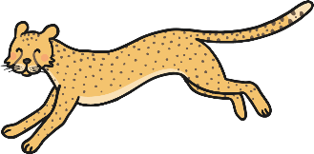
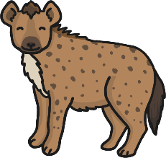
Feeding Time!
Click the correct time.
half past 1
half past 7
half past 2

Slide 28
Feeding Time!
Oops!
Try again

Slide 29
Feeding Time!
Well done!

Slide 30
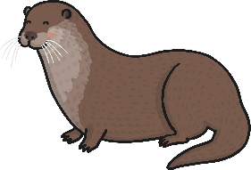
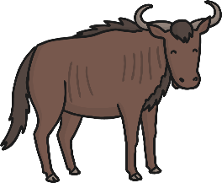
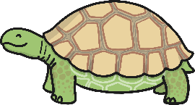
Feeding Time!
Click the correct time.
half past 7
half past 1
half past 6

Slide 31
Feeding Time!
Oops!
Try again

Slide 32
Feeding Time!
Well done!

Slide 33

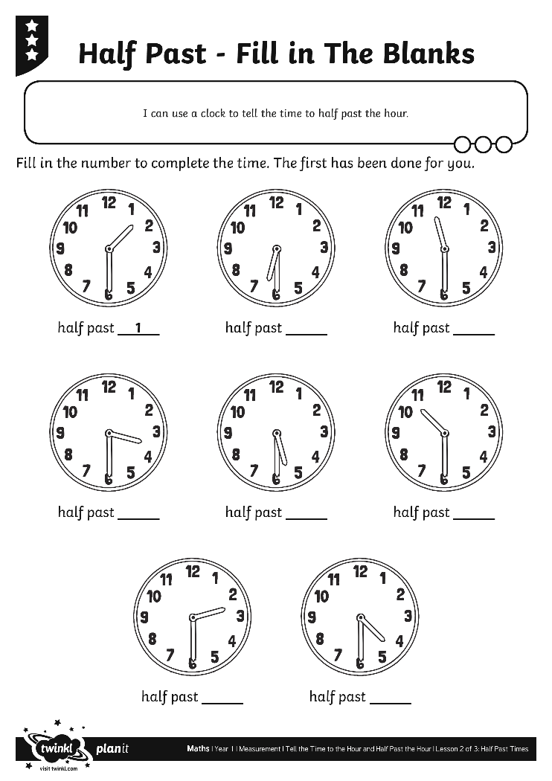
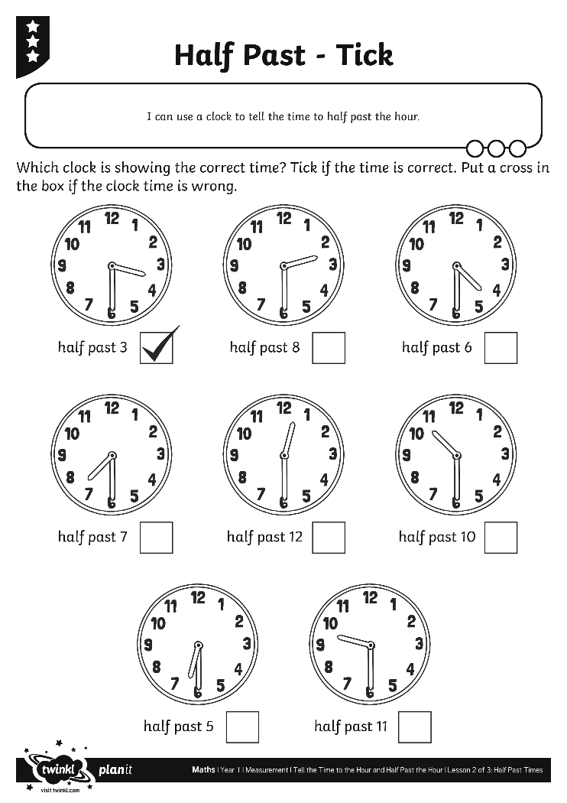
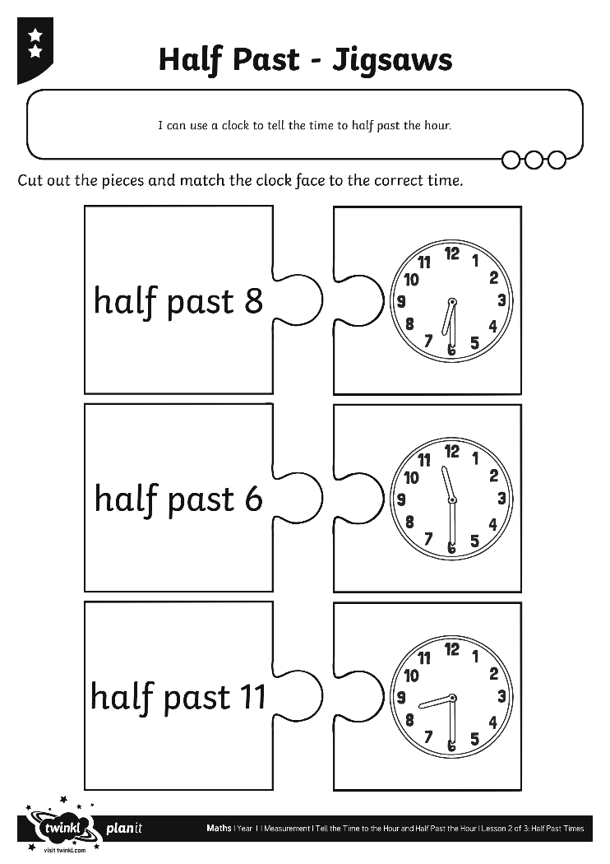
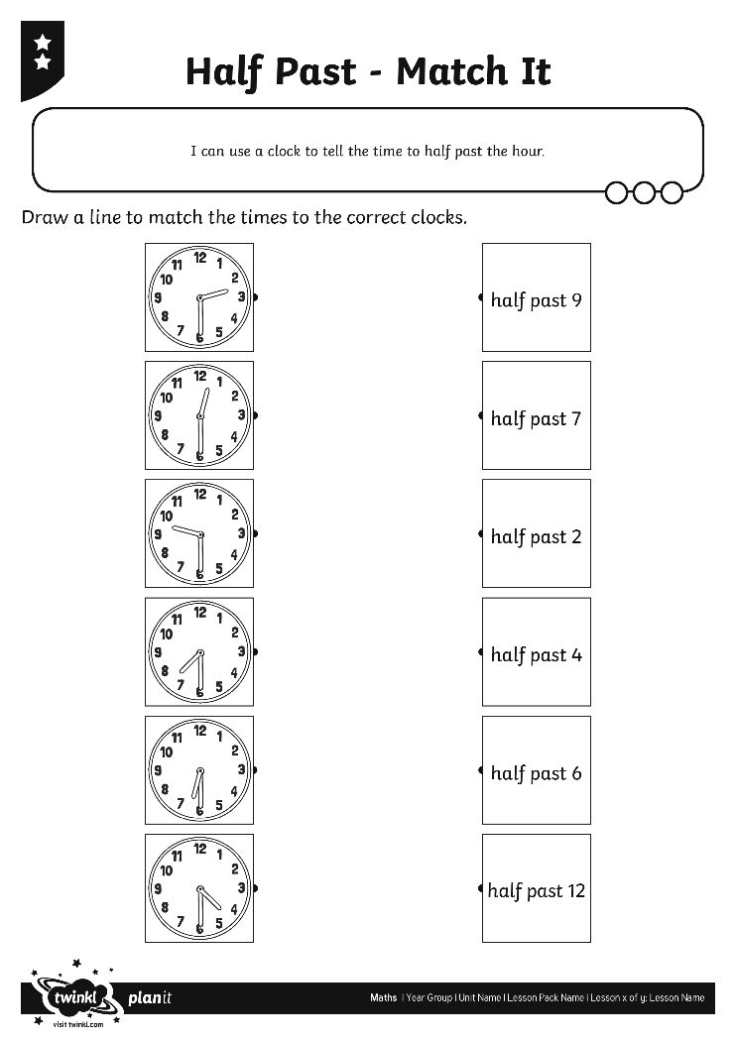
Half Past Activities

Slide 34
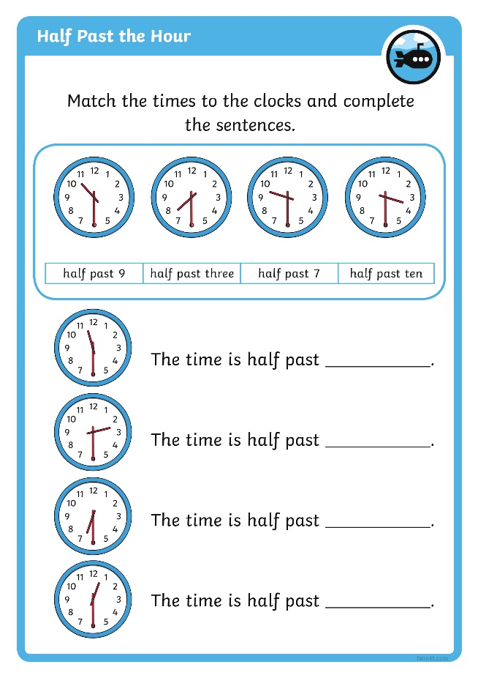
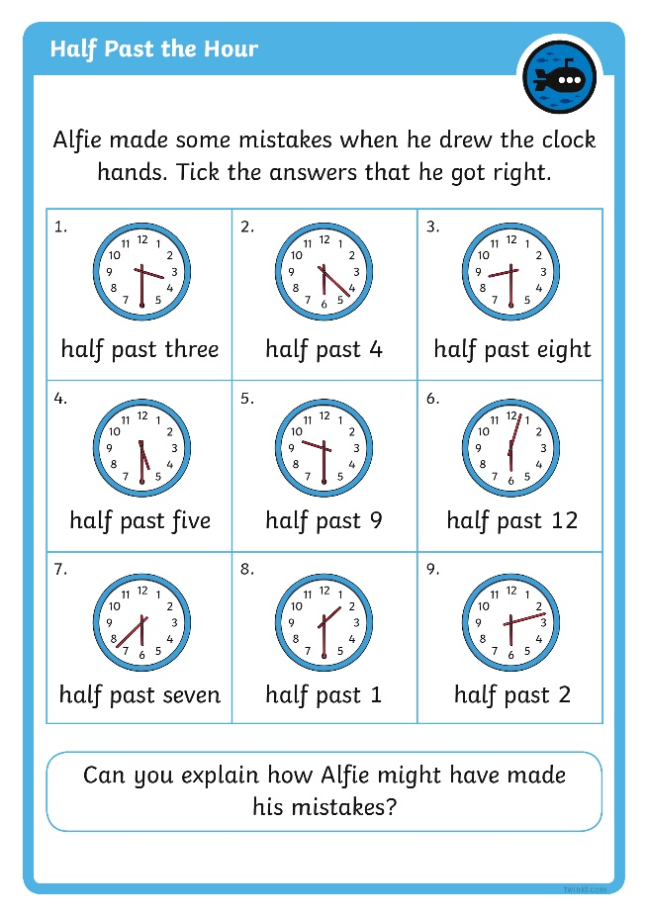

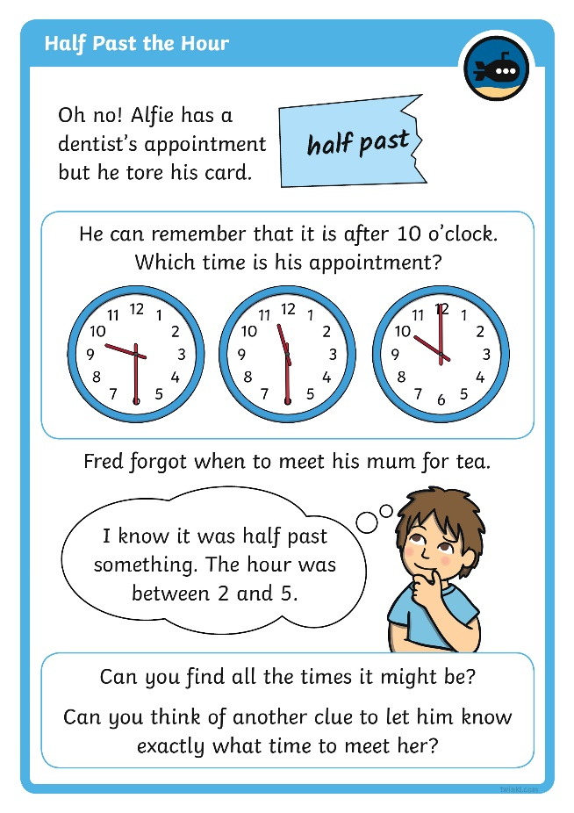
Diving into Mastery
Dive in by completing your own activity!

Slide 35
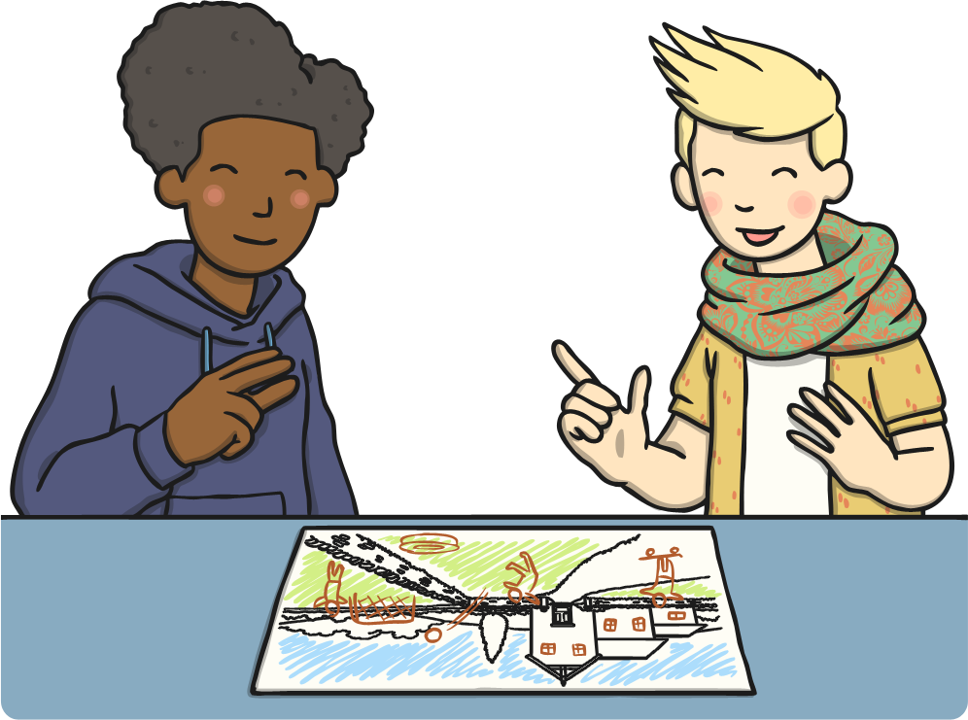
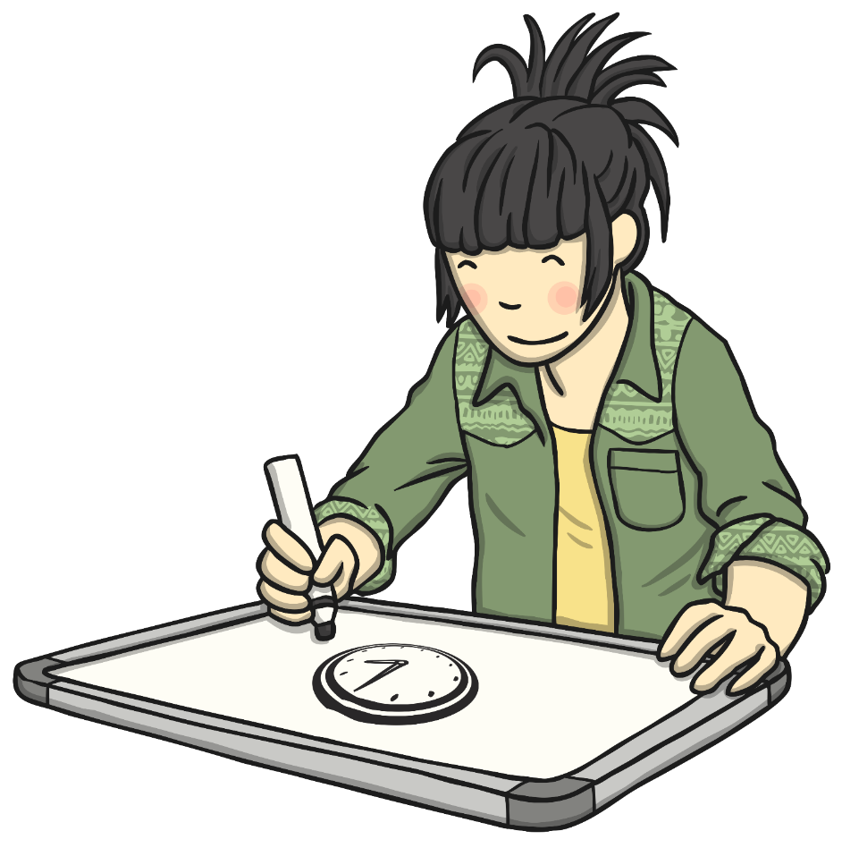
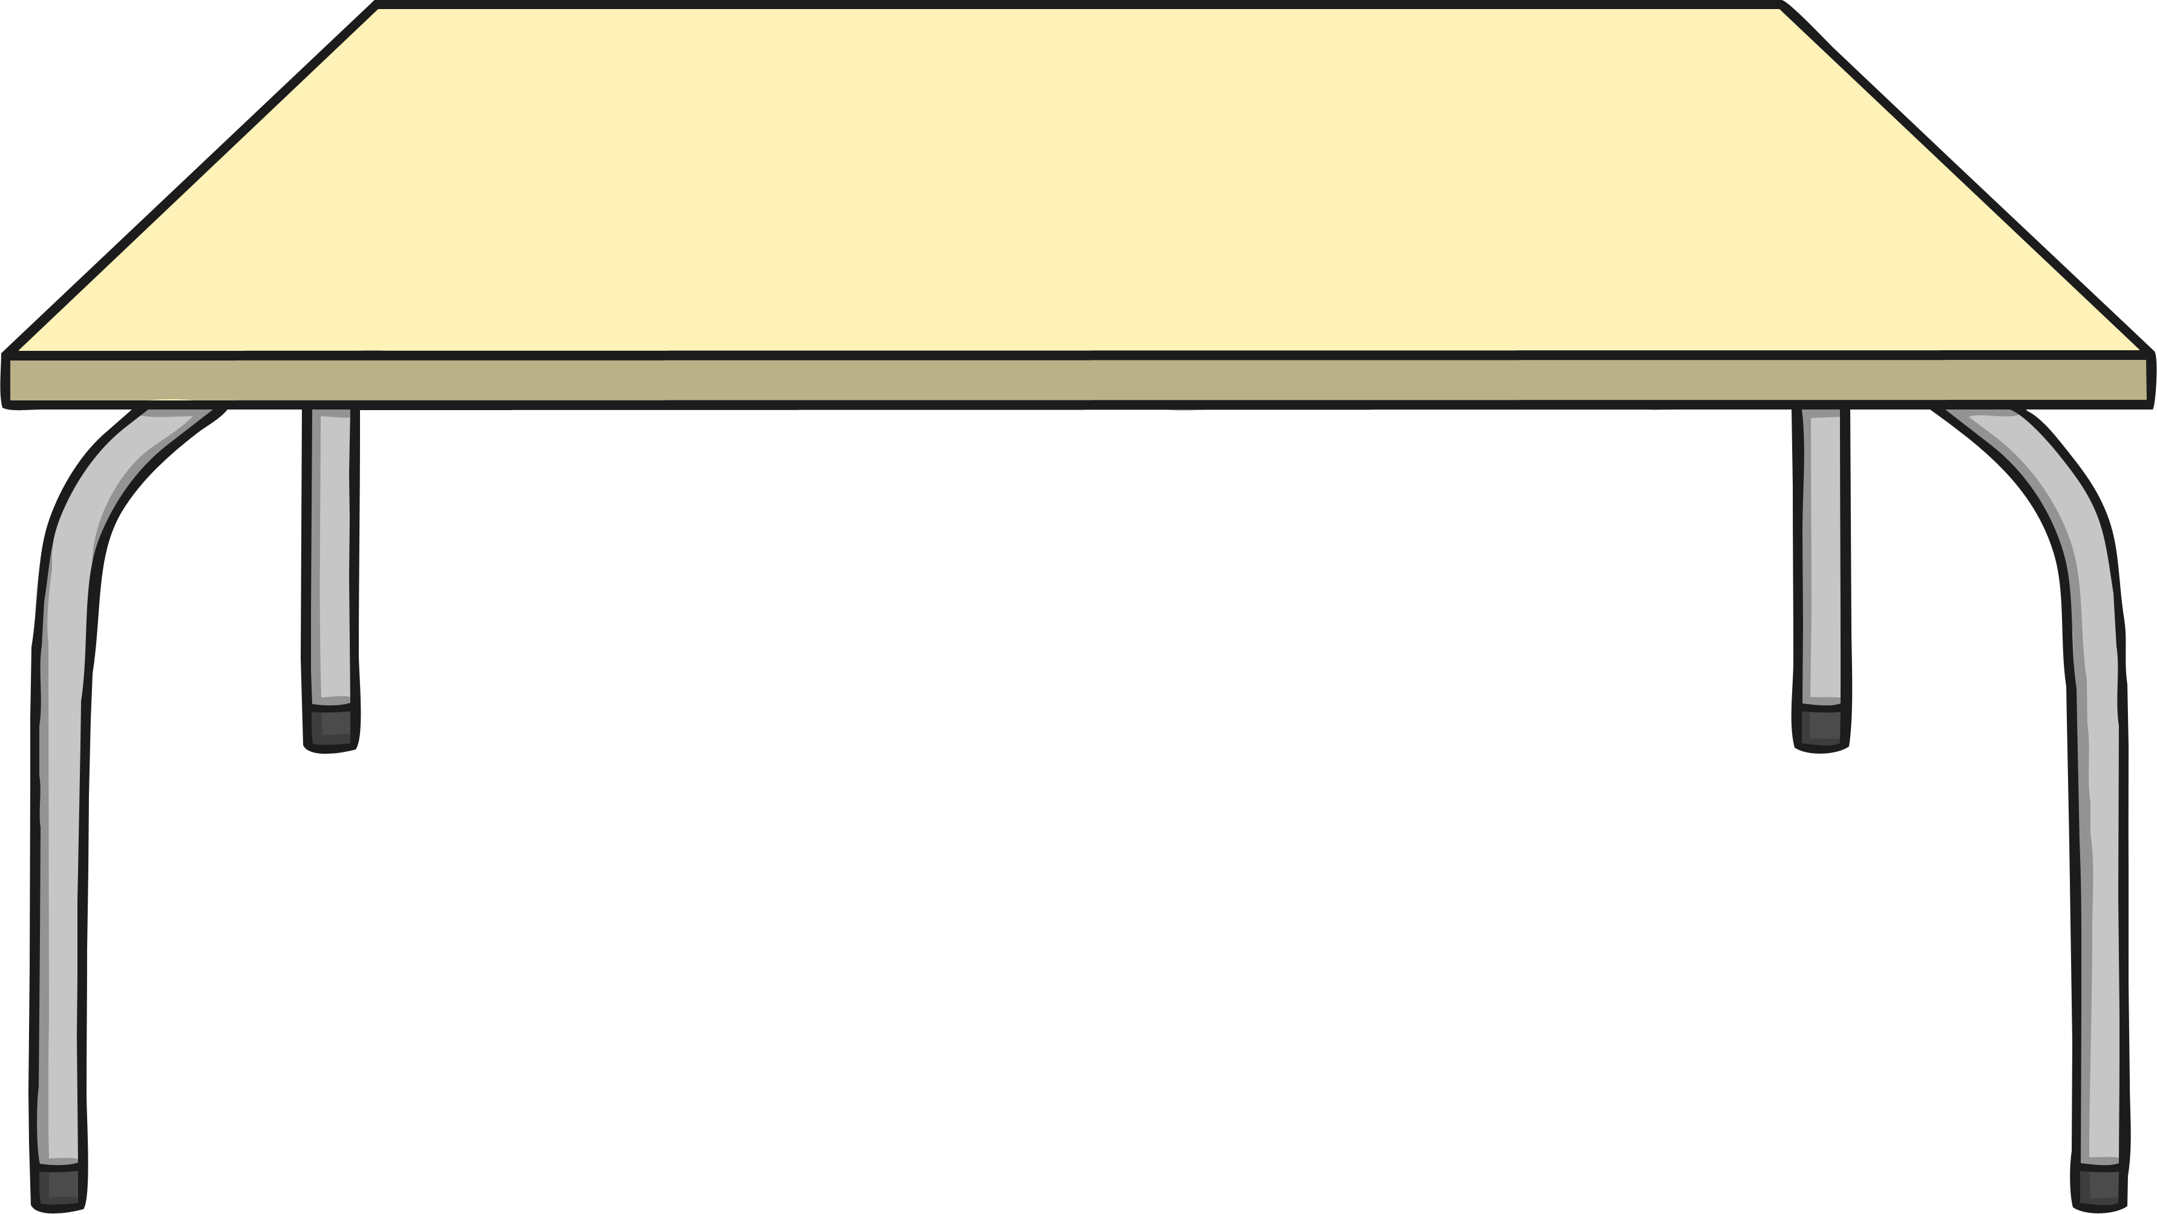
Quick Draw
Can you draw a clock on your whiteboard?
Draw a circle.
Write the numbers round the circle.
Draw the hands.

Slide 36
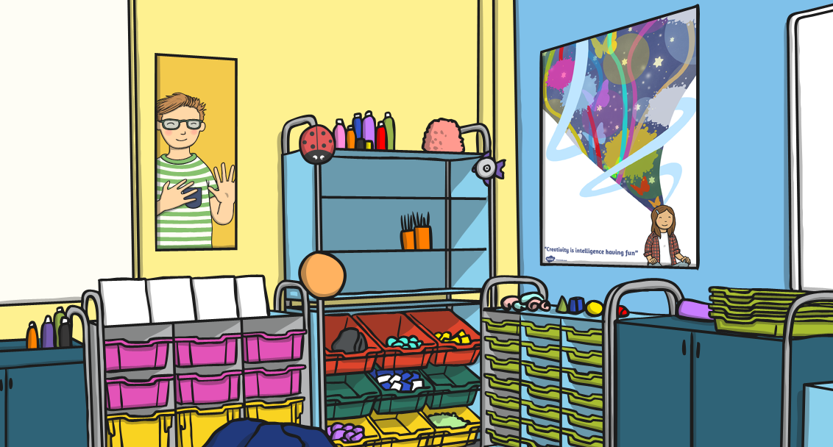
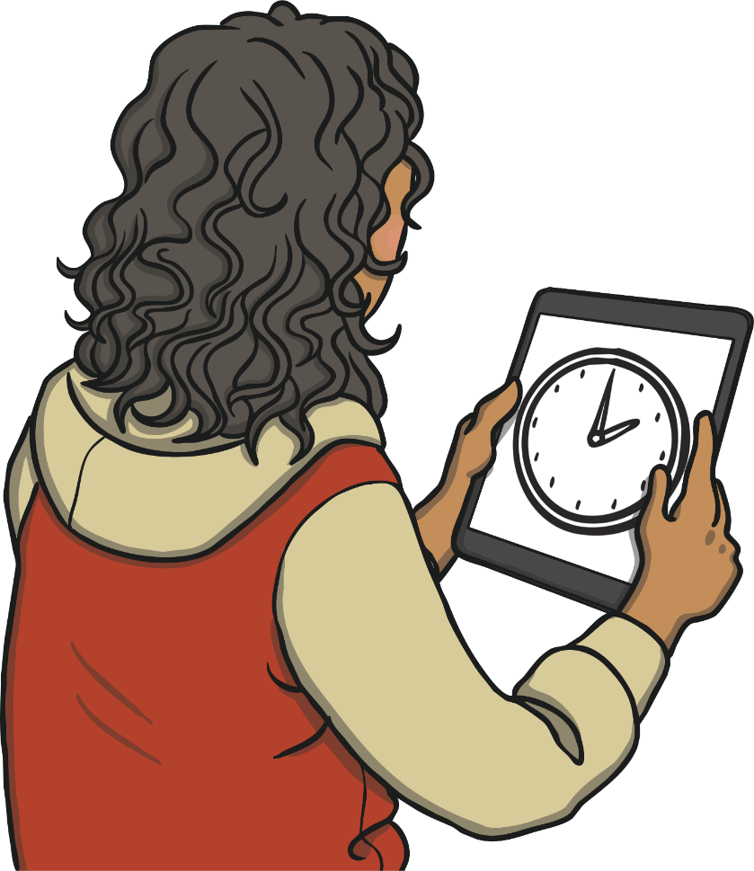
Quick Draw
Show your clock to your partner.
Where are the numbers?
Where are the hands?

Slide 37
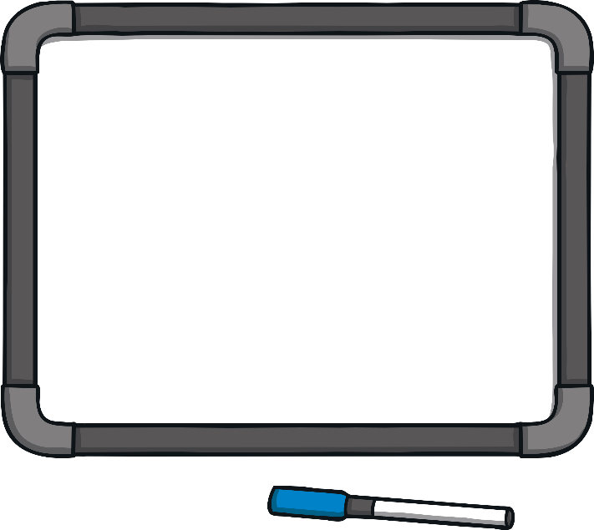

Quick Draw
Where would the minute hand point to show an o’clock time?
Where would the minute hand point to show a half past time?

Slide 38
Aim
I can use a clock to tell the time to half past the hour.
Success Criteria
I can describe the parts of a clock face.
I can read a clock showing half past times.

Slide 39


