Slide 2
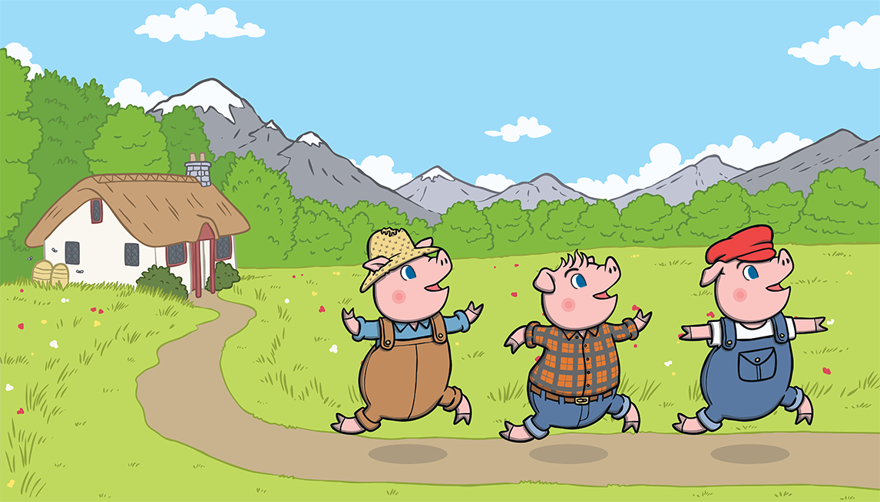
Once upon a time, there lived three little pigs.

Slide 3
One day, they decided to leave home and build houses of their own.

Slide 4
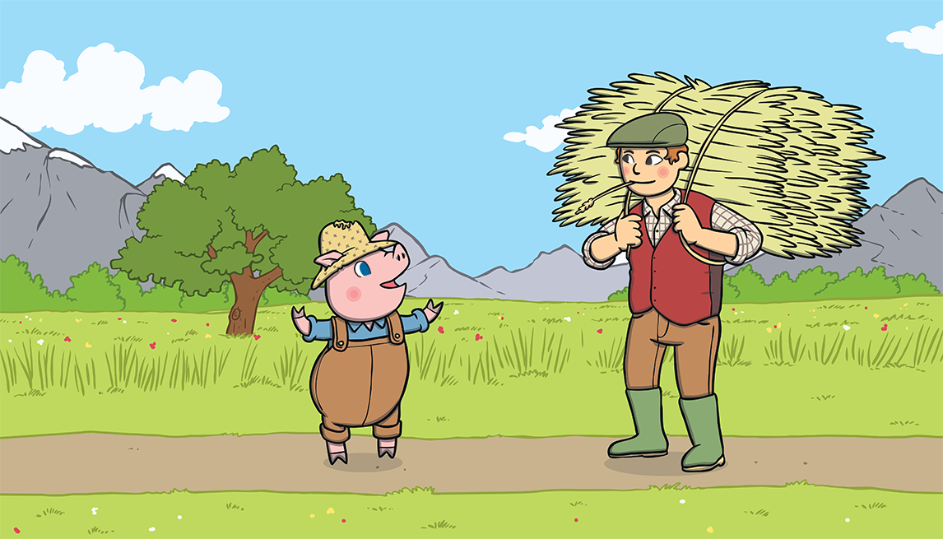
The first little pig thought that straw would make a
good house.

Slide 5
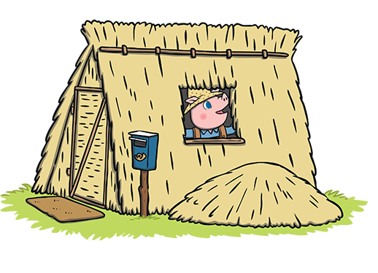
He built the house very quickly and he was very pleased with it.

Slide 6
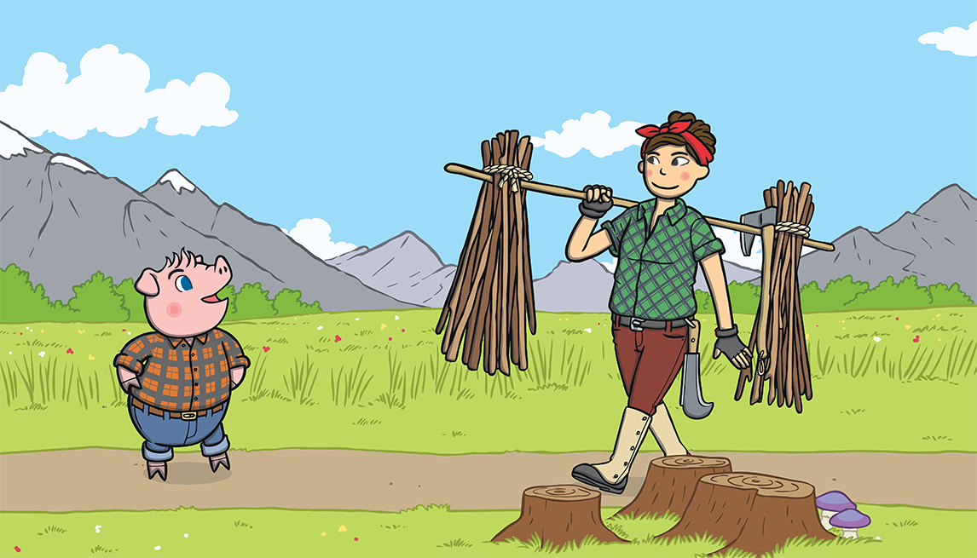
The second little pig thought that sticks would make a fine house.

Slide 7
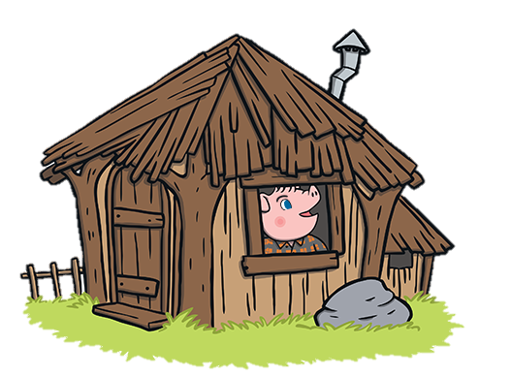
He built the house very quickly and he was very pleased with it.

Slide 8
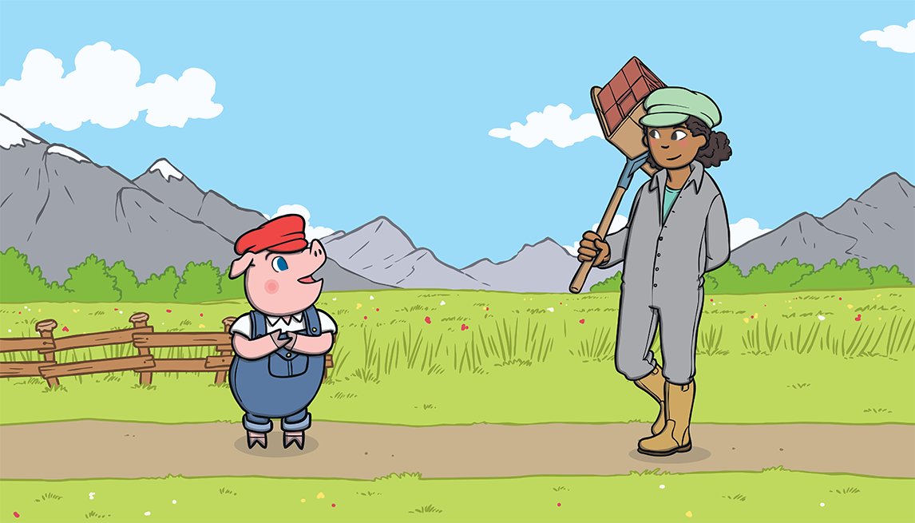
The third little pig thought that bricks would make a strong house.

Slide 9
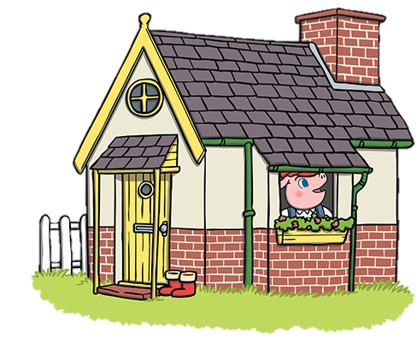
It took him a long time to build the house but he was very
pleased with it.

Slide 10
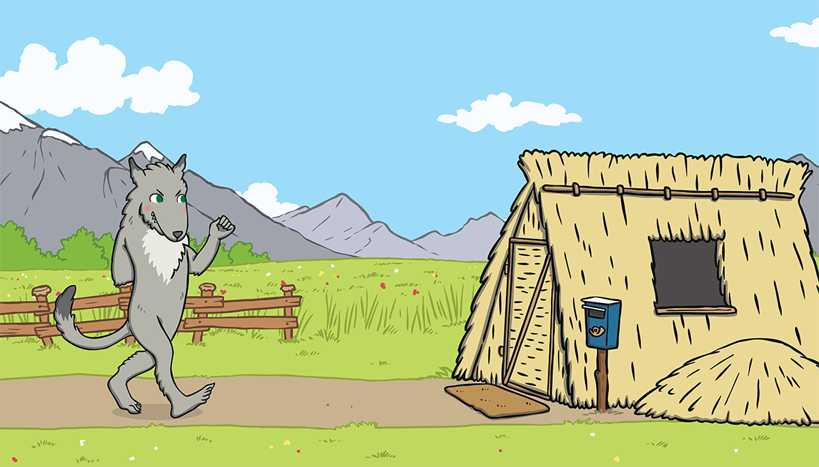
One day, a big bad wolf came along.

Slide 11
He saw the first little pig in his house of straw.

Slide 12
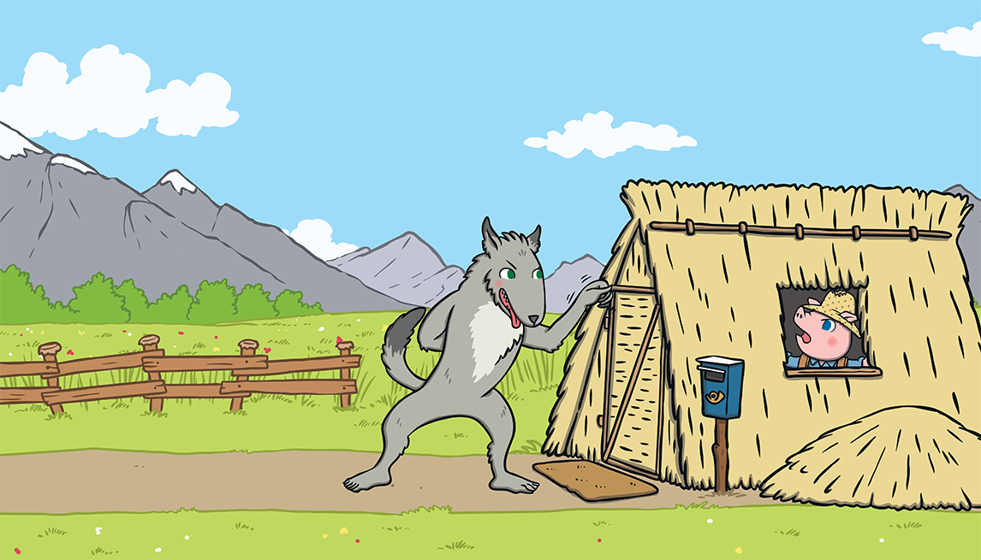
“Little pig, little pig, let me come in,” he snarled.
“Not by the hair on my chinny, chin, chin!” cried the first little pig.

Slide 13
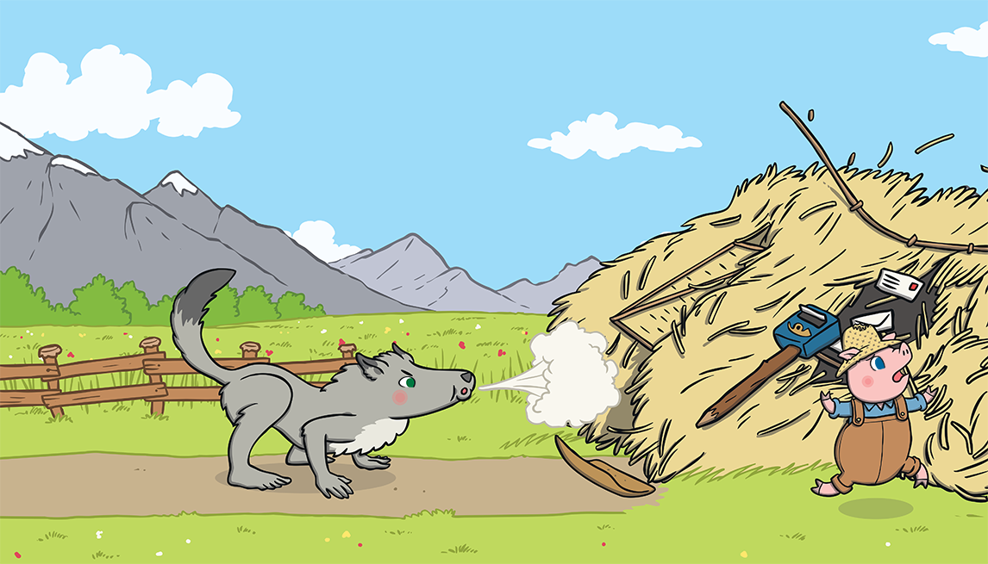
“Then I’ll huff and I’ll puff and I’ll blow your house down!” growled the big bad wolf.

Slide 14
So he huffed and he puffed and he blew the house down!

Slide 15
The first little pig escaped and ran to join his brother in the house made of sticks.

Slide 16
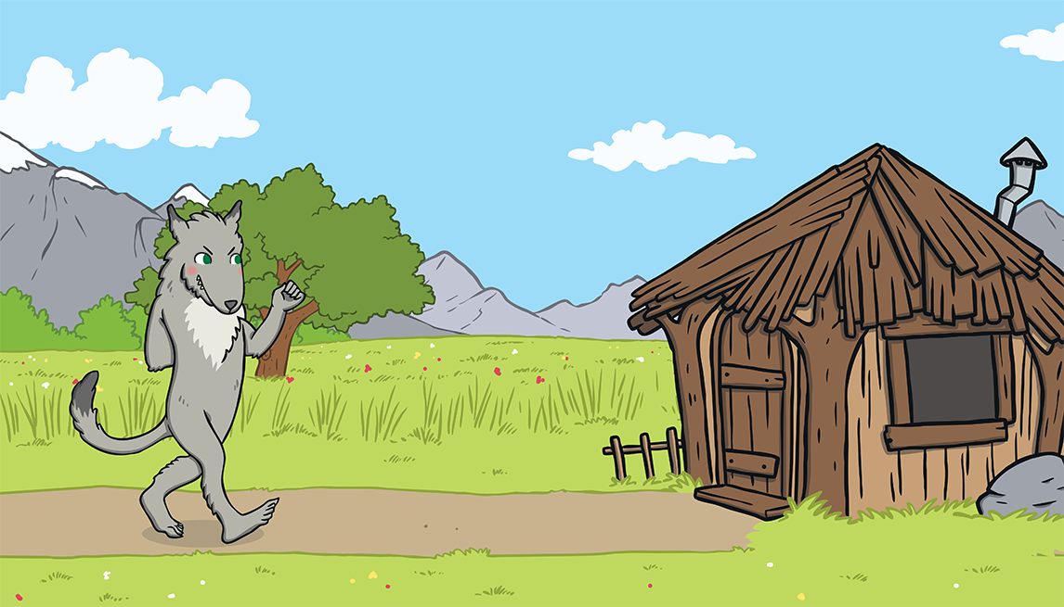
The big bad wolf followed the little pig to the house made of sticks.

Slide 17
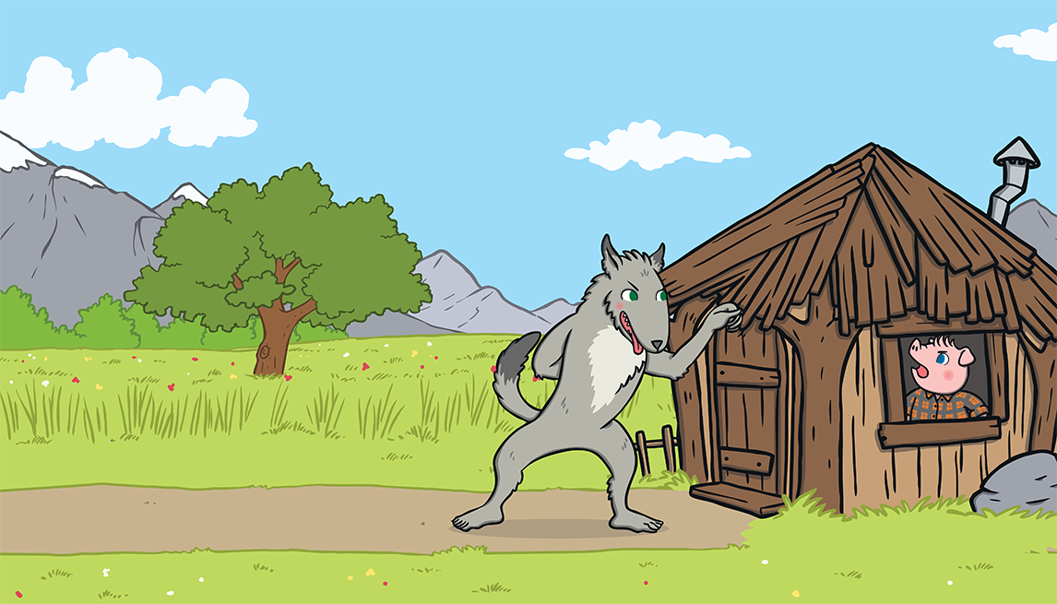
“Little pig, little pig, let me come in,” he snarled.
“Not by the hair on my chinny, chin, chin!” cried the second little pig.

Slide 18
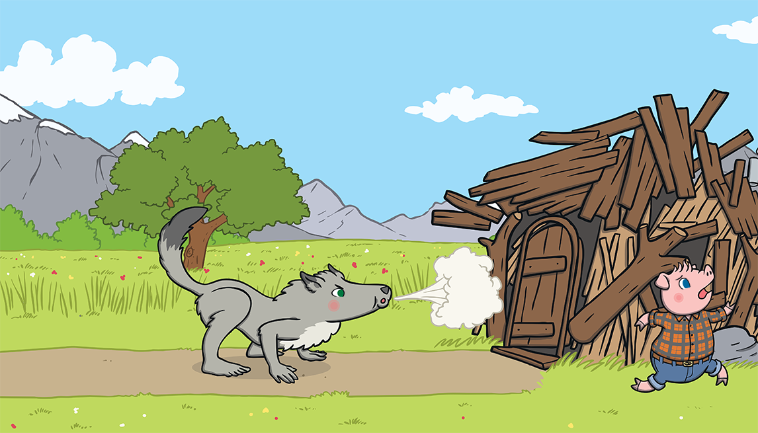
“Then I’ll huff and I’ll puff and I’ll blow your house down!” growled the big bad wolf.

Slide 19
So he huffed and he puffed and he blew the house down!

Slide 20
The two little pigs escaped and ran to join their brother in the house made of bricks.

Slide 21
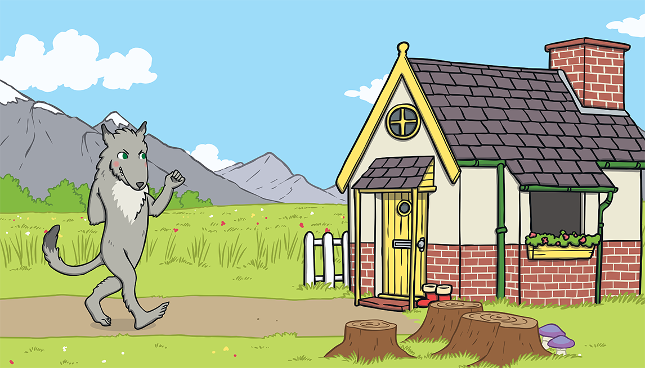
The big bad wolf followed the pigs to the house made of bricks.

Slide 22
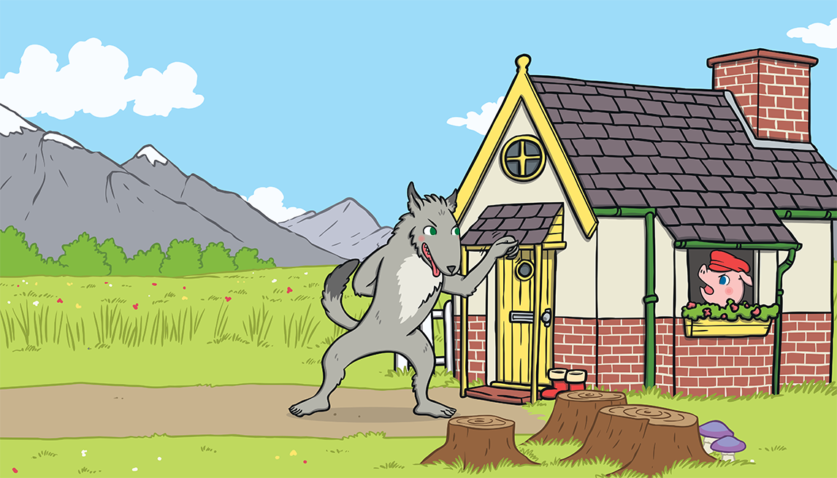
“Little pig, little pig, let me come in,” he snarled.
“Not by the hair on my chinny, chin, chin!” cried the third little pig.

Slide 23
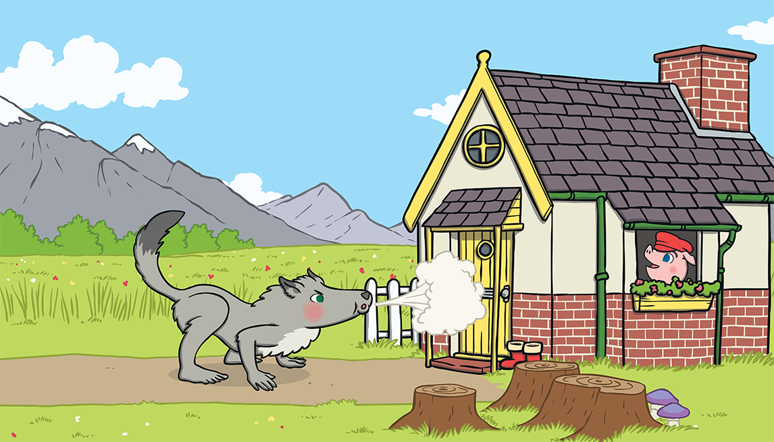
“Then I’ll huff and I’ll puff and I’ll blow your house down!” growled the big bad wolf.

Slide 24
He huffed and he puffed, but the house was too strong. He could not blow it down!

Slide 25
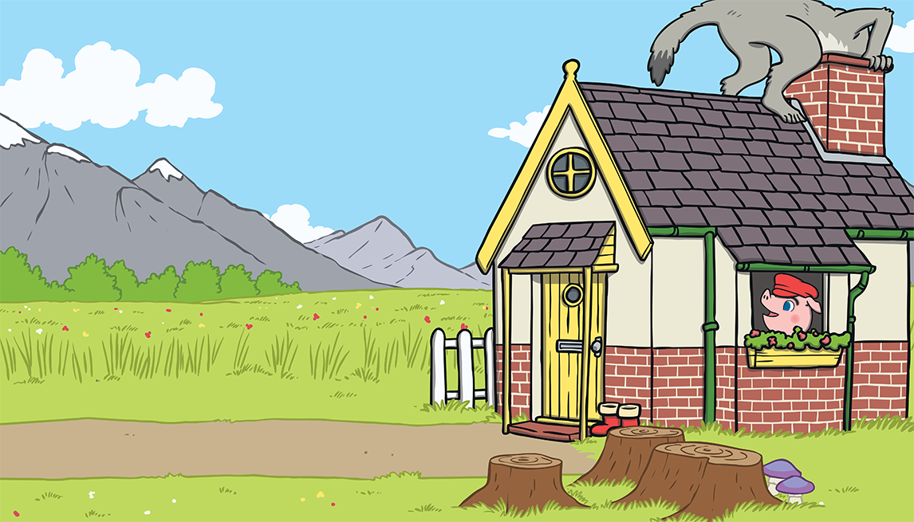
This made the big bad wolf very angry.
He climbed onto the roof of the house so he could crawl down the chimney.

Slide 26
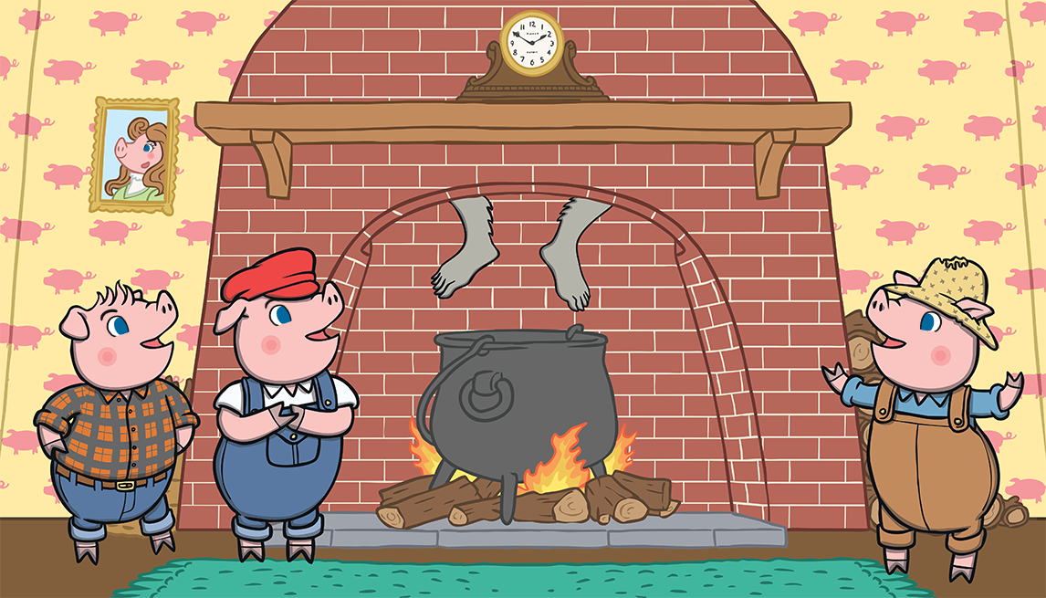
The big bad wolf was in for a big surprise!

Slide 27
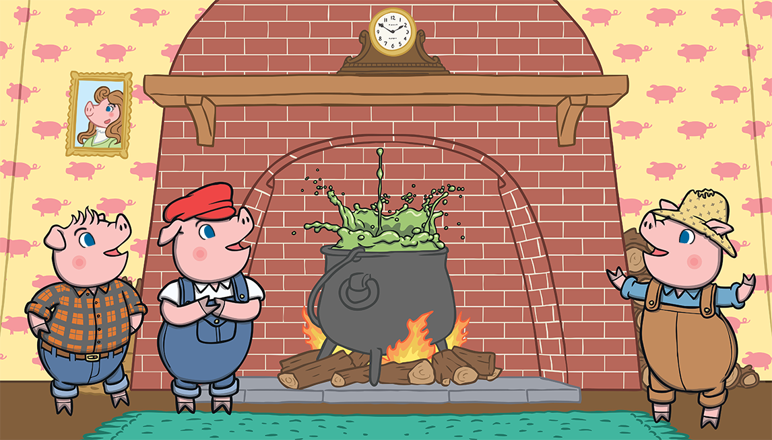
The third little pig had been cooking a big pot of stew and SPLASH! The wolf fell right into the pot!

Slide 28
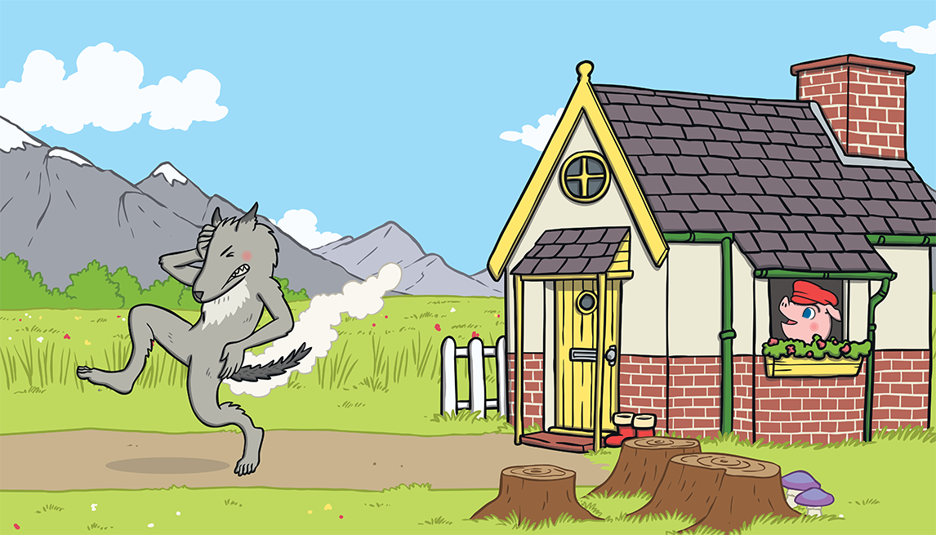
The wolf was very shocked. He jumped out of the pot and ran straight out of the house. He never came back again.

Slide 29
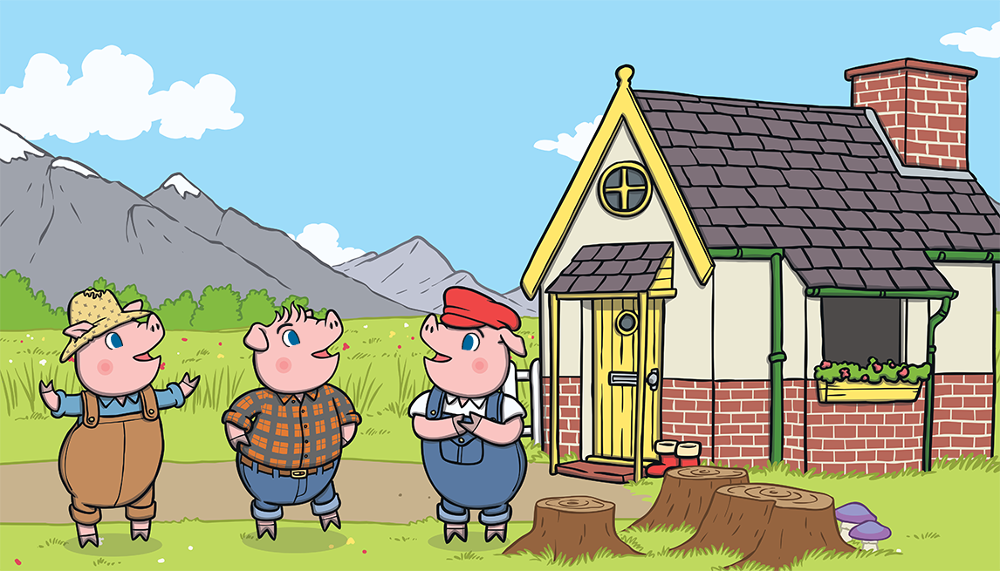
The little pigs lived happily ever after in the house made of bricks.

