Slide 2


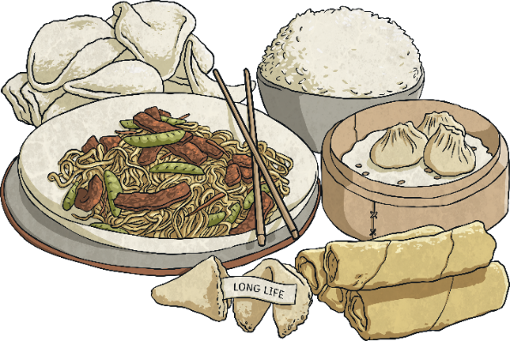

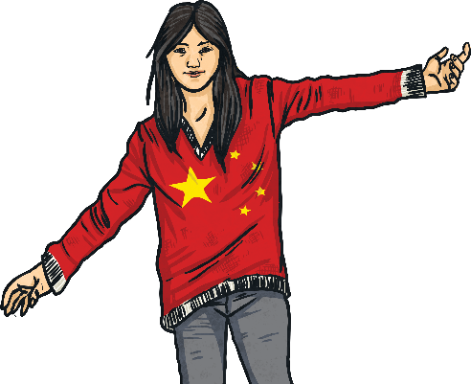


Slide 3
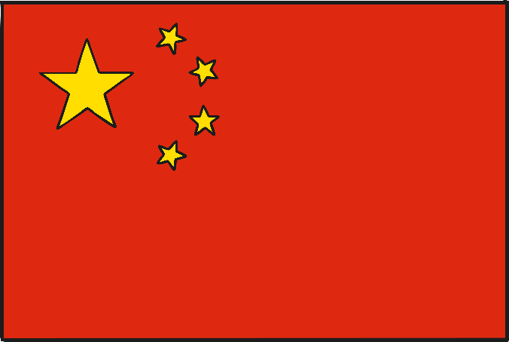
Culture
The national flag of the People’s Republic of China is red with 5 golden stars.
Red represents the communist revolution and the stars represent the unity of the Chinese people under their leadership.
China used to have a strict policy only allowing one child per family due to overpopulation. They can now have two children if either parent was an only child.

Slide 4
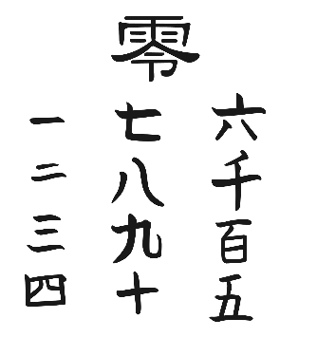
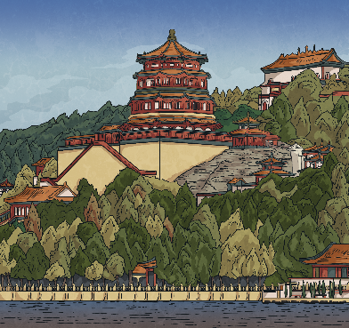
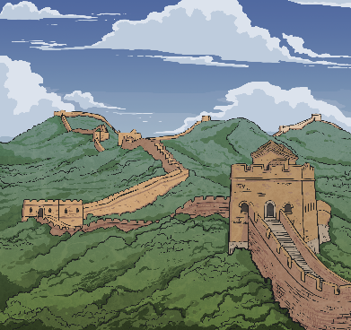

Culture
Official Language: Mandarin
Capital City: Beijing
Landmarks:
Great Wall of China
Population: 1.4 billion
Major Religion: Buddhism
Followed by Christianity

Slide 5
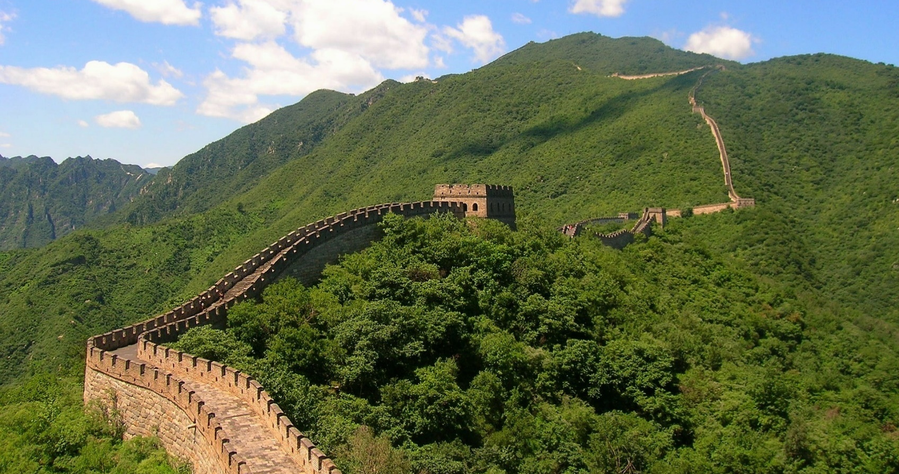
The Great Wall of China

Slide 6
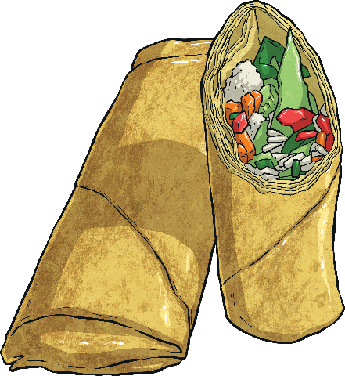
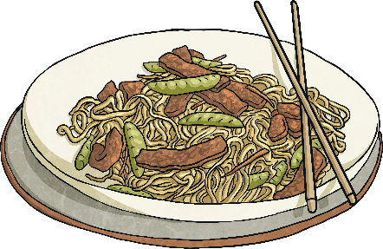
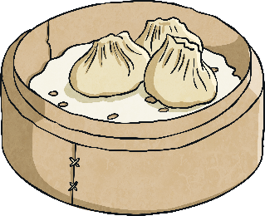
Food
Chinese cuisine is famous for being very vast and includes a huge range of ingredients.
Most Chinese people use chopsticks to eat with.
Rice is a very important food in China and eaten every day. ‘Dim sum’ is a type of Chinese food that is made up of small, tasty dishes served in bamboo steamers. These can be dumplings, meat or vegetables and steamed or fried.

Slide 7
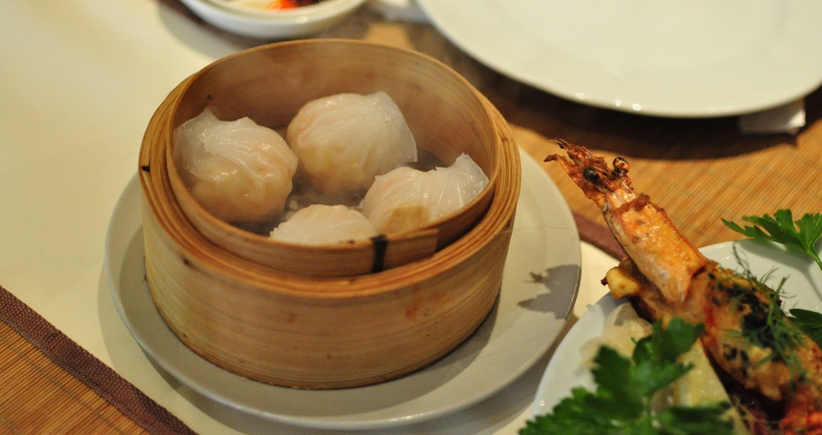
Dim Sum

Slide 8
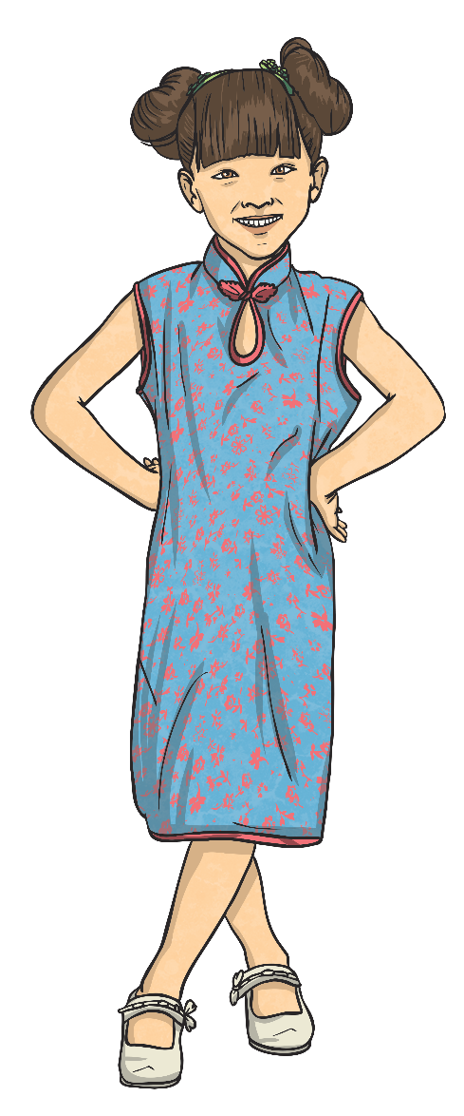
School
Education in China is compulsory for 9 years, starting from the age of 6 or 7.
Schools can range from being very poor to being well funded and modern.
Teaching in China is influenced by the Chinese Communist Party.
The Chinese have an annual festival called Teacher’s Day on September 10th.

Slide 9
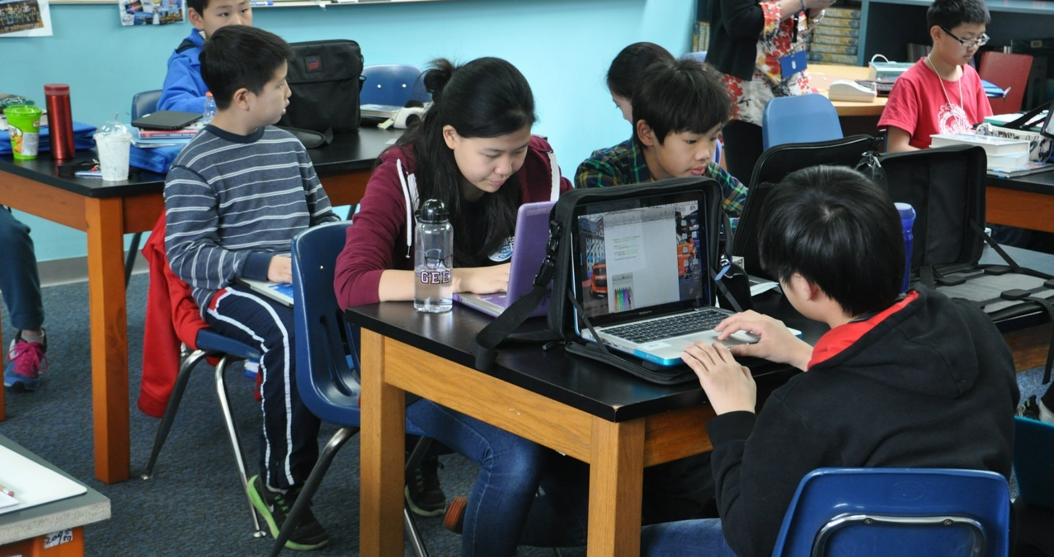
Chinese School

