Slide 2
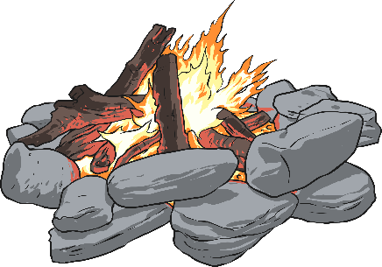

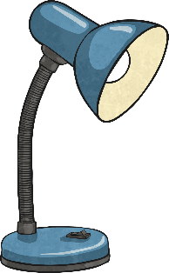



Objects that give out light are called
sources of light.

Slide 3


Shadows
Shadows are created when a source of light shines on an object but the light is blocked and does not pass through it.

Slide 4
Opaque
When light will not pass through an object.
Translucent
When an object allows some light to pass through it.
Transparent
When light passes through an object.

Slide 5

Are the following objects opaque, translucent or transparent?

Slide 6

A book
Opaque

Slide 7
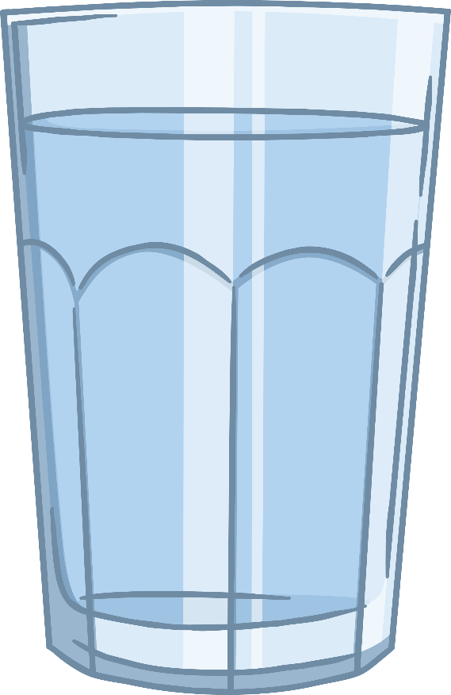
A glass
Transparent

Slide 8

Tracing paper
Translucent

Slide 9
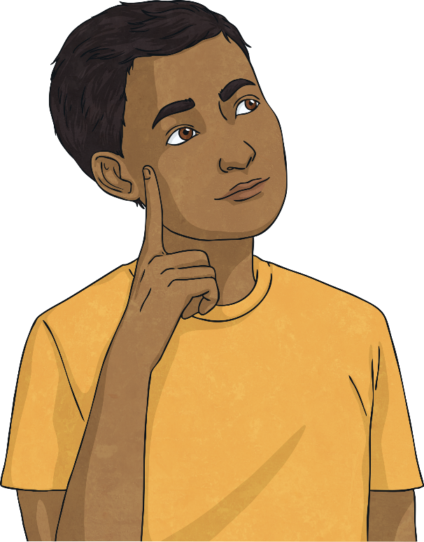
Which sort of objects make the darkest shadow?
How can you change the size of a shadow?

