Slide 1


RE
Islam
Year One
RE | Year 3 | Islam | Holy Book | Lesson 5

Slide 2
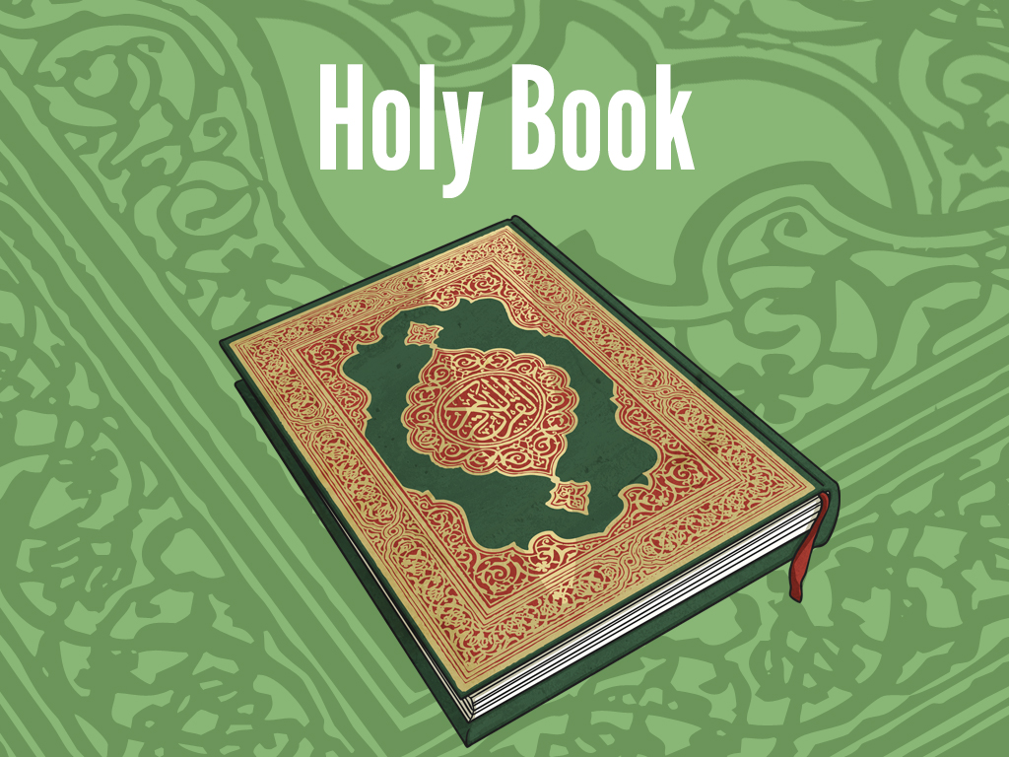


Slide 3
Aim
I can explain what the Muslim holy book is and how it is used.
Success Criteria
I can say what the Muslim holy book is called.
I can explain how the words in the Qur’an were revealed to Muhammad.

Slide 4

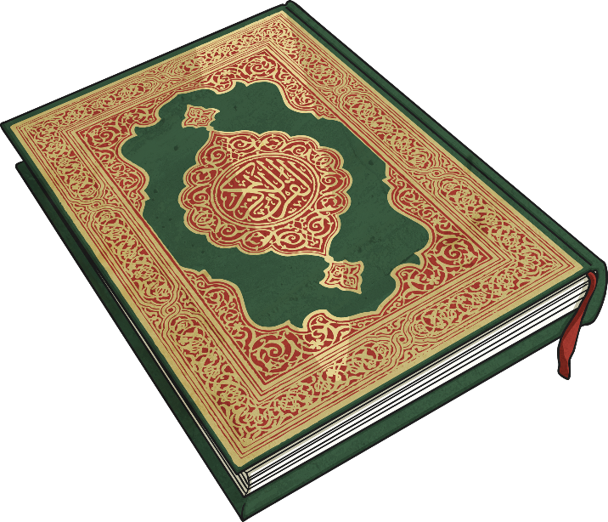
Archangel Gabriel
The Qur’an is the name of the Muslim holy book. Muslims believe that it is a record of the exact words revealed by Allah through the Archangel Gabriel to Prophet Muhammad.
Muhammad memorised the words and wrote them down.
Muhammad used these words to live his daily life and in the words he spoke.
Therefore, lots of the things Muhammad did and said were remembered and recorded carefully.
As well as the Qur’an, the other sacred sources in Islam are the Sunnah (soo-n-uh), which contains the practises and examples of the Prophet Muhammad and Hadith (hah-deeth), which reports of the Prophet Muhammad said or approved.

Slide 5

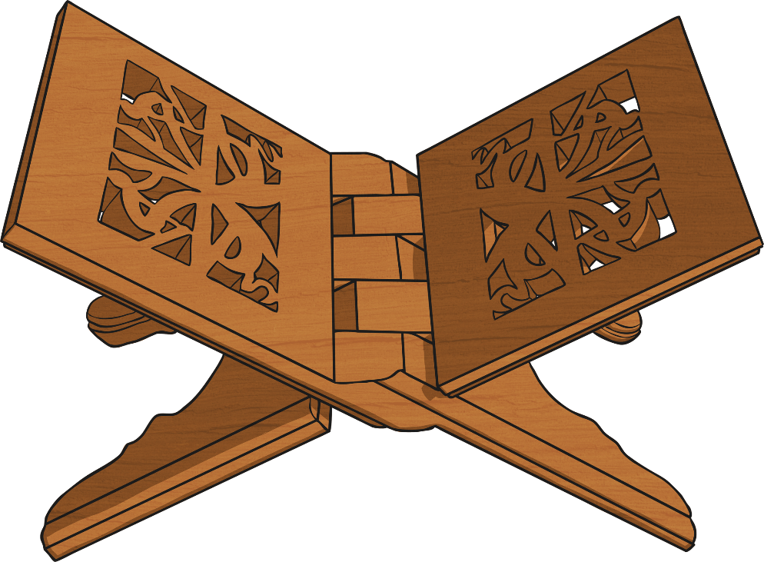
The Qur’an
Muslims treat the Qur’an with a huge amount of respect, as they believe it is literally from Allah and therefore every word is sacred.
The Qur’an is usually placed on a special wooden stand to be read.
Muslims believe that the Qur’an is the unaltered words of Allah.
In pairs, discuss how the Qur’an is similar to holy books in other religions.
Is it different in any way?
Write down your ideas on your whiteboard for us all to share together as a class.

Slide 6

Video
Watch this video clip about the Qur’an.
You can write key information down whilst watching the video on your whiteboards to help you with the next task.

Slide 7
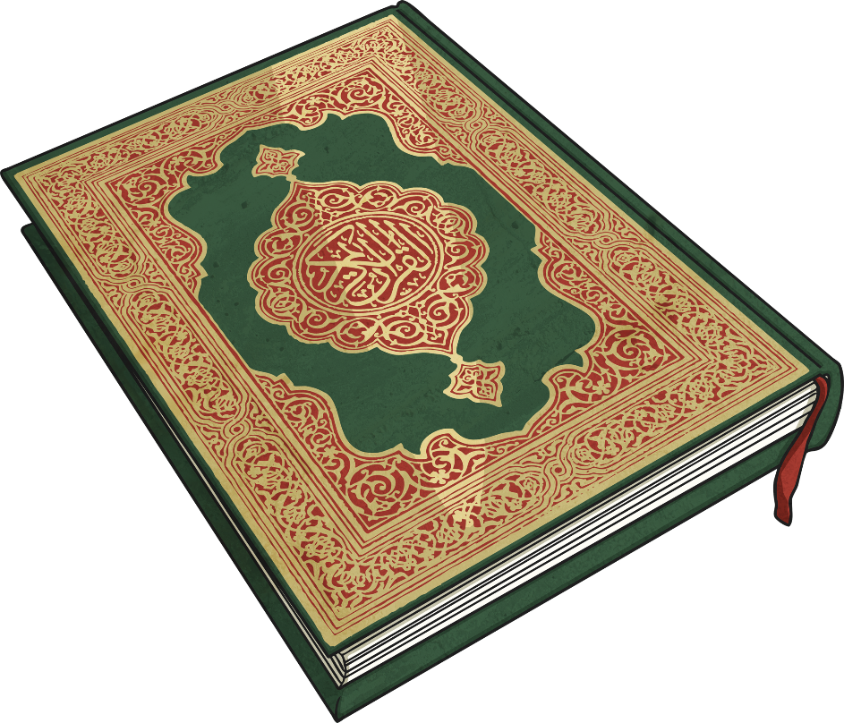
Quiz
What is the Muslim holy book called?
The Qur’an

Slide 8
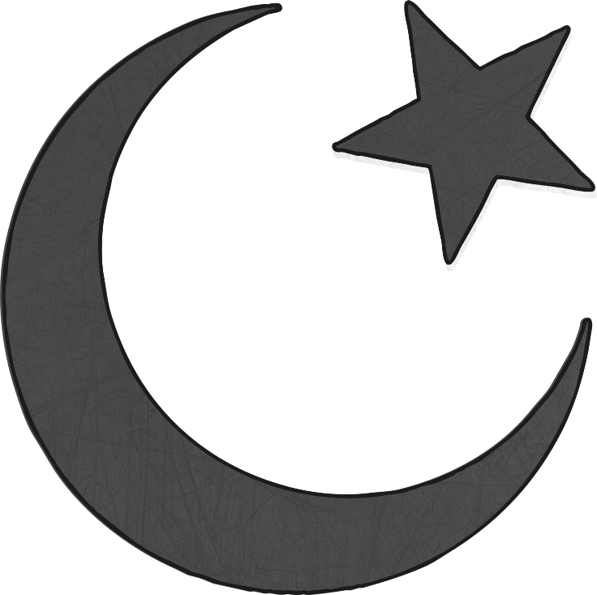
Quiz
Who were the words of Allah revealed to Muhammad through?
The Archangel Gabriel

Slide 9
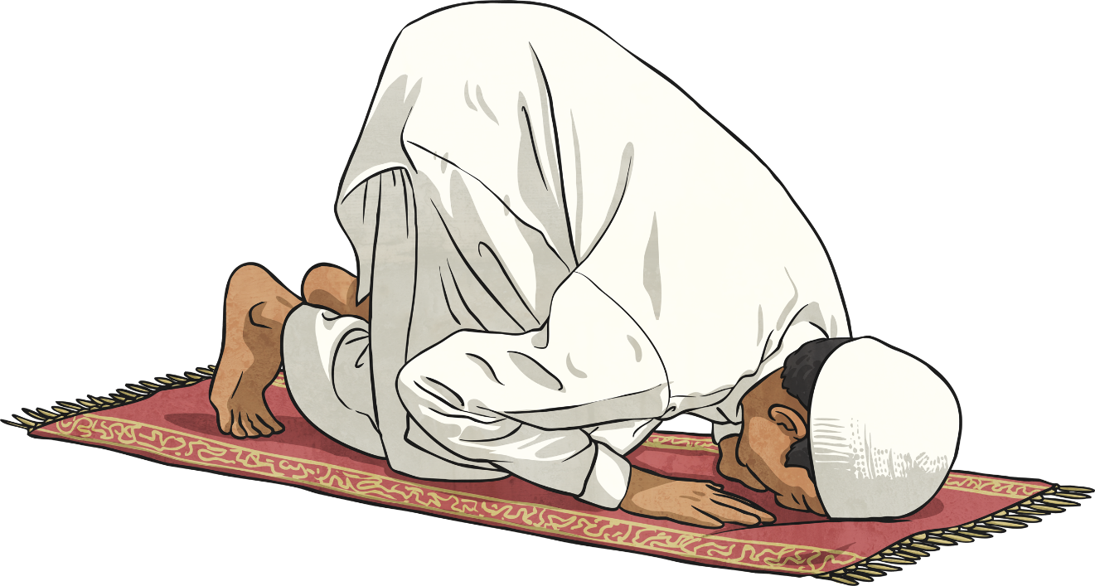
Quiz
Muslims believe the Qur’an is literally the words of Allah.
Is this true or false?
True

Slide 10
Quiz
What is the Qur’an placed on to be read?
A special wooden stand

Slide 11

Aim
I can explain what the Muslim holy book is and how it is used.
Success Criteria
I can say what the Muslim holy book is called.
I can explain how the words in the Qur’an were revealed to Muhammad.

