Slide 1


Science
Animals Including Humans
Year One
Science | Year 2 | Animals Including Humans | Healthy Eating | Lesson 4

Slide 2
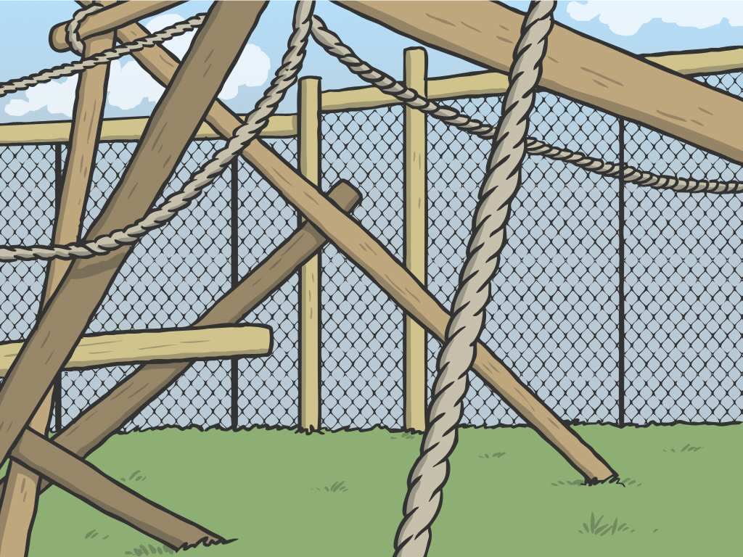
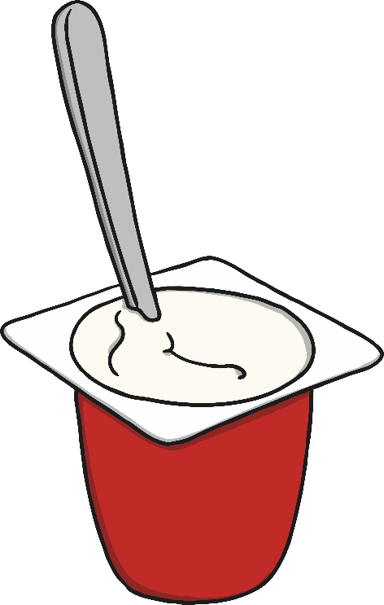
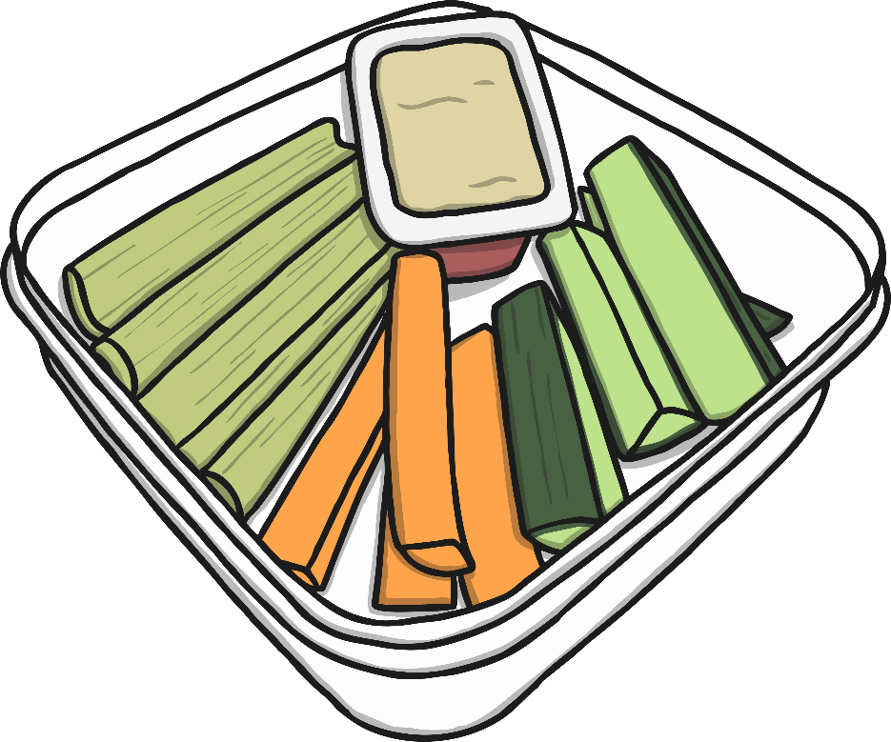

Healthy Eating

Slide 3
Aim
I can identify healthy and unhealthy food, and say how much of them I should eat.
I can suggest ways to improve my diet.
Success Criteria
I can say which foods are healthy and which are less healthy.
I can design a menu that has the right amount of each food type.
I can say what is healthy about my diet.
I can say how I could improve my diet.

Slide 4
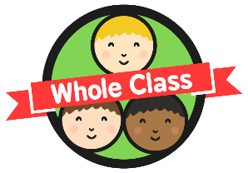

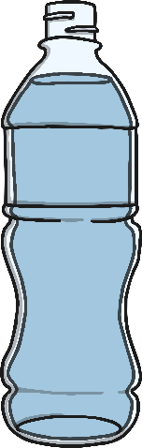
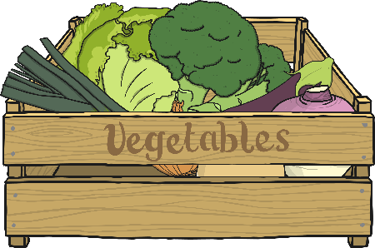

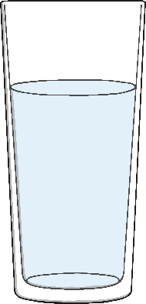
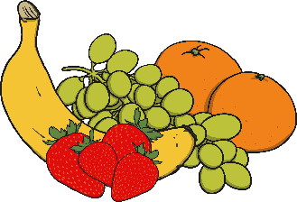
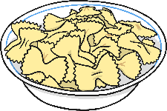
Basic Needs
Humans and other animals need certain things to keep alive. These are called basic needs. Can you remember what they are?
Food
Air
Water
?
?
?

Slide 5
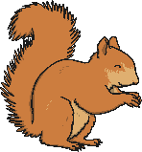
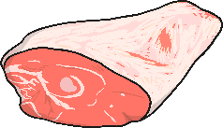
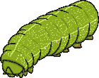
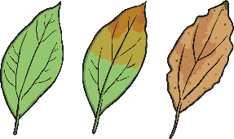
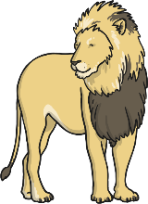
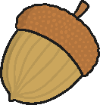
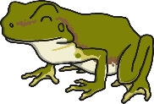
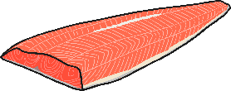
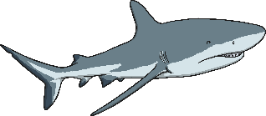
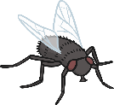


Basic Needs
All animals need particular kinds of food to keep them healthy and strong. Can you match the food to the animal that eats it?
Notes:
Click on the animal to show which type of food it eats.

Slide 6
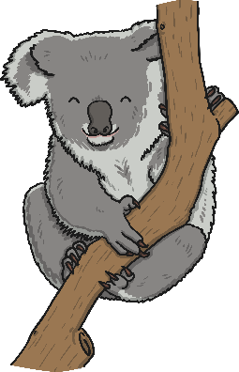
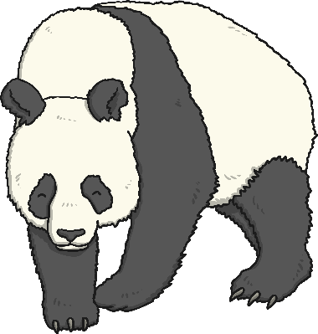
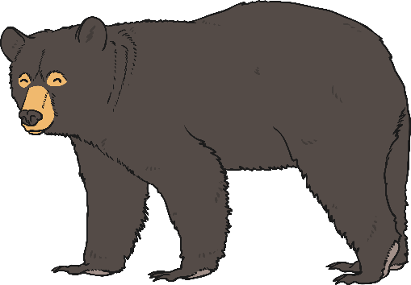
Basic Needs
Some animals only need to eat one kind of food.
Other animals need to eat lots of different kinds of food to stay healthy.
Koalas only eat the leaves of the eucalyptus tree.
Panda bears only eat bamboo.
Black bears eat roots, leaves, fruit, nuts, insects, eggs, meat, fish and honey.
What about humans?

Slide 7
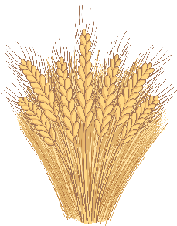

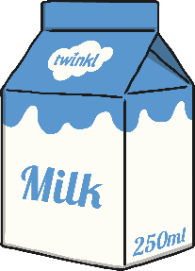
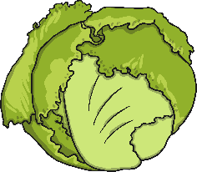

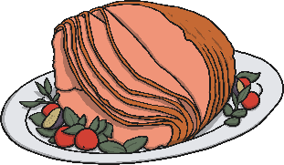
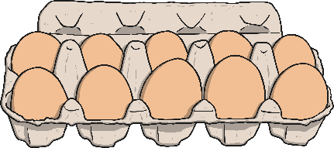
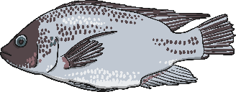
Basic Needs
Humans need to eat lots of different kinds of food to stay healthy. We call this ‘a balanced diet’.
Lettuce
Wheat
Fruit
Milk
Fish
Meat
Eggs

Slide 8

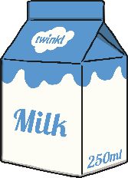


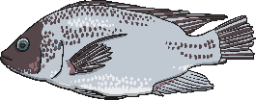
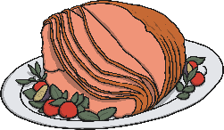
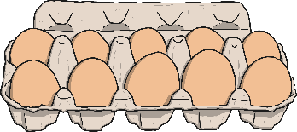
Lots, Some or Only a Little?
We need to eat a balanced diet because different kinds of food, do different jobs in our bodies.
Some kinds of food are very good for us. We can eat as much of these as we like.
Some of the foods we eat are good for us, but only if we don’t eat too much.
Some of the foods are not good for us. It is fine to eat a small amount of these foods, but if we eat too much it could make us less healthy.

Slide 9
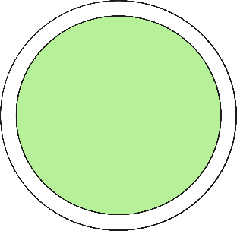

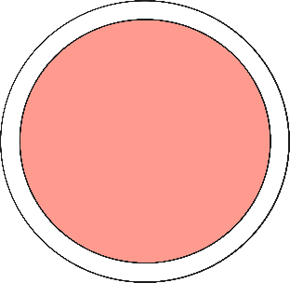
Lots, Some or Only a Little?
Sort the foods onto the different plates, depending on how much of them you should eat.
I should eat lots of these foods (at every meal).
I should eat these foods sometimes (a few times a day).
I should only eat a little bit of these foods (only as a treat).

Slide 10
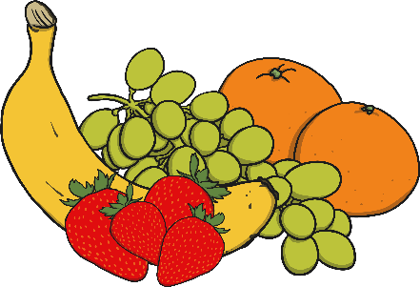
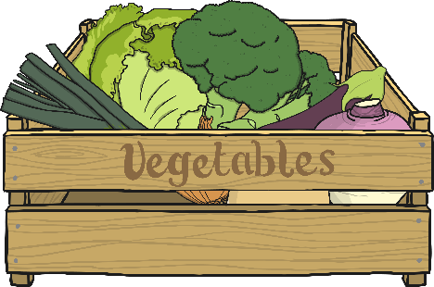
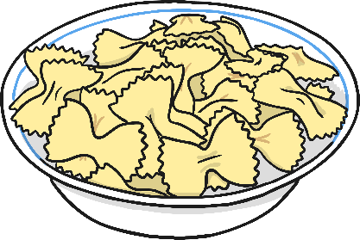
Lots, Some or Only a Little?
Lots
Fruit and vegetables.
Starchy food like bread, pasta and potatoes.
Eat these at every meal and for snacks.

Slide 11
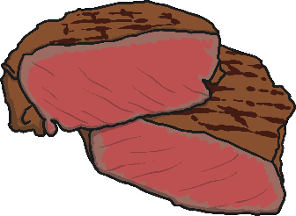

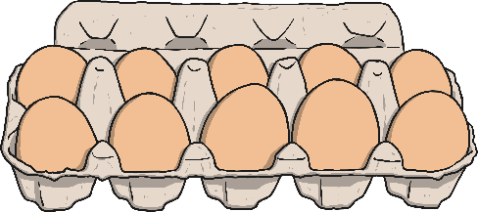
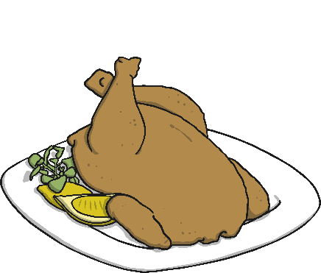

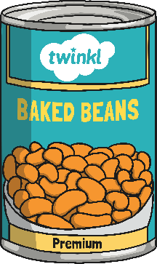

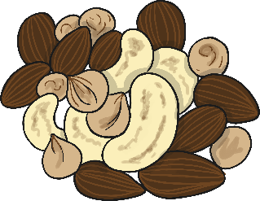
Lots, Some or Only a Little?
Some
High protein foods like meat, fish, beans, eggs and nuts.
Dairy foods like cheese, milk and yogurt.
Eat these two or three times a day.

Slide 12
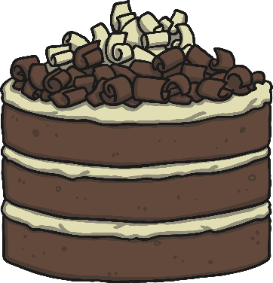
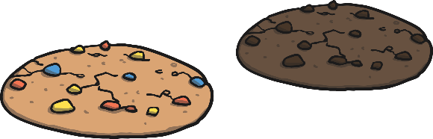
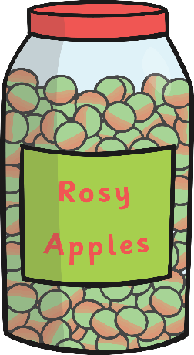
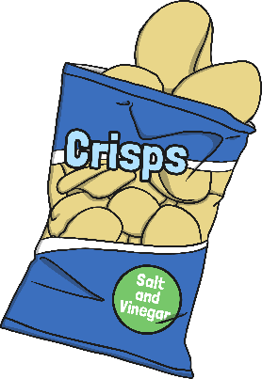
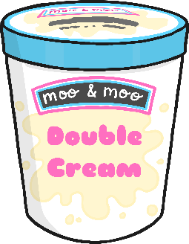
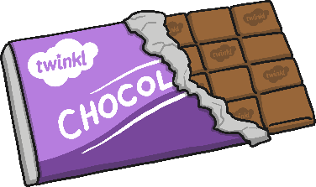

Lots, Some or Only a Little?
Only a little
Food that is high in sugar or fat.
Eat food like this no more than once a day.

Slide 13
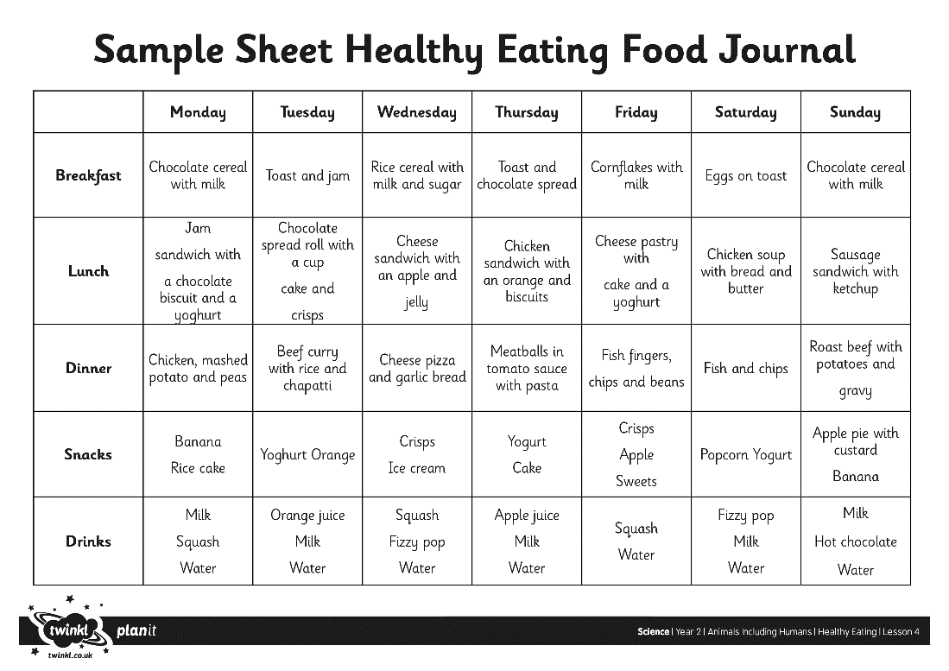
Healthy Eating Journal
We call the things that we eat, our ‘diet’.
Looking at our diet can tell us if we are already eating healthily, or if we could improve our eating habits.
What good eating habits can you see in this Healthy Eating Journal?
How could we improve this diet to make it healthier?

Slide 14

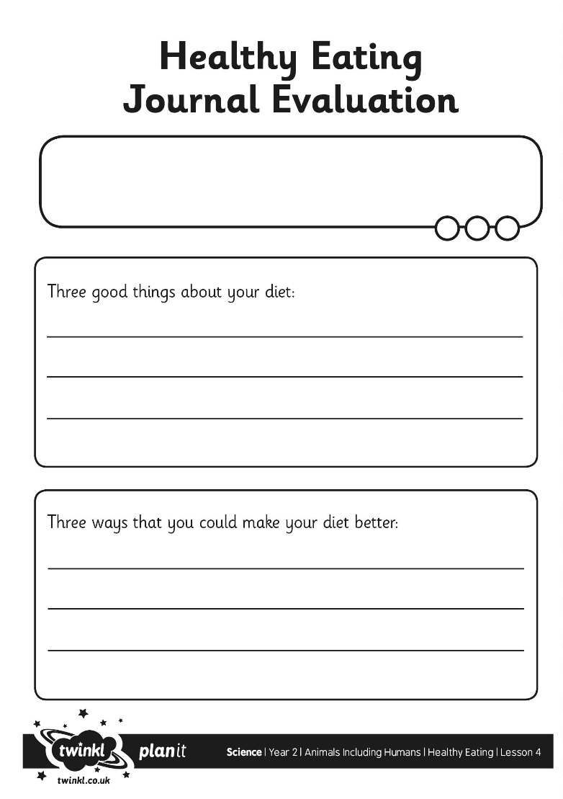
Healthy Eating Journal
Working in pairs, look carefully at your Healthy Eating Journal to find three good healthy eating habits, and three ways you can improve your diet to make it more healthy.

Slide 15
Aim
I can identify healthy and unhealthy food, and say how much of them I should eat.
I can suggest ways to improve my diet.
Success Criteria
I can say which foods are healthy and which are less healthy.
I can design a menu that has the right amount of each food type.
I can say what is healthy about my diet.
I can say how I could improve my diet.

