Slide 2
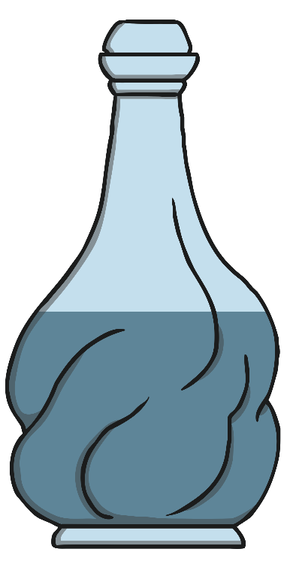
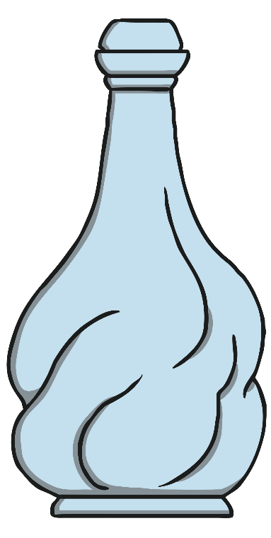
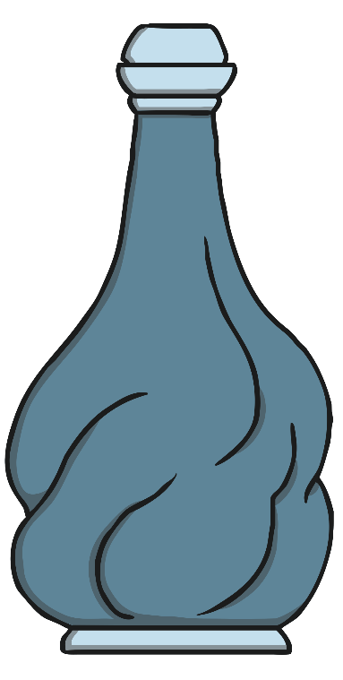
Pick the Perfume
The Perfumers need help finding the right perfume.
Click on the perfume that is full.
back
next

Slide 3
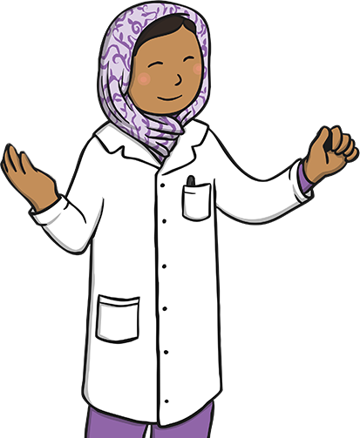
Try again!
back

Slide 4

Correct!
next

Slide 5
Pick the Perfume
The Perfumers need help finding the right perfume.
Click on the perfume that is empty.
back
next

Slide 6
Try again!
back

Slide 7
Correct!
next

Slide 8
Pick the Perfume
The Perfumers need help finding the right perfume.
Click on the perfume that is half full.
back
next

Slide 9
Try again!
back

Slide 10
Correct!
next

Slide 11
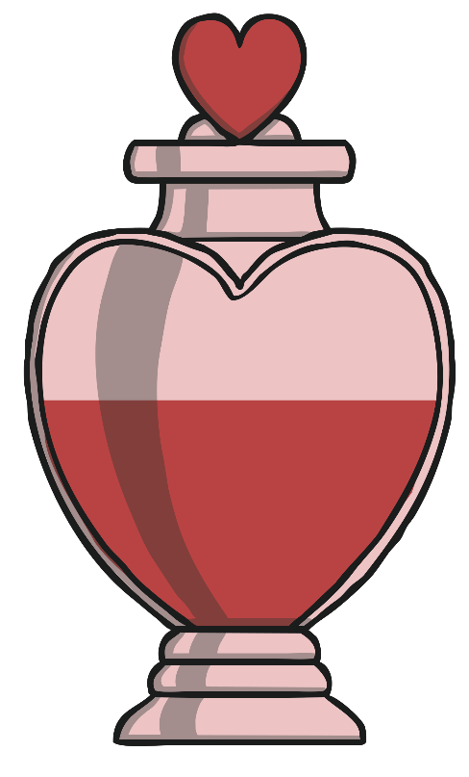
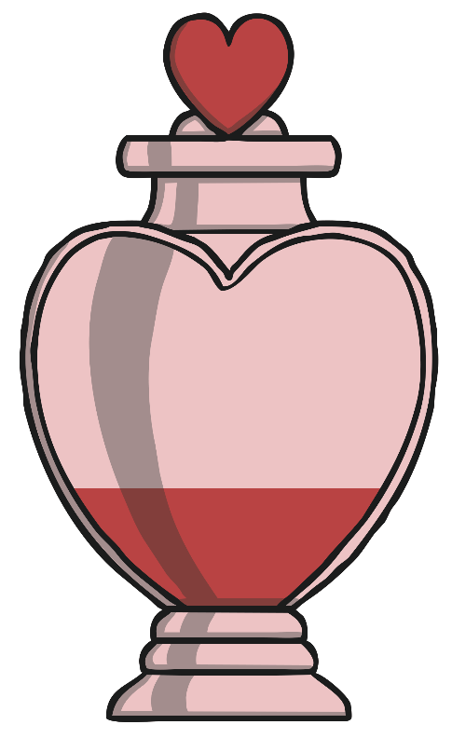
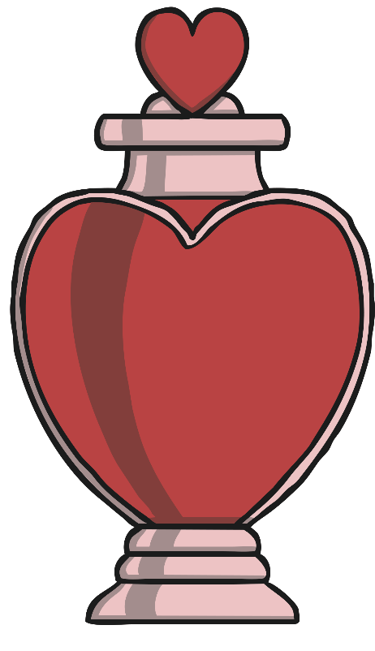
Order the Perfumes
The perfumers need help to put the perfumes in order.
Click on the bottle that has the least.
back
next

Slide 12
Try again!
back

Slide 13
Correct!
next

Slide 14
Order the Perfumes
The perfumers need help to put the perfumes in order.
Click on the bottle that has the most.
back
next

Slide 15
Try again!
back

Slide 16
Correct!
next

Slide 17
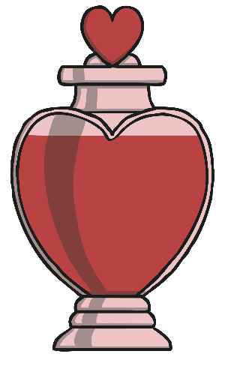
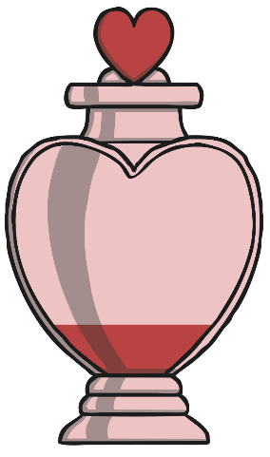
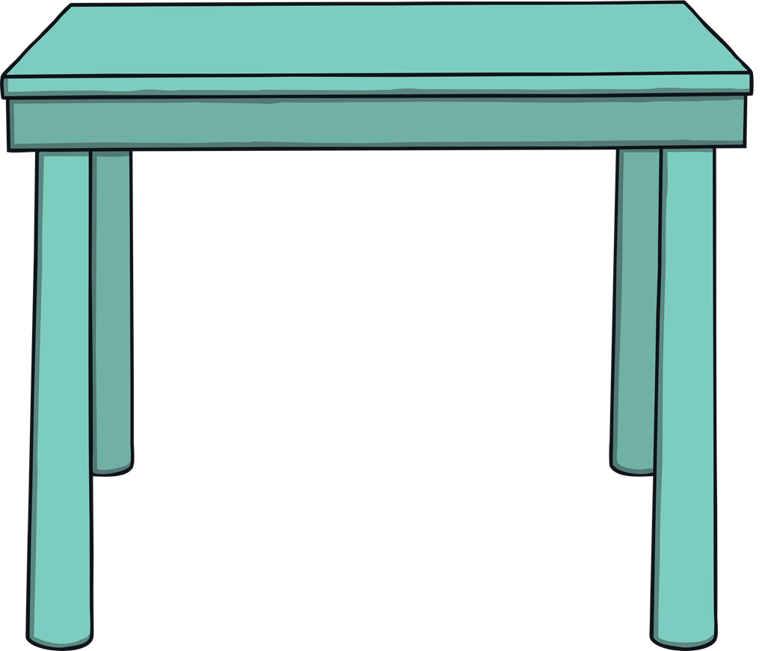
Order the Perfumes
Talk about where these two perfumes would go on the table from the least to the most. Click on each perfume to check.
least
most
back
next

Slide 18
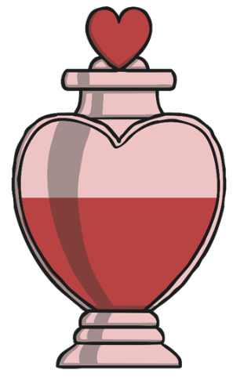
Order the Perfumes
Talk about where these three perfumes would go on the table from the least to the most. Click on each perfume to check.
least
most
back
next

Slide 19
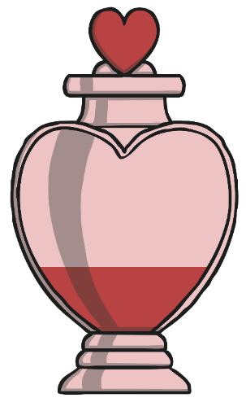
Order the Perfumes
Talk about where these four perfumes would go on the table from the least to the most. Click on each perfume to check.
least
most
back
next

Slide 20
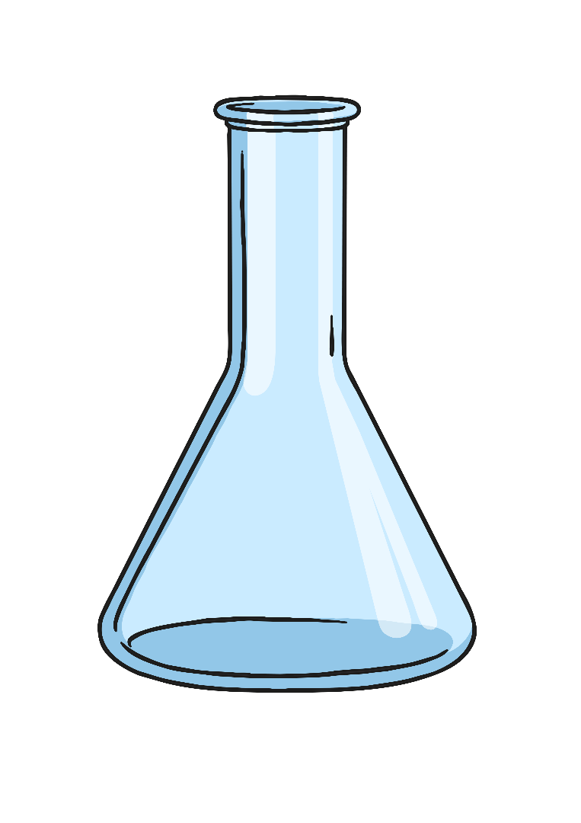
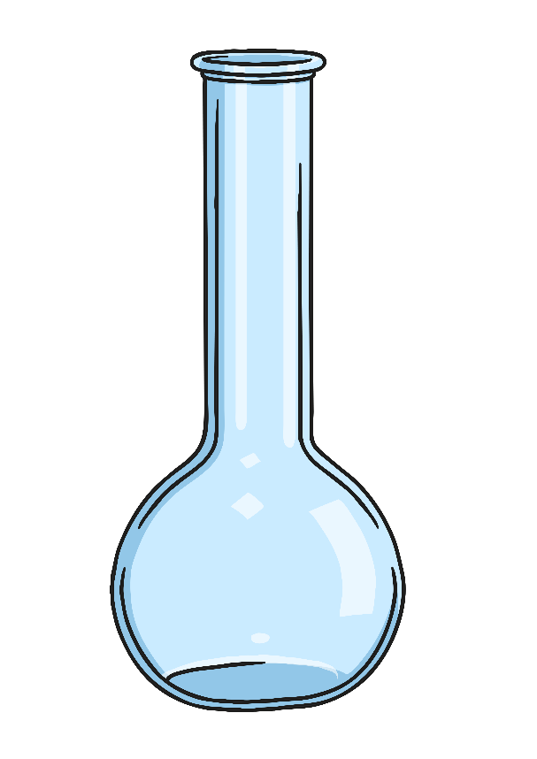
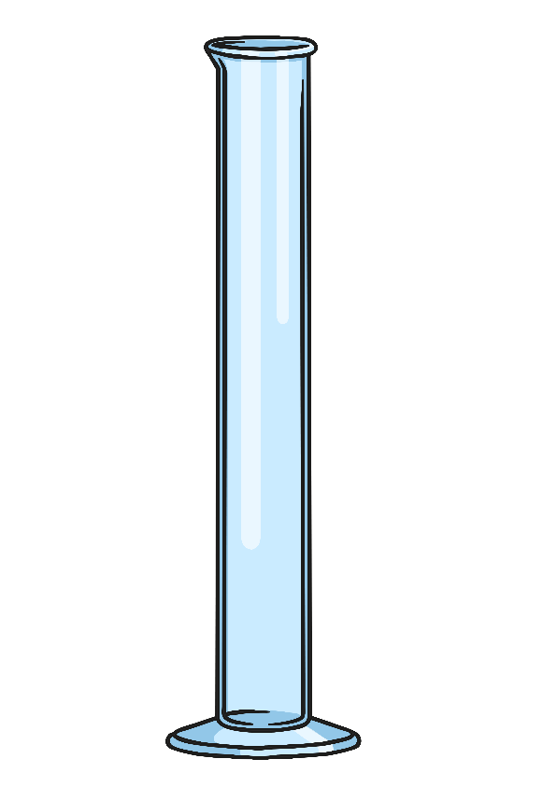
Choose the Container
The perfumers need your help to choose the container that will hold the most liquid, to put their perfect perfume into. Click on the container that will hold the most.
back
next

Slide 21
Try again!
back

Slide 22
Correct!
next

Slide 23
Choose the Container
The perfumers need your help to choose the container that will hold the least liquid, to put their perfect perfume into. Click on the container that will hold the least.
back
next

Slide 24
Try again!
back

Slide 25
Correct!
next

Slide 26
Perfumer Challenge!
The perfumers have one final challenge...
They tried filling their perfume bottle by pouring in 4 test tubes, but this wasn’t enough to fill it.
The next day, they started again and tried pouring in 6, but it overflowed!
How many perfume bottles should they use to fill up their perfume bottle? Click the answer button to check!
Check the answer
back

Slide 27
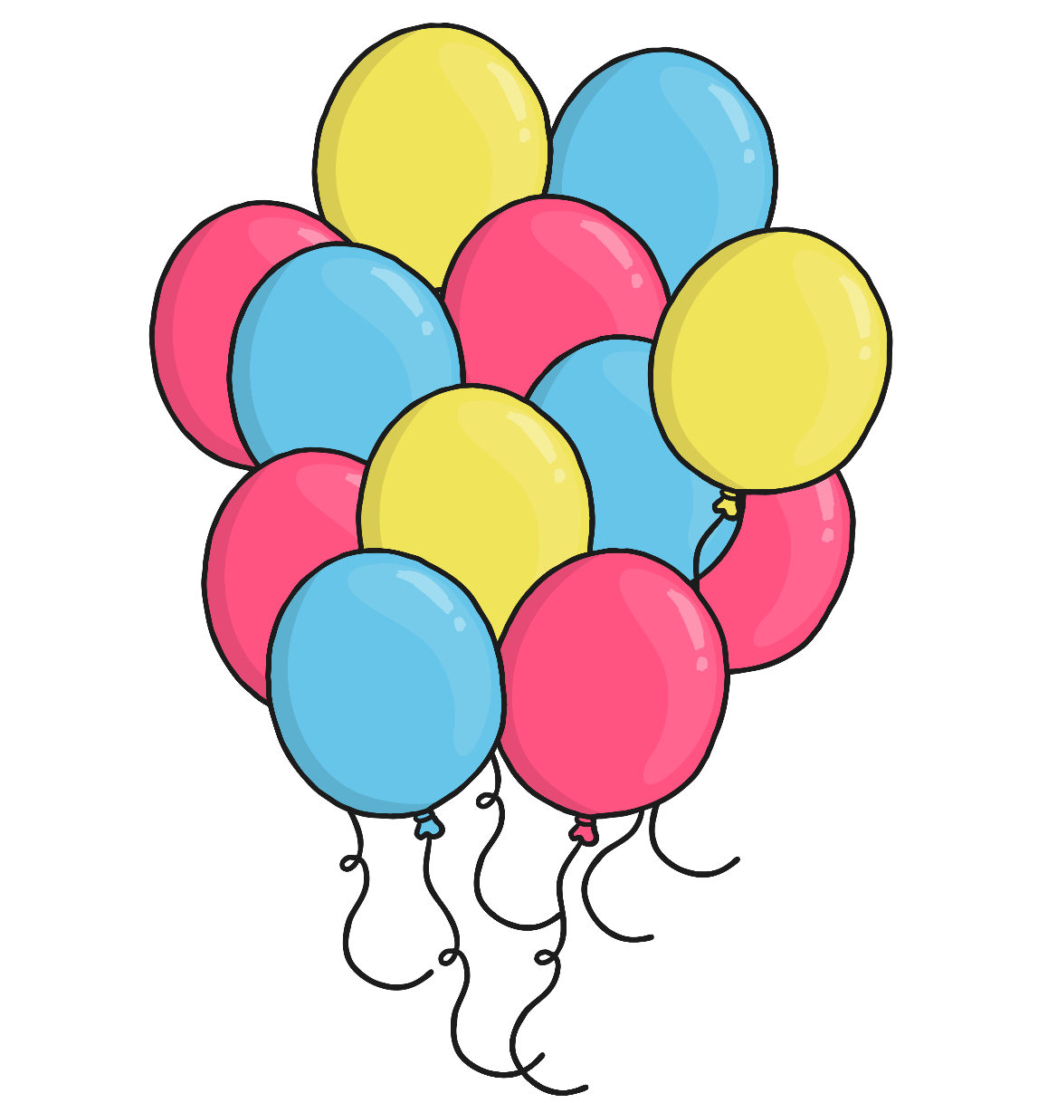
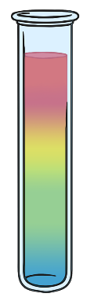
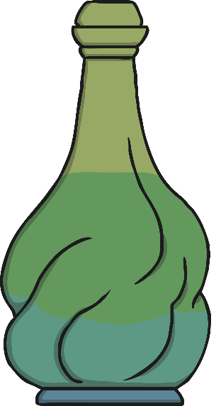
Perfumer Challenge Answer!
5
back
finish

