Slide 2


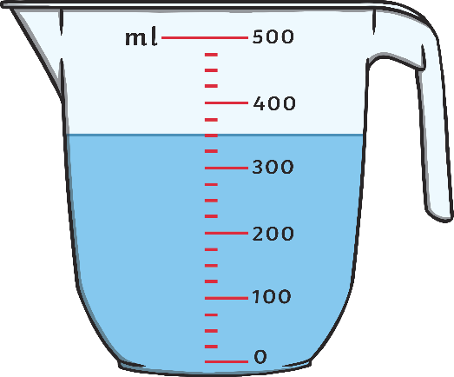
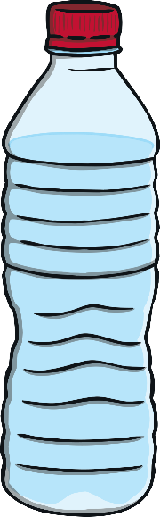
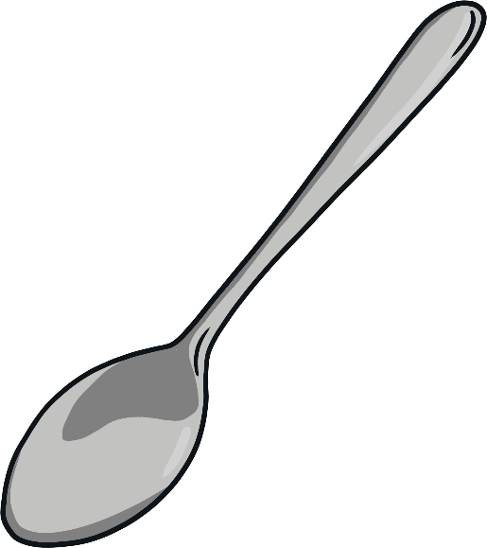
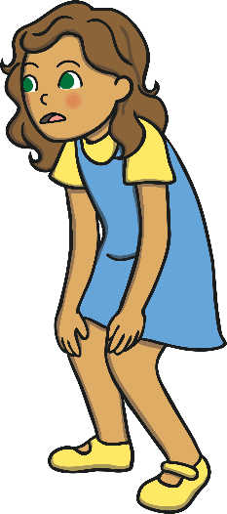
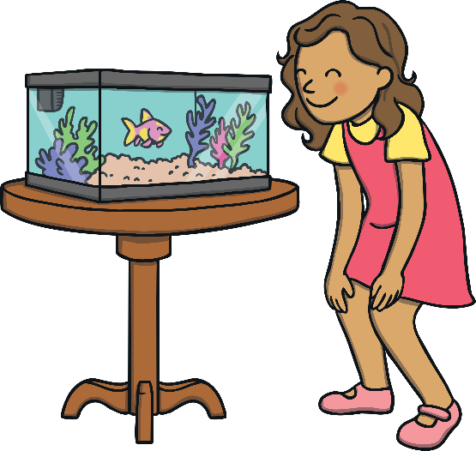
Capacity
Capacity is a measure of how much something can hold.

Slide 3
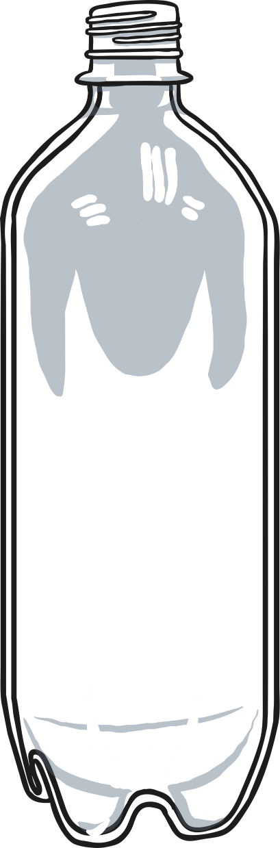
Empty

Slide 4
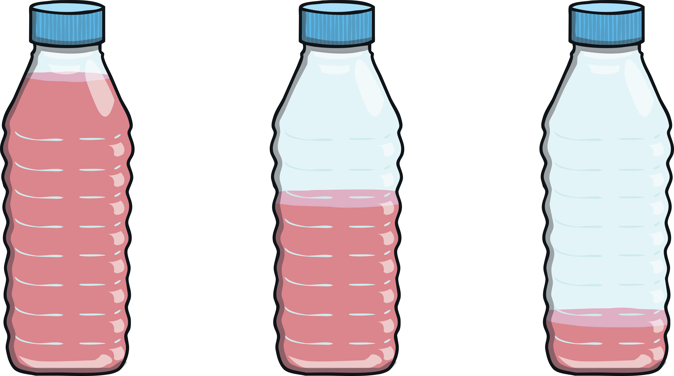
Nearly Empty

Slide 5
Half-Full

Slide 6
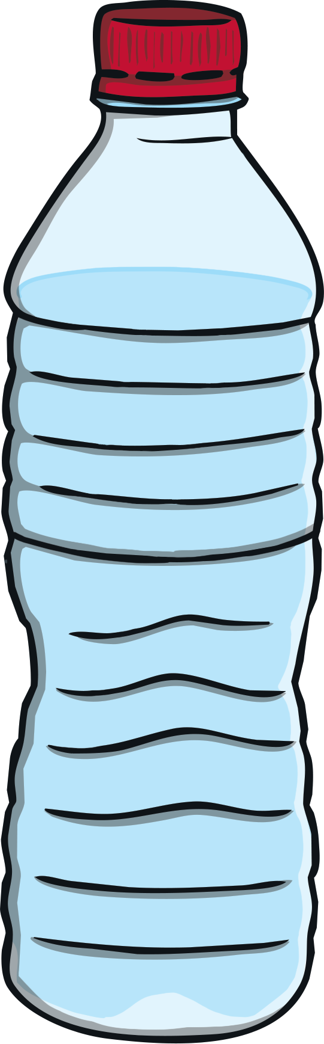
Nearly Full

Slide 7
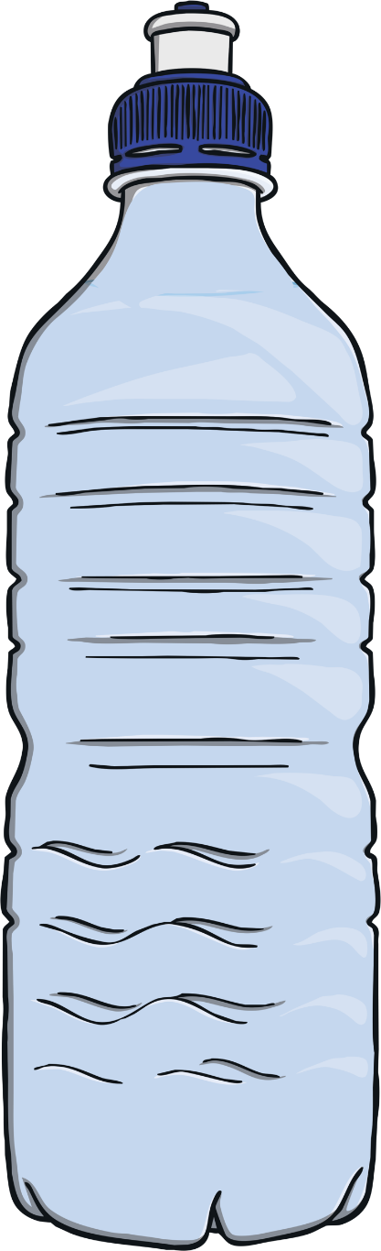
Full

Slide 8
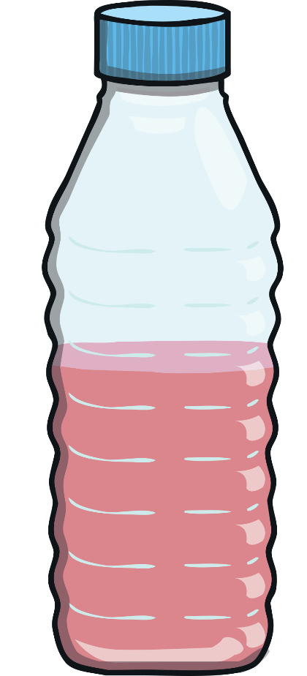
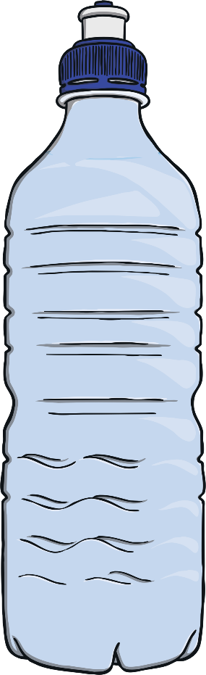
More or less?
Which bottle contains less liquid?

Slide 9
Try again!
Back

Slide 10

Correct!

Slide 11
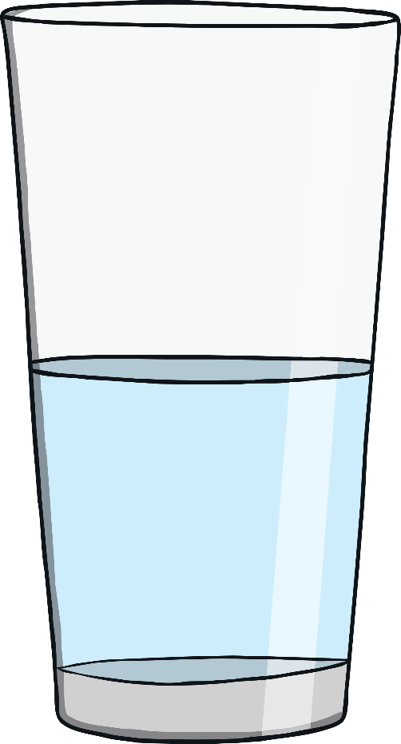
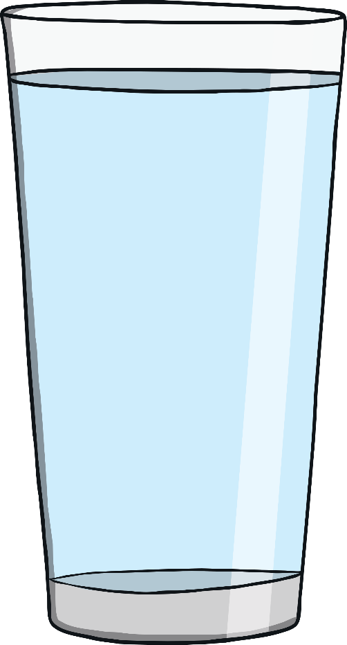
More or less?
Which glass contains more liquid?

Slide 12
Try again!
Back

Slide 13
Correct!

Slide 14
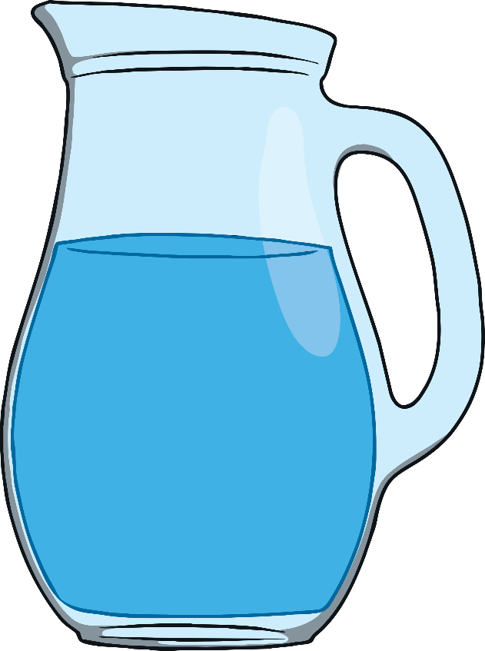
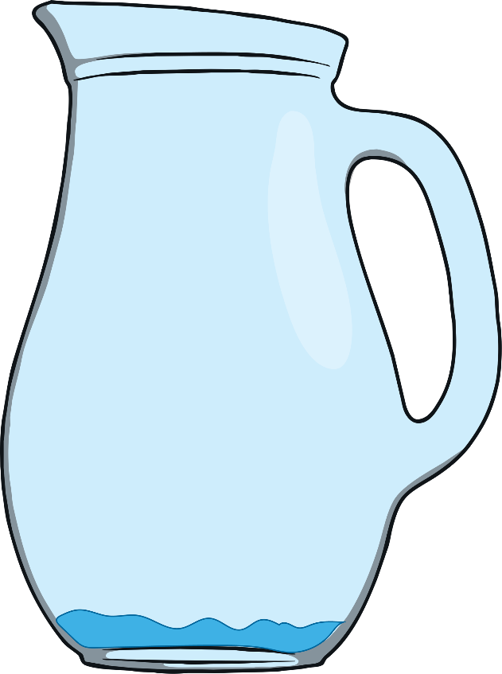
More or less?
Which jug contains more liquid?

Slide 15
Try again!
Back

Slide 16
Correct!

Slide 17
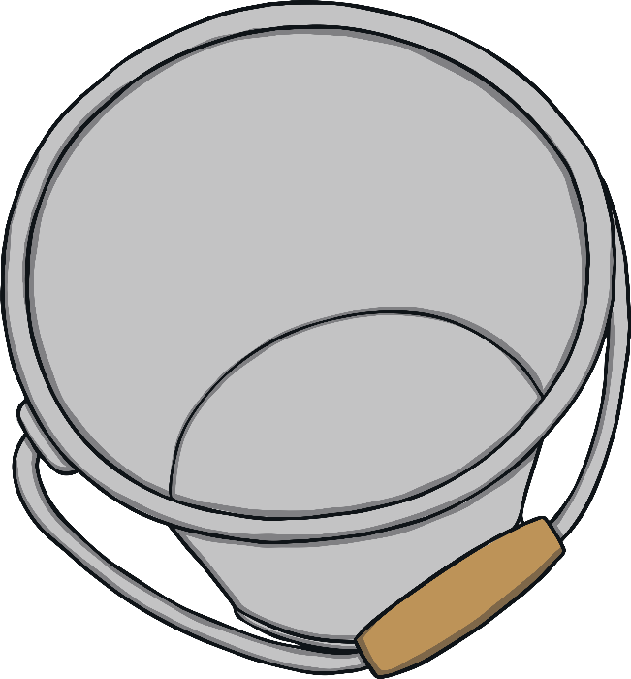
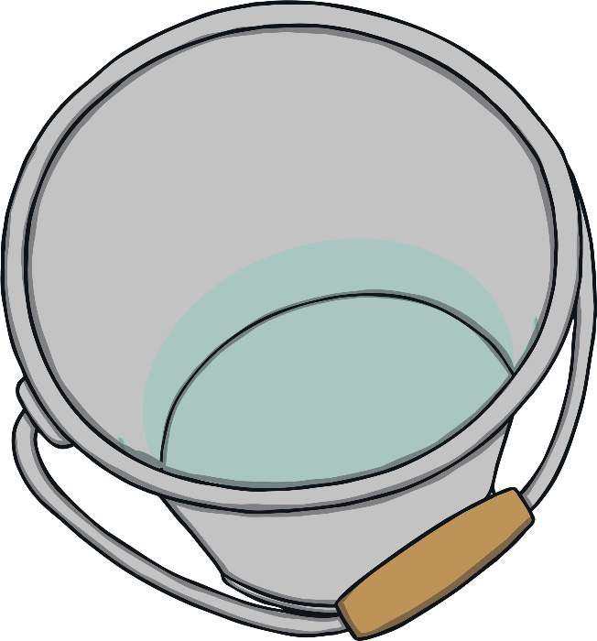
More or less?
Which bucket contains less liquid?

Slide 18
Try again!
Back

Slide 19
Correct!

Slide 20
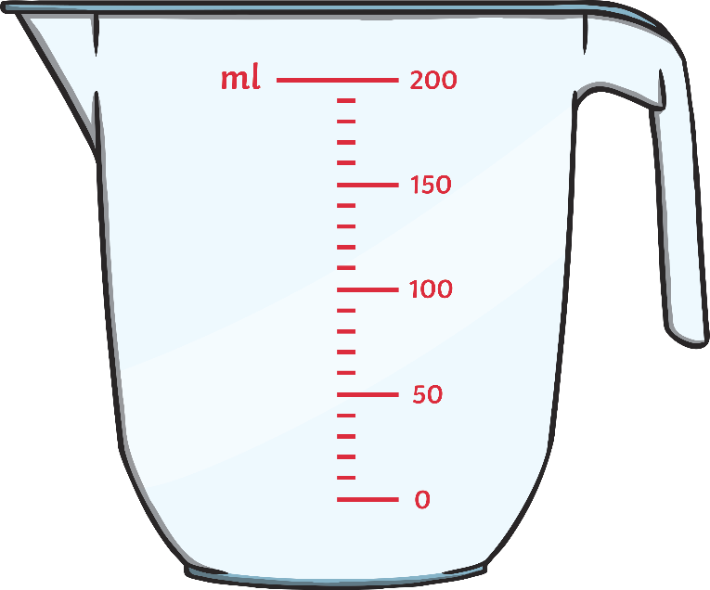
Capacity and Volume
The beaker is….
Reveal
Empty
Nearly empty
Half-full
Full

Slide 21

Capacity and Volume
Reveal
The bottle is….
Empty
Half-full
Nearly empty
Full

Slide 22

Capacity and Volume
The jug is….
Reveal
Empty
Nearly empty
Half-full
Full

Slide 23
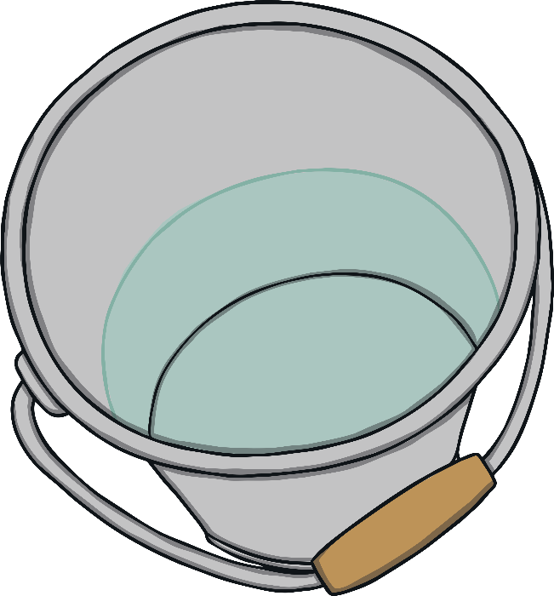
Capacity and Volume
The bucket is….
Reveal
Empty
Nearly empty
Half-full
Full

Slide 24
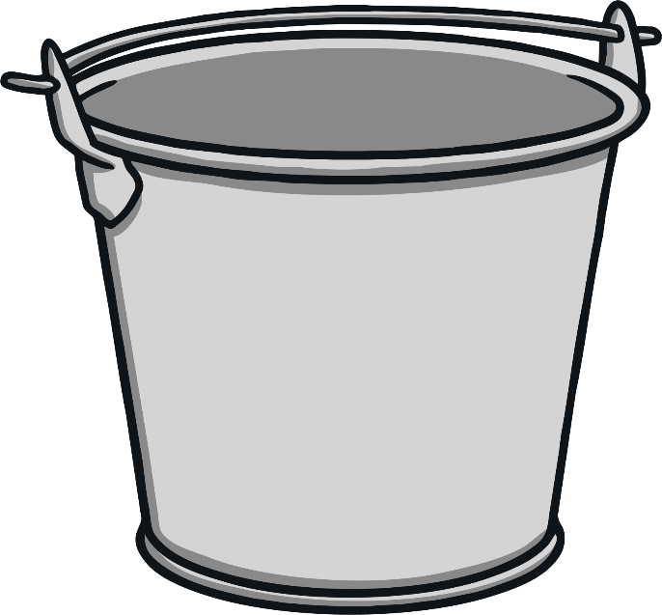
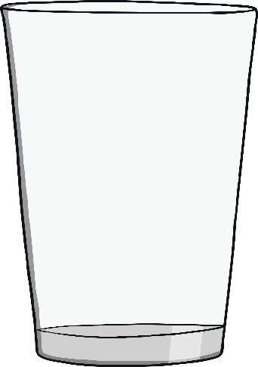
Which container
holds more?

Slide 25
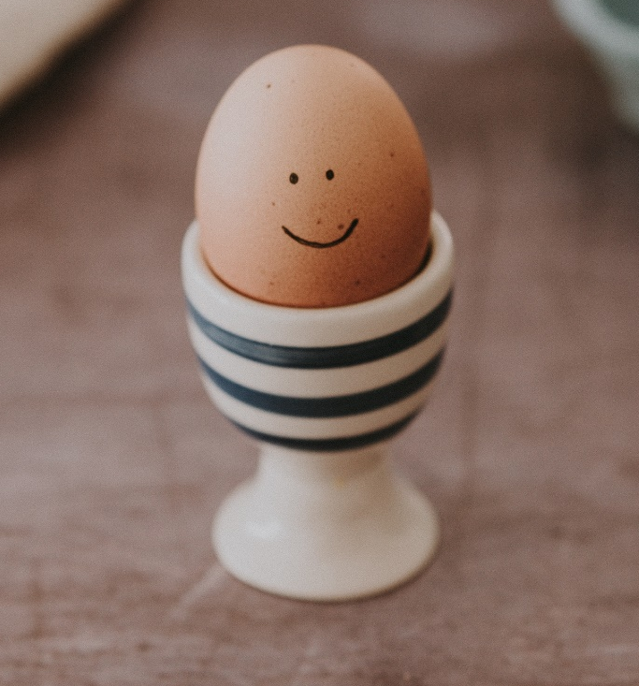
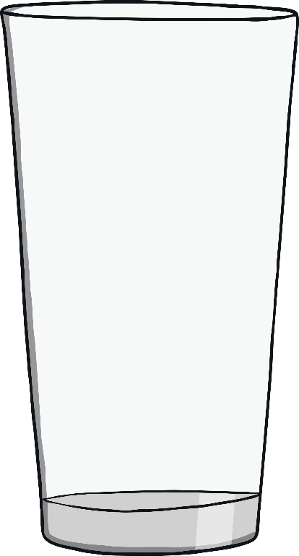
Which container
holds more?

Slide 26
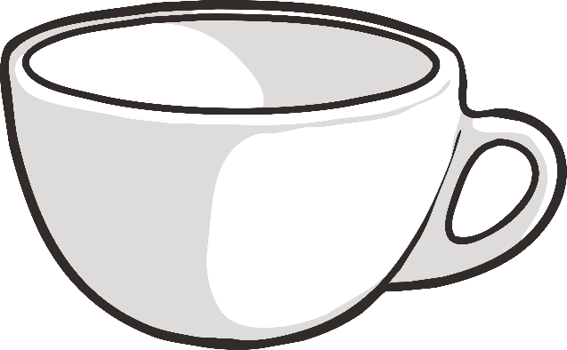
Which container
holds more?

Slide 27
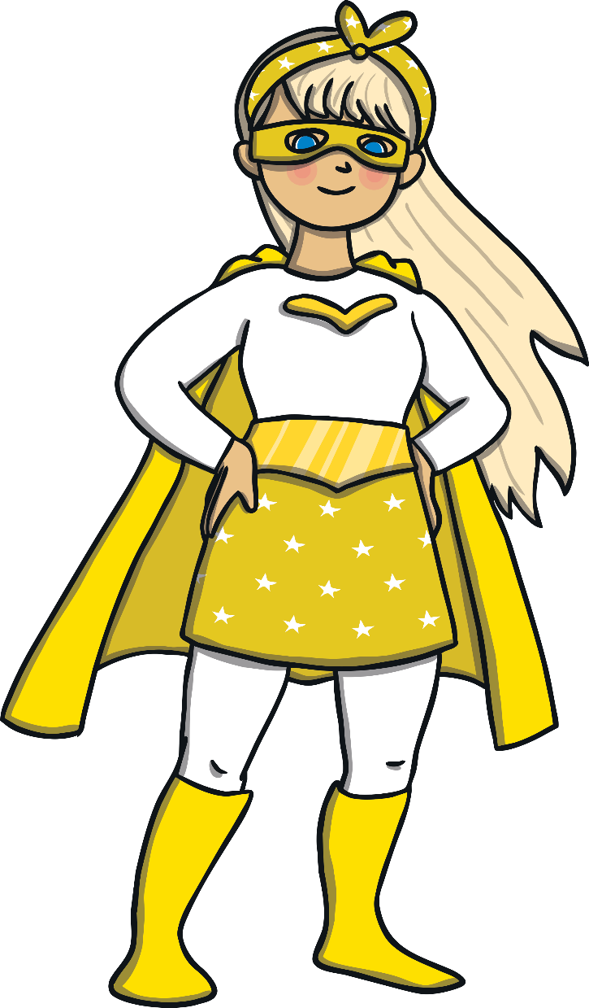
Captain Capacity needs your help!

Slide 28
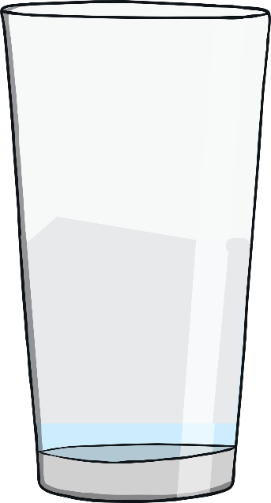

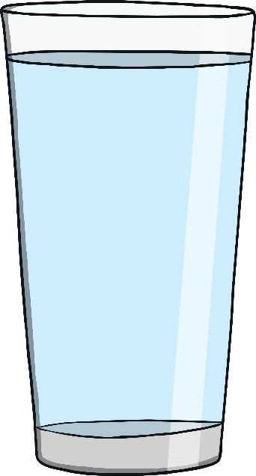
Captain Capacity needs your help!
Captain Capacity is very thirsty.
Which glass holds the most water?

Slide 29
Captain Capacity needs your help!

Slide 30
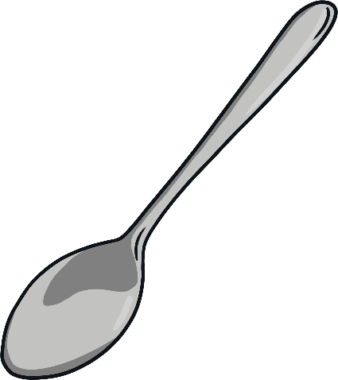
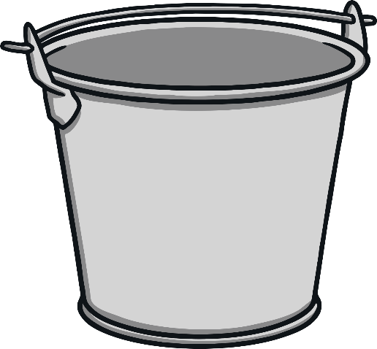

Capacity Contest

Slide 31
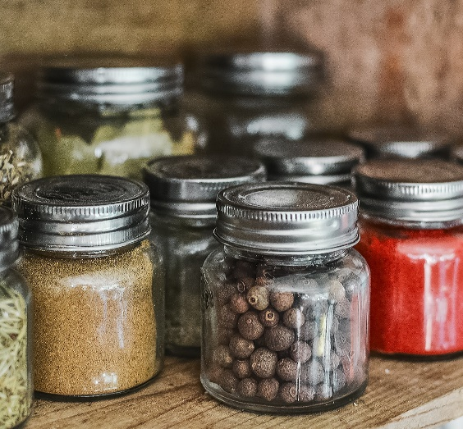
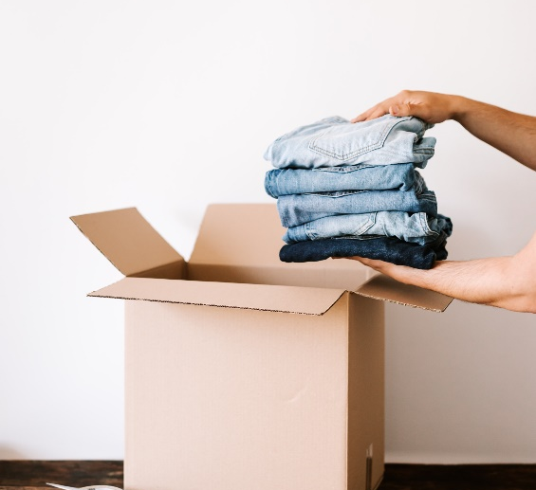
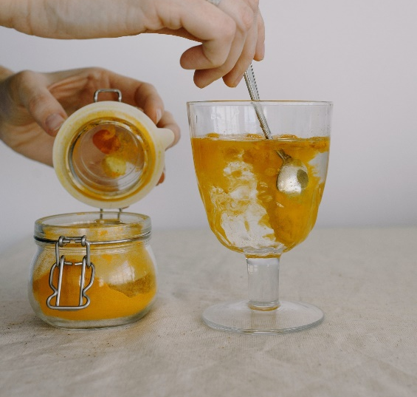
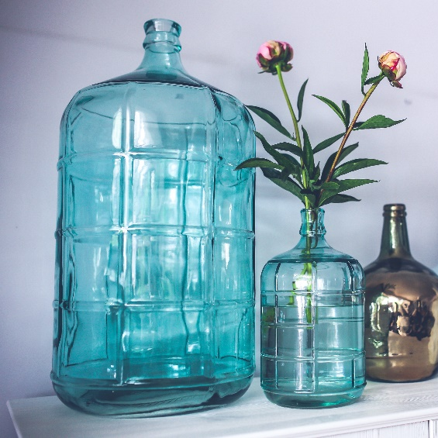
Let’s have some
fun with capacity!

Slide 32


Capacity
How can we find the capacity of the glass?

