Slide 2
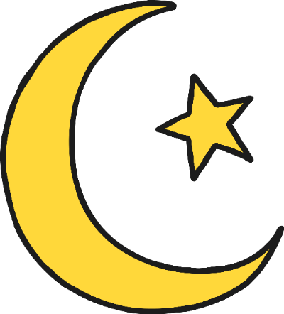
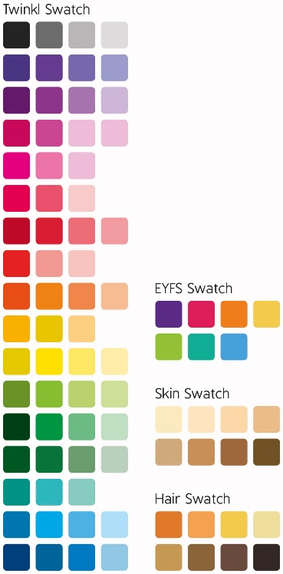
Information About Ramadan and
Eid al-Fitr
Eid al-Fitr is a Muslim festival which comes at the end of the month of Ramadan.
What is Ramadan?
During Ramadan, healthy grown-ups who are Muslims do not eat or drink anything, including water, during the day while the sun shines. This is called fasting.

Slide 3
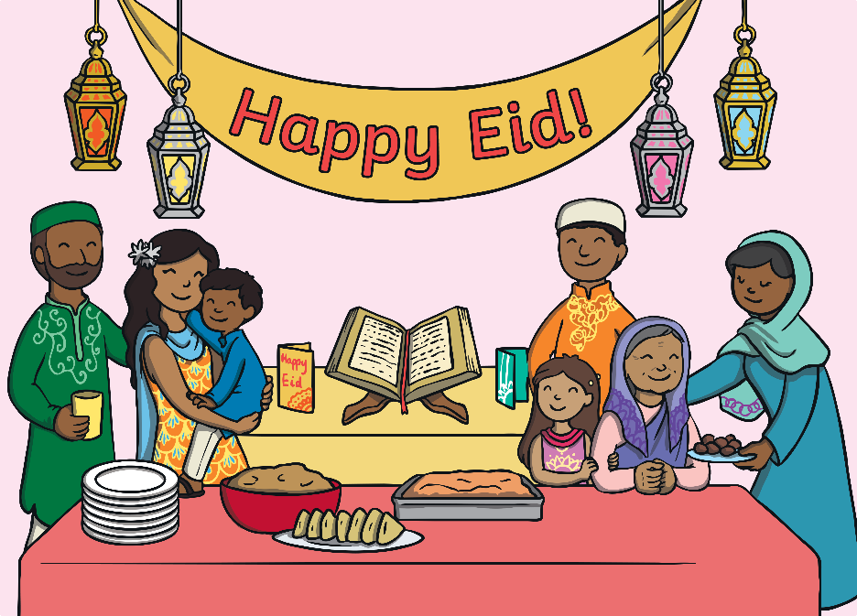
Information About Eid al-Fitr
‘Eid’ means festival or celebration. ‘al-Fitr’ means ‘breaking of the fast.
This shows that Eid al-Fitr is the festival after the fasting during the month of Ramadan.
‘Eid Mubarak’ is a greeting often used during the festival. It means ‘Have a blessed Eid!’

Slide 4
How Is Eid al-Fitr Celebrated?
Muslim families celebrate Eid al-Fitr by putting on new clothes.
They enjoy sharing meals with family and friends. They prepare all different kinds of foods like samosas, pakoras, kebabs and much much more.

Slide 5
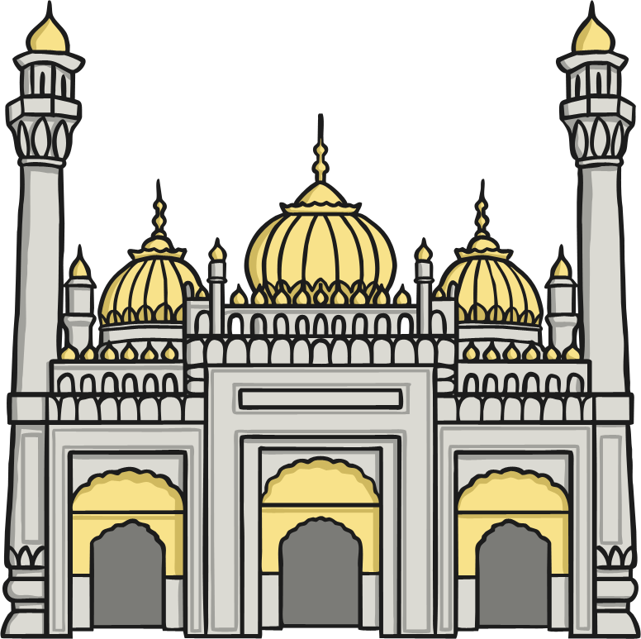
How Is Eid al-Fitr Celebrated?
Homes are decorated with colourful decorations and lanterns.
Muslims read their holy book, the Qur’an, and go to a mosque to pray.

Slide 6

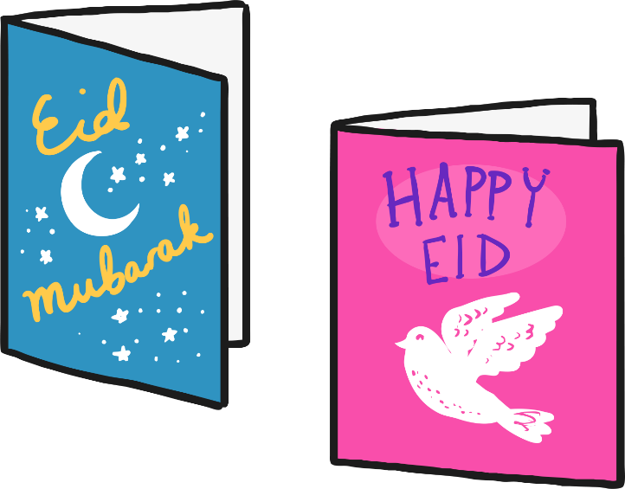
Muslims visit their friends and family. They give greetings cards and children may receive gifts of money, clothes and toys.

Slide 7
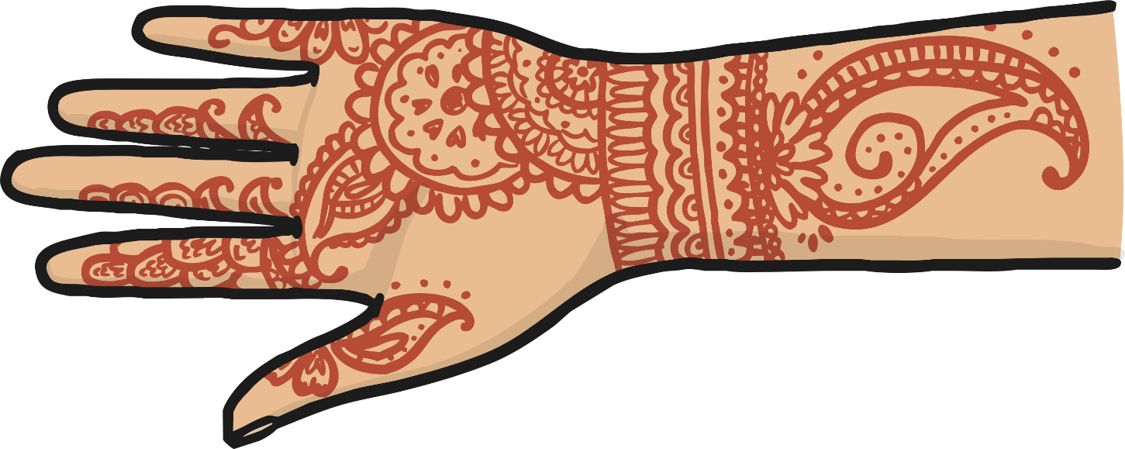
Women and girls decorate their hands with mehndi patterns. Mehndi is made from crushed henna leaves mixed with oil and other liquids such as lemon juice, water or tea.

Slide 8
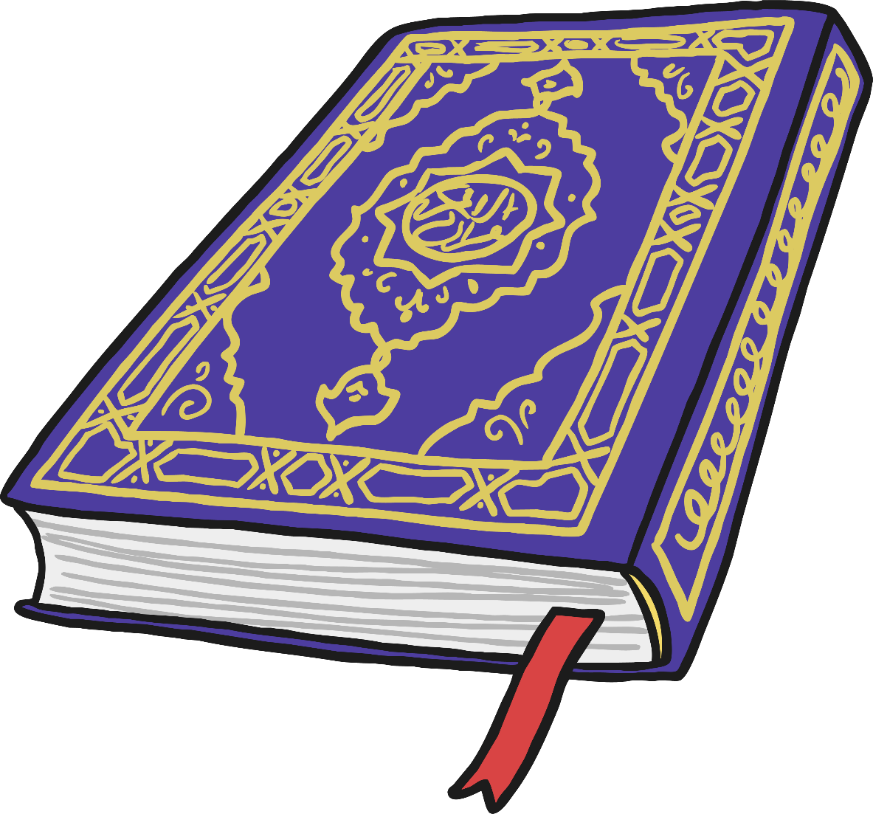
Eid al-Fitr is a time for Muslim people to thank Allah for the strength that he has given them to have self-control during Ramadan. It is a time to celebrate with family and friends.

