Slide 1


Science
Animals Including Humans
Year One
Science | Year 2 | Animals Including Humans | Basic Needs | Lesson 3

Slide 2
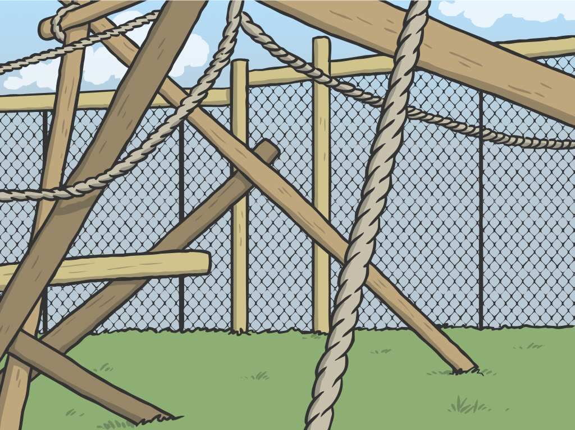


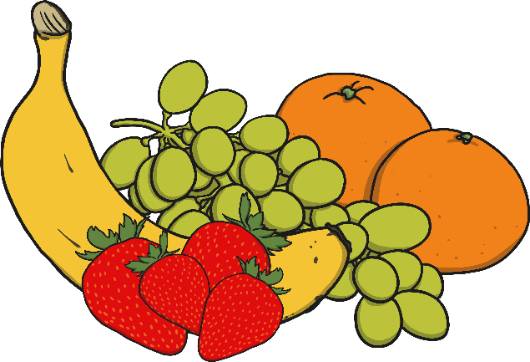




Basic Needs

Slide 3
Aim
I can describe the basic needs of humans and animals.
I can ask and answer questions about a pet.
Success Criteria
I can say the three things that humans need to stay alive.
I can say how an animal gets air, food and water.
I can ask some questions about a pet that I have chosen.
I can find out the answer to a question.

Slide 4


Basic Needs
Imagine that you have been chosen to lead a mission into space.
You are going to be all alone for two weeks, while you rocket towards the Moon. What do you need to take with you to keep yourself happy and healthy?
Think of three things that you would like to take.
1…
2…
3…

Slide 5
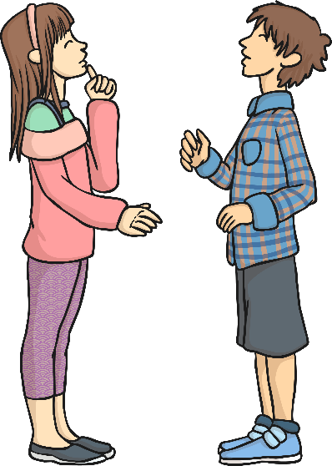
Basic Needs
What did you decide to take with you?
Do you need these things to keep you alive?

Slide 6




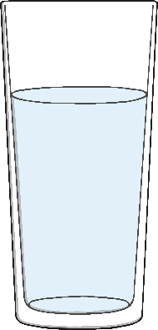
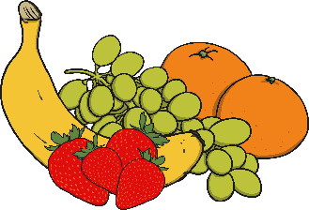
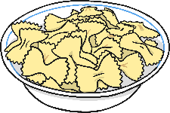
Basic Needs
There are many things that humans like to have to make their lives more enjoyable or more comfortable. But there are only a few things that we really need. Do you know what they are?
Food
Air
Water
?
?
?

Slide 7
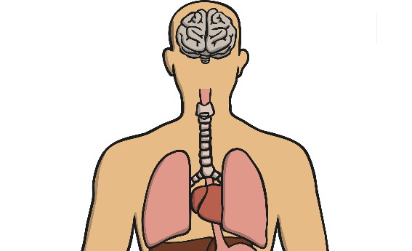
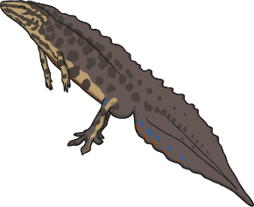
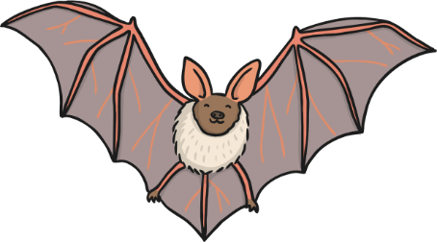
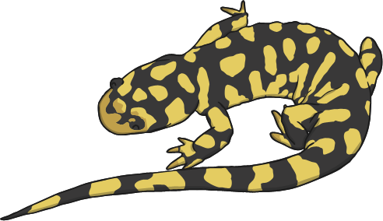
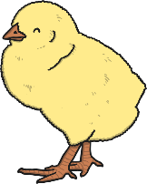

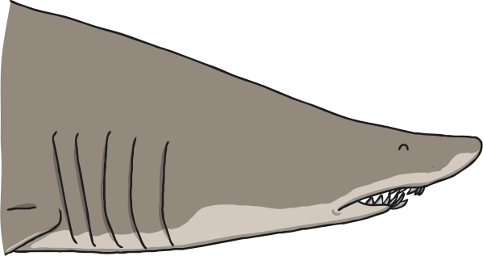


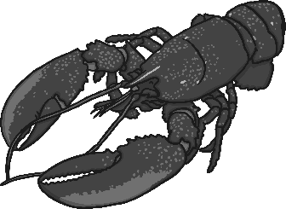
Basic Needs
Air
Mammals, reptiles and birds breathe air through their nose or mouth into their lungs.
Fish and other sea creatures breathe under water through special organs called gills.

Slide 8
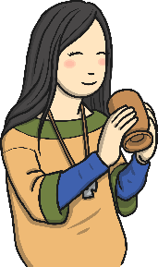
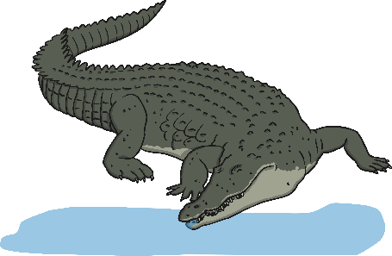

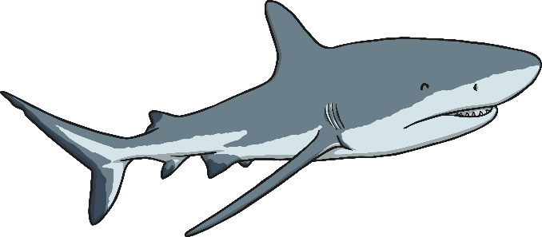
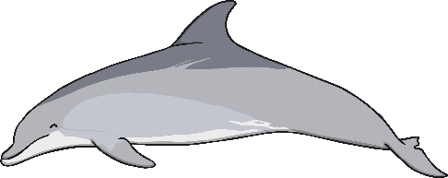
Basic Needs
Water
Creatures that live on the land get water by drinking, and from the food that
they eat.
Animals that live in water take in water by drinking, through their skin and from
their food.

Slide 9


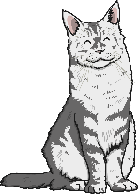
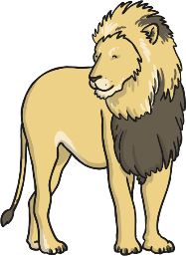
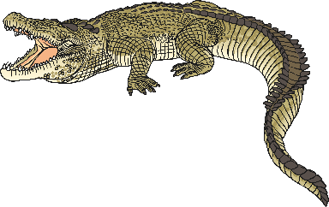


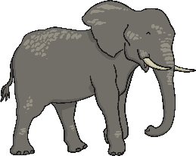
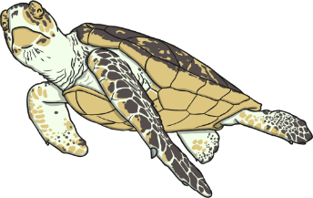
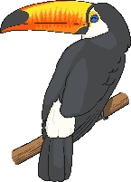
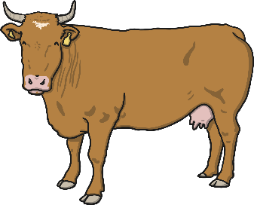
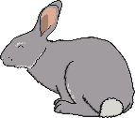

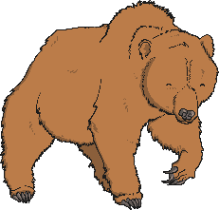

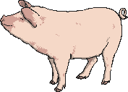
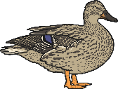
Basic Needs
Food
All animals need to eat food to stay alive.
Some animals eat only other animals. These animals are carnivores.
Some animals eat only plants. These animals are herbivores.
Some animals eat animals and plants. These animals are omnivores.

Slide 10


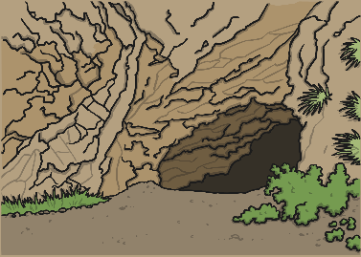

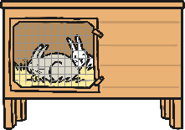
Basic Needs
For humans and most animals, shelter is very important too.
This keeps us safe from predators, gives us a place to rest and have young, and protects us from the getting wet, too hot or too cold.

Slide 11

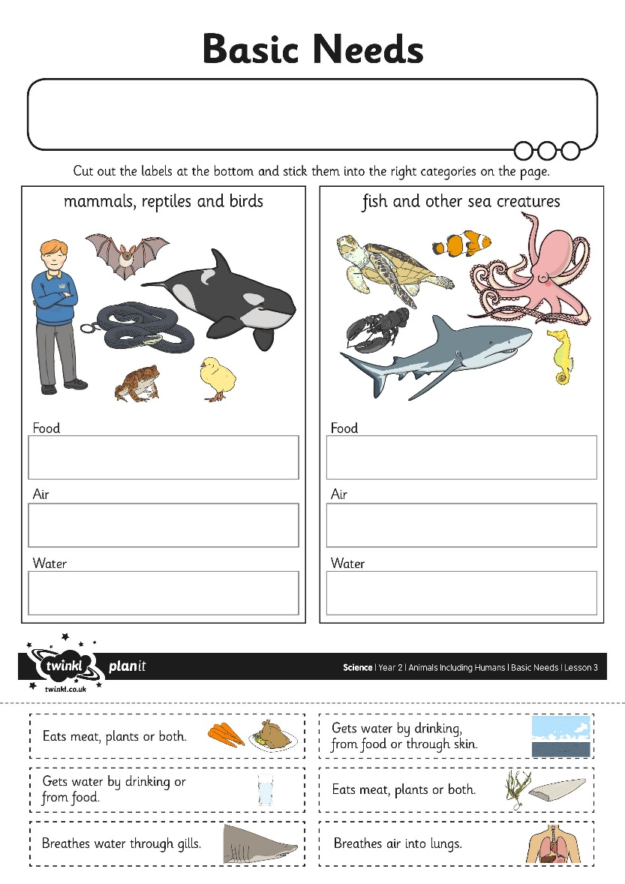
Basic Needs Activity Sheet

Slide 12


Caring for Animals
Animals in nature have a habitat. This habitat provides them with everything they need.
This squirrel lives in a hole in an oak tree.
The oak tree gives it shelter.
The squirrel eats the acorns from the oak tree.
It drinks water from ponds and puddles.
The squirrel takes care of itself because the habitat provides everything that it needs.

Slide 13
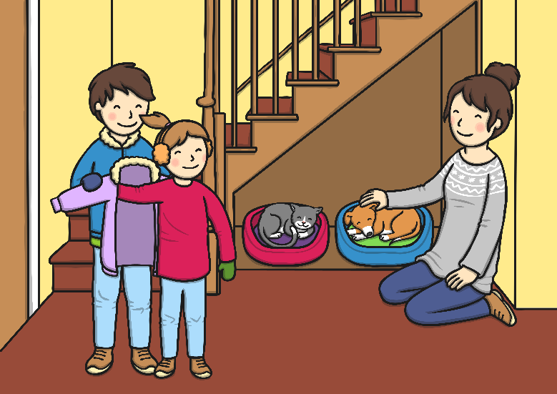
Caring for Animals
When animals are cared for by humans, they are no longer in their natural habitat.
We are responsible for looking after the animals in our care, as they cannot look
after themselves.
When animals are cared for by humans, they are no longer in their natural habitat.
We also need to care for them in other ways, to keep them happy and healthy.

Slide 14
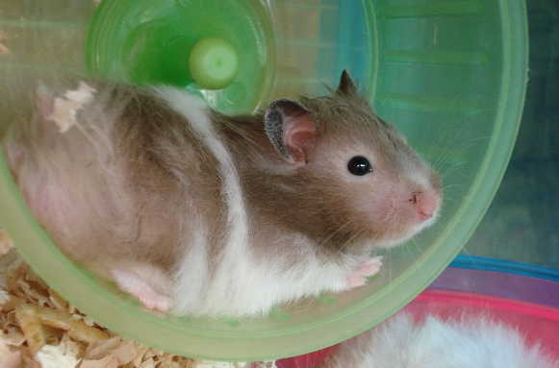
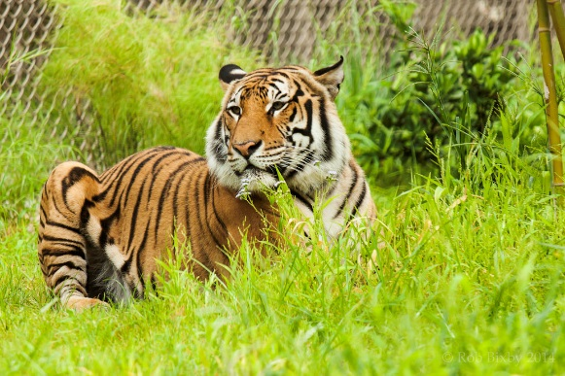
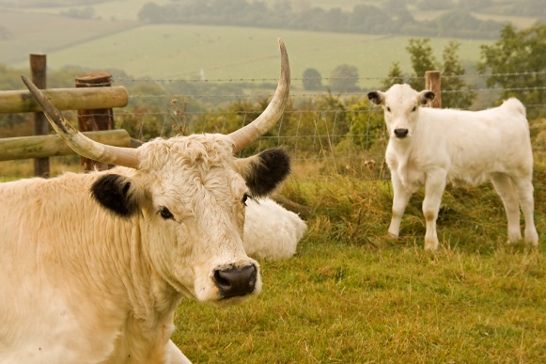
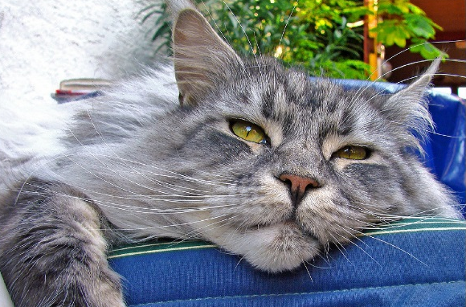
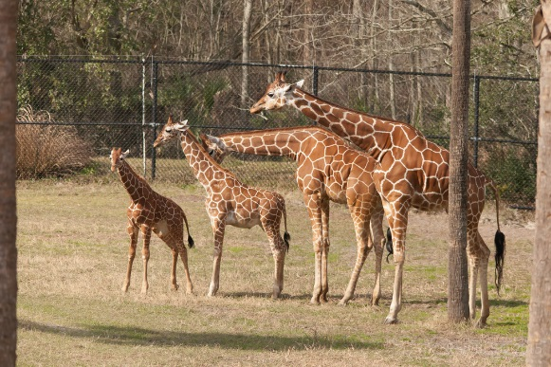
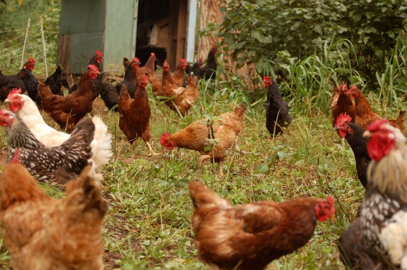
Caring for Animals
We keep animals as pets.
We keep animals in zoos.
We keep animals on farms.
All of these animals need to be cared for in different ways, to make sure they have a healthy, happy life.
Photo courtesy of Barbara Müller-Walter, Haundreis, MarilynJane, RobBixbyPhotography, Scrap Pile, (@flickr.com) - granted under creative commons licence – attribution

Slide 15

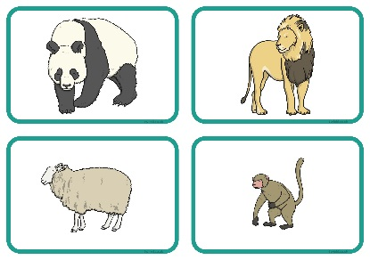
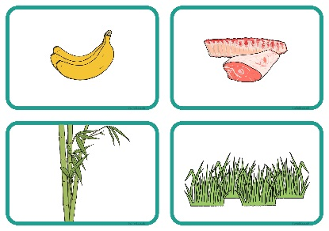
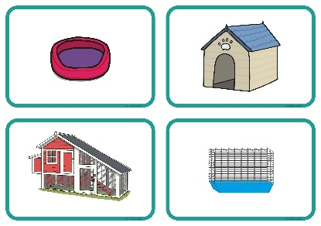
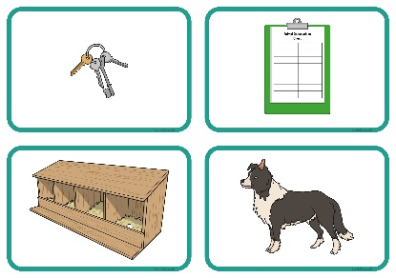
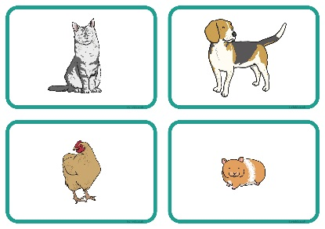
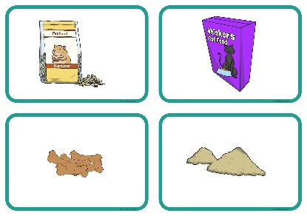
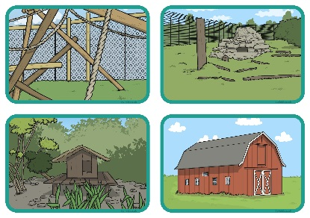
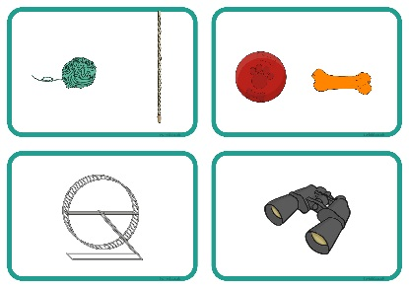
Caring for Animals
Complete the activity by matching the cards to show what care is needed for each group of animals.
Can you think of anything else these animals might need? What about other animals in our care? Discuss this in your groups.

Slide 16


Pet Fact File
Working in pairs, you are going to choose a pet and find out all about it. Think of some interesting questions that you would like to ask about your pet.
Use these question words to give you some ideas:
Who?
Where?
How?
What?
Why?
When?
When you have thought of some interesting questions, choose your favourite one.

Slide 17
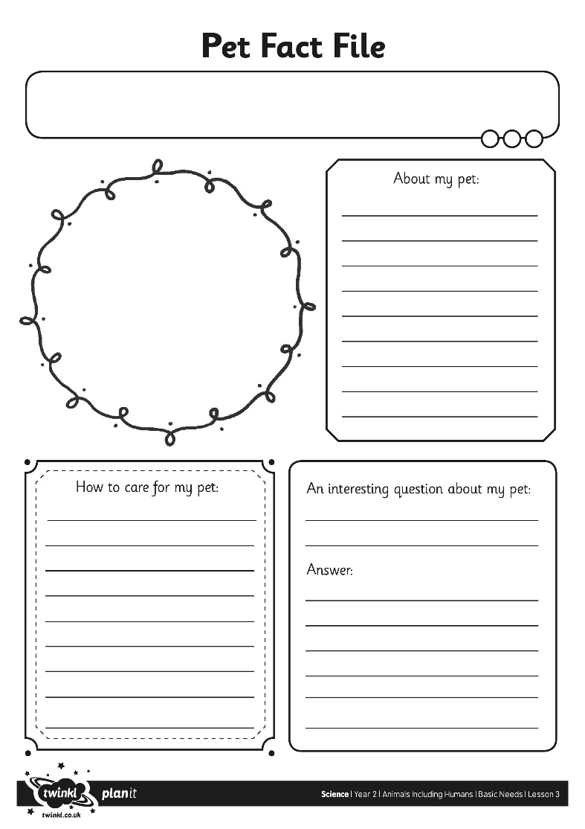
Pet Fact File
Use books, leaflets and the Internet to find out about your chosen pet.
Find out what the animal looks like, what it likes to eat, where it lives and how to care for it.
Write a fact file to teach people all about your pet.
Don’t forget to write down your interesting question and find out the answer!

Slide 18

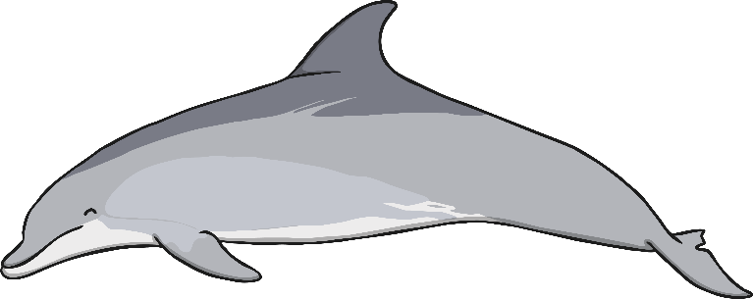


True or False?
Creatures that live under water don’t need to breathe.
False
True

Slide 19
True or False?
Correct!
The statement is false. Fish and most other sea creatures, breathe under water through special organs called gills.
Well done!
Next question

Slide 20
True or False?
Bad Luck!
The statement is false. Fish and most other sea creatures, breathe underwater through special organs called gills.
Next question

Slide 21




True or False?
Water is the best drink for humans and other animals.
False
True

Slide 22
True or False?
Bad Luck!
The statement is true. Humans have lots of drinks to choose from, but nothing is as good for our bodies, or animal bodies, as fresh, clean water.
Next question

Slide 23
True or False?
Correct!
The statement is true. Humans have lots of drinks to choose from, but nothing is as good for our bodies, or animal bodies, as fresh, clean water.
Well done!
Next question

Slide 24

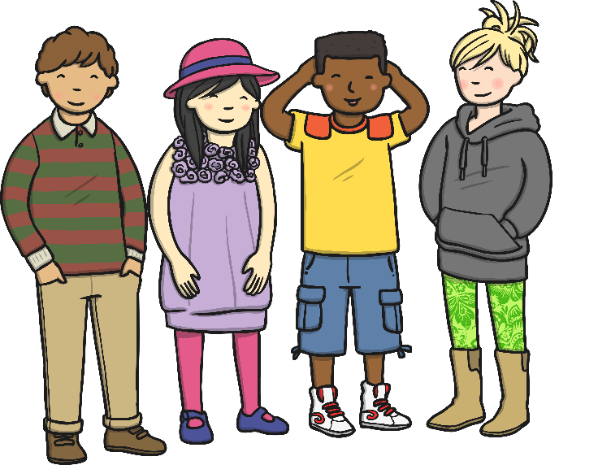

True or False?
Humans are herbivores, they eat only plants.
False
True

Slide 25
True or False?
Correct!
The statement is false. Humans eat animals and plants. They are omnivores.
Well done!
Next question

Slide 26
True or False?
Bad Luck!
The statement is false. Humans eat animals and plants. They are omnivores.
Next question

Slide 27

True or False?
Fish never drink.
False
True

Slide 28
True or False?
Correct!
The statement is false. Some fish drink water, some fish get water from their food, and some absorb water through their skin.
Well done!
Next question

Slide 29
True or False?
Bad Luck!
The statement is false. Some fish drink water, some fish get water from their food, and some absorb water through their skin.
Next question

Slide 30

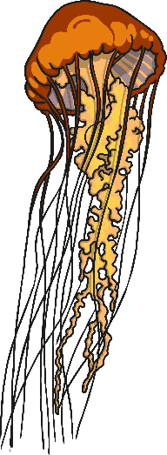





True or False?
Some creatures that live in the sea, breathe air.
False
True

Slide 31
True or False?
Bad Luck!
The statement is true. Marine mammals, like dolphins and whales, and marine reptiles, like sea turtles, need to come to the surface of the water to breathe air, like we do.
Next question

Slide 32
True or False?
Correct!
The statement is true. Marine mammals, like dolphins and whales, and marine reptiles, like sea turtles, need to come to the surface of the water to breathe air, like we do.
Well done!
Next question

Slide 33



True or False?
Pets only need water, food and air to be happy and healthy.
False
True

Slide 34
True or False?
Correct!
The statement is false. A pet might survive on only water, food and air, but it could be very unhappy. Pets also need shelter and special care. Each pet has different needs.
Well done!
Aims

Slide 35
True or False?
Bad Luck!
The statement is false. A pet might survive on only water, food and air, but it could be very unhappy. Pets also need shelter and special care. Each pet has different needs.
Aims

Slide 36

Aim
I can describe the basic needs of humans and animals.
I can ask and answer questions about a pet.
Success Criteria
I can say the three things that humans need to stay alive.
I can say how an animal gets air, food and water.
I can ask some questions about a pet that I have chosen.
I can find out the answer to a question.

Slide 37
Aim

