Slide 2
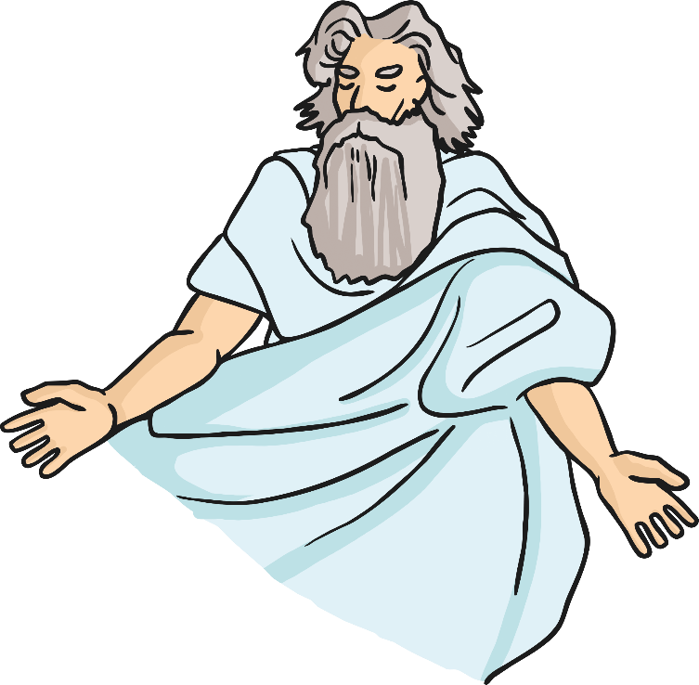
1
You shall have no other
Gods but me.

Slide 3
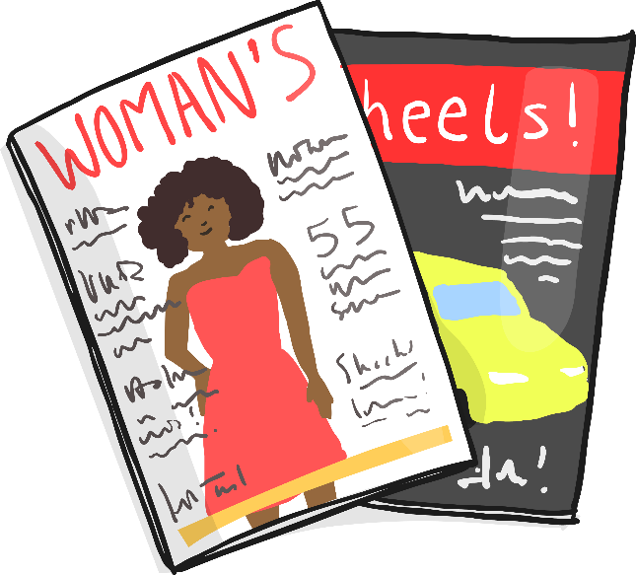
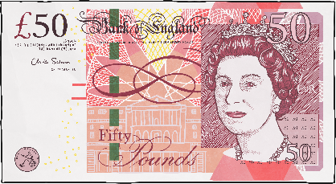
2
You shall not make for yourself any idol, nor bow down to it or worship it.

Slide 4
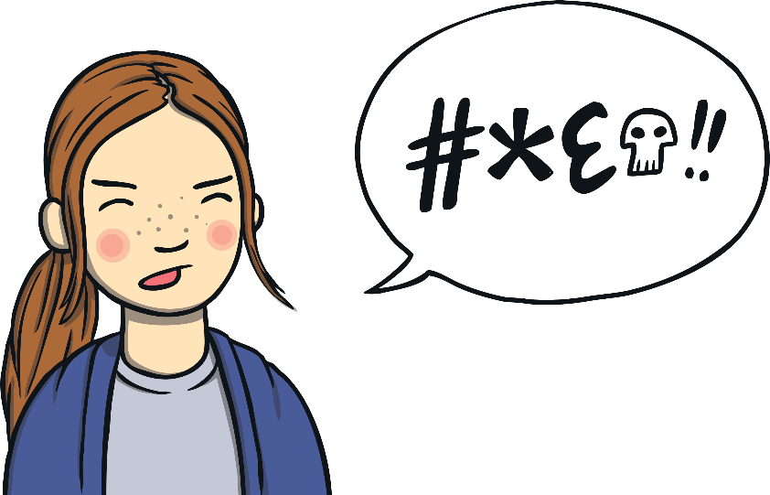
3
You shall not misuse the name of the Lord your God.

Slide 5
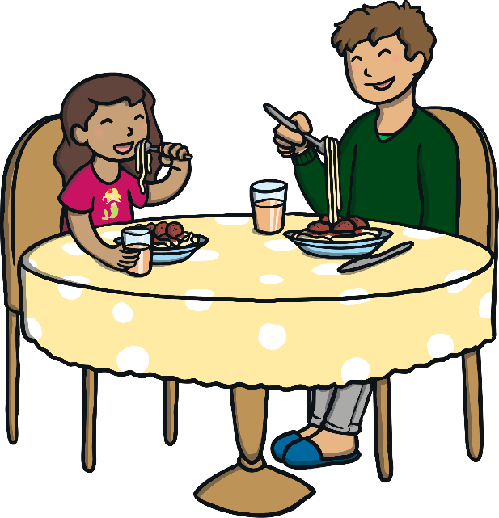
4
You shall remember and keep the Sabbath day holy.

Slide 6

5
Respect your father and mother.

Slide 7
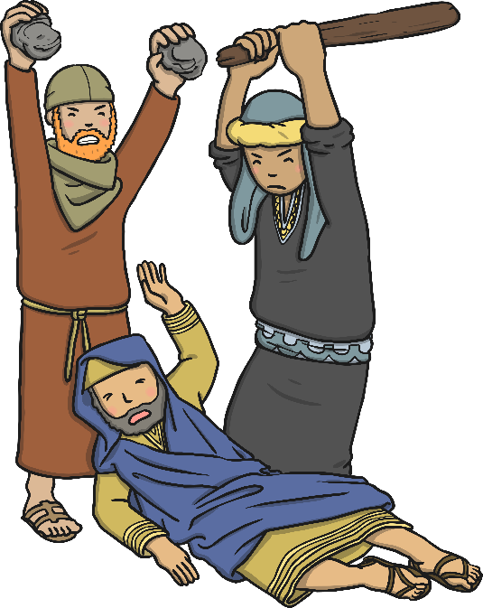
6
You must not commit murder.

Slide 8

7
You must not commit adultery.

Slide 9

8
You must not steal.

Slide 10
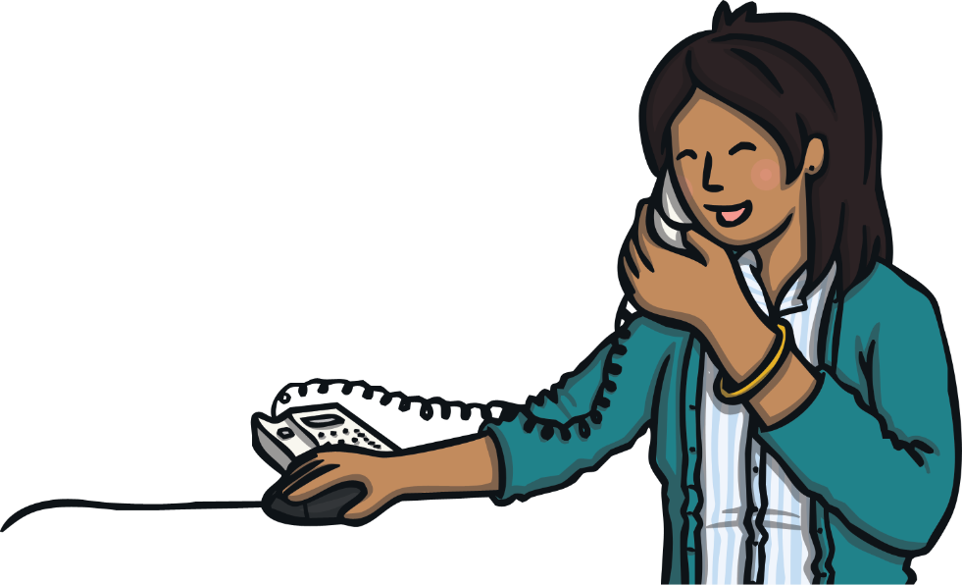
9
You must not give false evidence against your neighbour.

Slide 11
10
You must not be envious of your neighbour's goods.
You shall not be envious of his house nor his wife, nor anything that belongs to your neighbour.

