Slide 1


Science
States of Matter
Year One
Science | Year 4 | States of Matter | The Water Cycle | Lesson 6

Slide 2
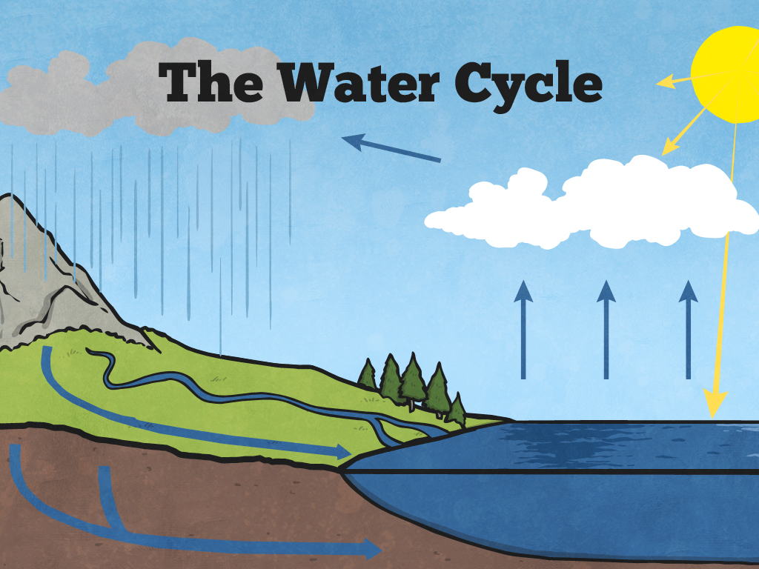


Slide 3
Aim
I can identify and describe the different stages of the water cycle.
Success Criteria
I can describe the different stages of the water cycle.
I can explain the role of evaporation and condensation in the water cycle.

Slide 4

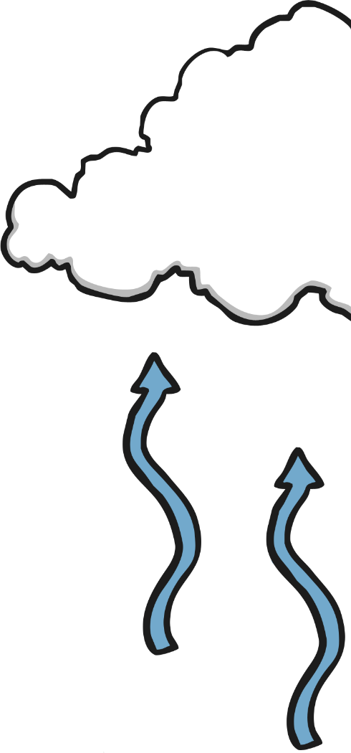
What Is the Water Cycle?
More than three quarters of the Earth's surface is water.
Some of this water evaporates in the heat of the Sun.
When the water has evaporated, it is in the form of water vapour.
Clouds are made from water vapour that has condensed to form tiny water droplets.
When the water droplets get too big, they fall from the clouds.
The water droplets can fall as rain, hail or snow.
Three hundred millions litres of water falls on dry land each day.

Slide 5
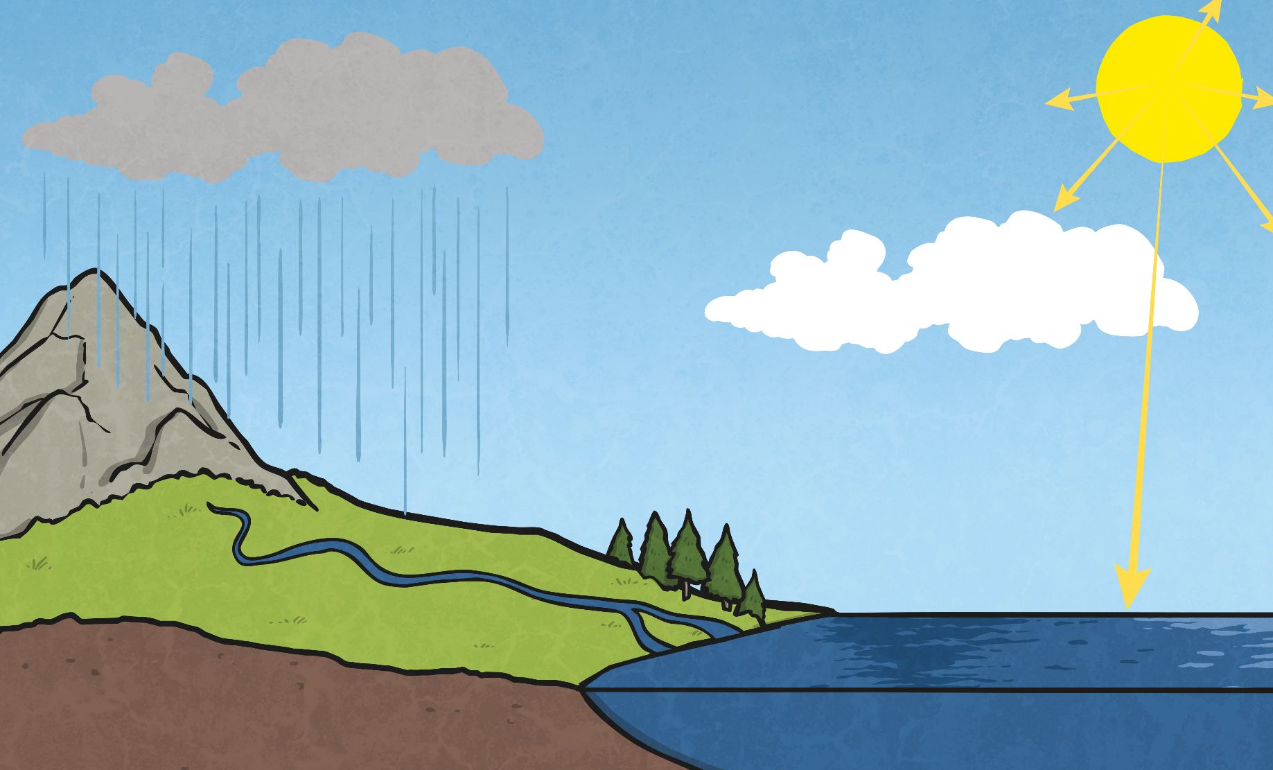

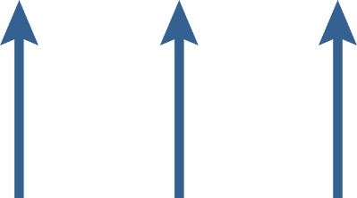


What Is the Water Cycle?

Slide 6
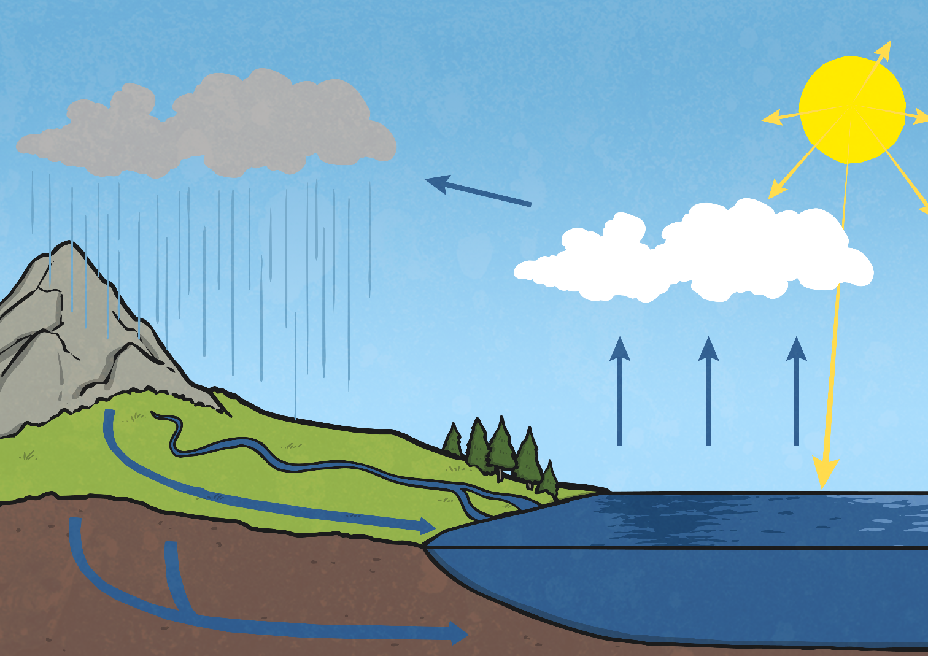
The Stages of the Water Cycle
sun
precipitation
wind
rain
condensation
evaporation
collection
ground
run-off
rivers and
streams
underground
water
sea

Slide 7
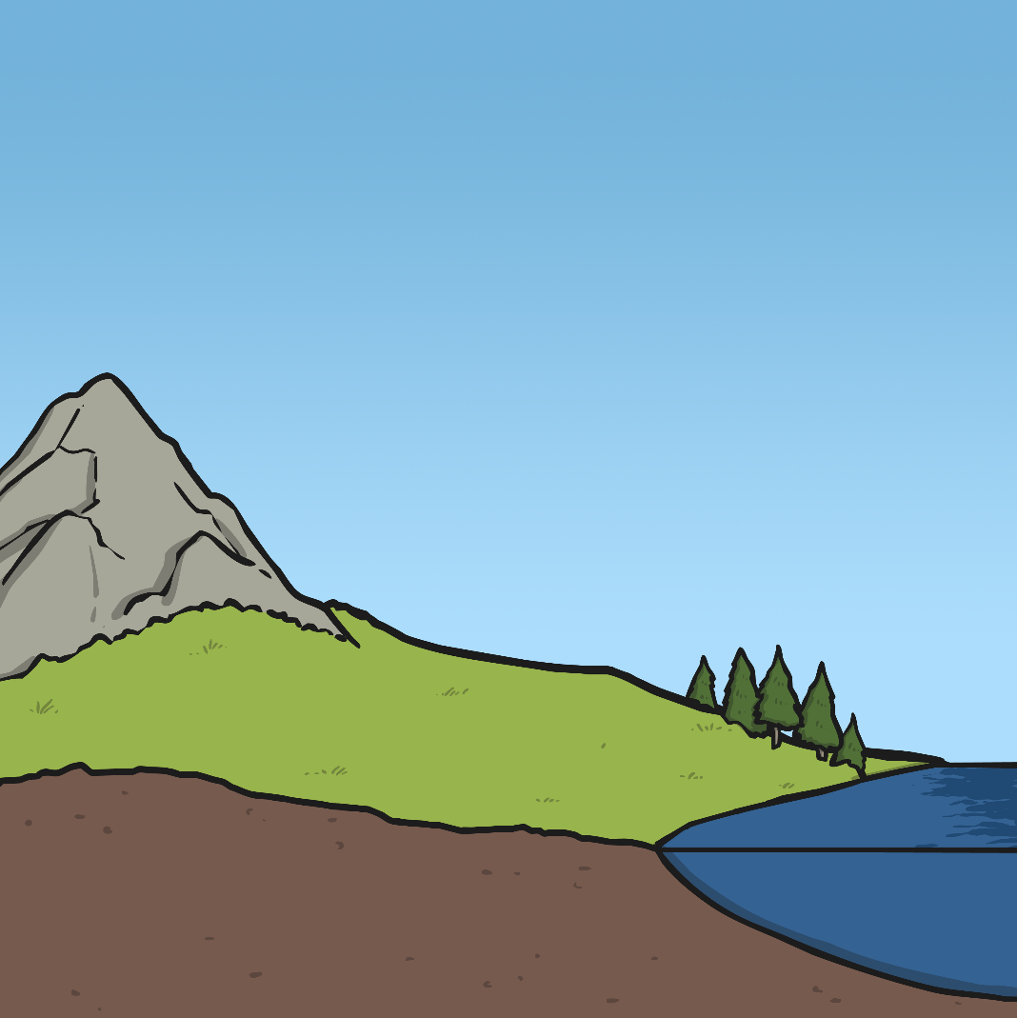
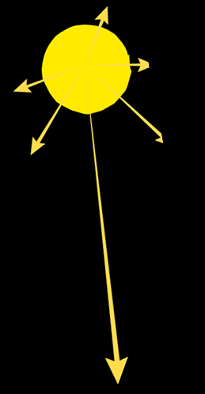
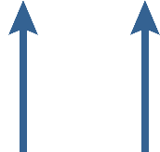
The Stages of the Water Cycle
Evaporation
Heat from the Sun causes water to evaporate from seas, lakes, rivers and streams. Water also evaporates from puddles and ponds.
This evaporation happens even on cloudy or cold days.
The liquid water turns into water vapour when it has evaporated.
sun
evaporation
sea

Slide 8



The Stages of the Water Cycle
Condensation
The water vapour in the air rises, and as it does so, it cools down.
Eventually, it cools enough for the water vapour to condense and form small droplets of water.
The droplets of water clump together to form clouds.
wind
sun
condensation
evaporation
sea

Slide 9

The Stages of the Water Cycle
Precipitation
As more water vapour condenses, more water droplets are formed in the clouds.
Eventually, the water droplets are large enough and heavy enough to fall back to the surface of the Earth.
These droplets of water fall from the clouds in the form of rain, sleet, hail or snow.
precipitation
wind
sun
precipitation
condensation
rain
evaporation
sea

Slide 10



The Stages of the Water Cycle
Collection
When water falls back to Earth as precipitation, the water may fall on oceans, lakes, rivers or on the ground.
Water that falls on the ground is either absorbed into the soil, and is used as drinking water for animals and plants, or it runs over the ground and collects in the oceans, lakes and rivers.
This water is then evaporated and the cycle starts all over again!
wind
sun
precipitation
condensation
rain
rivers and
streams
evaporation
ground run-off
underground
water
sea

Slide 11

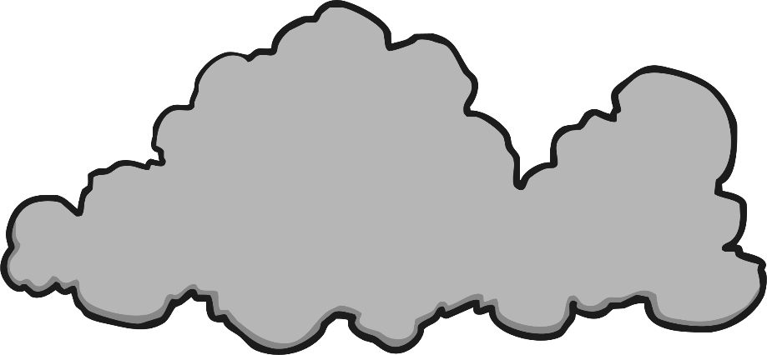
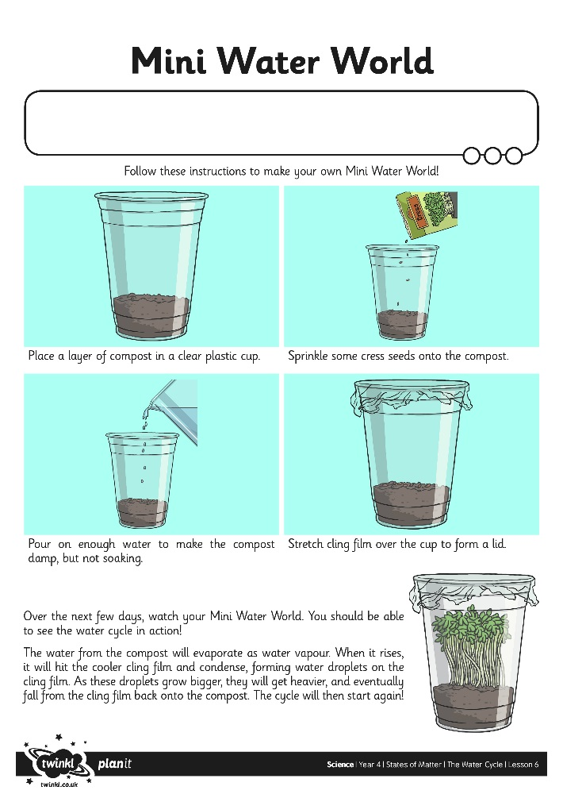

Mini Water Worlds
Make your own mini water world to watch the water cycle in action!
Follow the instructions on your Mini Water Worlds Activity Sheet.

Slide 12
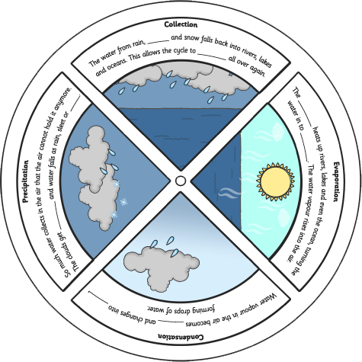
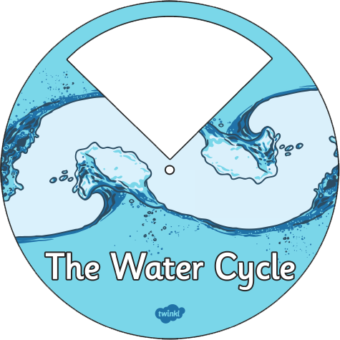
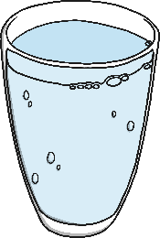
Water Wheel
Can you remember the stages of the water cycle?
Use your knowledge to create this interactive Water Wheel.

Slide 13



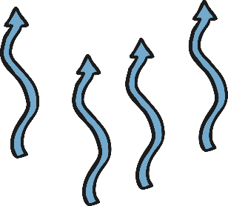
Sort the Stages
Rearrange the letters of each word below to
make the name of a stage of the water cycle.
Can you put the stages in order?
donsaictenon
lictencool
condensation
collection
1
2
cronitpitpeia
vaintoreapo
precipitation
evaporation
3
4

Slide 14

Aim
I can identify and describe the different stages of the water cycle.
Success Criteria
I can describe the different stages of the water cycle.
I can explain the role of evaporation and condensation in the water cycle.

