Slide 2


Slide 3
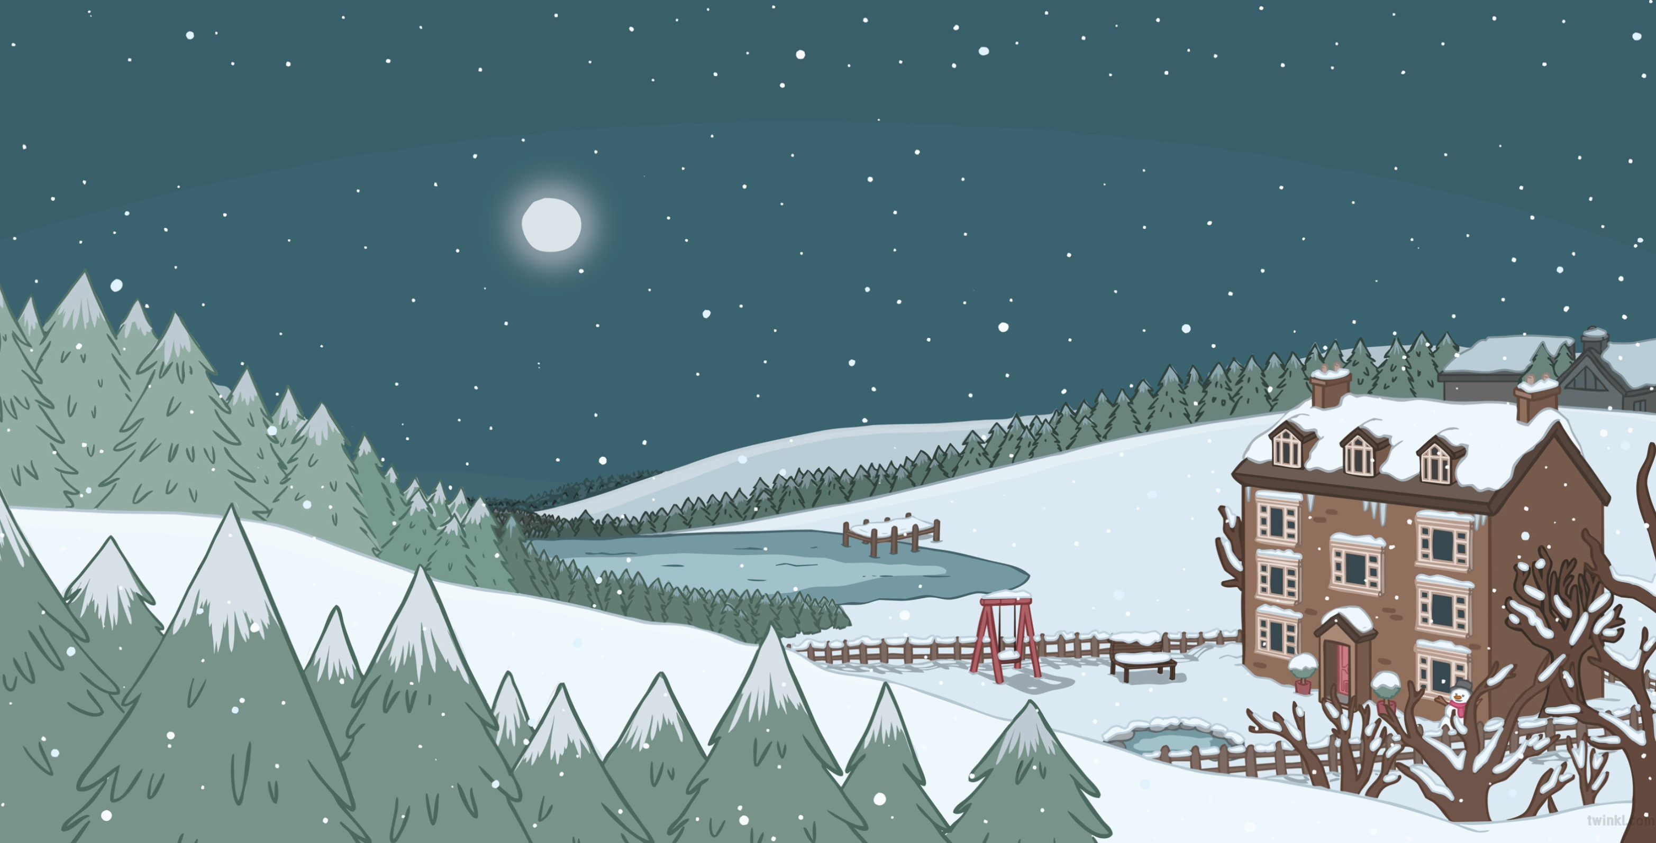
At the edge of a wintry wood, a large house stood silent and still.
The silvery light of the moon reflected off the fresh white snow below.

Slide 4
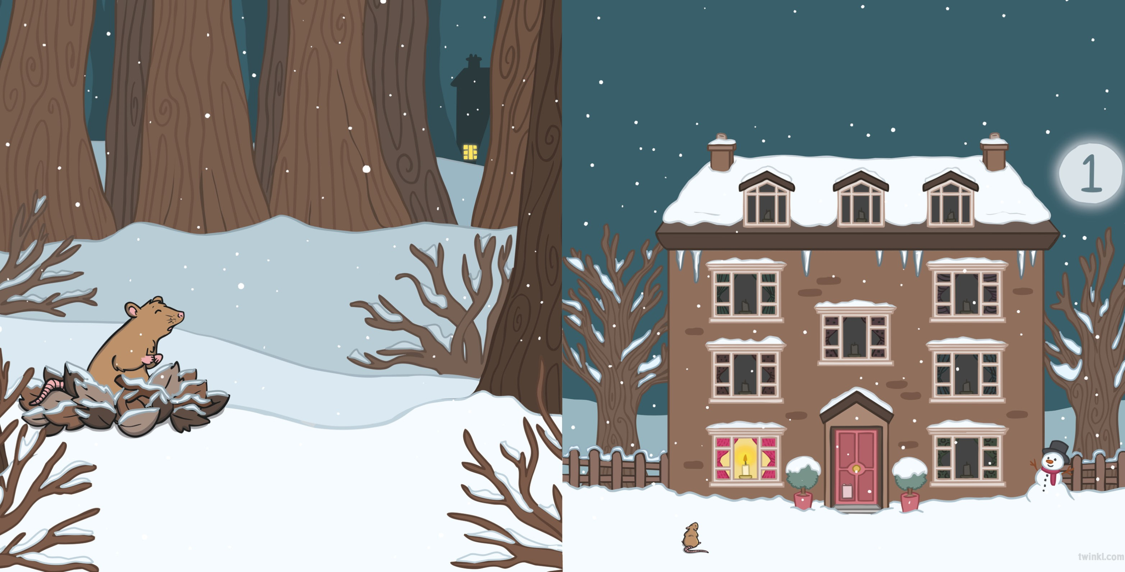
One little light was shining out in the night and a rat was dreaming of a warm cosy fire.
A warm golden glow attracted a rat, who was scurrying in the frozen leaves.

Slide 5
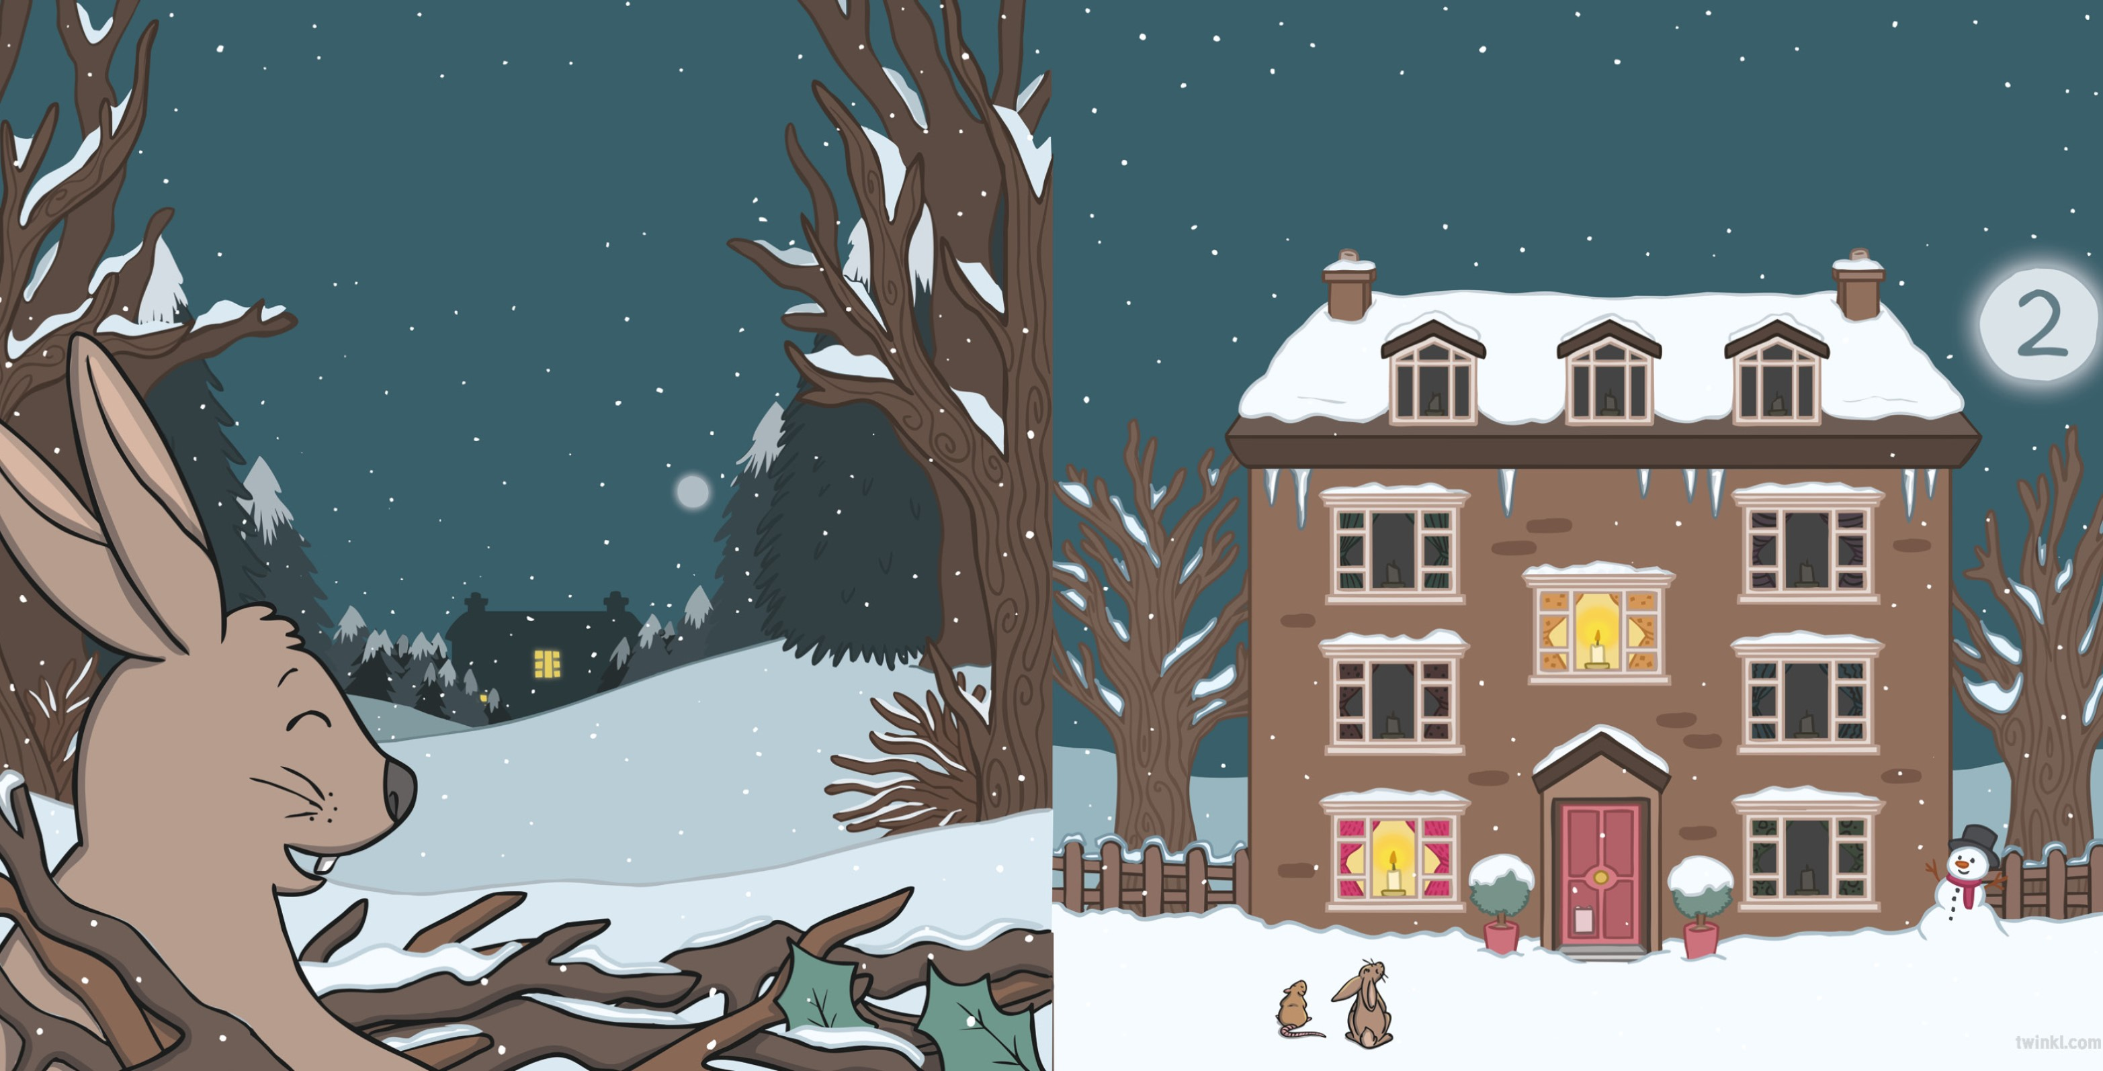
The glow became brighter and attracted a hare, who was snuffling in some crunchy twigs.
Two little lights were shining out in the night and a rat and a hare were dreaming of a warm cosy fire.

Slide 6
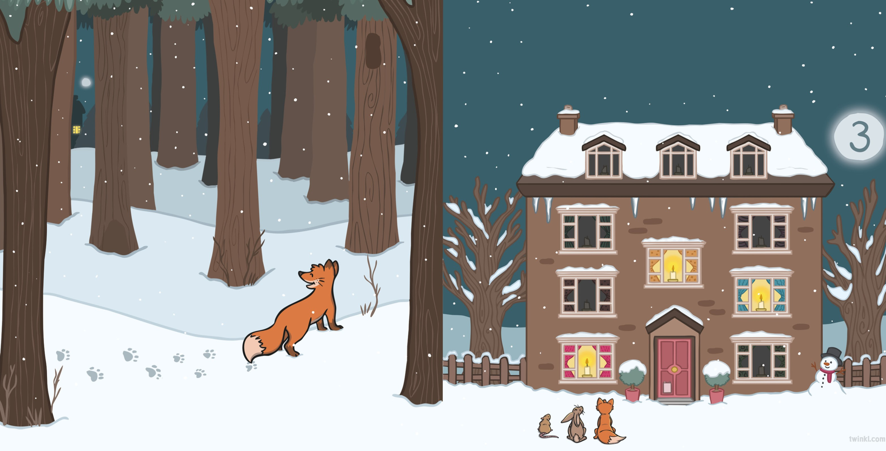
Three little lights were shining out in the night and a rat, a hare and a fox were dreaming of a warm cosy fire.
The glow became brighter and attracted a fox, who was prowling in the powdery snow.

Slide 7
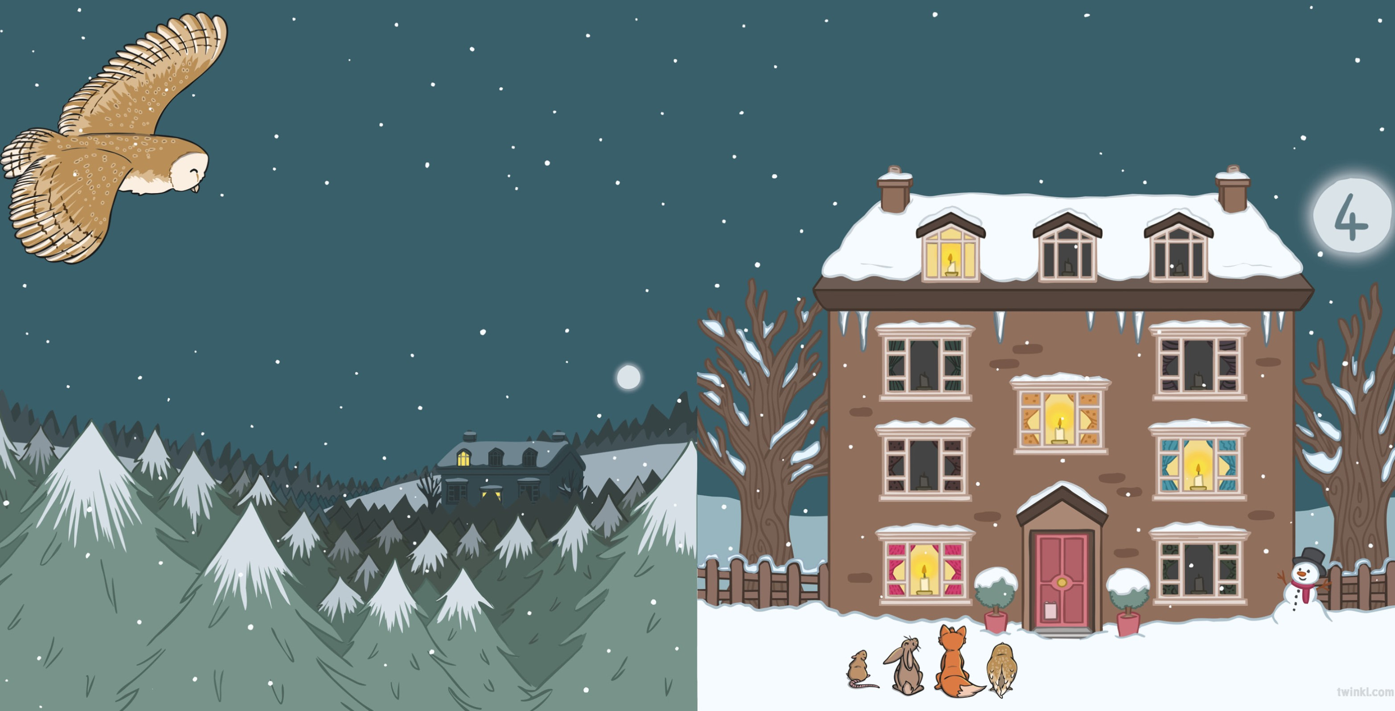
Four little lights were shining out in the night and a rat, a hare, a fox and an owl were dreaming of a warm cosy fire.
The glow became brighter and attracted an owl, who was gliding between the glistening trees.

Slide 8
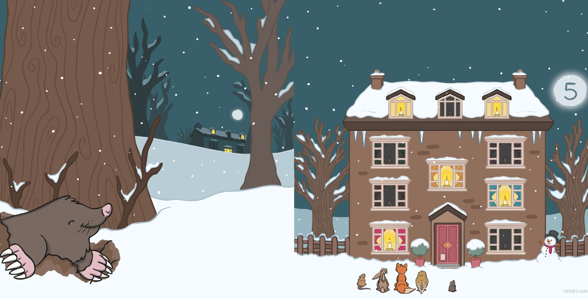
Five little lights were shining out in the night and a rat, a hare, a fox, an owl and a mole were dreaming of a warm cosy fire.
The glow became brighter and attracted a mole, who was digging in the icy soil.

Slide 9
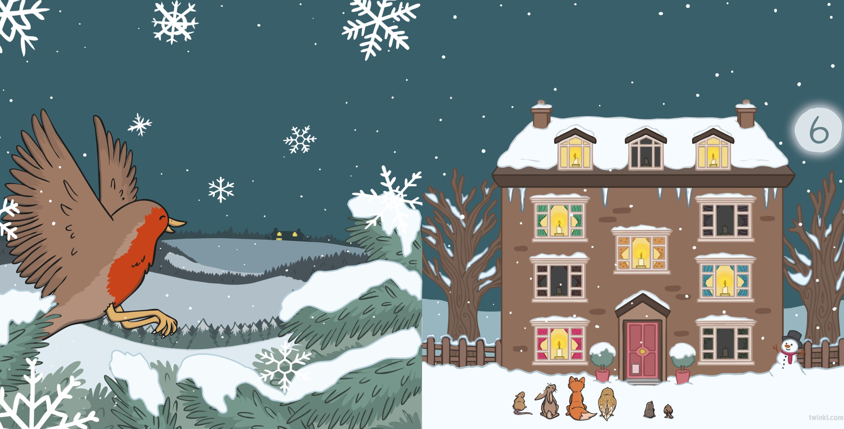
Six little lights were shining out in the night, and a rat, a hare, a fox, an owl, a mole and a robin were dreaming of a warm cosy fire.
The glow became brighter and attracted a robin, who was darting between lacy snowflakes.

Slide 10
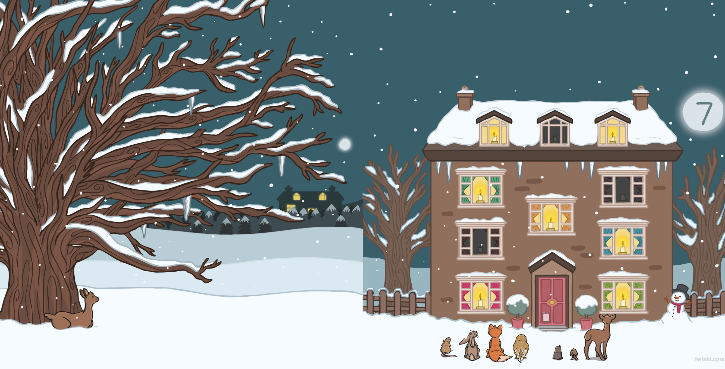
Seven little lights were shining out in the night, and a rat, a hare, a fox, an owl, a mole, a robin and a deer were dreaming of a warm cosy fire.
The glow became brighter and attracted a deer, who was sheltering under the bare branches of an old oak tree.

Slide 11
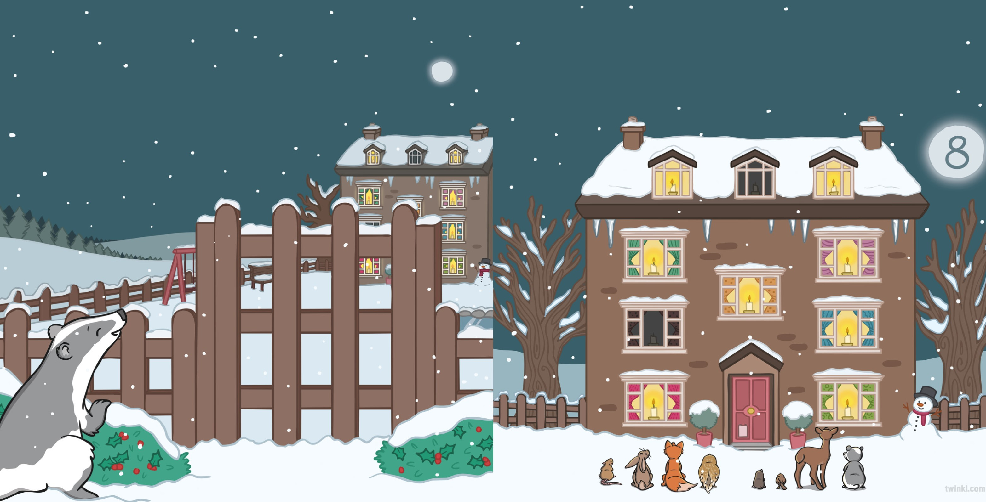
Eight little lights were shining out in the night, and a rat, a hare, a fox, an owl, a mole, a robin, a deer and a badger were dreaming of a warm cosy fire.
The glow became brighter and attracted a badger, who was foraging in the frosty bushes.

Slide 12
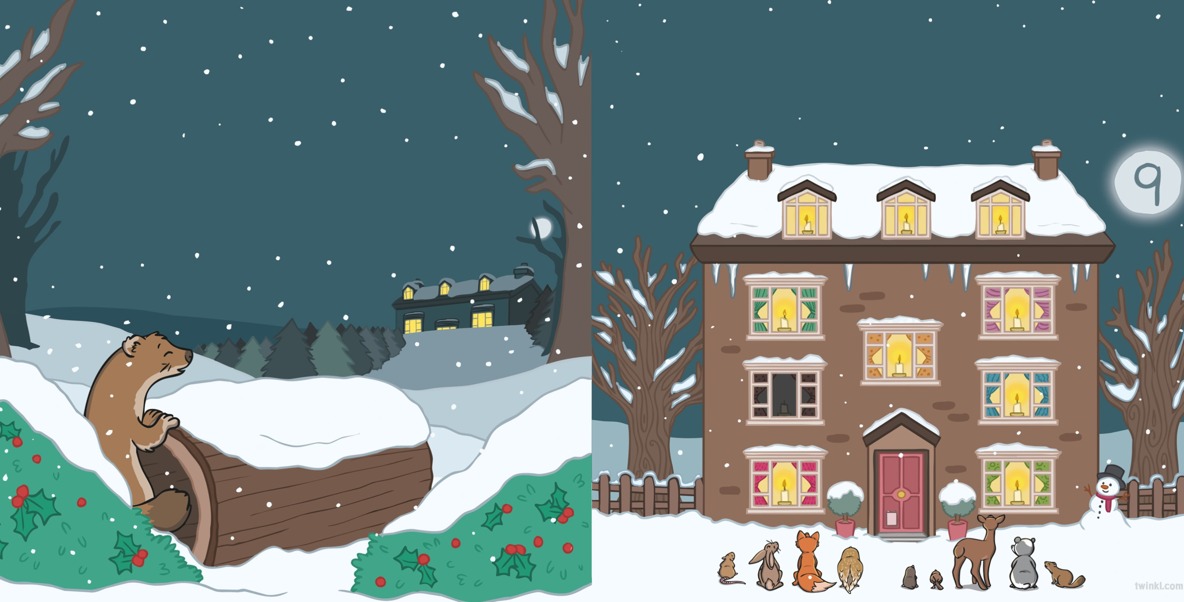
Nine little lights were shining out in the night and a rat, a hare, a fox, an owl, a mole, a robin, a deer, a badger and a stoat were dreaming of a warm cosy fire.
The glow became brighter and attracted a stoat, who was scampering through a hollow log.

Slide 13
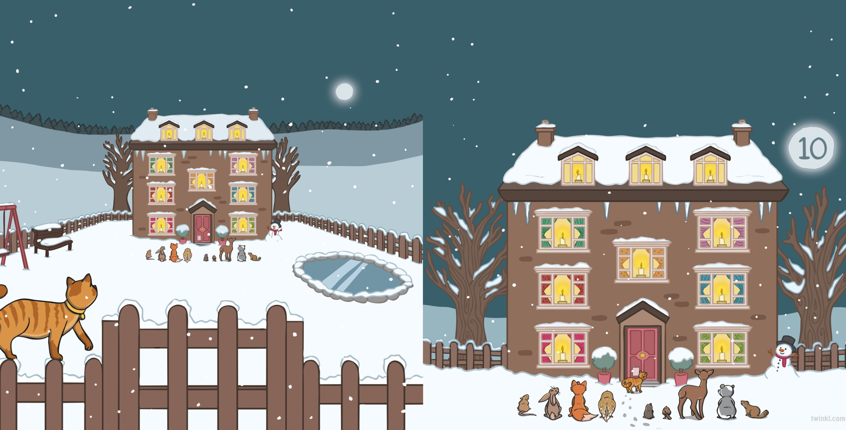
The glow became brighter and attracted a cat, who was returning to its toasty bed across the thick blanket of snow.
Ten little lights were shining out in the night and a cat was looking back at a rat, a hare, a fox, an owl, a mole, a robin, a deer, a badger and a stoat, who were all dreaming of a warm cosy fire.

Slide 14
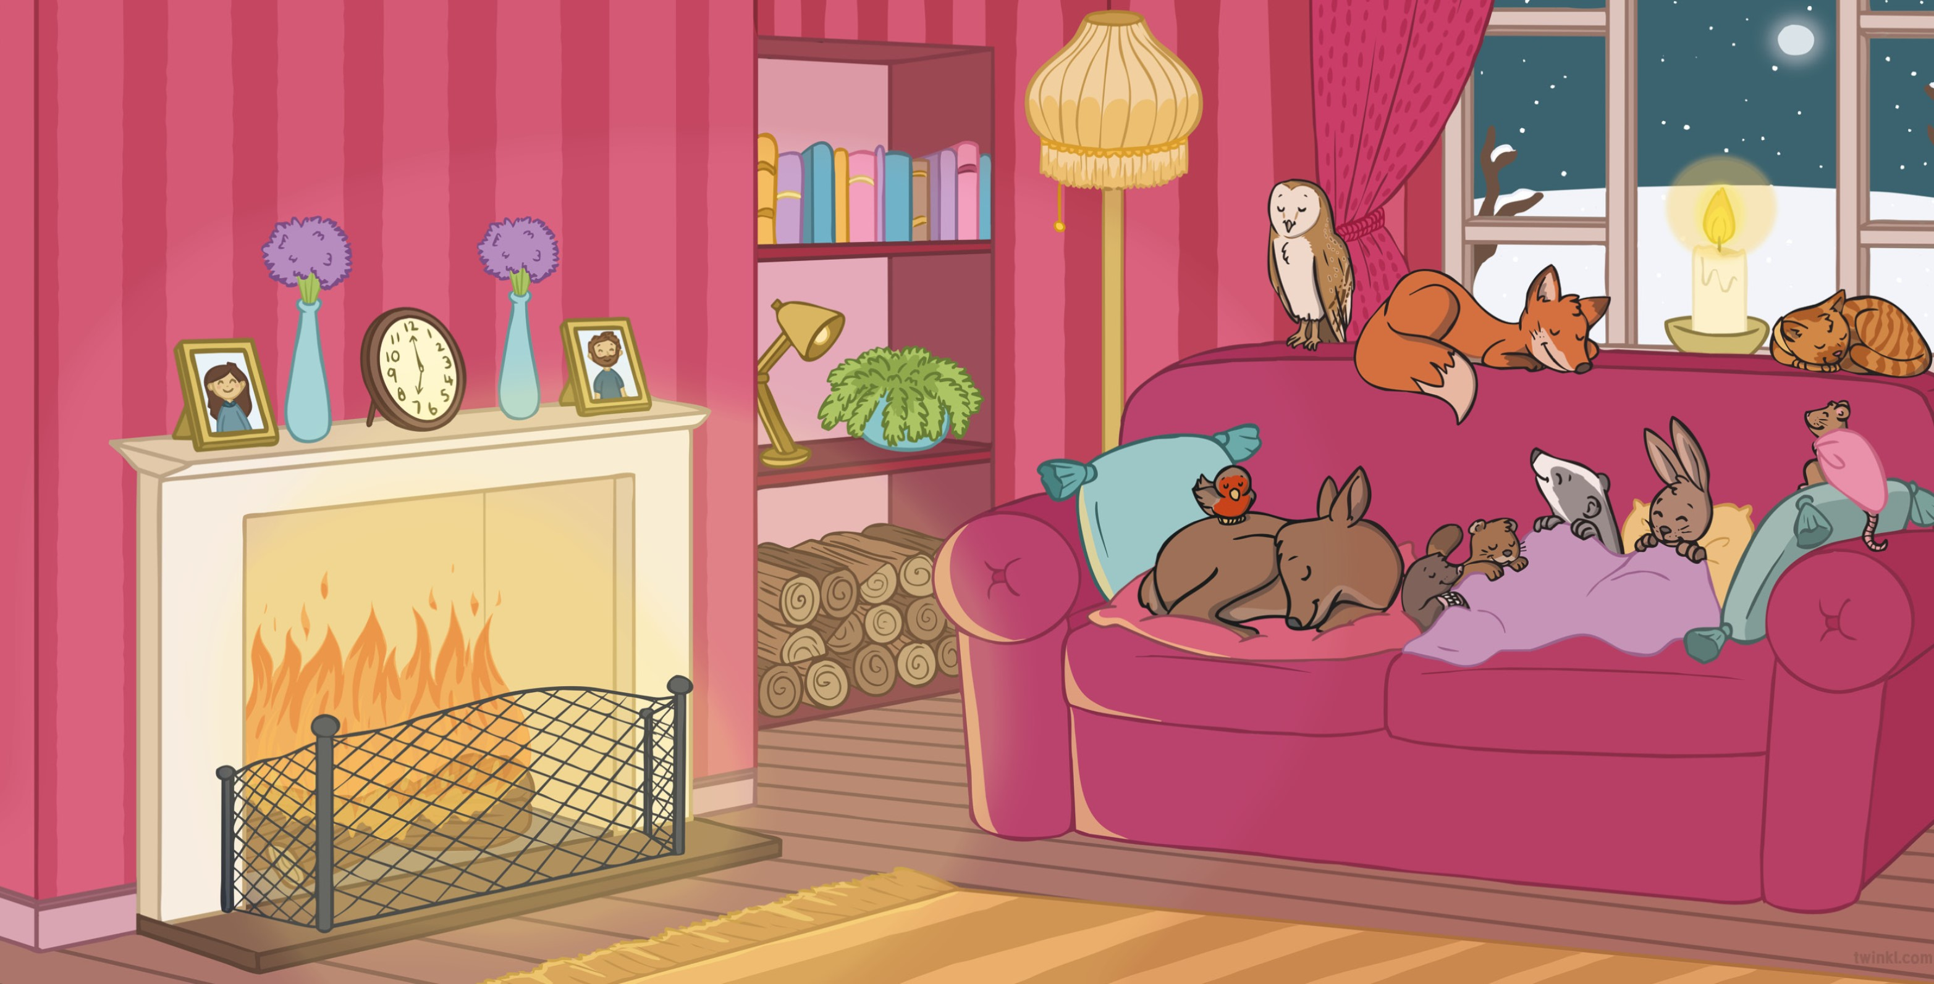
Ten little lights were shining out in the night...
and ten little friends were snuggled up very tight.

Slide 16


