Slide 1


Science
Uses of Everyday Materials
Year One
Science | Year 2 | Uses of Everyday Materials | Identifying Uses | Lesson 1

Slide 2
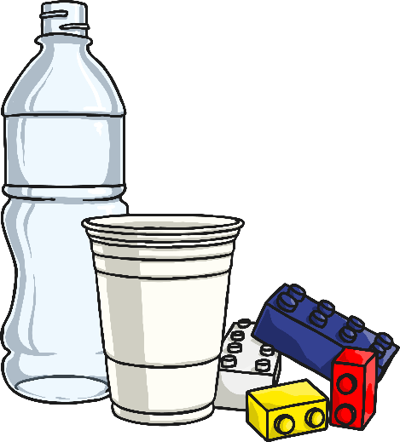
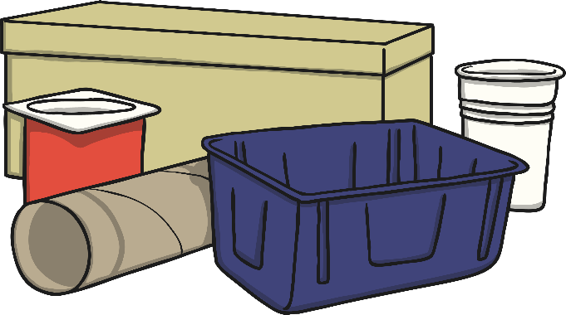
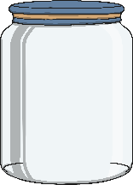
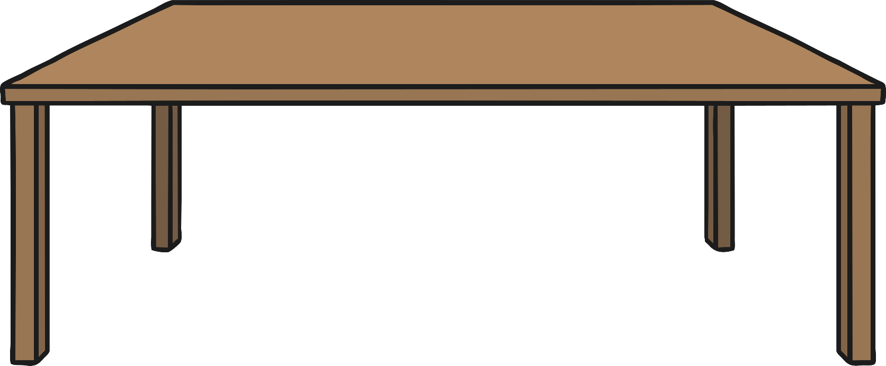

Identifying Uses

Slide 3
Aim
I can identify uses of different everyday materials.
Success Criteria
I can identify different everyday materials.
I can suggest materials that familiar objects are made from.
I can explain what 3 different materials can be used for.

Slide 4





What Do We Already Know?
Think back to your Science learning in Year 1. See if you can answer some of these questions with a partner:
How many everyday materials can you name and what were the materials used for?
Can you remember anything about them?
- What did they look like?
- What did they feel like?
- How did they behave?
Can you remember doing any investigations?
What did you find out and what did you learn?

Slide 5

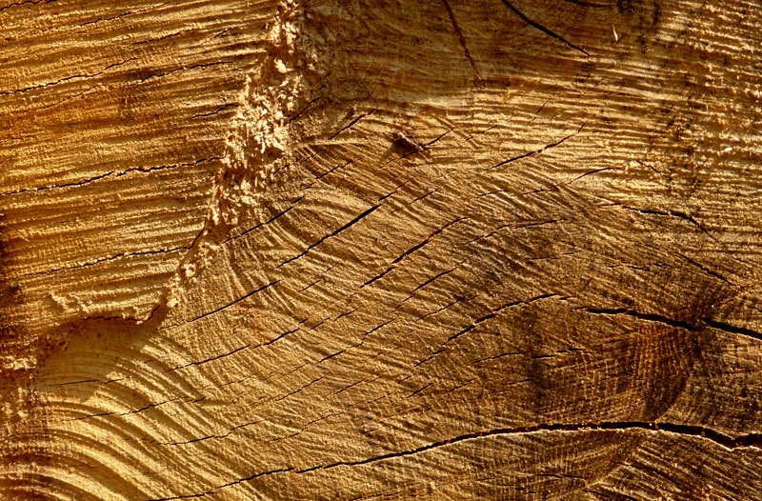
Identifying Materials
Wood
Photo courtesy of Kat… (@flickr.com) - granted under creative commons licence – attribution

Slide 6
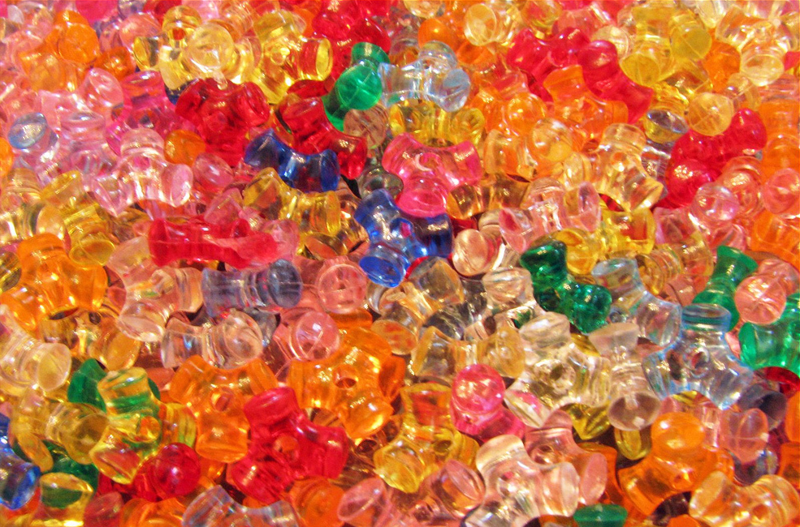
Identifying Materials
Plastic
Photo courtesy of terren in Virginia (@flickr.com) - granted under creative commons licence – attribution

Slide 7
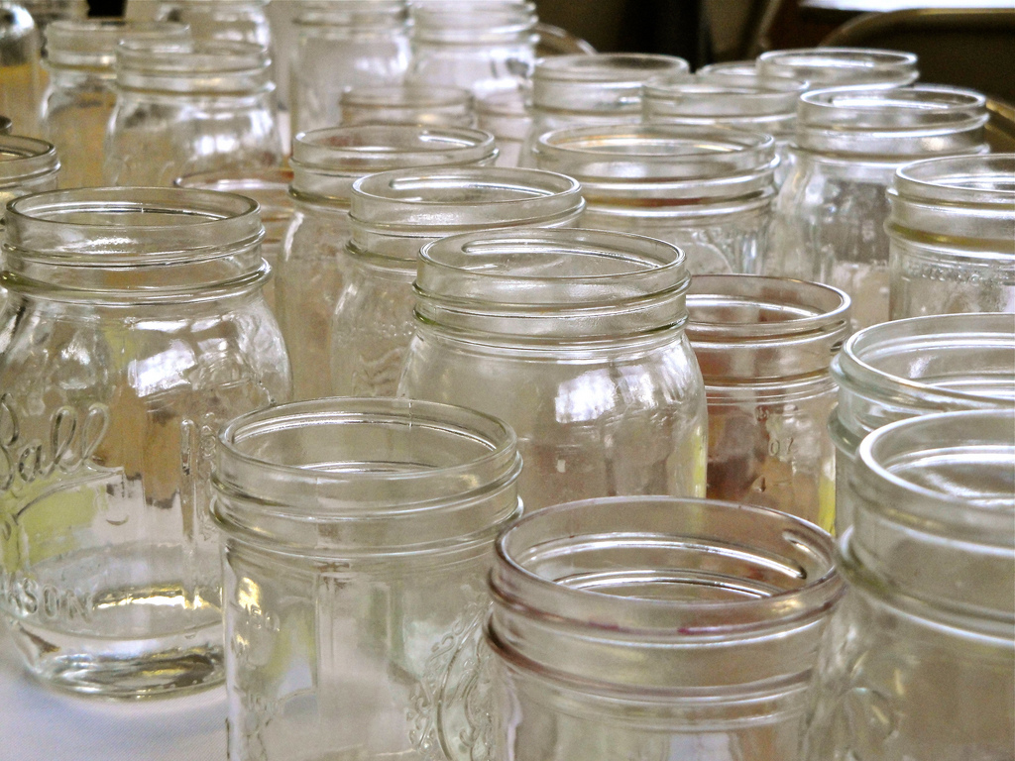
Identifying Materials
Glass
Photo courtesy of RecoilRick (@flickr.com) - granted under creative commons licence – attribution

Slide 8
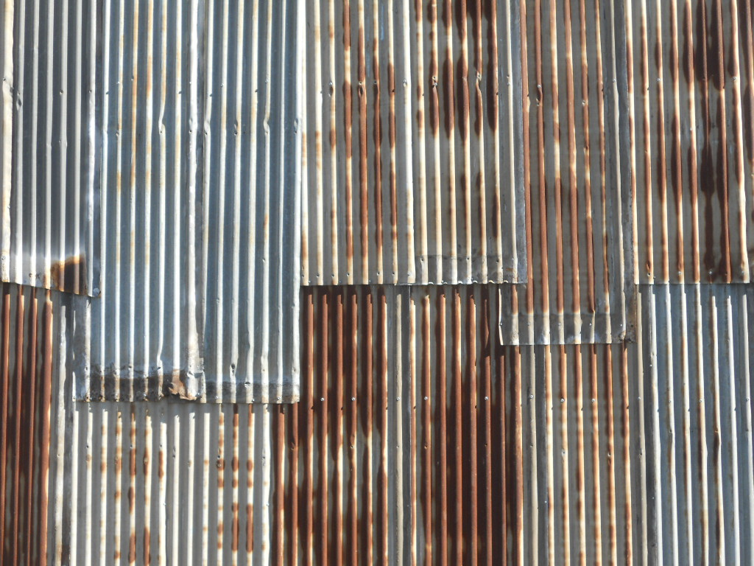
Identifying Materials
Metal
Photo courtesy of mikecogh (@flickr.com) - granted under creative commons licence – attribution

Slide 9
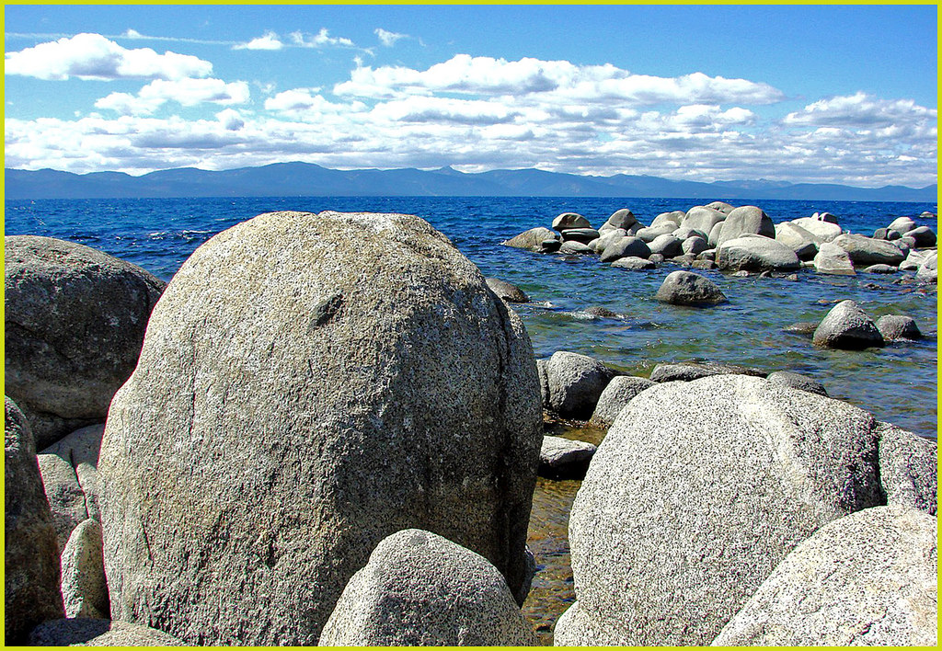
Identifying Materials
Rock
Photo courtesy of inkknife_2000 (4.5 million views) (@flickr.com) - granted under creative commons licence – attribution

Slide 10
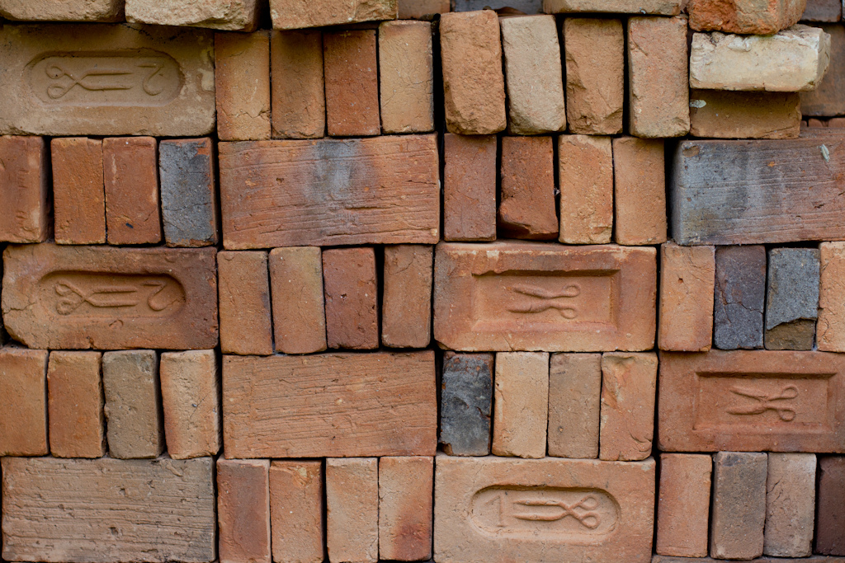
Identifying Materials
Brick
Photo courtesy of Thiago Avancini (@flickr.com) - granted under creative commons licence – attribution

Slide 11
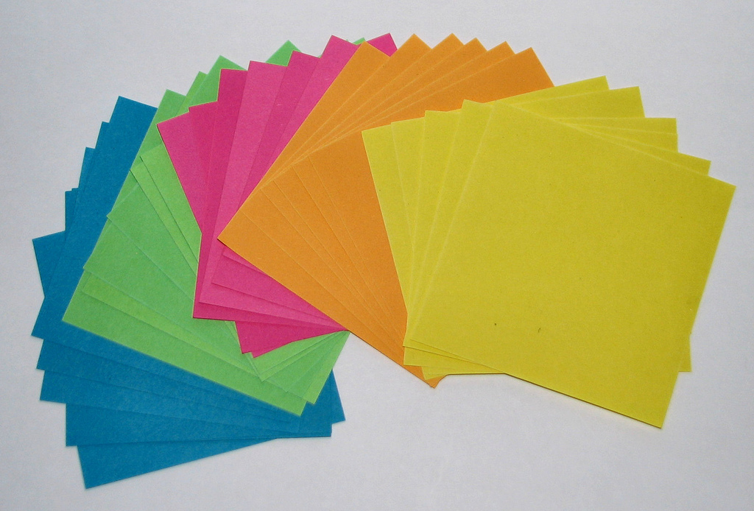
Identifying Materials
Paper
Photo courtesy of Andreas (@flickr.com) - granted under creative commons licence – attribution

Slide 12

Identifying Materials
Cardboard
Photo courtesy of SixRevisions (@flickr.com) - granted under creative commons licence – attribution

Slide 13







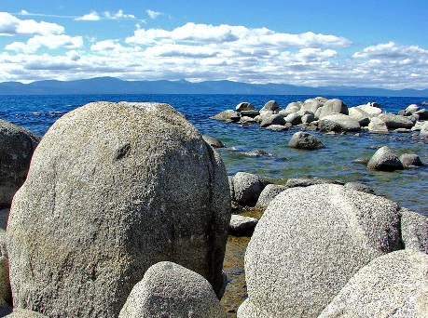

Think Again…
Look at the materials in these photos. What might they be used for?
Have a look around the classroom. Can you see any familiar objects which are made from these materials?
Photo courtesy of Andrea; inkknife_2000 (4.5 million views); Kat…; mikecogh; RecoilRick; Six Revisions; terren in Virginia; Thiago Avancini (@flickr.com) - granted under creative commons licence – attribution

Slide 14

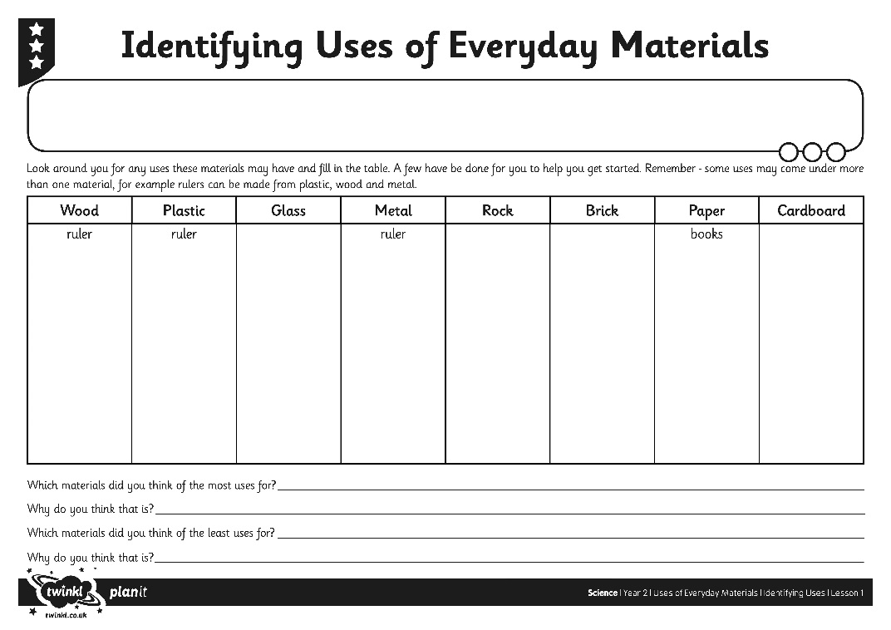
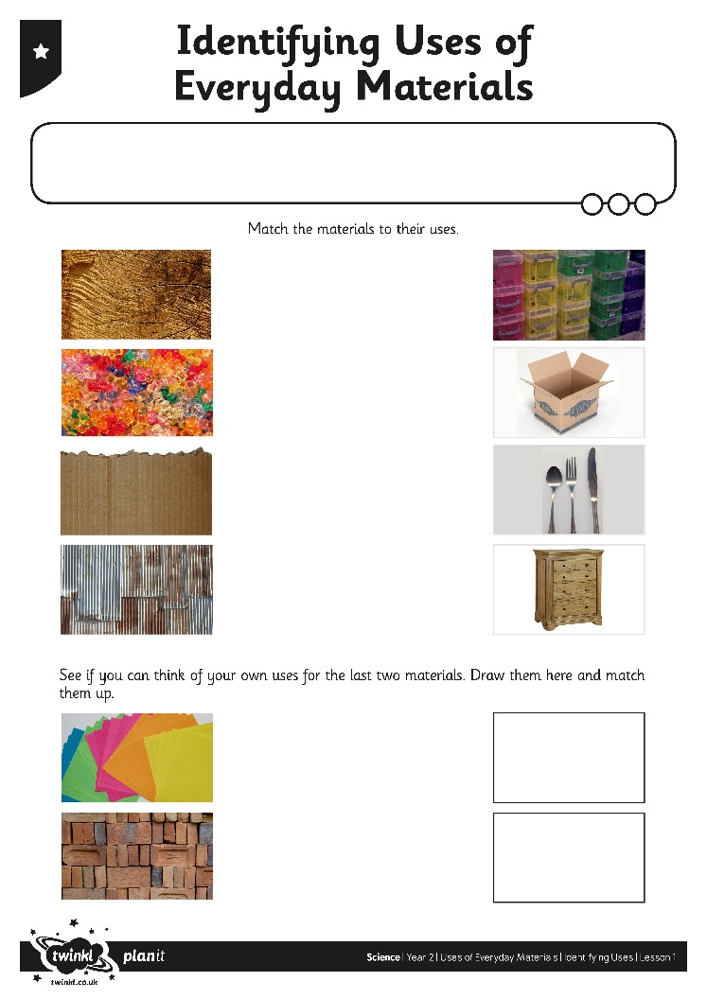
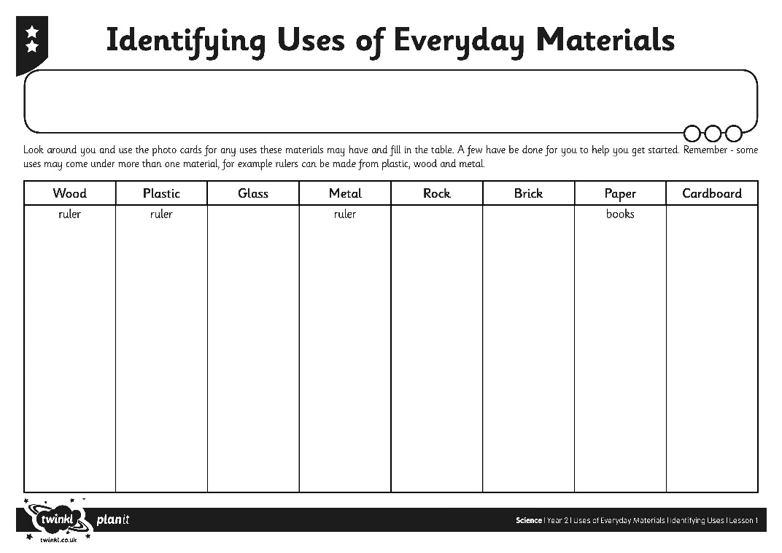
Identifying Uses of
Everyday Materials
Photo courtesy of Andrea; inkknife_2000 (4.5 million views); Kat…; mikecogh; RecoilRick; Six Revisions; terren in Virginia; Thiago Avancini (@flickr.com) - granted under creative commons licence – attribution

Slide 15
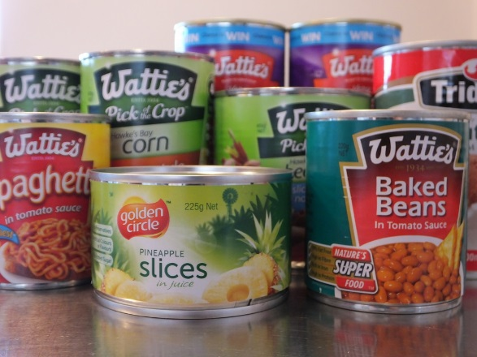
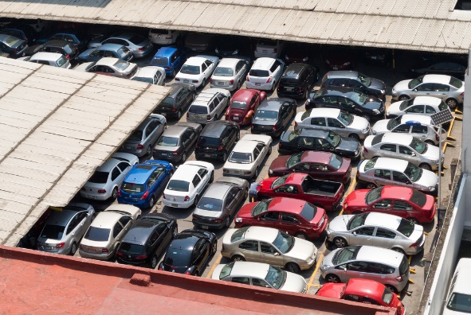
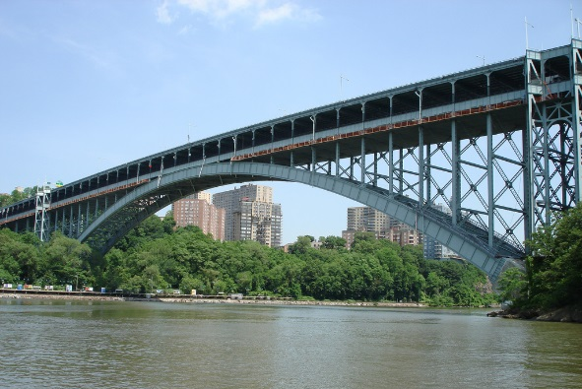
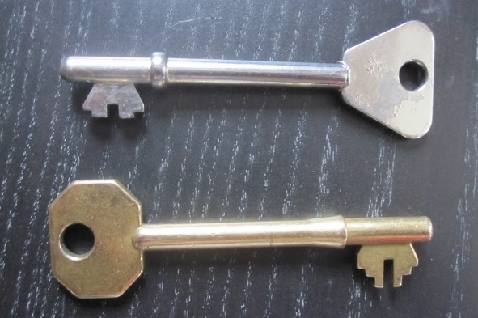
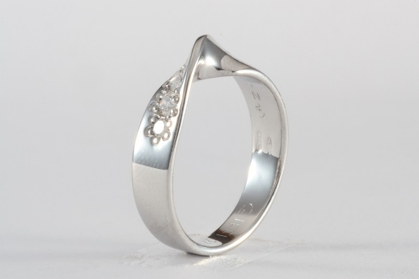
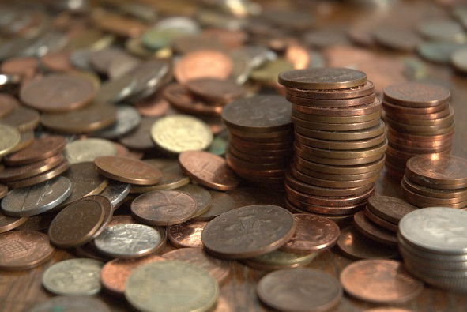
Same Material, Different Uses
Photo courtesy of icoNYC; Ismael villafranco; Jacqui.brown33; Richard-G; SlowJewellery; xJason.Rogersx (@flickr.com) - granted under creative commons licence – attribution

Slide 16

Aim
I can identify uses of different everyday materials.
Success Criteria
I can identify different everyday materials.
I can suggest materials that familiar objects are made from.
I can explain what 3 different materials can be used for.

