Slide 1


Science
Everyday Materials
Year One
Science | Year 1 | Everyday Materials | Objects and Materials | Lesson 2

Slide 2
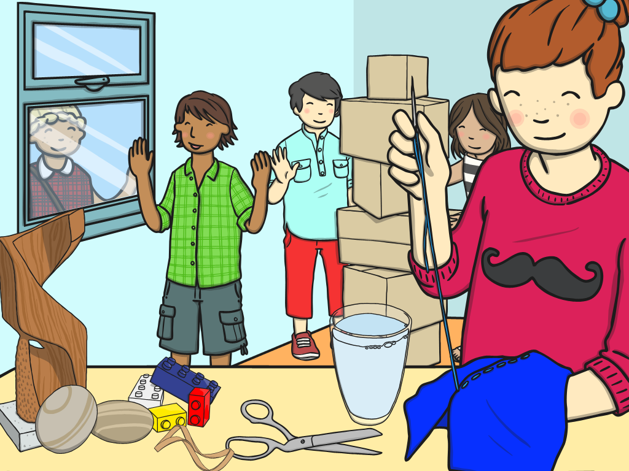

Objects and Materials

Slide 3
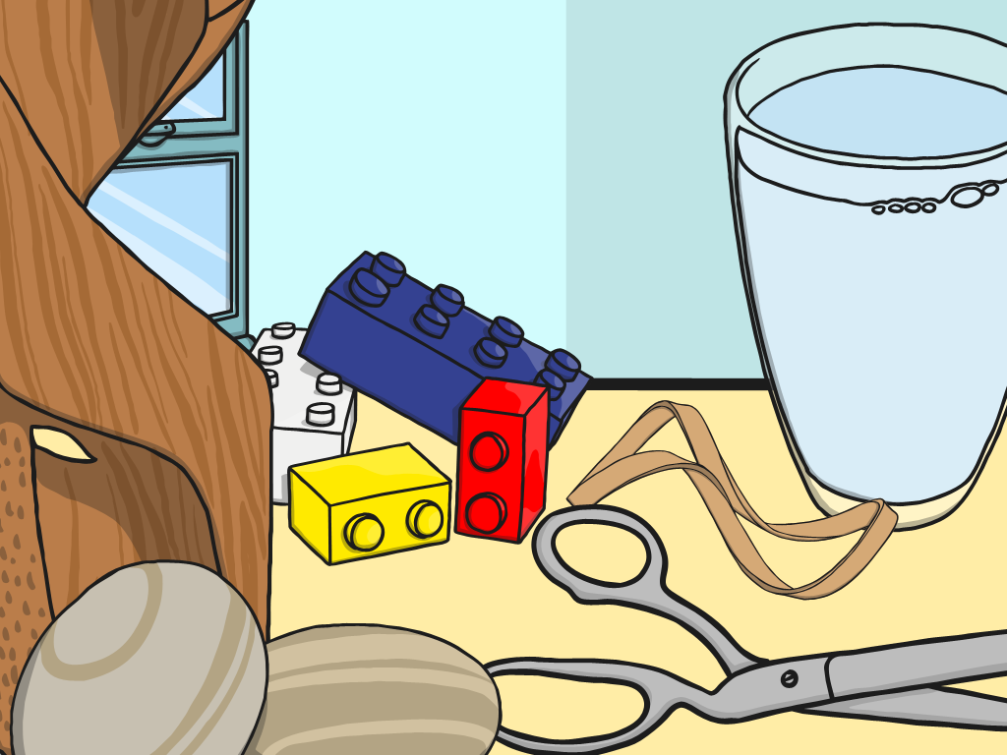
Aim
I can tell the difference between an object and the materials it is made from.
Success Criteria
I can name specific objects.
I can identify the materials which specific objects are made from.
I can explain the difference between objects and materials.

Slide 4

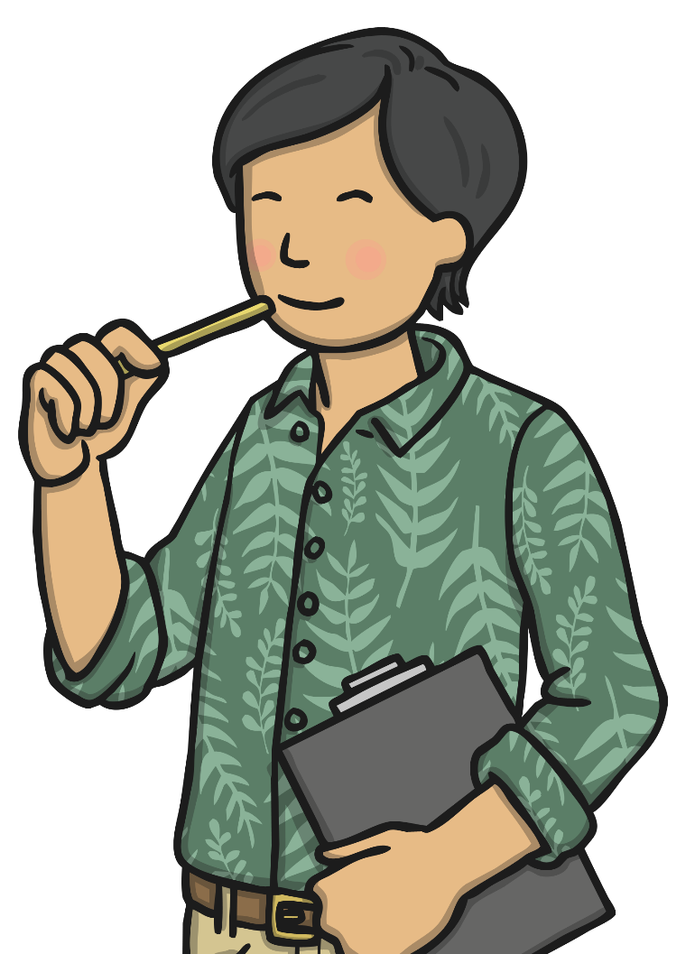
Object Challenge
In your group, look at the objects. What have they all got in common?

Slide 5

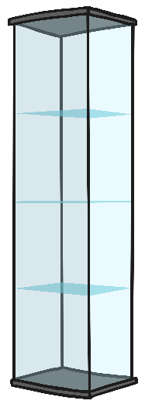
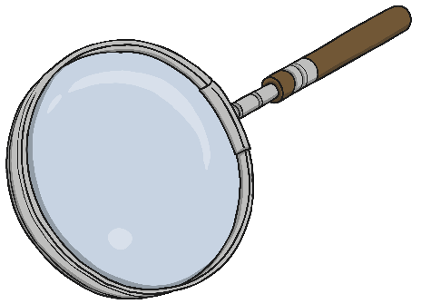
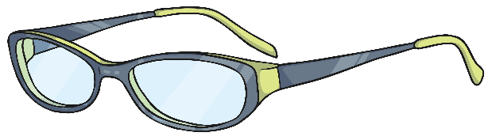
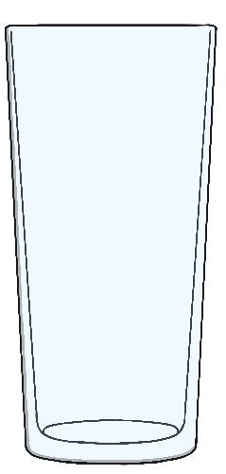

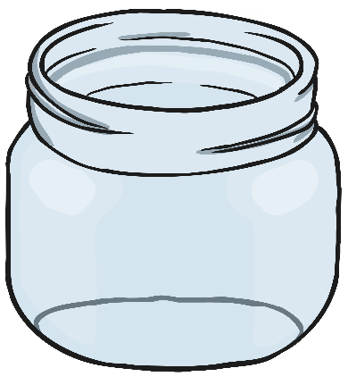
Object Challenge Answers
What do these objects have in common?
These objects are all made from glass!

Slide 6

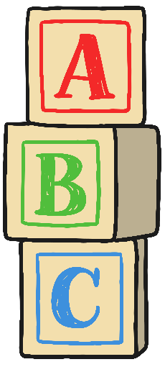
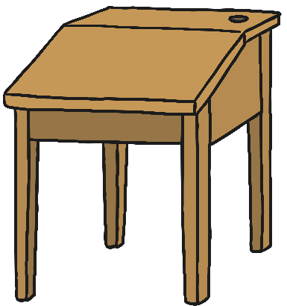
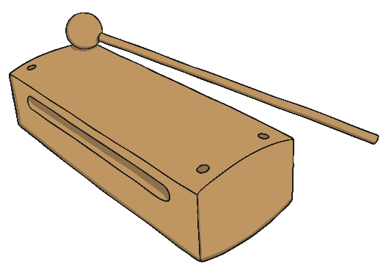
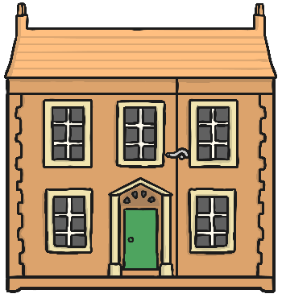
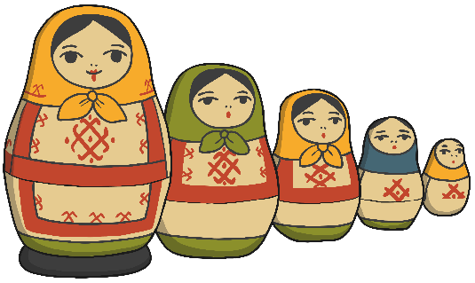
Object Challenge Answers
These objects are all made from wood!
What do these objects have in common?

Slide 7
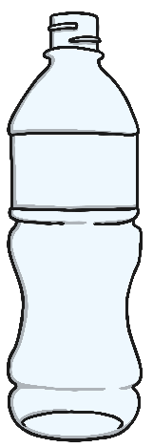

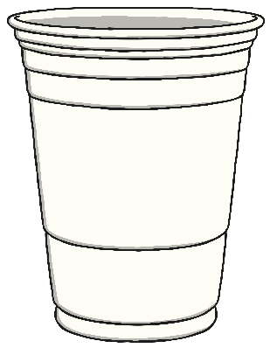
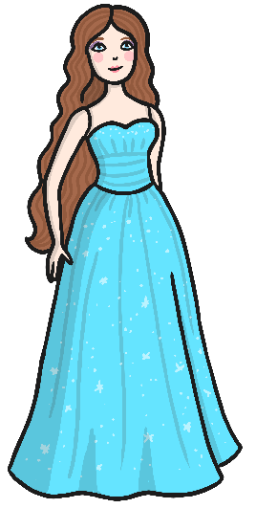

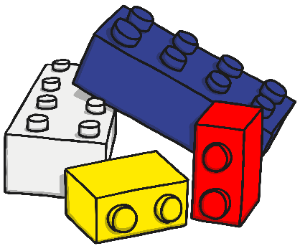
Object Challenge Answers
What do these objects have in common?
These objects are all made from plastic!

Slide 8


Material Challenge
What objects can you see in this picture?
What materials do you think these objects are made from?
How do you know?
glass
wood
start
Time up!
Photo courtesy of Radiobrain_@flickr.com) - granted under creative commons licence – attribution
Notes:
Click the slide to start the minute timer

Slide 9
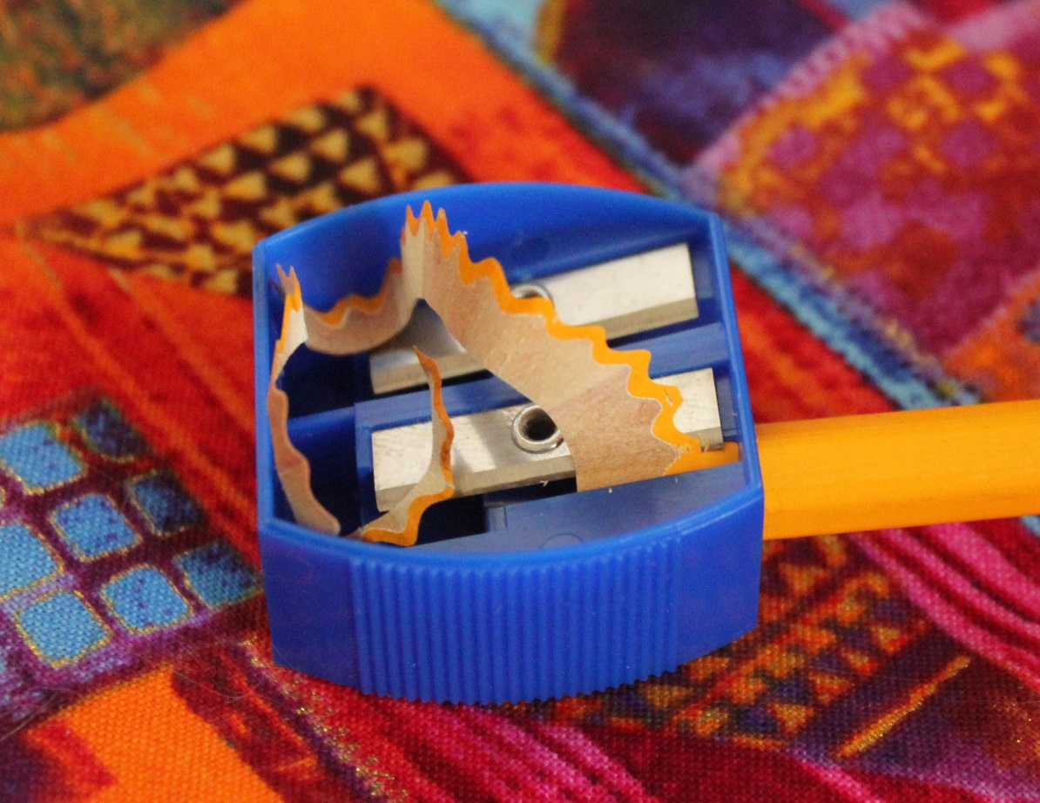
Material Challenge
What material is this pencil sharpener made from?
How do you know?
Is it made from one material?
metal
plastic
start
Time up!
Photo courtesy of quinnanya@flickr.com) - granted under creative commons licence – attribution
Notes:
Click the slide to start the minute timer

Slide 10
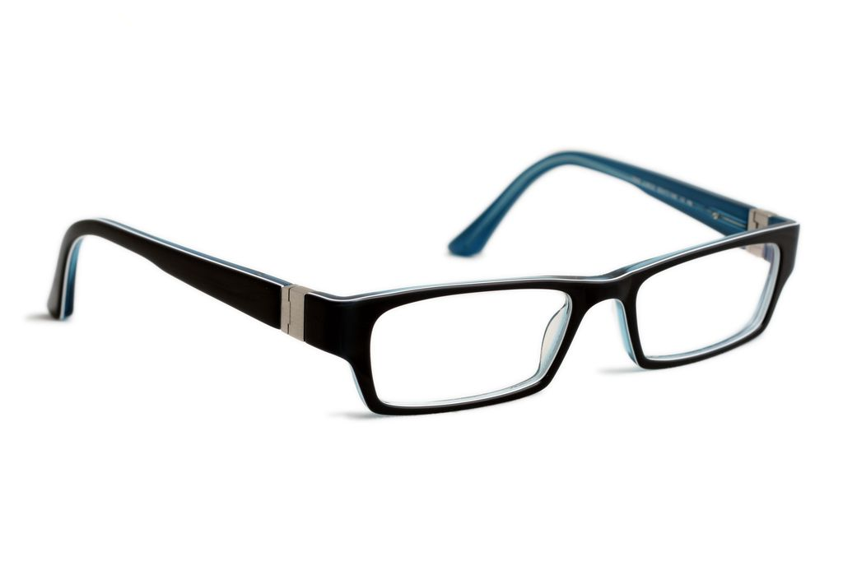
Material Challenge
plastic
What materials are these glasses made from?
How do you know?
glass
start
Time up!
Photo courtesy of WillVision@flickr.com) - granted under creative commons licence – attribution
Notes:
Click the slide to start the minute timer

Slide 11

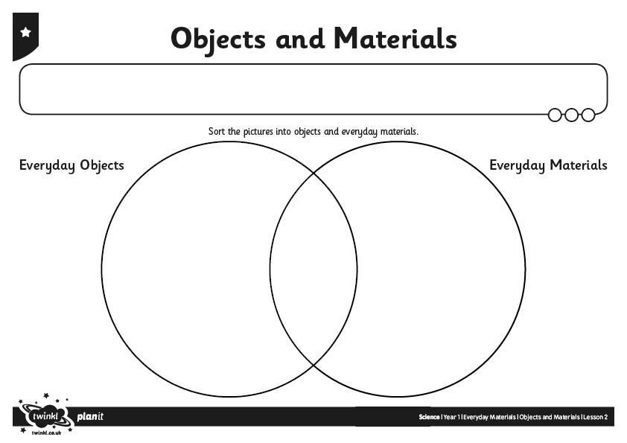
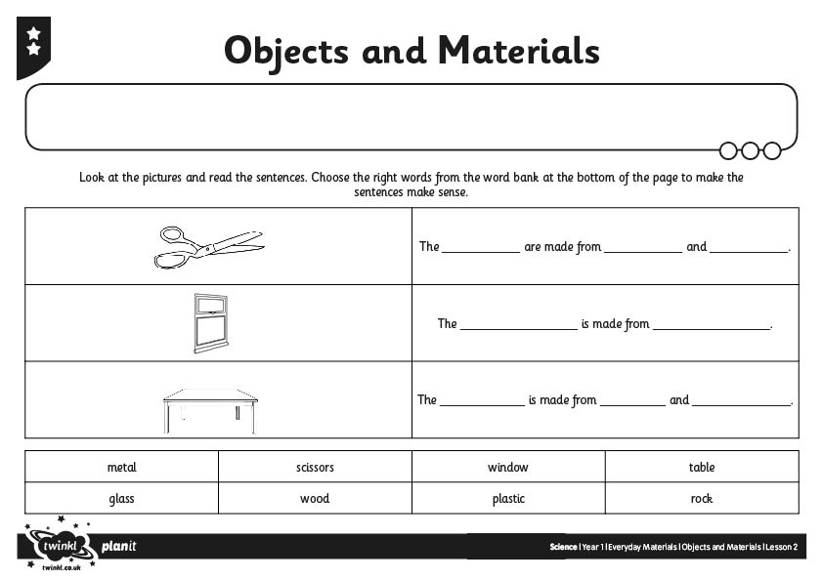
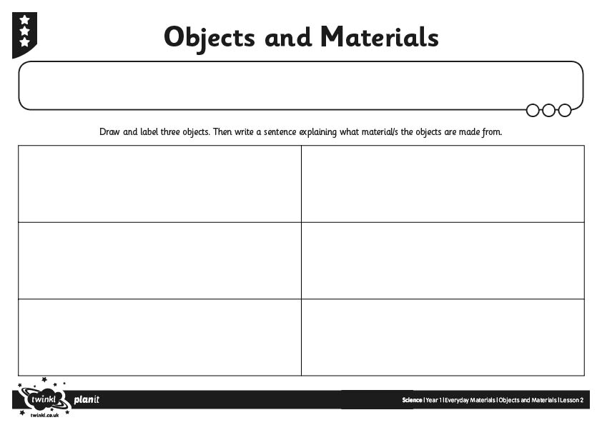
Objects and Materials

Slide 12

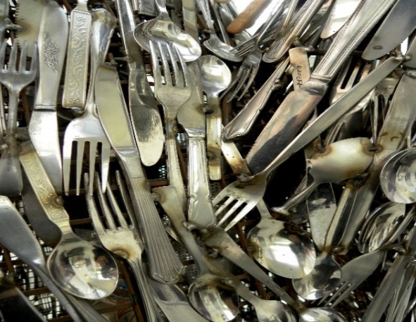
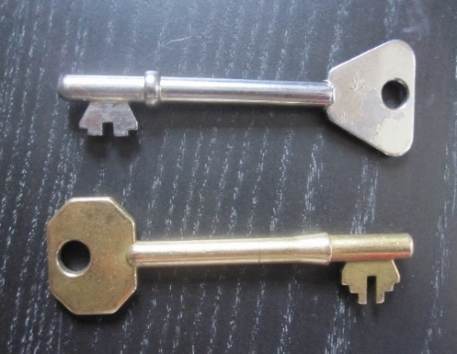
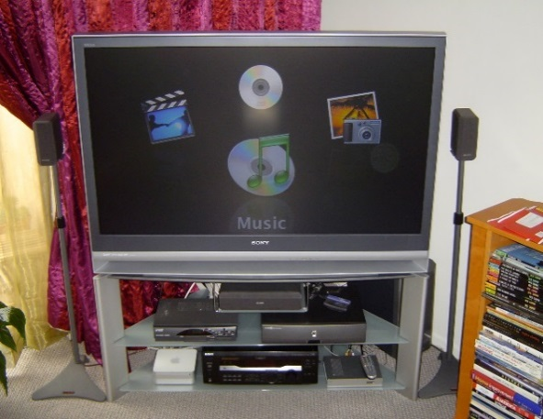
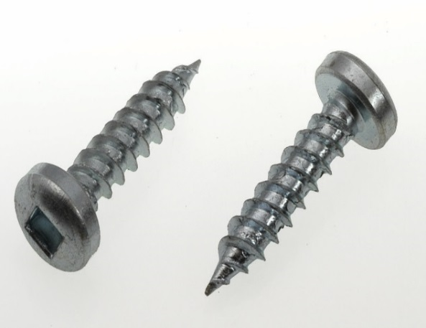
Odd One Out
Which of these do you think is the odd one out? Why?
Photo courtesy of Rev Stani@flickr.com, Richard-Gi@flickr.com, CARLISLEHVACi@flickr.com and Horrortaxi@flickr.com) - granted under creative commons licence – attribution

Slide 13

Aim
I can tell the difference between an object and the materials it is made from.
Success Criteria
I can name specific objects.
I can identify the materials which specific objects are made from.
I can explain the difference between objects and materials

Slide 14


