Slide 1


Science
States of Matter
Year One
Science | Year 4 | States of Matter | Wonderful Water | Lesson 5

Slide 2
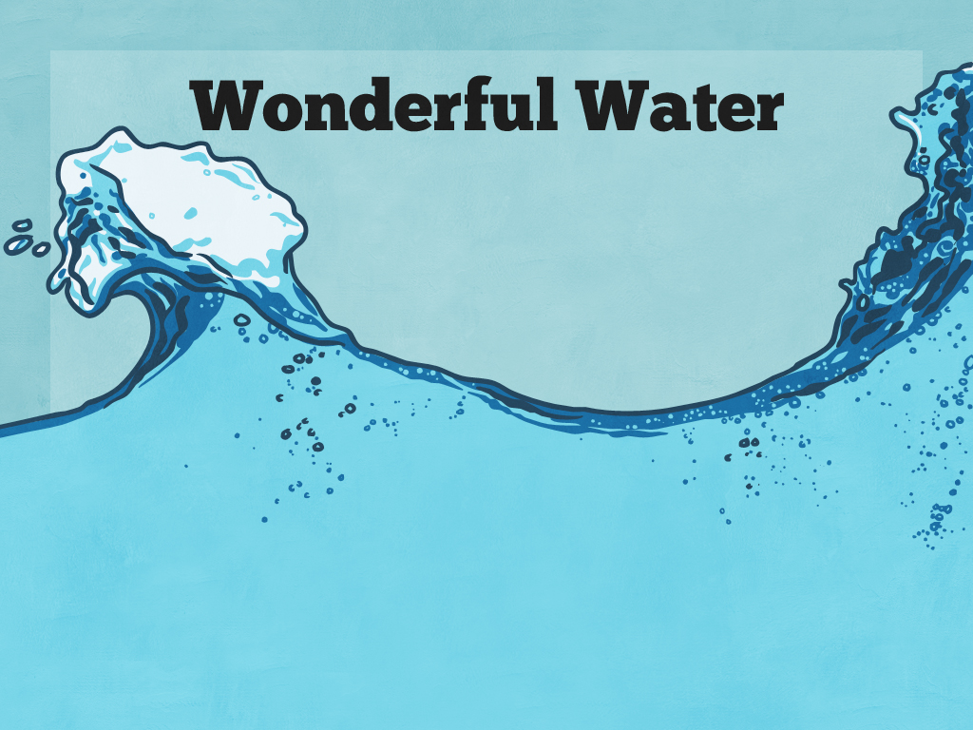


Slide 3
Aim
I can explore how water changes state.
Success Criteria
I can identify the different states water can be in.
I can identify the temperatures at which water changes state.
I can identify and observe the processes that cause water to change state.

Slide 4

The Three States of Water
Water can be in one of three states - solid, liquid or gas.
Your group has six questions about the three states of water.

Slide 5

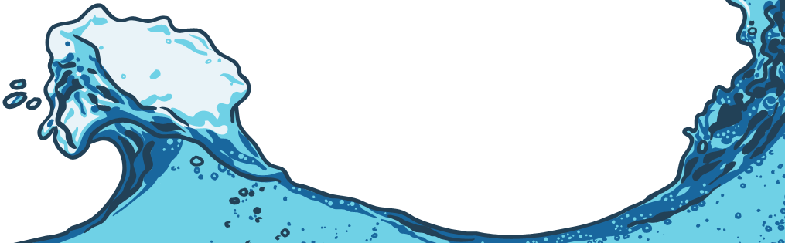
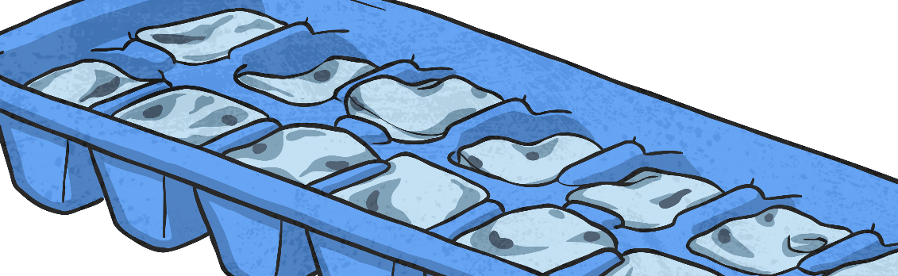
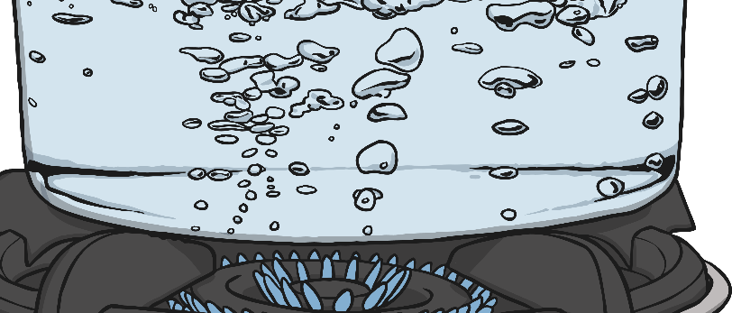
Exploring the Processes
Let’s find out more about how water changes state, the processes that cause it to change and the temperatures at which it changes.

Slide 6
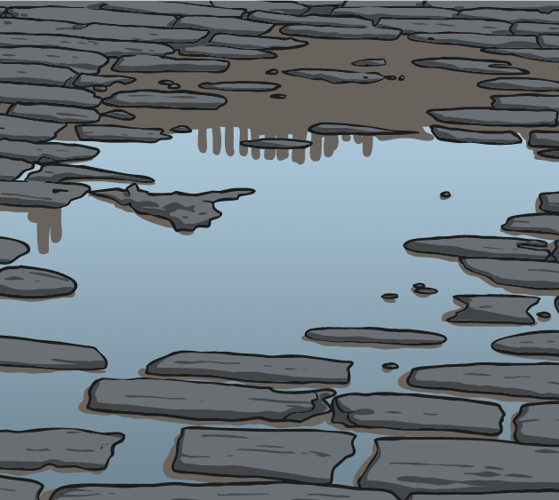
Exploring the Processes
Evaporation is when water turns into water vapour (a liquid turning to a gas).
Evaporation happens very easily when water reaches its boiling point of 100˚C.
However, evaporation can happen more
slowly at much lower temperatures. For example, when water in a puddle warms up, water from the surface of the puddle slowly changes to water vapour.

Slide 7
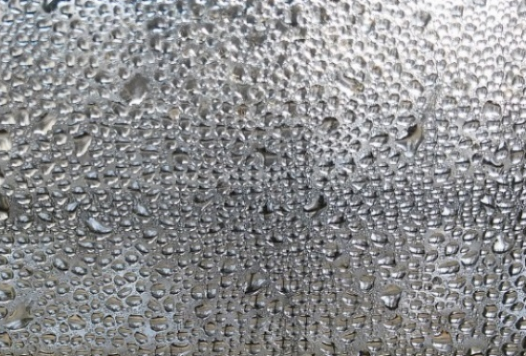
Exploring the Processes
Condensation is when water vapour is cooled down and turns to water (a gas turning to a liquid).
You can see that condensation has happened when you see droplets of water on a window or mirror in a warm room. The water vapour in the air has been cooled by touching the cold surface and this causes it to change to water.

Slide 8
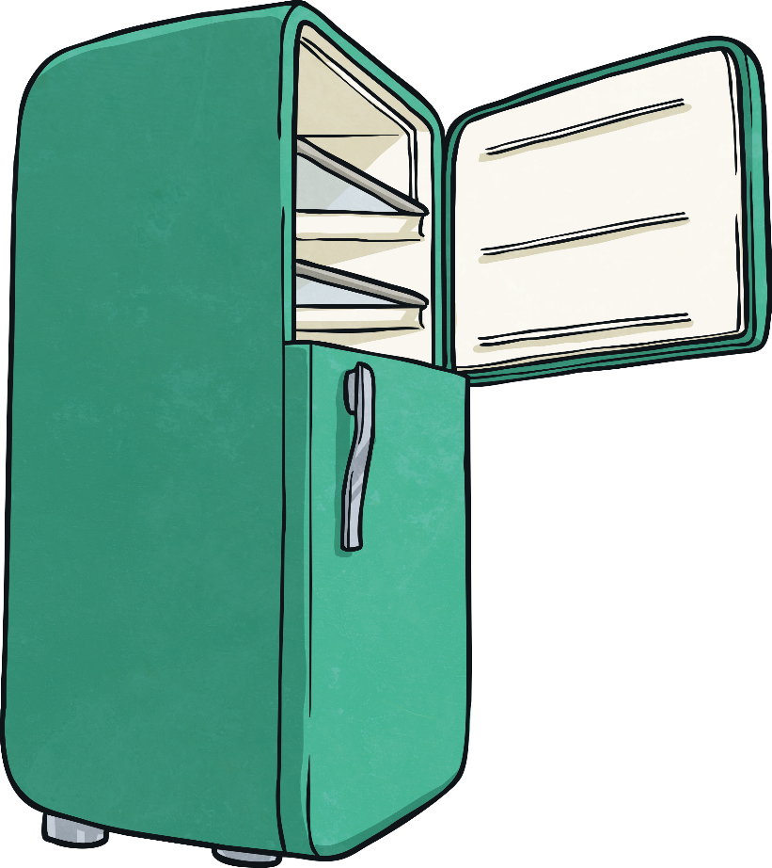
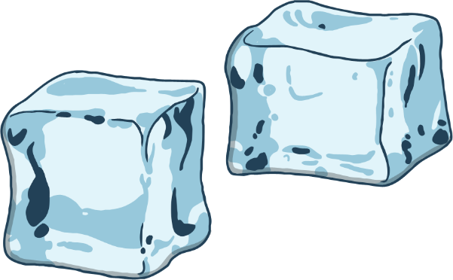
Exploring the Processes
Freezing occurs when water is made very cold. When water reaches 0˚C it turns to ice. (Freezing is a liquid turning to a solid.)

Slide 9
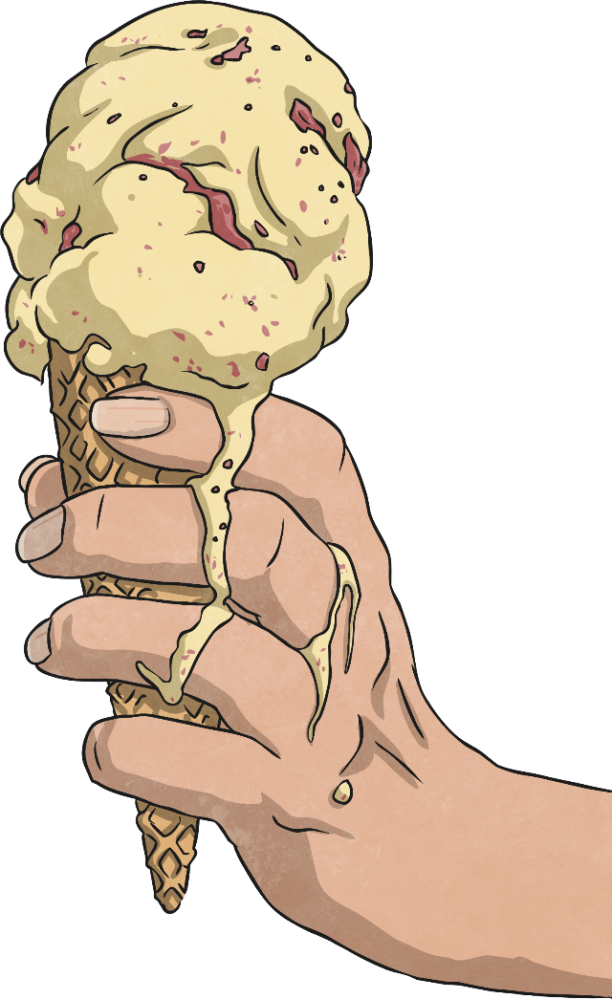
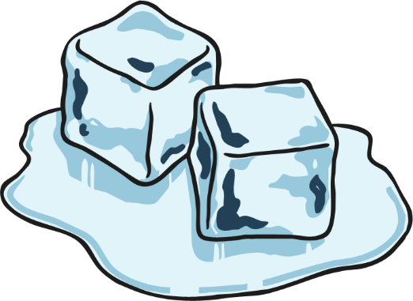
Exploring the Processes
Melting occurs when ice warms up and changes to water (a solid changing to a liquid).
At temperatures above 0˚C, ice will melt.

Slide 10

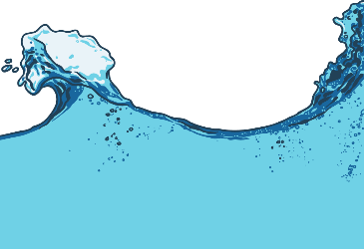
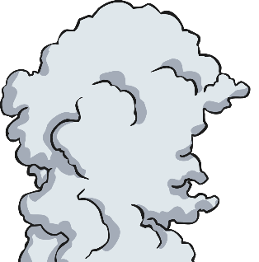
Exploring the Processes
melting
evaporation
freezing
condensation
ice
water
water
vapour
Water changes state as a result of these processes.
You will move around the classroom to explore the different processes in a series of activities.
Keep a record of your observations on your Changing State Activity Sheet.

Slide 11
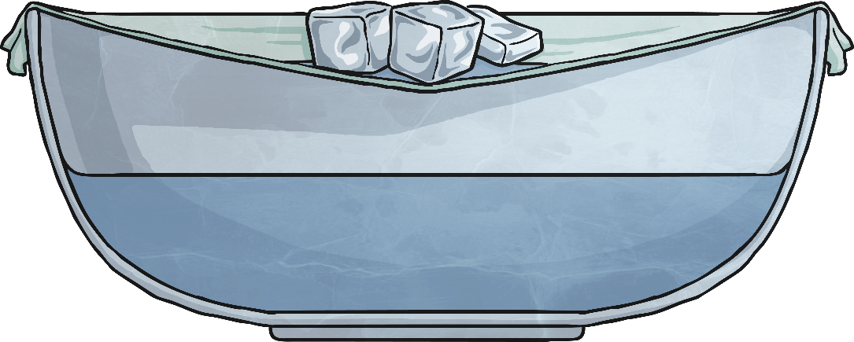
Ice Cube Investigation
In this activity, you will place two or three ice cubes on some cling film stretched over a container of warm water.
What do you see in the container?
What can you observe on the cling film?
What processes are occurring?

Slide 12
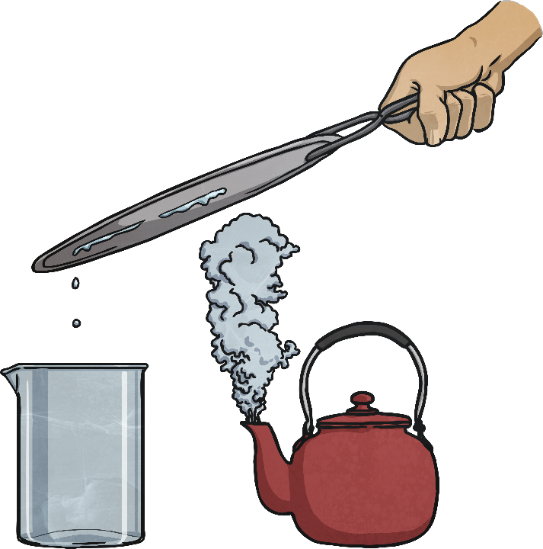
Reversing Changes
Work with an adult for this activity.
Your teacher will boil a kettle. Watch the water vapour form as it boils.
How can this gas be turned back into a liquid? Can you reverse the change?
Watch your teacher demonstrate this process.
What can you see?
Which processes have you observed?
How has the temperature caused these processes?

Slide 13
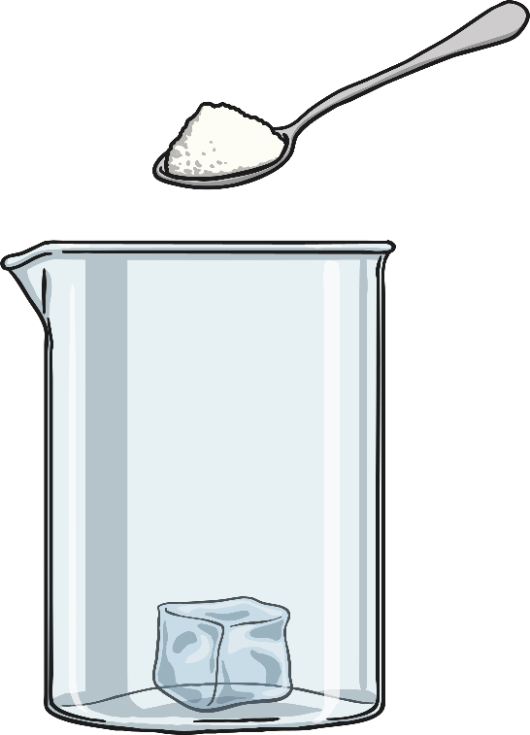
Salt and Ice
Put two ice cubes in two beakers. Put a teaspoon of salt on one ice cube, and observe what happens over a few minutes.
Use a thermometer to observe how the temperature in the beakers changes.
What do you notice happening to the two ice cubes?
What process is occurring?
What happened to the temperature in the different glasses?

Slide 14
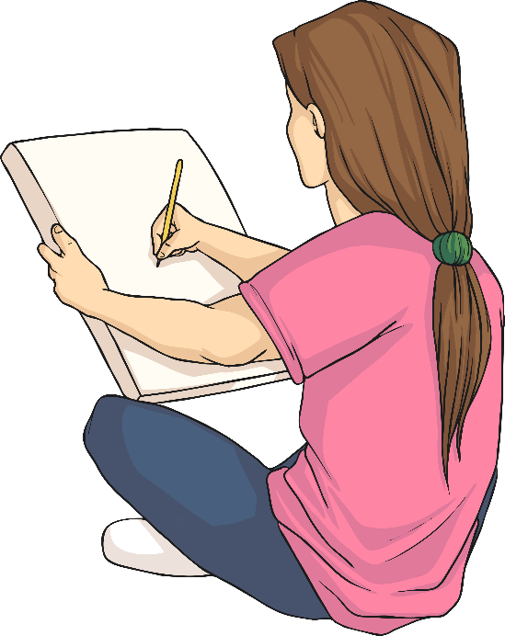
Guess the Process
This is a team game in which you have to guess what your team member is drawing.
Choose one person from your group to be the artist.
The artists should go to the teacher, who will tell you
the name of a process that causes a change of state.
The artists should go back to their groups, and when everybody is ready they should draw the process for their group to guess. The artist is not allowed to speak or write any words.
The first group to guess the process is the winner!

Slide 15

Aim
I can explore how water changes state.
Success Criteria
I can identify the different states water can be in.
I can identify the temperatures at which water changes state.
I can identify and observe the processes that cause water to change state.

