Slide 2

Instructions
Instructions are written for someone who needs to know how to do something.

Slide 3
What are instructions for?
Some examples…

Slide 4
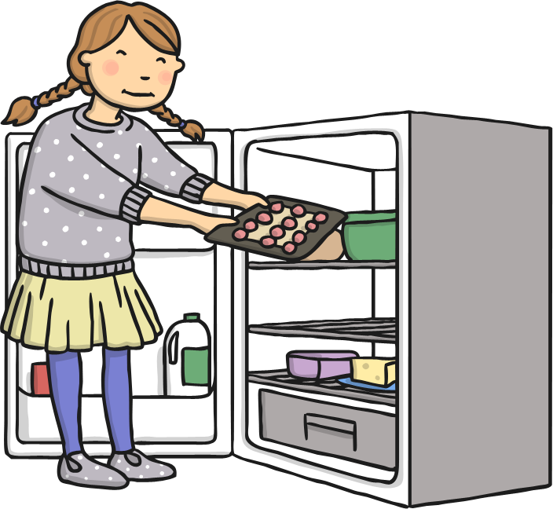
Recipes

Slide 5
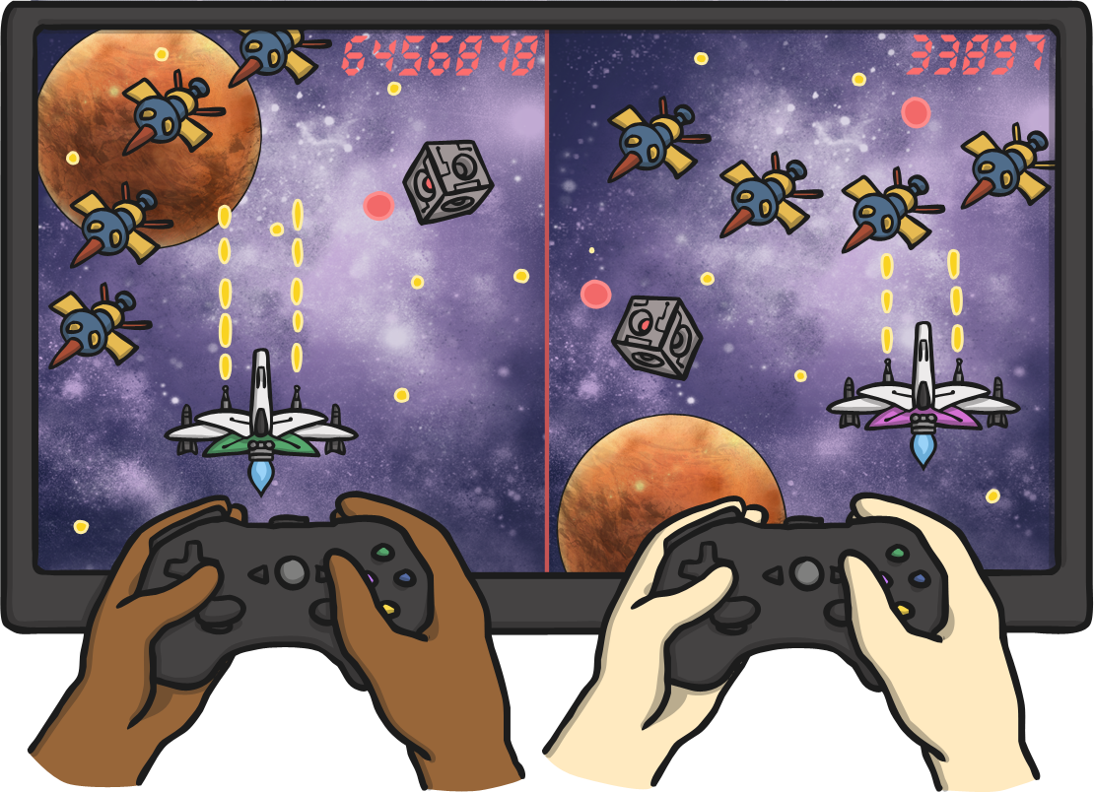
‘How to play a game’

Slide 6
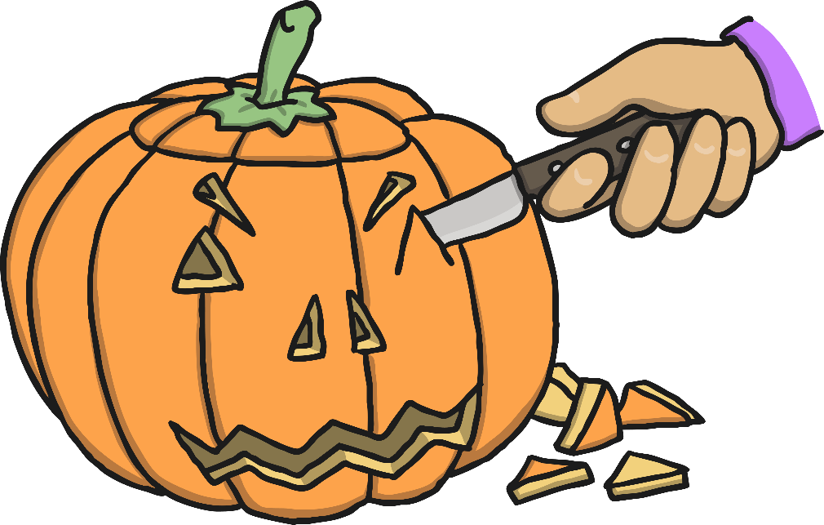
‘How to make a…’

Slide 7

Safety Procedure Posters

Slide 8
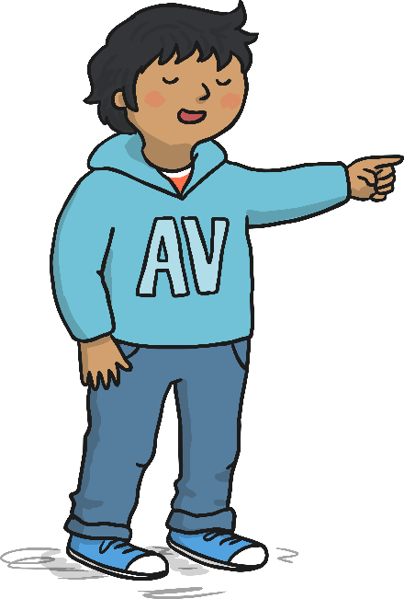

How to Write Instructions
1. Write in the present tense.
2. Use imperative verbs and adverbs to begin each step.
3. Use topic words.
4. Use time conjunctions.
5. Use clear descriptions.

Slide 9
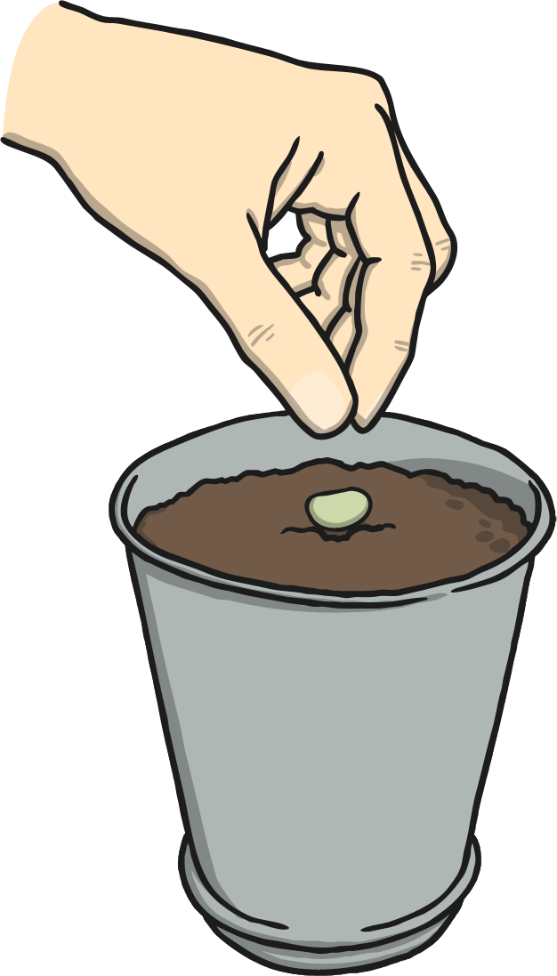
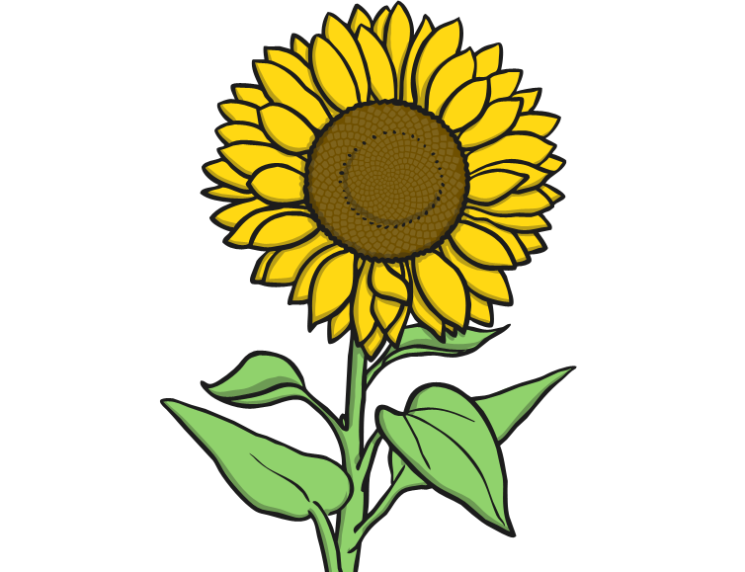
How To Plant A Sunflower Seed
What you need:
A small pot
Soil
Seeds
Watering can
Water
What you do:
First, fill the pot with soil to just below the top.
Then, add a little water to the soil.
Next, carefully put 1 or 2 seeds onto the soil.
Cover the seeds with a little more soil.
Gently pour more water onto the soil.
Top Tip:
Water the soil everyday to help your sunflower grow.
Notes:
Pictures from Create – I searched ‘planting a seed’ and ‘sunflower’

Slide 10
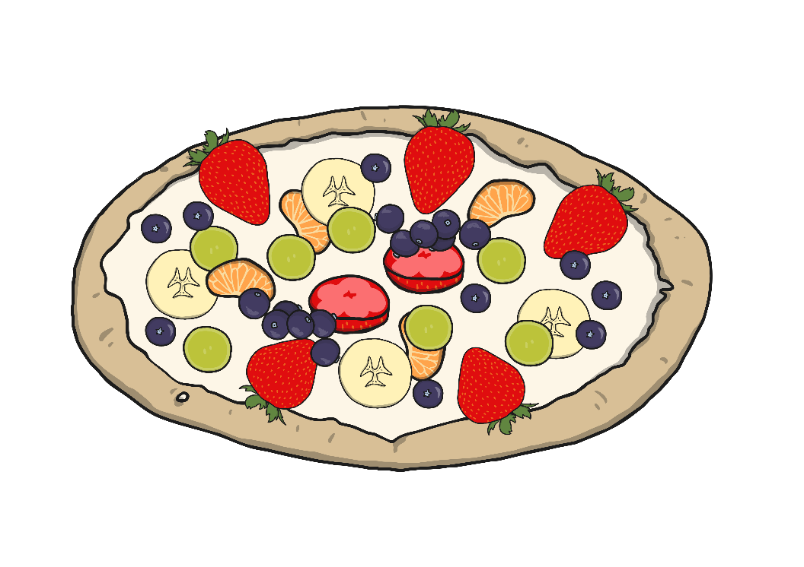
How To Make Fruit Pizzas
You will need:
Digestive biscuits
Natural yoghurt
3 – 4 different types of fruit e.g. Apple, banana, grapes, orange
Plate
Spreading knife
Sharp knife
A grown up!
What to do:
First, place your biscuits on the plate.
Then, spread the yogurt onto the biscuit.
Carefully cut up the fruit into small pieces. (Ask a grown up to help you with the sharp knife)
Finally, put the fruit on top of the yogurt.
Enjoy!
Top Tip:
Keep the fruit pizzas in the fridge once made.
Notes:
Image request has been made to change this pavlova image to have a biscuit base.

