Slide 2
Instructions
Click the object that you think
will be able to hold more inside it.
If correct, a green circle will appear.
If incorrect, a red circle will appear.

Slide 3
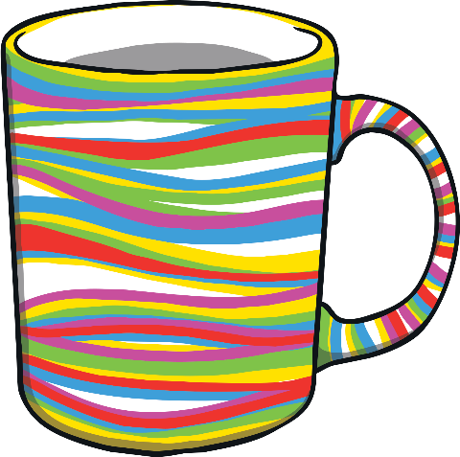
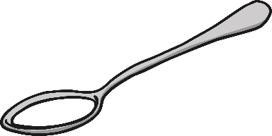
Capacity
Which holds more?
the mug
the tablespoon

Slide 4
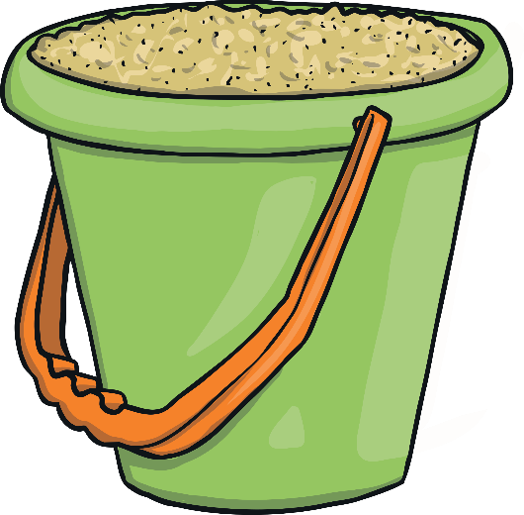
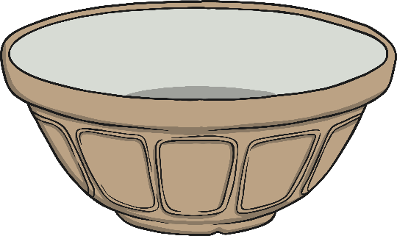
Capacity
Which holds more?
the bowl
the bucket

Slide 5
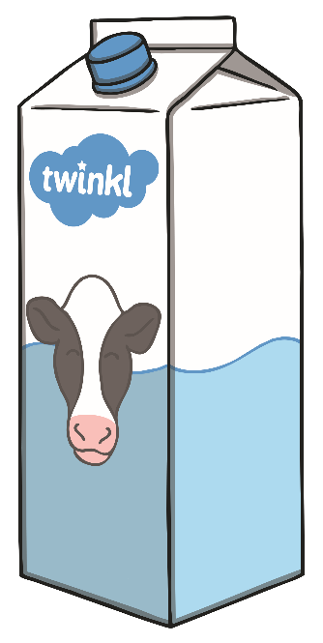
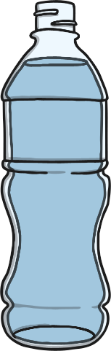
Capacity
Which holds more?
the water bottle
the milk carton

Slide 6
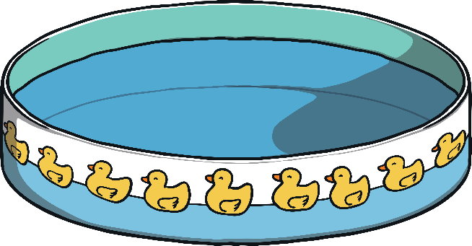
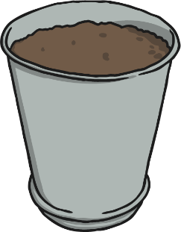
Capacity
Which holds more?
the kids pool
the plant pot

Slide 7
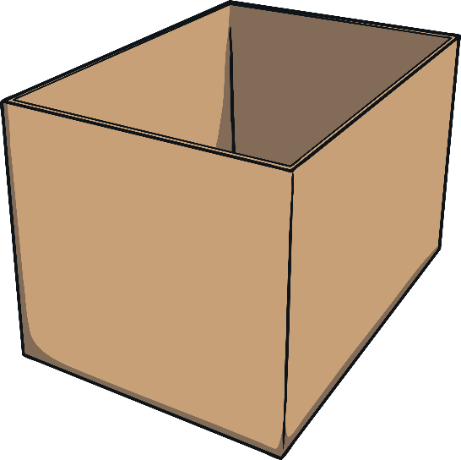
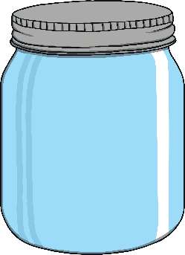
Capacity
Which holds more?
the box
the jar

Slide 8
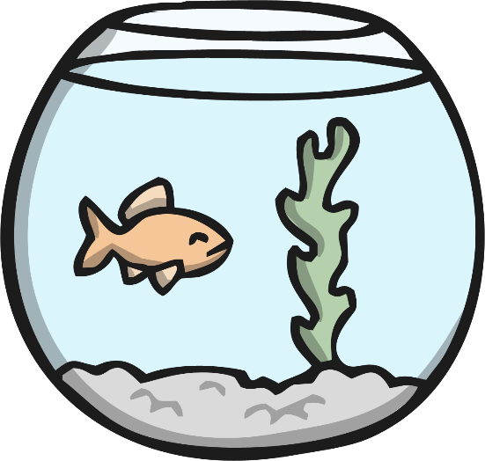
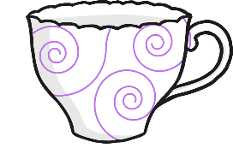
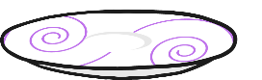
Capacity
Which holds more?
the teacup
The fish bowl

Slide 9
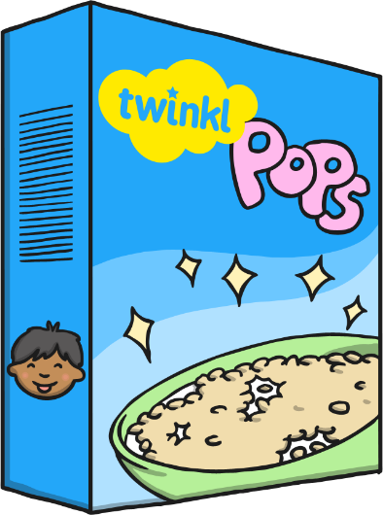
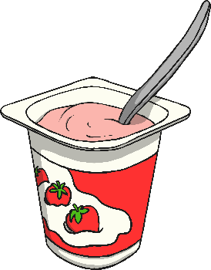
Capacity
Which holds more?
the yoghurt tub
The cereal box

