Slide 1


RE
Islam
Year One
RE | Year 3 | Islam | Who and Where? | Lesson 1

Slide 2
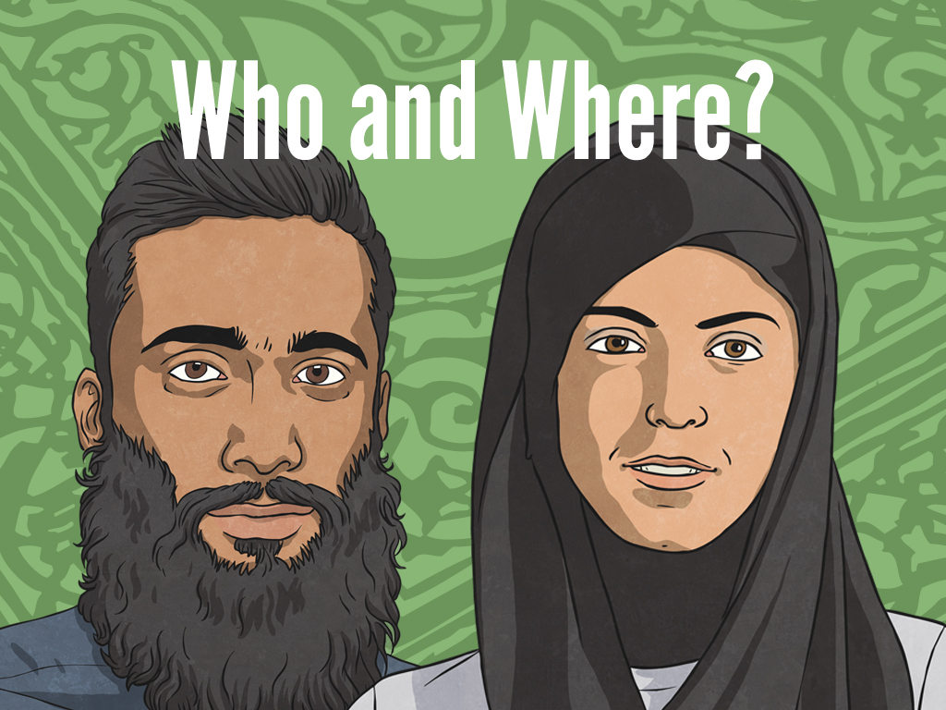


Slide 3
Aim
I can explain where Islam was founded and who founded the Muslim faith.
Success Criteria
I can create a map jigsaw to show where Islam was founded.
I can name some of the prophets sent by Allah and explain who the key prophet was.

Slide 4

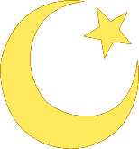
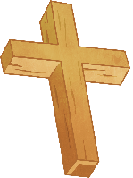


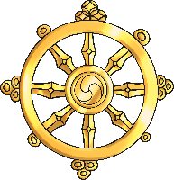
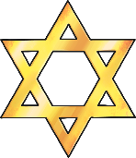
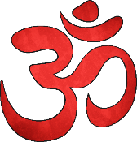
Religions of the World
Christianity
Sikhism
Islam
Humanism
Buddhism
Judaism
Hinduism

Slide 5
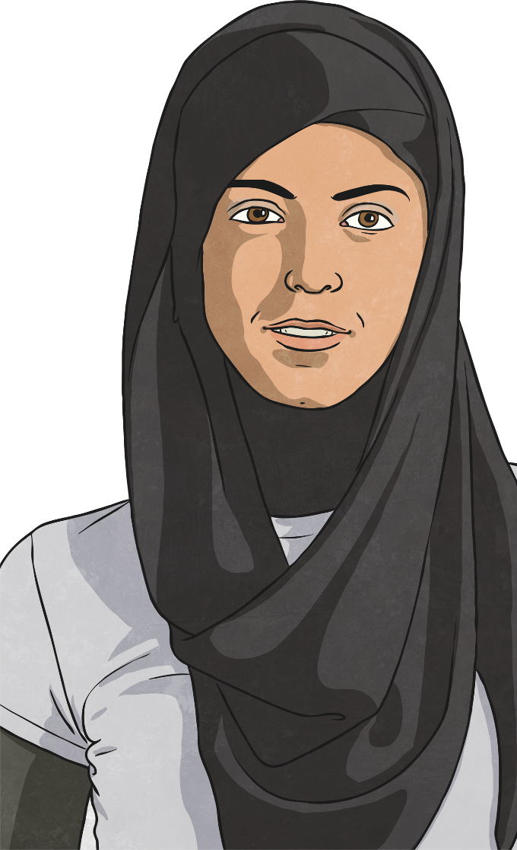
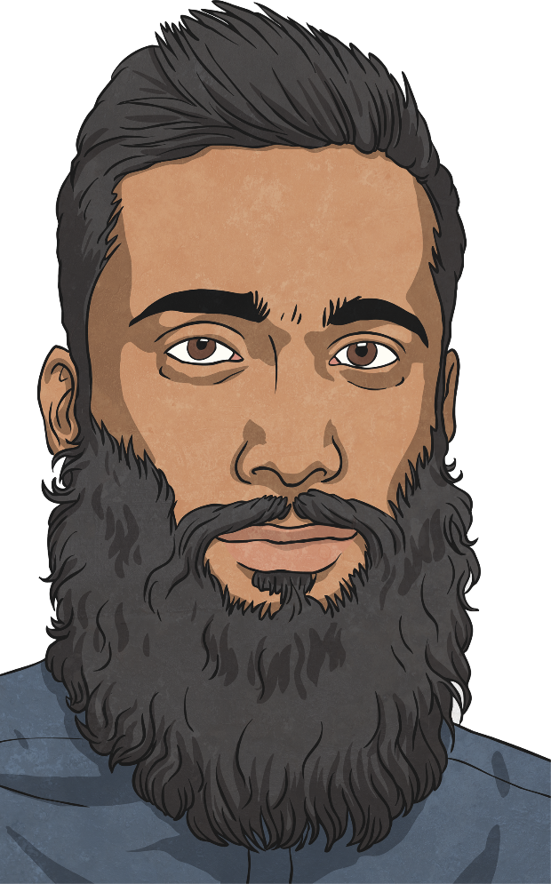
Prophets
People who follow the Islam faith are called Muslims.
Allah is the name Muslims use for their God.
Muhammad is seen as the founder of Islam.
Muhammad is so highly respected by Muslims that they will say “peace be upon him” after his name is spoken.
Before Muhammad, Allah had already sent several prophets. Prophets were special messengers sent by Allah to teach about His nature and His guidance for humans. The prophets included: Adam, Noah, Abraham (Ibrahim), Ishmael, Isaac, Jacob, Joseph, Job, Moses (Musa), Aaron, David, Solomon, Elias, Jonah, John the Baptist and Jesus (Isa).

Slide 6


Find It
Can you find the following countries on the map?
Iran, Egypt, United Kingdom, Spain, Italy, Saudi Arabia.
United Kingdom
Italy
Iran
Spain
Egypt
Saudi Arabia

Slide 7

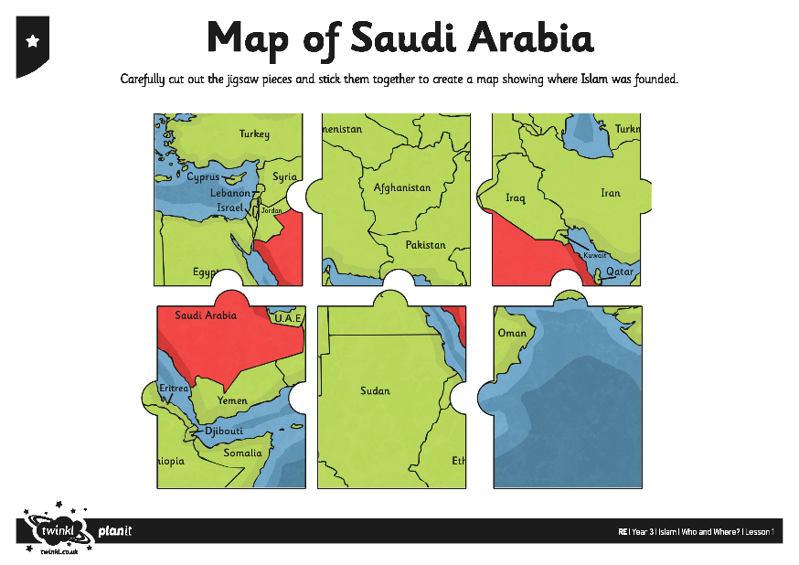
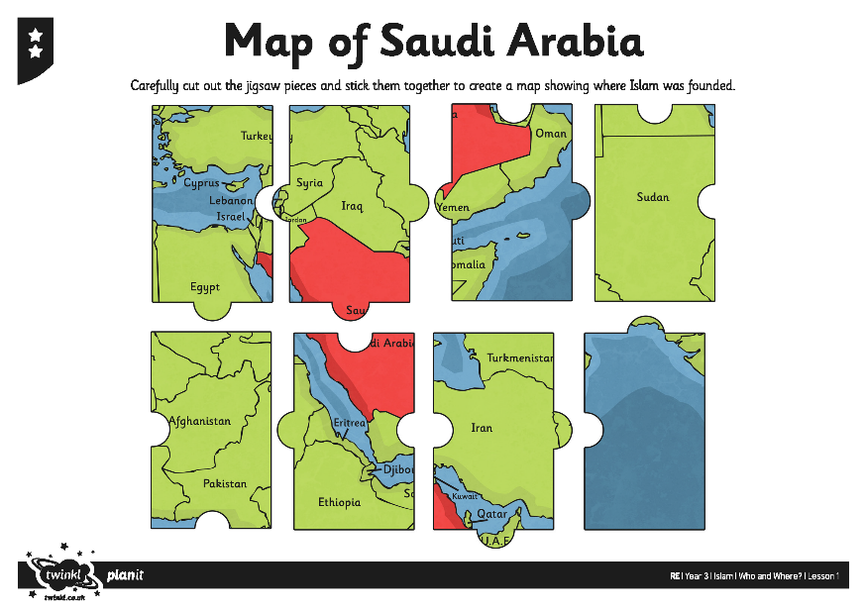
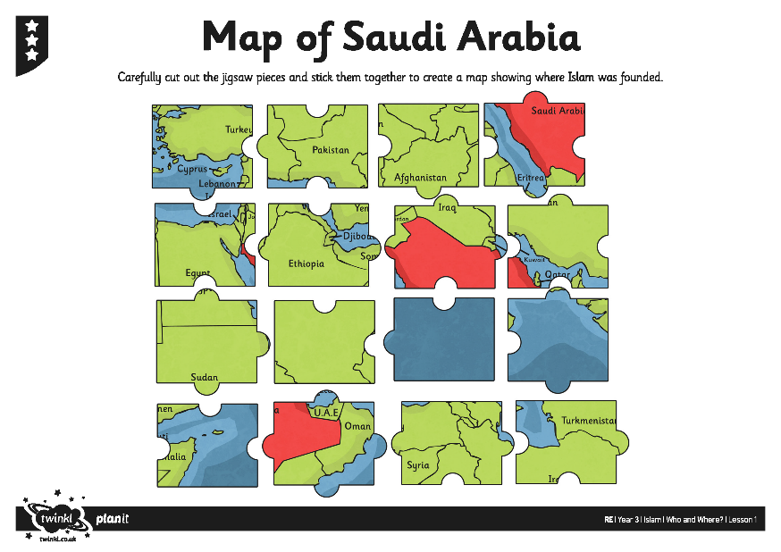
Jigsaw Time
Can you complete your own jigsaw to show where Islam was founded (Saudi Arabia)? Use your Map of Saudi Arabia Activity Sheet and Reference Map to help you make your jigsaw.

Slide 8
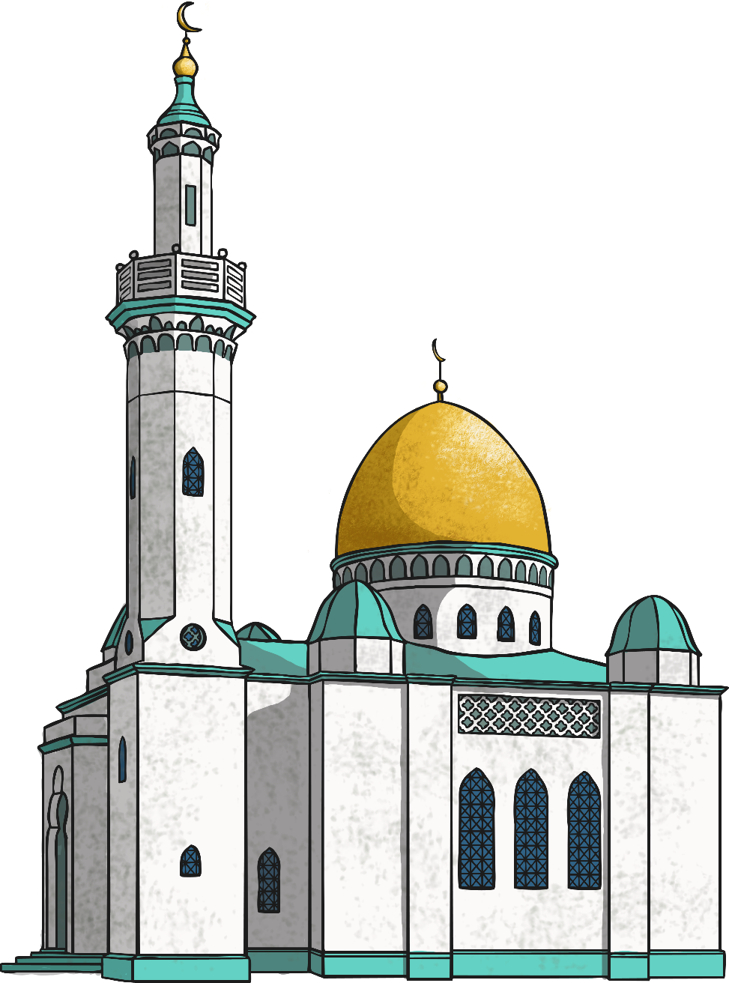
Memory Time
Can you remember the names of any of the prophets sent by Allah?
Can you think of any ways to remember the names of the prophets?

Slide 9

Aim
I can explain where Islam was founded and who founded the Muslim faith.
Success Criteria
I can create a map jigsaw to show where Islam was founded.
I can name some of the prophets sent by Allah and explain who the key prophet was.

