Slide 1

PSHE and Citizenship
Living in the Wider World | Diverse Britain
PSHE and Citizenship | KS1 | Living in the Wider World | Diverse Britain | My Community | Lesson 2

Slide 3
Aim
I can describe ways that I can be a good neighbour.
Success Criteria
I can talk about my local community.
I can identify ways that I can help my community.
I can talk about what might happen if I made unhelpful choices.
This resource is fully in line with the Learning Outcomes and Core Themes outlined in the PSHE Association’s Programme of Study.

Slide 4
The Big Questions

Slide 5

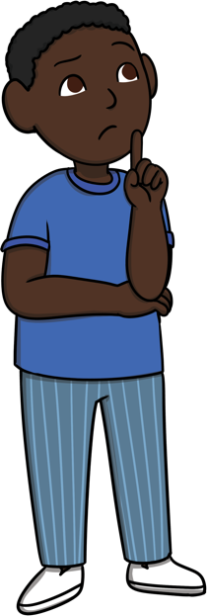
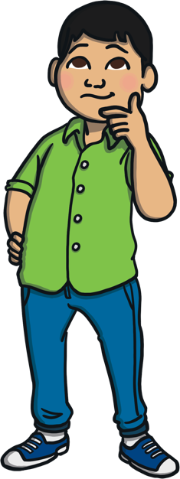
What is it like in our community?
How can we be good neighbours?

Slide 6
Reconnecting

Slide 7

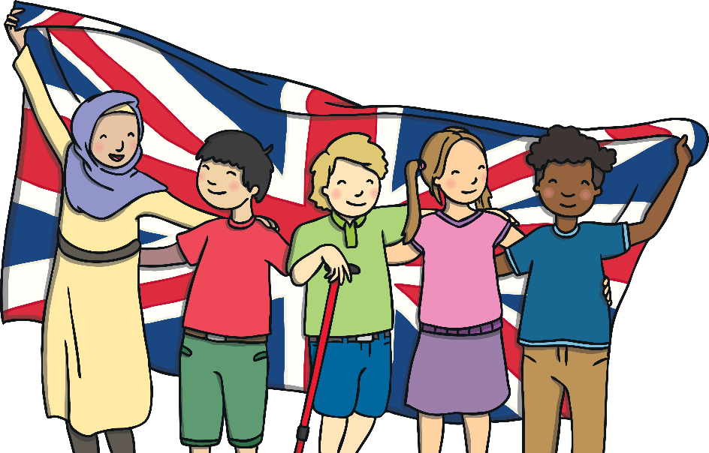
The Local Area
A community is a group of people who
live or work together in the same place,
or like to do the same kind of things.
What different places are there in your local community?
What kinds of people are there in your local community?
Where you live is called your local area. The local area and the people who live there are known as the local community.
What different roles and responsibilities do people have in your
local community?
Talk to a partner and then share your ideas with the class.
Places and People in Our Local Communities

Slide 8
Exploring

Slide 9

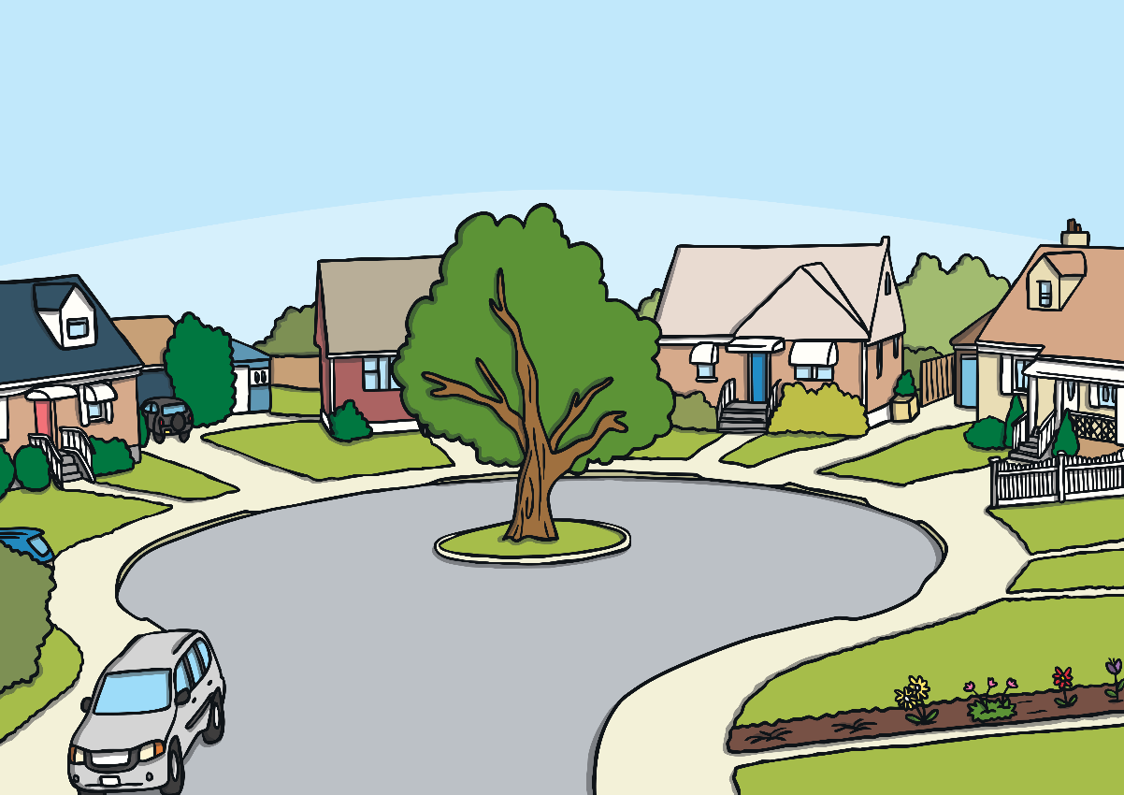
Neighbours
Our neighbours are the people who live and work in our community.
These might be the people who live in the houses near to us, the people we see when we go to the shops, the people who play in our local park, or even the people that we see at school.
Who are your neighbours?

Slide 10
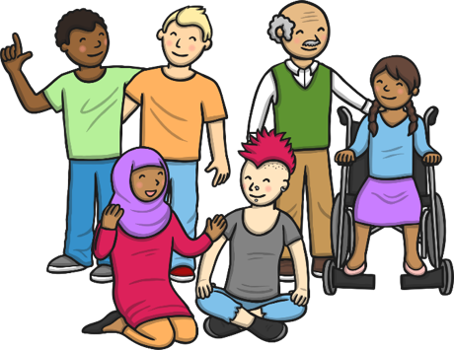
Neighbours
We can choose to be good neighbours to people who live and work in our local community.
A good neighbour is someone who thinks about what other people need to feel happy.
You can be a good neighbour by…
speaking politely
using good manners
showing respect
looking after the environment
smiling
helping people
Can you think of any other ways that you can be a good neighbour to people in your community?

Slide 11
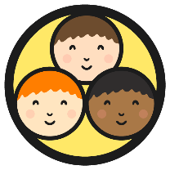
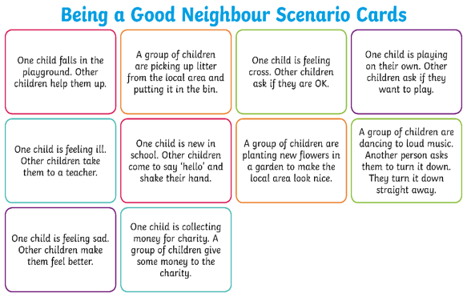
Putting It into Action
You are going to work in groups to perform a mime. A mime is acting without using any words. Your mime will be about being a good neighbour.
With your group, read the instructions on your card and then take some time to practise your mime.
Now share your mime with the class, and your classmates will guess what you are doing to be a good neighbour.
Consolidating
Reflecting

Slide 12
Consolidating

Slide 13
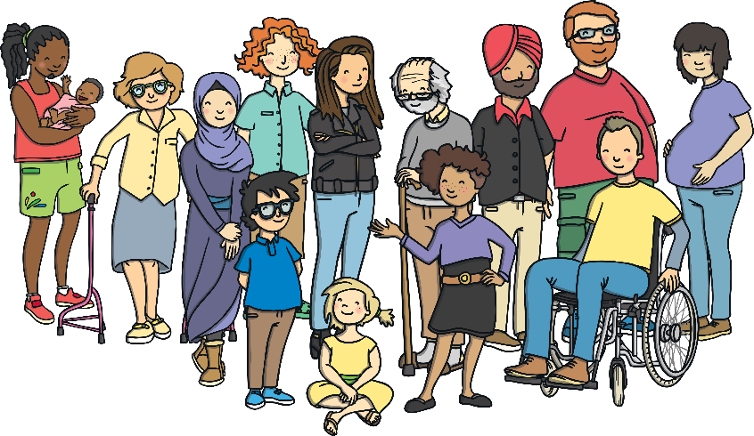
Being a Good Neighbour
We all have choices about our behaviour. We can make good choices about how we behave to our neighbours, or we could make choices that are not so good. It is up to each of us to choose.
The choices that we make have consequences. When we make good choices, there are good consequences for us and the people around us.
This means that, when we make good choices about our behaviour, we can make good things happen!
When we choose to be good neighbours, we help to make other people feel happy. This helps to make our community a happy place to live for all of us.

Slide 14

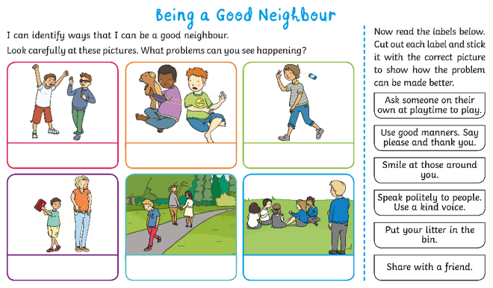


Being a Good Neighbour
You are going to complete a matching activity.
Look carefully at the pictures of a problem you might find in your school or local community.
Find a label that describes a helpful choice to make the problem better.
Key Words
Cut out the label and stick it under the picture.
community
local area
neighbour
helpful
kind
caring

Slide 15
Reflecting

Slide 16
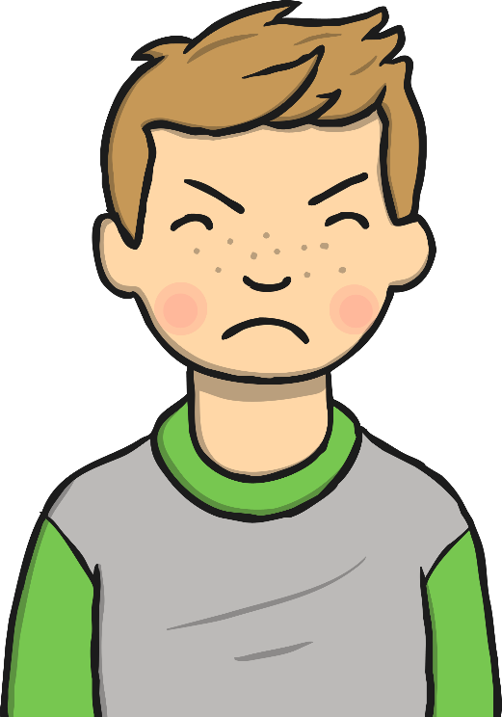
How Can We Help?
This is Hurley. Hurley is rude to his neighbours. He never stops to say ‘hello’. He sticks his tongue out when grown-ups talk to him. He throws his rubbish on the floor. Hurley doesn’t like to help.
What would our community be like if all the people in it chose to behave like Hurley?
Talk to your partner, then share your thoughts with the class.

Slide 17
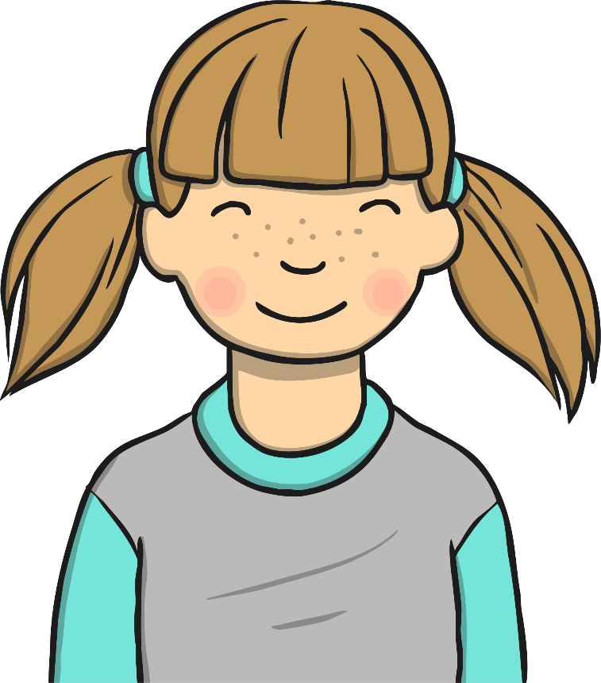
How Can We Help?
We don’t want to be like Hurley!
What can you do to be a good neighbour and help your community?
Talk to your partner, then share your thoughts with the class.

Slide 18
The Big Questions

Slide 19
What is it like in our community?
How can we be good neighbours?
What do you think is the most important thing that you have learnt today?

Slide 20
Aim
Aim
I can reflect on my learning.
I can describe ways that I can be a good neighbour.
Success Criteria
Success Criteria
I can describe something I have learnt, and something I have learnt how to do.
I can explain how I can apply my learning.
I can set a goal for the future.
I can talk about my local community.
I can identify ways that I can help my community.
I can talk about what might happen if I made unhelpful choices.

Slide 21


