Slide 1


Science
States of Matter
Year One
Science | Year 4 | States of Matter | Investigating Gases | Lesson 2

Slide 2
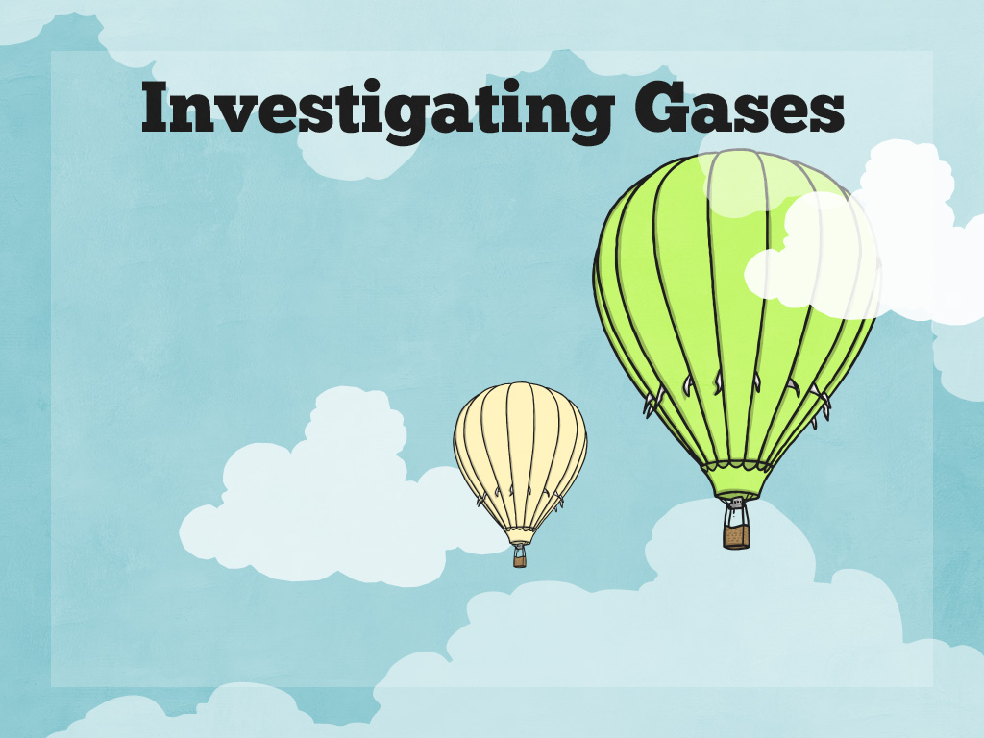


Slide 3
Aim
I can investigate gases and explain their properties.
Success Criteria
I can identify solids, liquids and gases.
I can explain some uses of gases.
I can investigate the weight of a gas.

Slide 4
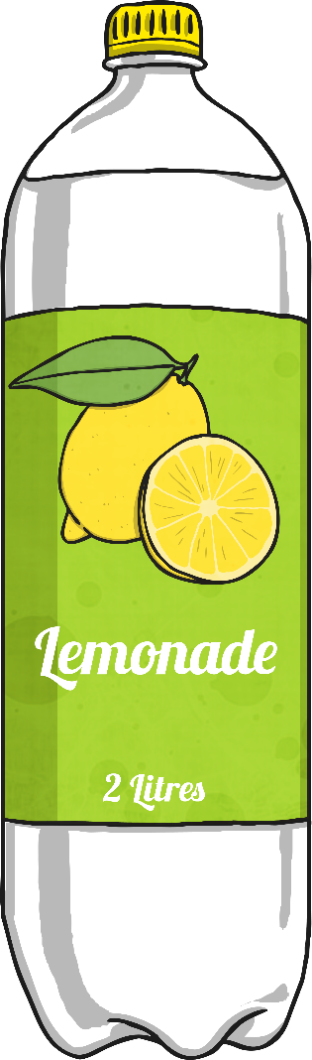
Identifying States of Matter
On your table you will see a bottle of fizzy drink.
Which states of matter can you identify in the materials that make up the bottle of fizzy drink?

Slide 5

Identifying States of Matter
Which of these materials and states of matter did you identify?
plastic lid
solid
plastic bottle
solid
bubbles
gas
paper label
solid
lemonade drink
liquid

Slide 6


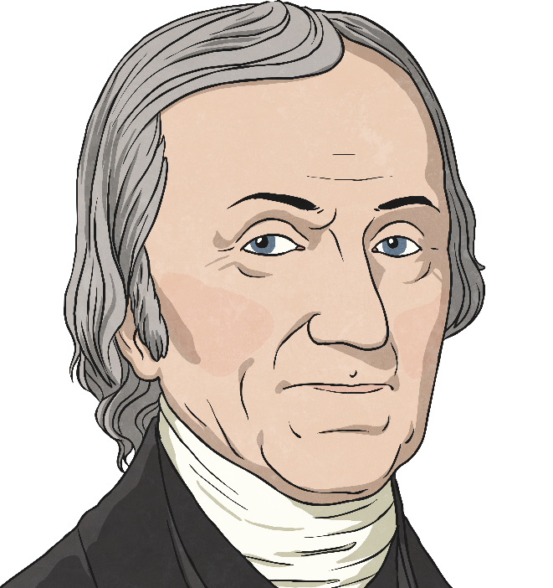
Bubbles of Gas
What are the bubbles in fizzy drinks made of?
Why are there bubbles in fizzy drinks?
How are fizzy drinks made?
Click on the bubbles by each question and read the short fact files to find the answers to these questions!
Next

Slide 7

What Are the Bubbles in Fizzy Drinks Made Of?
Bubbles in fizzy drinks are made from a gas called carbon dioxide.
Carbon dioxide is a gas that is all
around us. It makes up only about
0.04% of the Earth's atmosphere.
Back

Slide 8
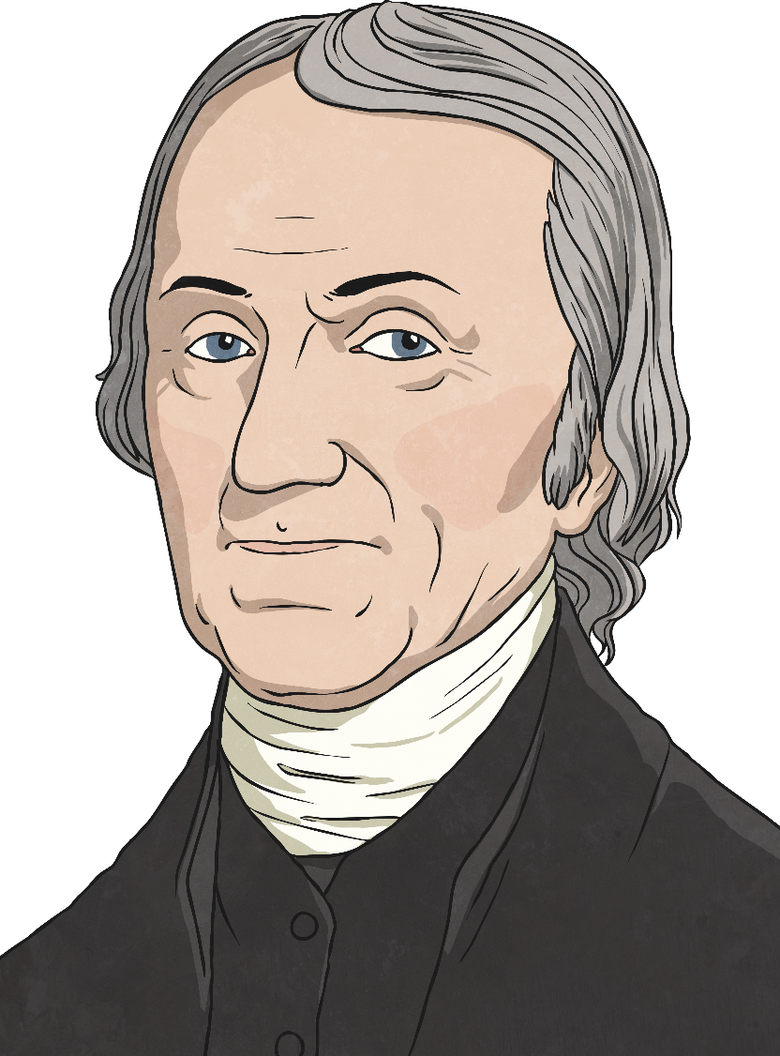
Who Invented the First
Fizzy Drink?
In 1767, a clergyman and scientist called Joseph Priestly accidentally invented the first fizzy drink. He found a way to dissolve gas in water, making the first soda water, or carbonated water.
When he drank the fizzy water, he described a “peculiar satisfaction”.
Back

Slide 9
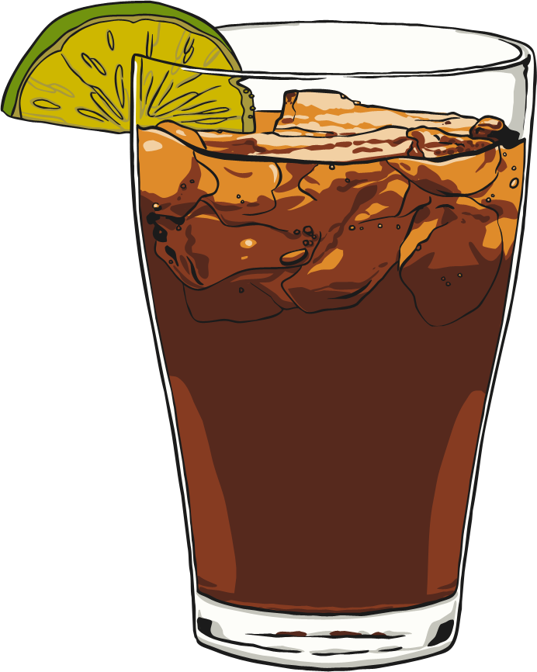
How Are Fizzy Drinks Made?
Fizzy drinks are made by adding carbon dioxide to liquid under huge pressure. The carbon dioxide dissolves in the liquid and settles in the space above the liquid in the bottle or can.
When the container is opened, the pressure decreases and the gas escapes quickly, making a hissing sound. The bubbles appear as the carbon dioxide turns into gas.
Back

Slide 10
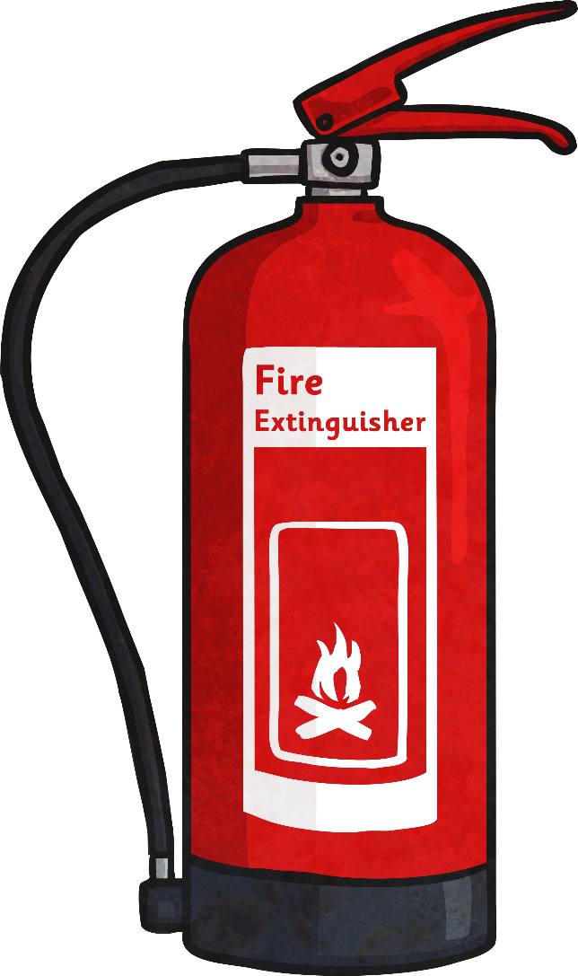
Bubbles of Gas
Carbon dioxide can be very useful.
Some fire extinguishers use carbon dioxide to cool flames and to stop oxygen getting to the fire.
Carbon dioxide freezes at -78°C, and it becomes a solid called dry ice. It is used to transport food that needs to be kept cool and fresh, such as on aeroplanes and trains.
And as you have read, carbon dioxide is dissolved in water to create fizzy drinks.

Slide 11



Do Gases Weigh Anything?
These children are talking about the weight of gas. Who do you agree with?
Gases are lighter than air, so they do not weigh anything.
Gas has no weight because it is invisible.
A gas does have weight because it is a material.

Slide 12
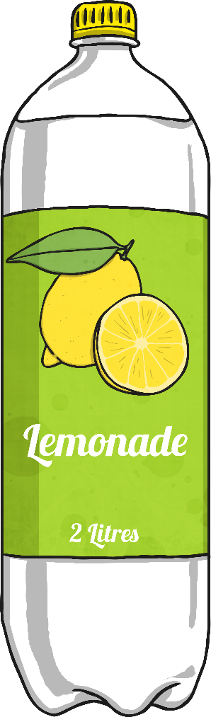
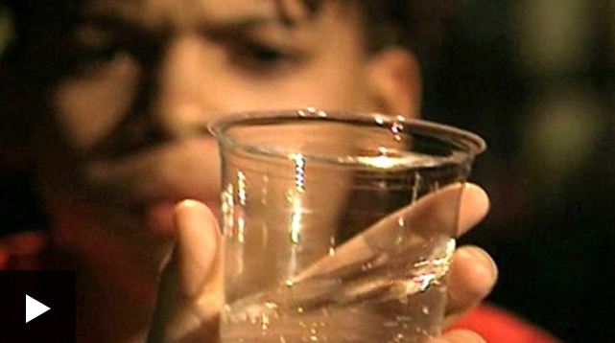
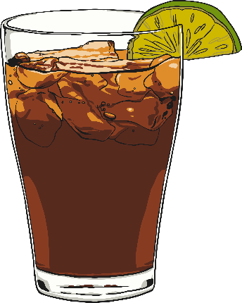
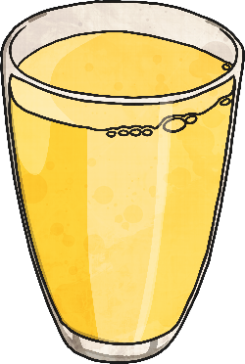

Do Gases Weigh Anything?
Watch this film to see some children thinking about this question by wondering about whether the bubbles of gas in a fizzy drink affect its weight.

Slide 13





Do Gases Weigh Anything?
This is Maya. She weighed a glass of fizzy lemonade. It weighed 173.1g. Gently, she swirled the glass around to make the liquid flat, in other words, to remove the carbon dioxide. She weighed the glass again and this time it weighed 172.6g. The drink was lighter after the gas had been removed.
This shows that the gas in the fizzy drink, carbon dioxide, does have a weight.
Do Gases Weigh Anything?
Answer: The glass of fizzy lemonade was heavier than the flat drink because it contained carbon dioxide. Some gases are lighter than air and some are heavier. Carbon dioxide is heavier than air.

Slide 14
Comparing the
Weight of Gases
What type of scientific enquiry do you think would be a good way for Maya to find out which drink is fizziest?
E.g.
observing;
noticing patterns;
grouping and classifying;
comparative and fair testing
researching from books or the internet.
Maya wants to find the fizziest drink to serve to guests at her party.

Slide 15
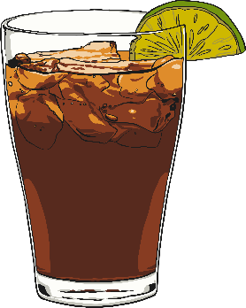
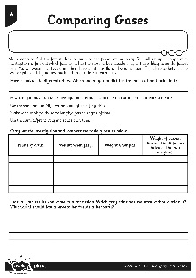
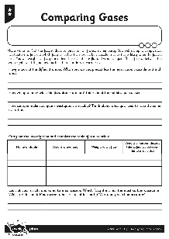
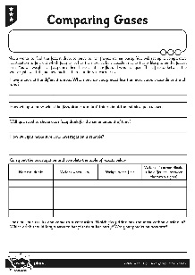
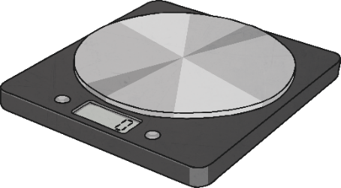
Comparing the
Weight of Gases
You will carry out a fair and comparative test.
You will weigh each fizzy drink, then shake it until it is flat and weigh it again.
The difference between the two weights will tell you how much carbon dioxide is
in each drink.
Use your Comparing Gases Activity Sheet to make your prediction, and answer the questions about your investigation.
When you have gathered your results, come to a conclusion and recommend a drink for Maya to serve at her party.

Slide 16

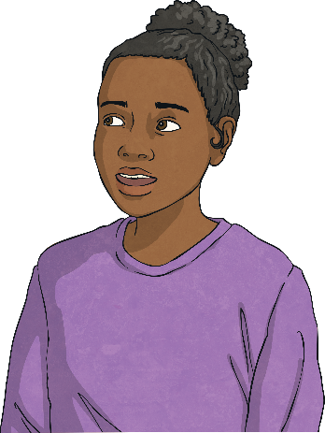

Evaluating
Can you think of any ways this investigation could be improved? Share your ideas with
your partner.
Having completed this investigation, are there any further questions you would like to test?
Discuss your ideas.

Slide 17
True or False?
Look at the statements and decide whether they are true or false.
Carbon dioxide is a gas at room temperature.
Gases keep
their shape.
Carbon dioxide
is useful.
The bubbles in
fizzy drinks are bubbles of gas.
Gases that are lighter than air weigh nothing.
You can find the weight of gases.

Slide 18
True or False?
How did you do?
True.
Carbon dioxide is a gas at room temperature.
Gases keep
their shape.
False.
Carbon dioxide
is useful.
True.
The bubbles in
fizzy drinks are bubbles of gas.
True.
Gases that are lighter than air weigh nothing.
False.
You can find the weight of gases.
True.

Slide 19

Aim
I can investigate gases and explain their properties.
Success Criteria
I can identify solids, liquids and gases.
I can explain some uses of gases.
I can investigate the weight of a gas.

