Slide 2
Alliteration
Alliteration is the stylistic device of using a series of words begin with the same consonant sound.

Slide 3
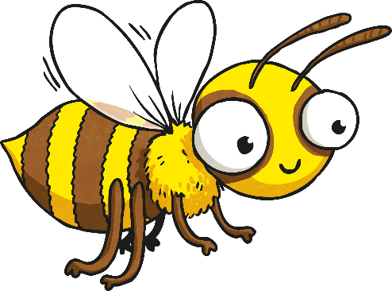
What Is It?
Characteristically, alliteration is the use of a series of words beginning with the same consonant or syllabic sound. While alliteration doesn't usually give much added depth to writing, it can add humour and expression.
Busy buzzing, the bee behaved beautifully.

Slide 4
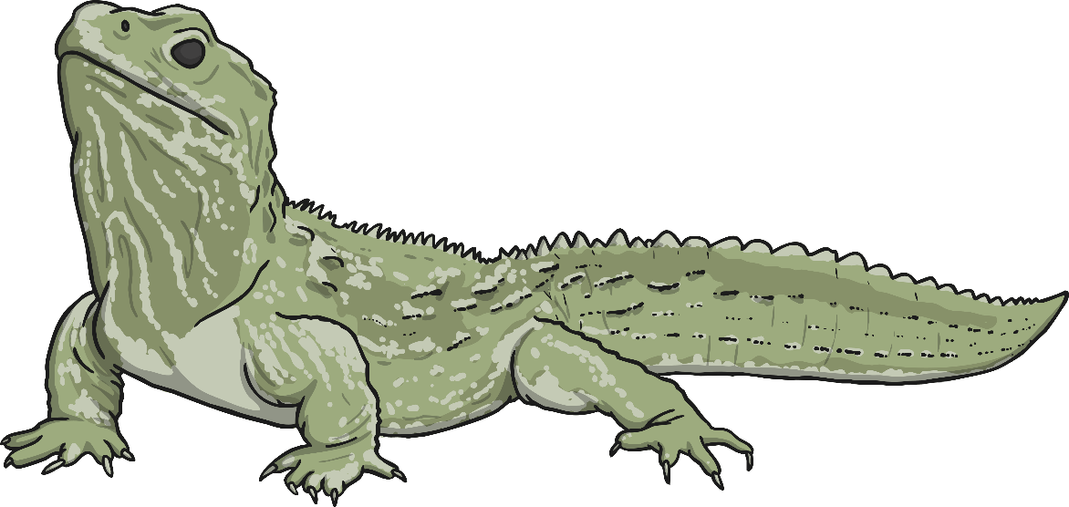
Why Use It?
As mentioned, it might not add to the depth of meaning of your writing, but it will make it sound better. Alliteration can make your words more engaging – and entertaining. And, when your writing engages your audience they are more likely to pay attention and remember what you say.
Larry’s leaping lizard.

Slide 5
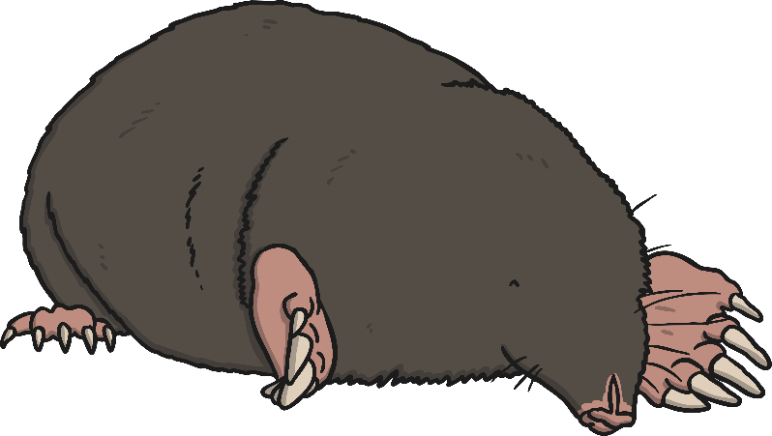
How to Use Alliteration
Alliteration is a technique that gives sentences a little more description, humour and energy. Try playing around with alliterative words and phrases to make your words come alive.
Alliteration is often found in sayings and humorous poetry, so be creative with the words and phrasing of your language.
Make a mountain out of a molehill.

Slide 6

How to Identify Alliteration
The best way to spot alliteration being used is to read out the sentence, listening for the words with the identical consonant sounds. As you read these sentences, identify the alliterative letter or sound.

Slide 7
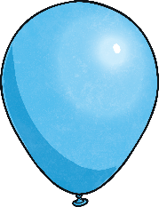
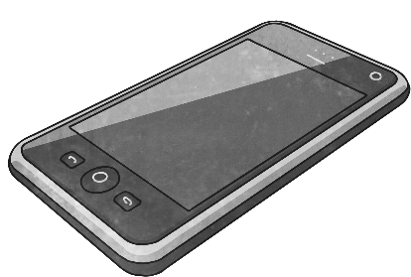
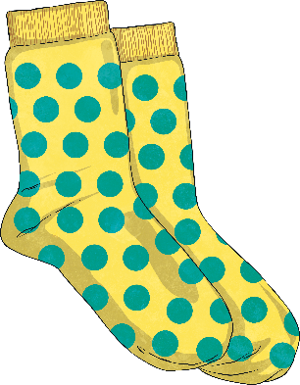
Check out the Consonant
Which letter is being repeated in the following sentences?
Betty and Bob brought back blue balloons from the big bazaar.
Four furious friends fought for the phone.
Sam's shop stocks short, spotted socks.

Slide 8
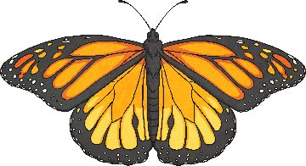
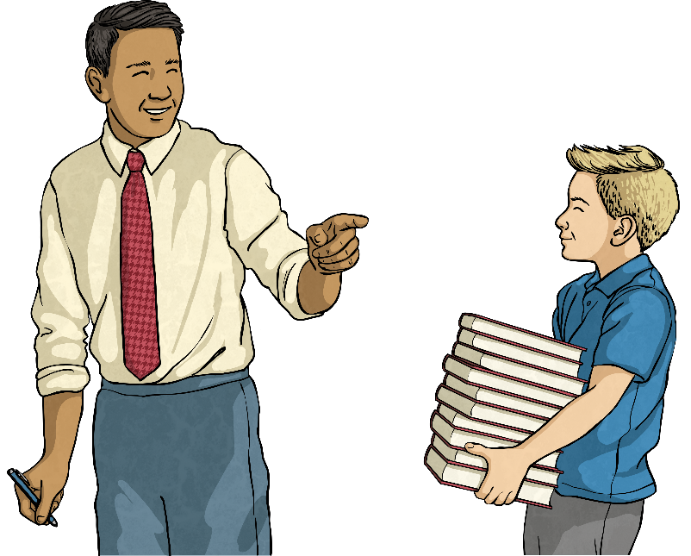
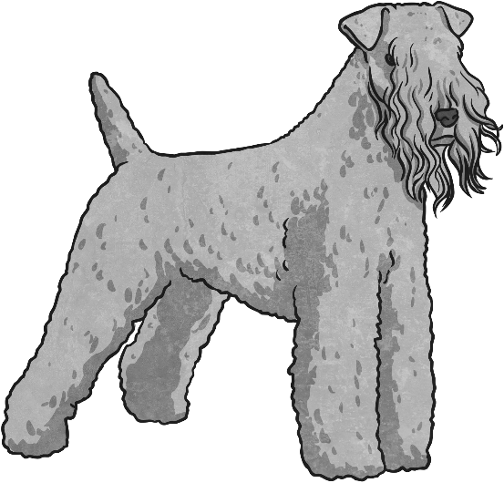
Try It Yourself
Look at the pictures and improve the sentences by using alliterative descriptions for each one.
Which sentence gives more description?
The butterfly flew past.
The butterfly brushed briefly against the beautiful bush.
Try it yourself.
The dog...
The teacher…
The pupil…

Slide 9
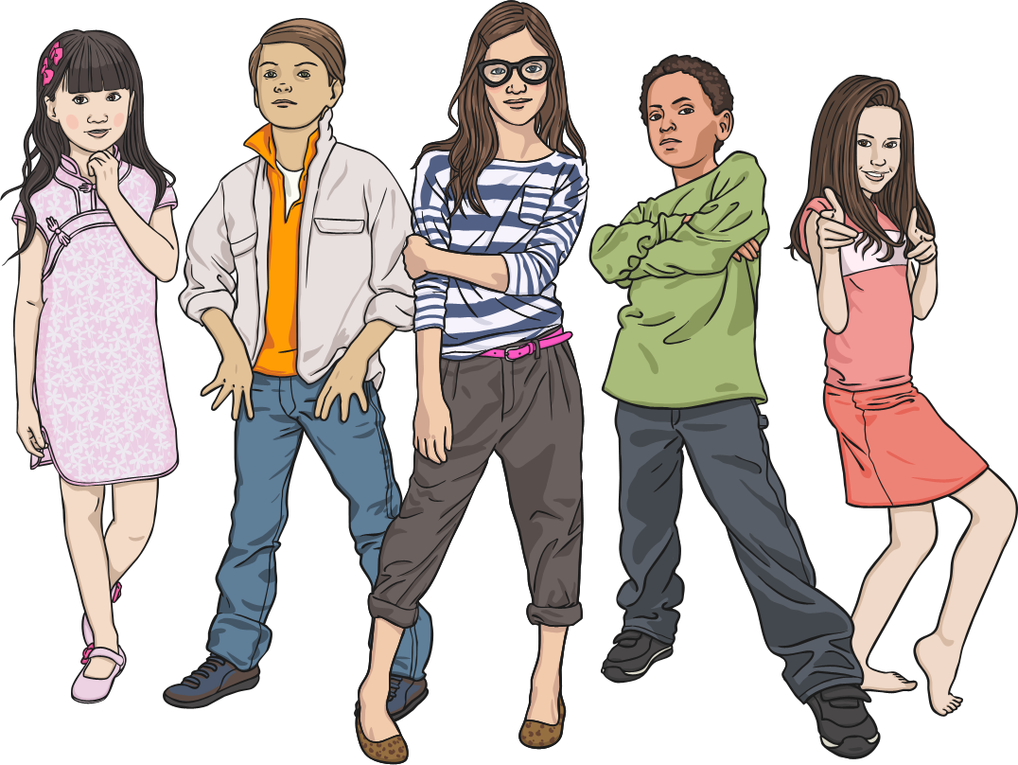
Notable Names
Cartoon characters have alliterative names because the creators want you to remember them. Does it work? How many can you name?
Can you think of an alliterative name for a friend?
Think about their personality as you try to describe them.
For example: Sam Smiley, Grace Grin, Moody Myrtle.

Slide 10

Brand Names
The most common use of alliteration is used in slogans for brand products. This is so that customers remember them easily.
Does it work? How many do you know?
Now, can you come up with your own original brand
slogan for a product?
For example:
Tessie’s tissues trap nose trickles.

Slide 11
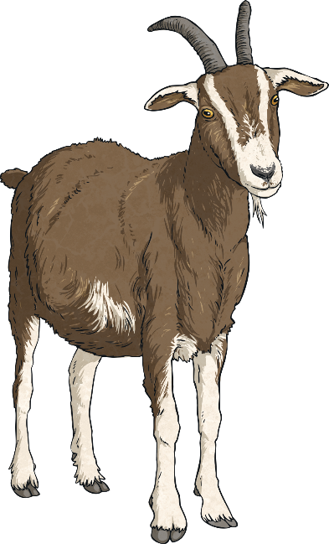
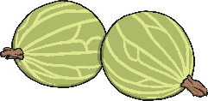
Vocabulary for Verse
In poetry, the vocabulary you choose can set the mood. Try using different alliterative words to create more detailed description of appearance, humour or character.
For example:
The glossy coat of the gentle goat glistened in the gloaming. (appearance)
The green goat gobbled gooseberries. (humour)
The grumpy goat groaned grotesquely. (character)

Slide 12
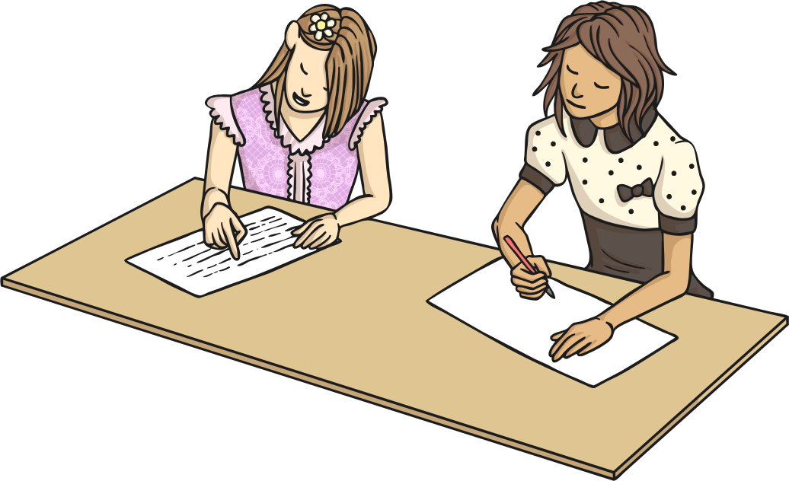
Have a Go
Find some alliterative words and phrases in poems that you know.
What effect does it have?
Does it add to the description of appearance, character or humour?
Have a go at adding alliteration to your own work to make it more interesting, memorable, humorous or descriptive.

Slide 13
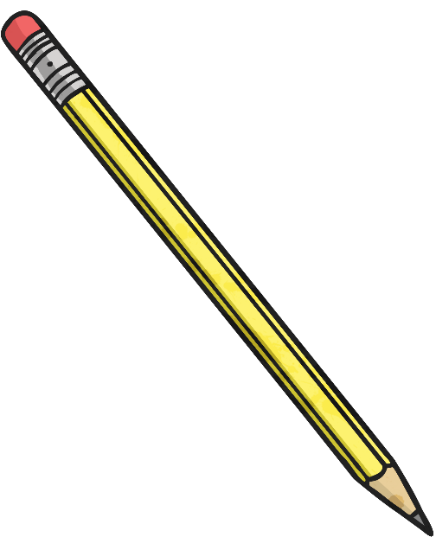
Adding Amazing Alliteration
Remember:
Not every word has to be alliterative.
You can use prepositions such as ‘the’ and 'of' and pronouns such as 'his' and ‘her’ and still maintain the alliterative effect.
Alliteration does not need to be an entire sentence.
Any two-word phrase can be alliterative.
Even some single words can be alliterative if they have multiple syllables which begin with the same consonant sound.
Is the slide heading alliteration?

