Slide 2
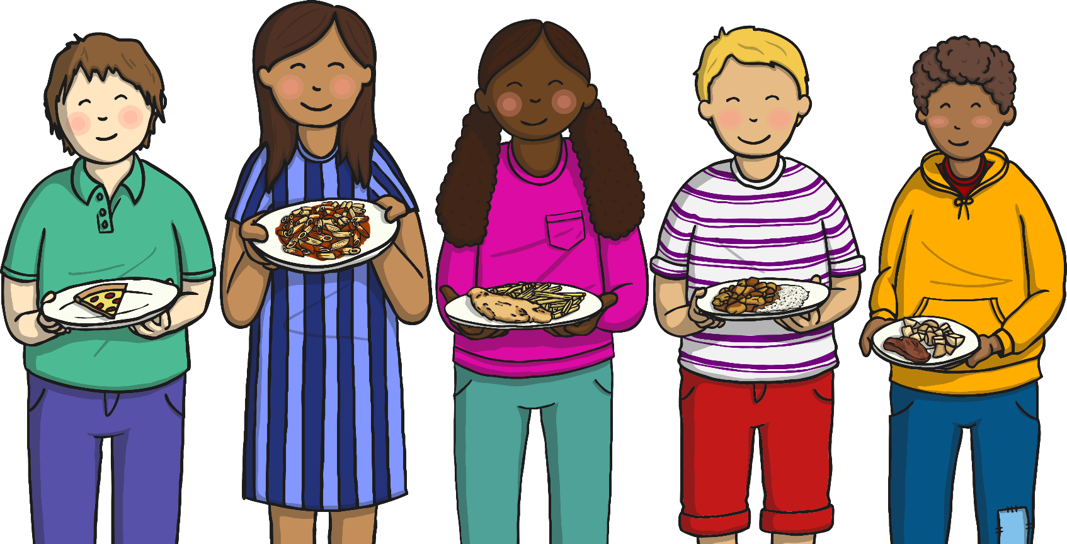
Healthy Eating Week
Healthy Eating Week is a week when people try to eat healthily.

Slide 3
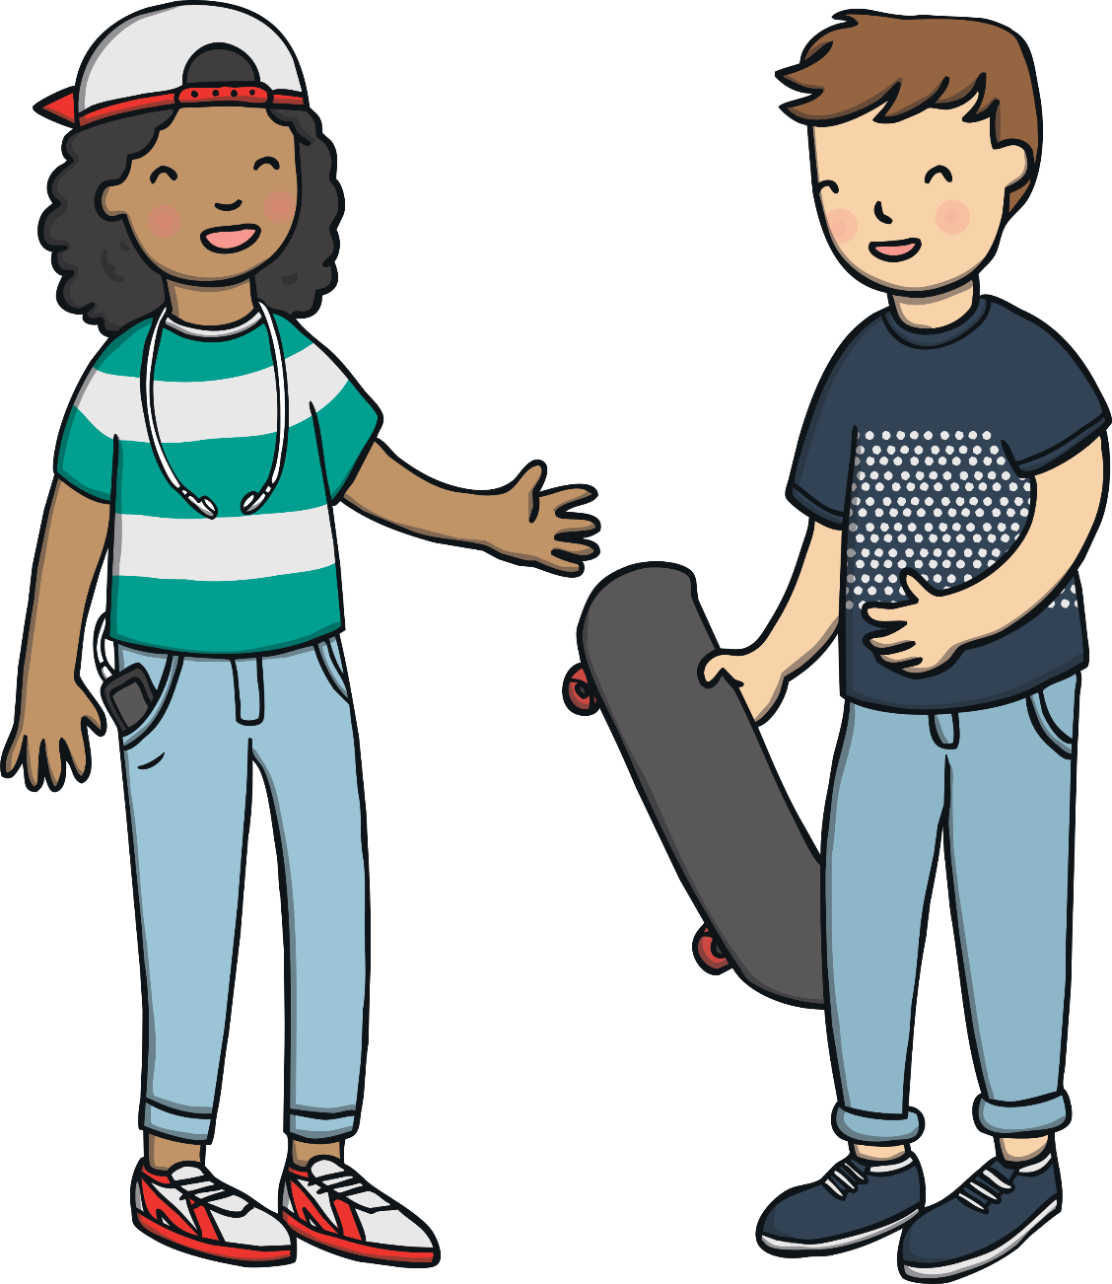
Healthy Eating
What do you know about eating healthily?
Tell your partner what you know.

Slide 4
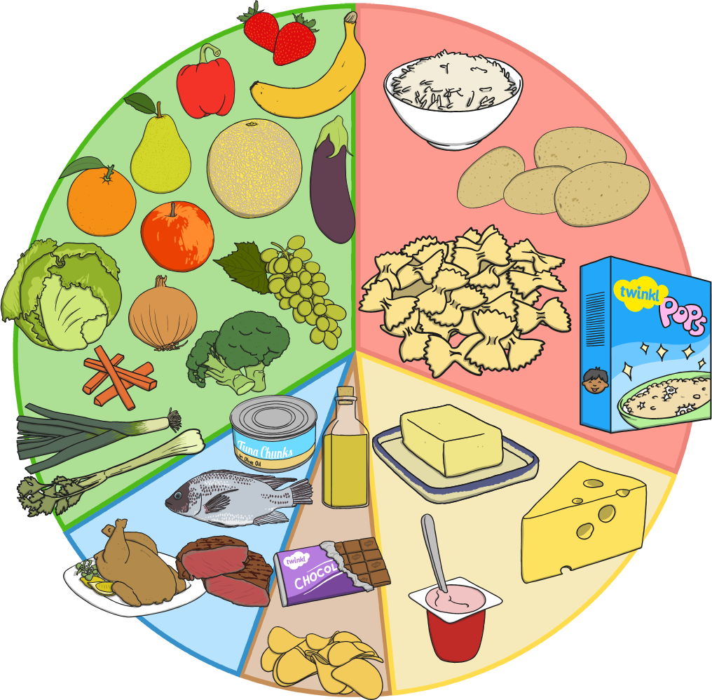
Eat Well Plate
This plate shows lots of different food.
The bigger the part of the plate, the more of those foods you should eat.

Slide 5
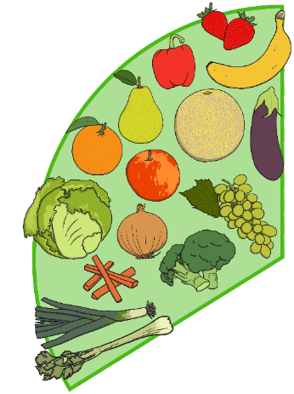





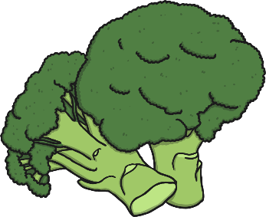
Fruit and Vegetables
Fruit and vegetables are a very important part of a healthy diet. You should aim to eat at least five portions of fruit and vegetables every day. A portion could be:

Slide 6
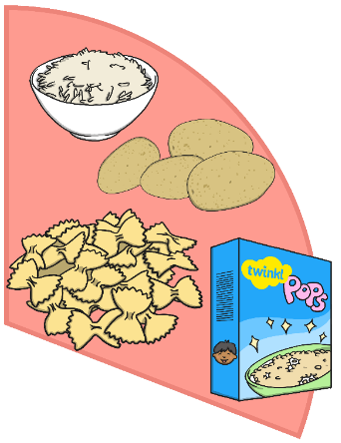


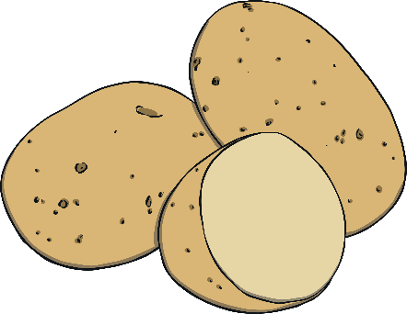

Carbohydrates
Carbohydrates give you energy.
You should eat lots of…

Slide 7
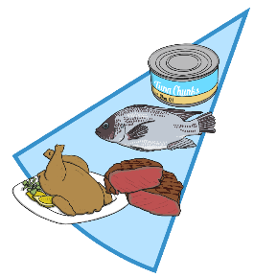
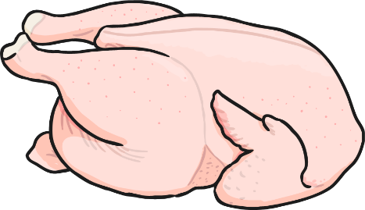



Protein
Protein helps to build and repair the muscles in your body. You should eat some protein. Foods with protein include…

Slide 8
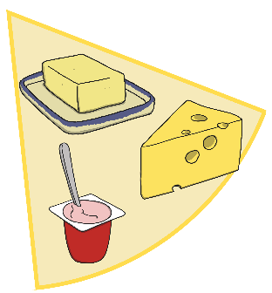
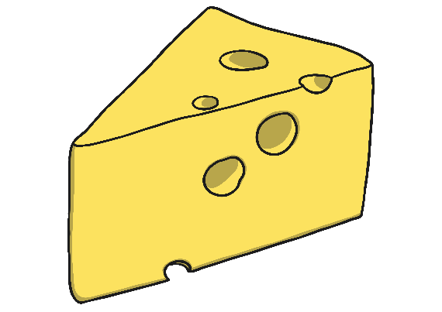

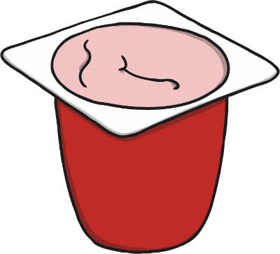

Dairy
Dairy helps to make your bones strong. You should eat or drink some dairy products. Examples include…

Slide 9



Fats and Oils
You should only eat very small amounts of fats and oils. These foods include…

Slide 10


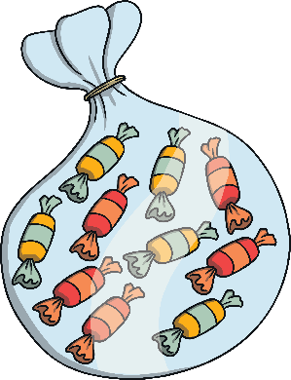

Less Healthy Food
There are some foods you should only have every so often. This is because they aren’t as healthy, and too much of them is bad for you. Examples of these foods and drinks include:

Slide 11
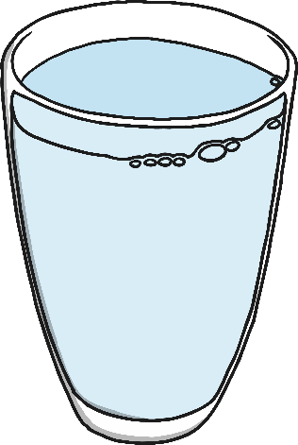
How Else Can You Have a Healthy Diet?
The healthiest thing you can drink is water. You should try to drink 5 glasses of water each day.

Slide 12

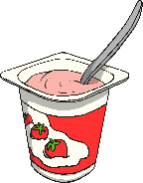

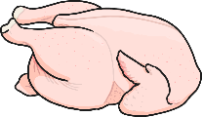
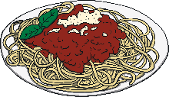
Lots, Some or a Little?
Look at these foods.
For each one, say ‘lots’, ‘little’ or ‘some’ to show how often you should eat it.
Grapes
Lots
Yoghurt
Some
Butter
Little
Chicken
Some
Spaghetti
Lots

