Slide 1
Properties of 3D Shapes
An introduction

Slide 2
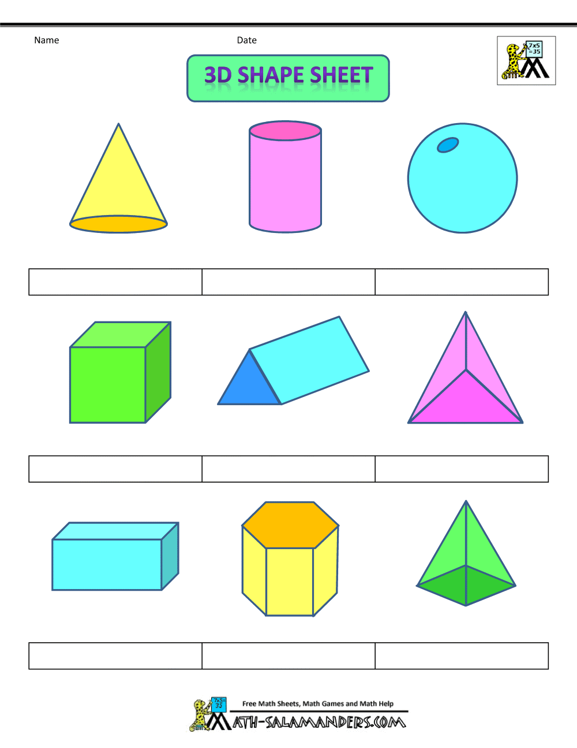
Faces, Vertices and Edges
Vertices
3D shapes can be described in 3 ways:
Faces – the sides of the shape
Vertices – the corners
Edges – where the faces meet
Faces
Edges

Slide 3
Cone
Faces – 2
Edges – 1
Vertices - 1
www.links2learn.co.uk

Slide 4
Cylinder
Faces – 3
Edges – 2
Vertices - 0
www.links2learn.co.uk

Slide 5
Sphere
Faces – 1
Edges – 1
Vertices - 0
www.links2learn.co.uk

Slide 6
Square Based Pyramid
Faces – 5
Edges – 8
Vertices - 5
www.links2learn.co.uk

Slide 7
Cube
Faces – 6
Edges – 12
Vertices - 8
www.links2learn.co.uk

Slide 8
Triangular Prism
Faces – 5
Edges – 9
Vertices - 6
www.links2learn.co.uk

Slide 9
Tetrahedron/
Triangular based pyramid
Faces – 4
Edges – 6
Vertices - 4
www.links2learn.co.uk

Slide 10
Cuboid
Faces – 6
Edges – 12
Vertices - 8
www.links2learn.co.uk

