Slide 2
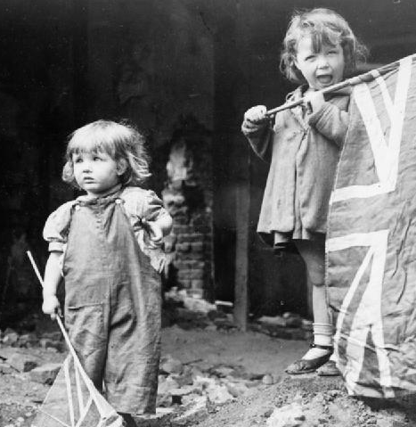
Victory in Europe
Victory in Europe Day/VE Day took place on May 8th 1945. It was a public holiday and day of celebration to mark the Germany’s surrender to the Allied forces in Second World War.
VE Day marked the formal conclusion of the war in Europe and brought to an end six years of suffering, courage and endurance for those countries.
The war in Europe was over, but fighting continued in other countries until 2nd September 1945, when Japan surrendered.
Did You Know?
Discuss It!
How do you think it felt when the war finally ended?

Slide 3
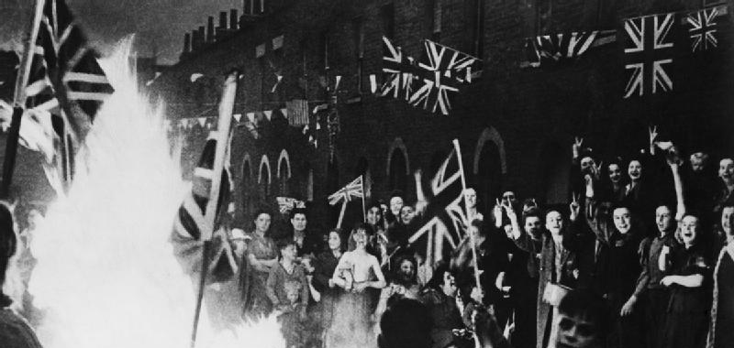
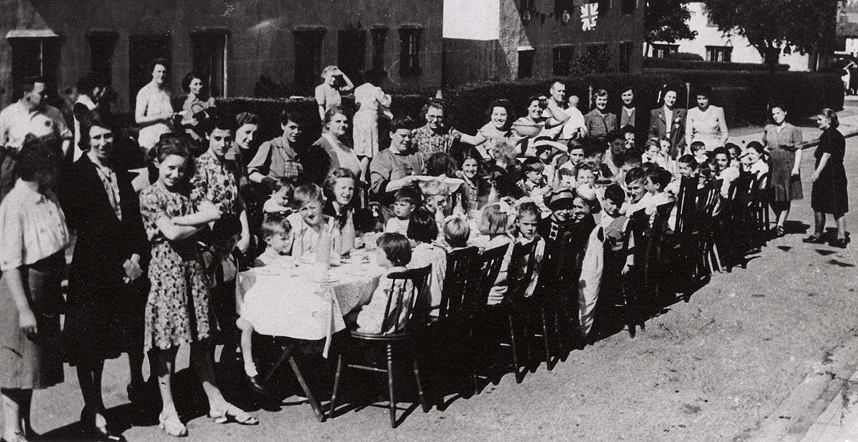
Time to Celebrate
People ran out on to the streets, hanging bunting and banners and dancing.
Church bells pealed across the country to share the news: peace in Europe!
Everyone brought out food to share at street parties.
Tuesday May 8th was to be a national day of celebration: Victory in Europe Day.

Slide 4


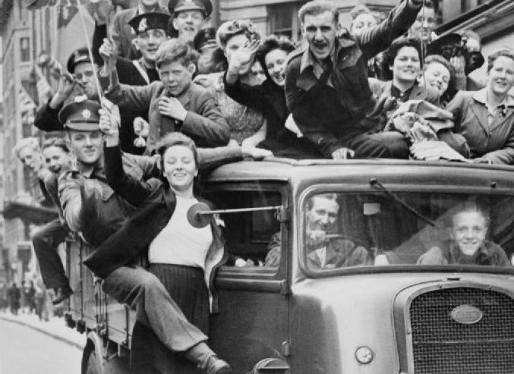
Time to Celebrate
The capital city, London, was the place to be on VE Day.
Anyone who could reach the city did so.
The centre of London was full of people wearing red, white and blue, waving flags, dancing and singing.
Fireworks filled the sky with flashes of light.
Try this!
Write a postcard to a missing family member telling them about your VE day celebrations. Draw a picture on the other side to show what you did and what you saw.

Slide 5
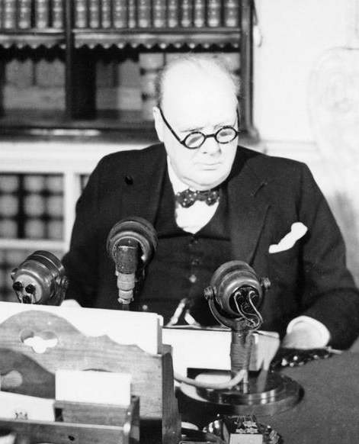
“The German war is therefore at an end.”
On VE Day, everyone, both in London and at home sitting by their wireless sets, wanted to hear just one man: Winston Churchill.
At 3pm the Prime Minister broadcast to the nation: the war was over for the British people.

Slide 6
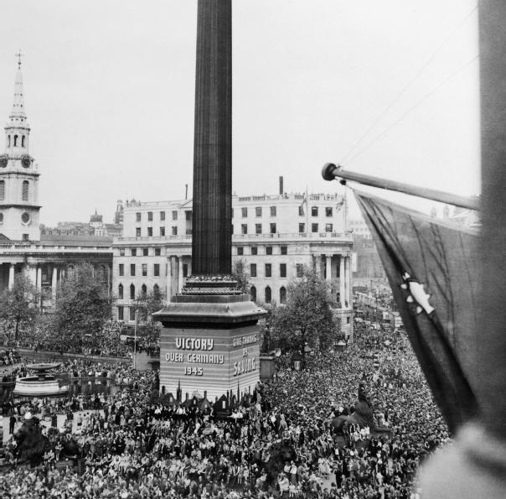
“The German war is therefore at an end.”
Crowds gathered in Trafalgar Square and up The Mall.
They were waiting for Winston Churchill and King George VI to make an appearance on the balcony of Buckingham Palace.
Try this!
Make your own radio broadcast to announce Victory in Europe. You could even pretend to be Winston Churchill!

Slide 7
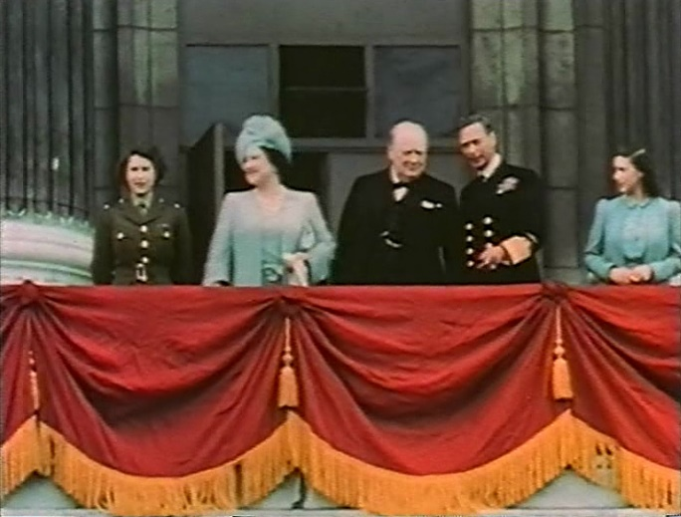
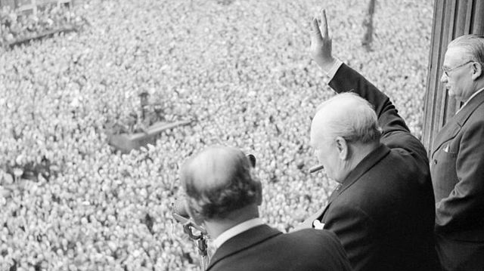
“This is your victory!”
Shortly after Churchill's speech, King George VI, Queen Elizabeth and the two princesses came out onto the balcony at Buckingham Palace.
Churchill told the crowds: “This is your victory!”
It was to be the first of eight appearances by the King and Queen on VE Day.
Try this!
Make your own radio broadcast to announce Victory in Europe. You could even pretend to be Winston Churchill!

Slide 8

On what date was Victory in Europe Day?
May 7th 1945
May 7th 1945
May 8th 2015
May 8th 2015
May 8th 2005
May 8th 1945
May 8th 2005
May 8th 1945

Slide 9
Why did people wear
red, white and blue?
They are the colours of the German flag.
That was all they could find.
They are the colours of the German flag.
That was all they could find.
They are the colours of the Union flag.
They looked pretty.
They are the colours of the Union flag.
They looked pretty.

Slide 10
Who mingled secretly with the crowds on VE Day?
Princess Elizabeth and Princess Margaret
Winston Churchill
Princess Elizabeth and Princess Margaret
Winston Churchill
Neville Chamberlain
King George VI
Neville Chamberlain
King George VI

Slide 11
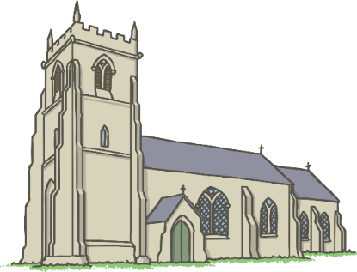
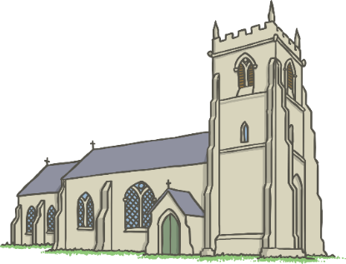
Why did people ring church bells?
For practice.
For practice.
To spread the news and celebrate.
To spread the news and celebrate.
To tell the time.
Because they are tuneful.
To tell the time.
Because they are tuneful.

