Slide 2
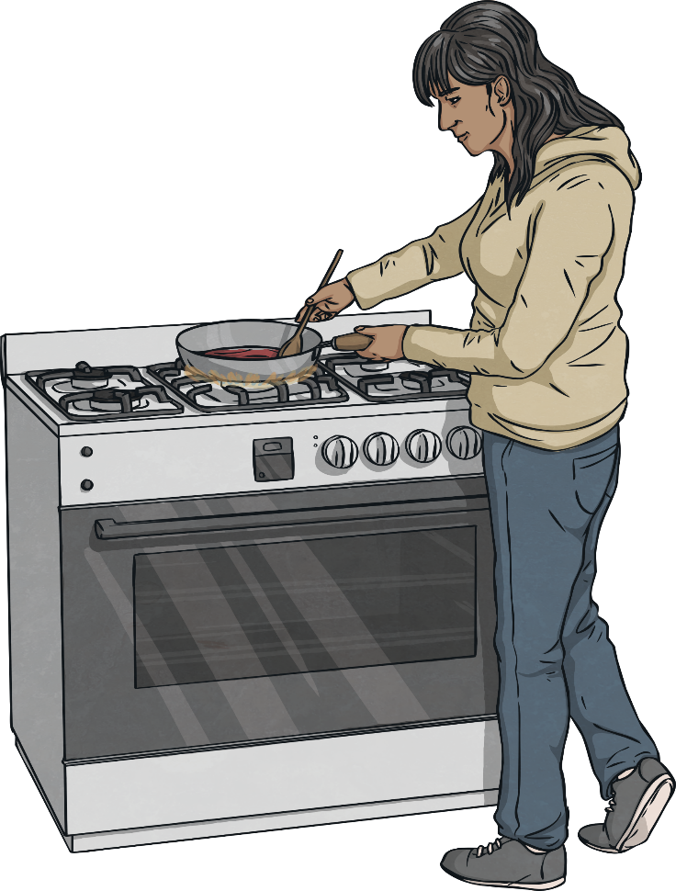
Proper Food Hygiene
It is really important that we develop proper food hygiene practices when preparing food to eat.
Poor food hygiene can result in illness, known as food poisoning.
There are some simple steps that everyone can take to ensure the food we prepare is safe for consumption.

Slide 3
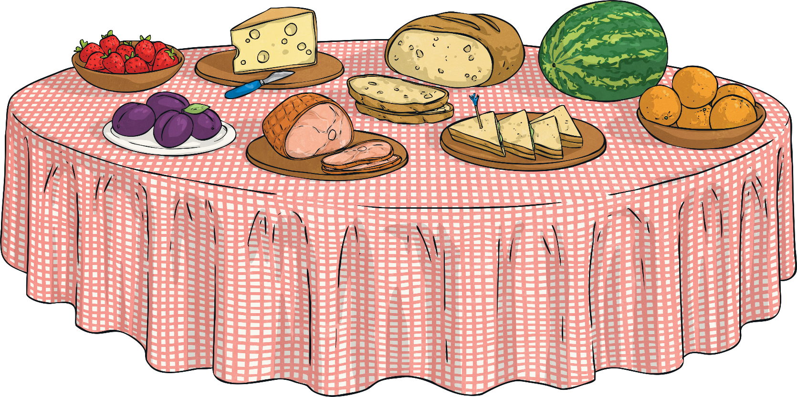
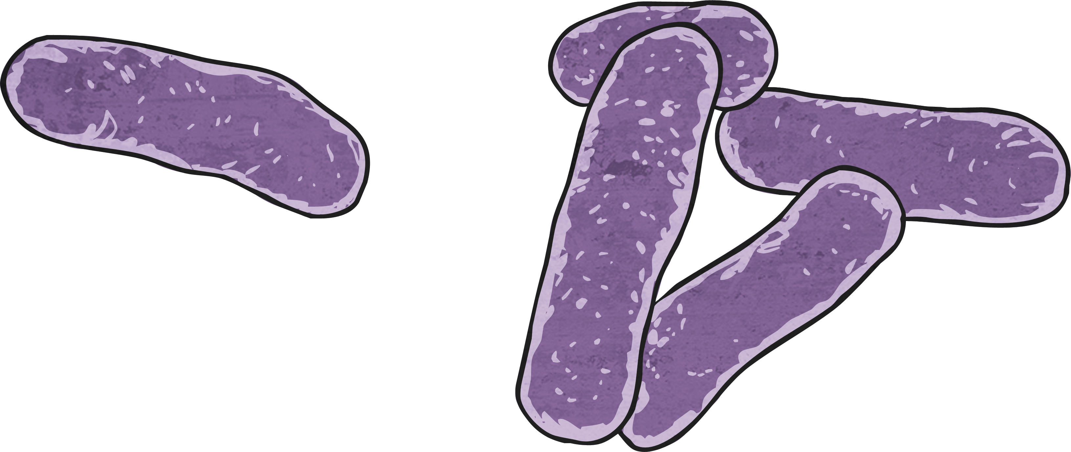
Cross-Contamination
Cross-contamination is the term used to describe harmful bacteria, or germs, passing from one food or surface to another.
Cross-contamination is one cause of food poisoning.

Slide 4
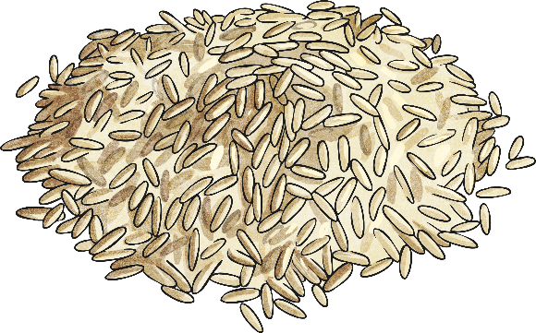
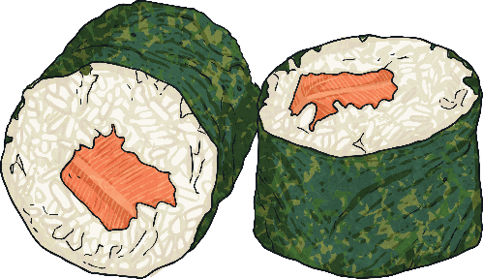
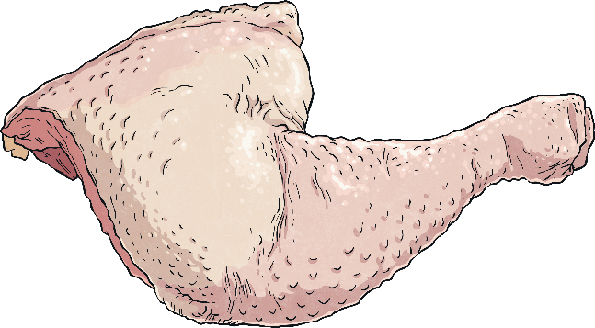
Contamination
Contamination occurs when contaminated food or surfaces come into contact with non-contaminated food and cause the bacteria to spread.
Raw food, undercooked food and unclean hands/food can cause the spread of bacteria.
Cooked rice, soft cheese, raw meat, poultry and seafood are some of the foods that pose the greatest risk of cross-contamination if not handled correctly.

Slide 5
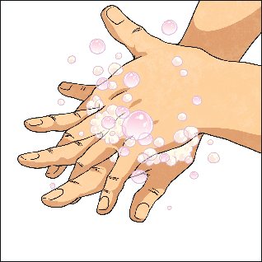
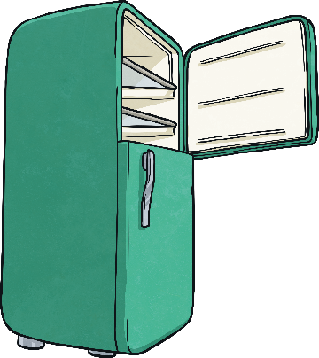
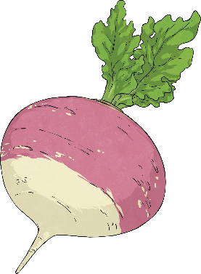
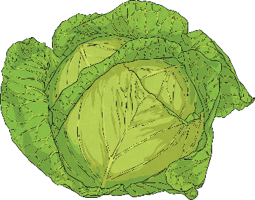
Prevention
To prevent contamination, always wash your hands thoroughly with soap and warm water before handling food and again after handling raw meat.
Keep raw and cooked meat apart. Store raw meat at the bottom of the fridge and make sure it is stored properly so the juices don’t leak onto other foods or surfaces.
Wash fruit and vegetables to ensure they are clean before consuming them.

Slide 6
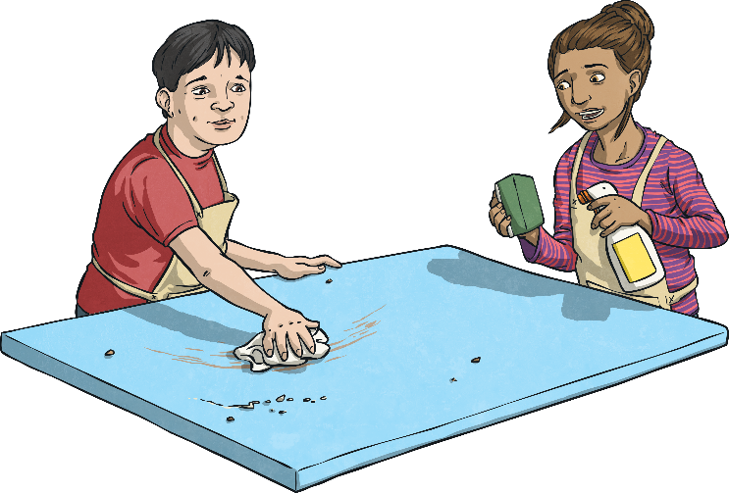
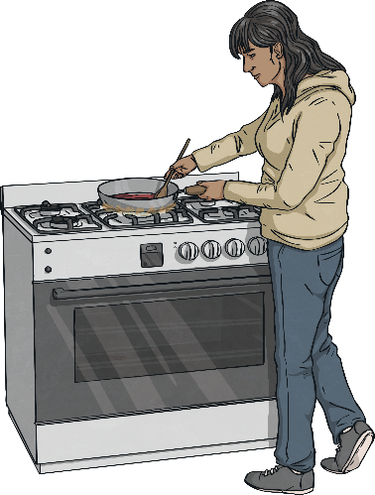
Prevention
Clean all surfaces, utensils, chopping boards and cutlery with hot soapy water.
Use separate utensils and surfaces for raw and cooked meat and clean them thoroughly.
Keep an eye on expiration dates and follow the food storage and cooking guidelines. The packaging will tell you how to store and cook the food properly.
It is vital that food is cooked thoroughly before it is consumed – the heat kills any germs that could be present.

Slide 7
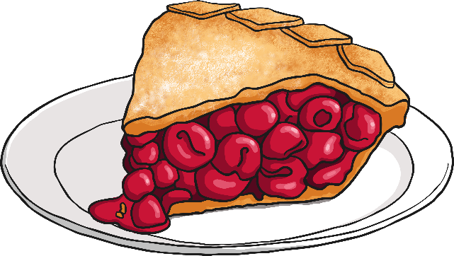
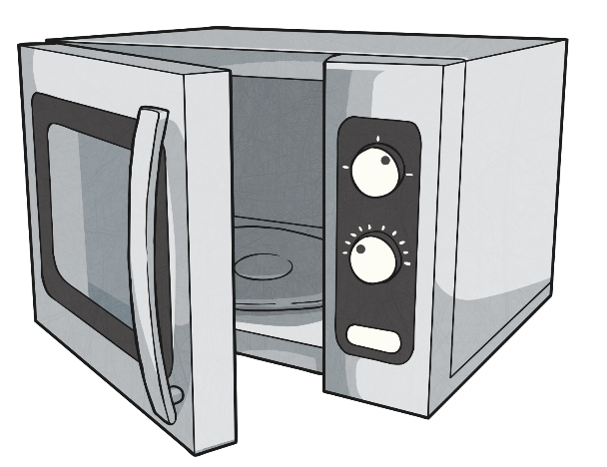
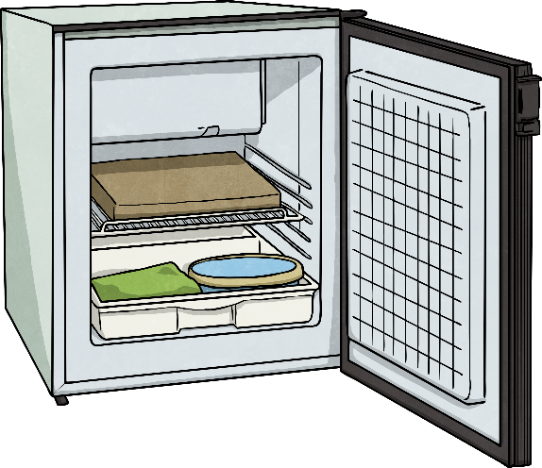
Prevention
Leftovers should be refrigerated in sealed containers and eaten within the suggested timeframe. This varies from food to food, but in most cases it doesn’t exceed 2-3 days.
Before eating leftovers, it is important they are heated thoroughly.
Put food into the fridge or freezer within two hours of buying it or cooking it.

Slide 8
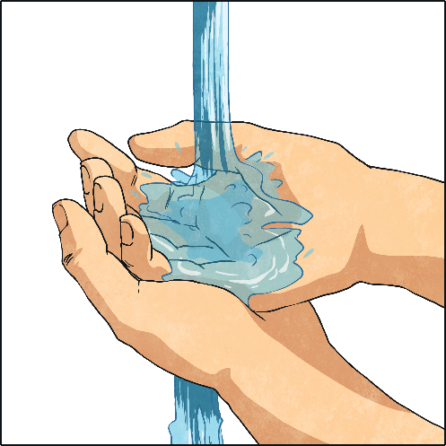
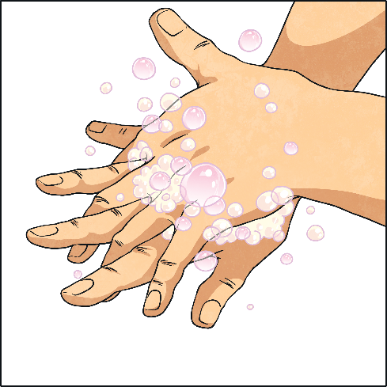
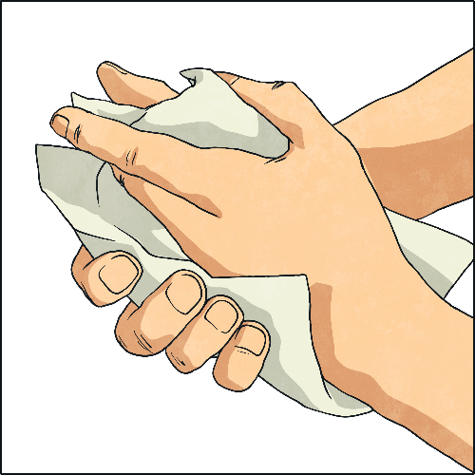
Washing Your Hands
There are many reasons to wash your hands during cooking and food preparation.

Slide 9
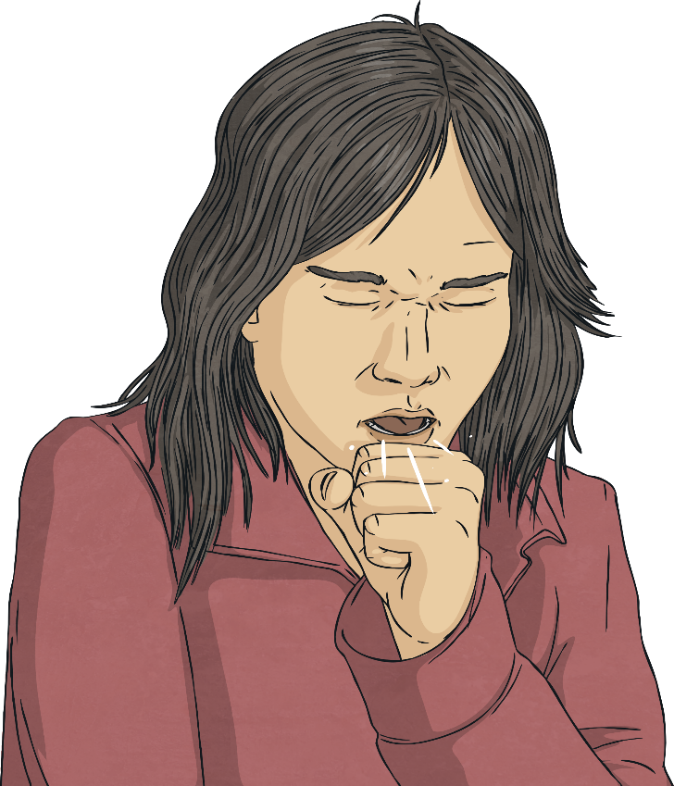
Washing Your Hands
Remember to Wash Your Hands After:
Coughing or sneezing
Handling a mobile phone or device (these devices can be covered in bacteria)
Wiping your hands with an unclean cloth
Handling raw meat
Being in contact with pets or animals
Going to the toilet
Being in contact with waste bins

Slide 10

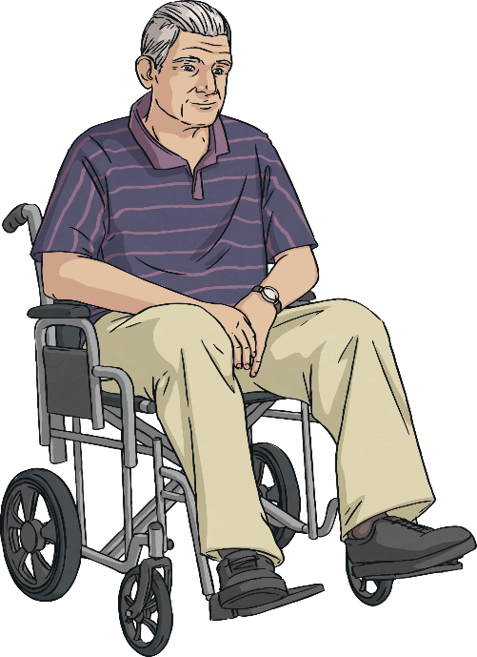
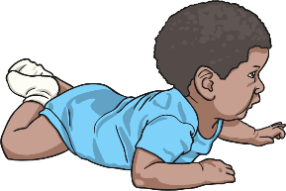
Who is at Risk?
Food contamination is a risk for everyone.
However, those who are most vulnerable are:
Babies
The elderly
Pregnant women
People who are sick

Slide 11
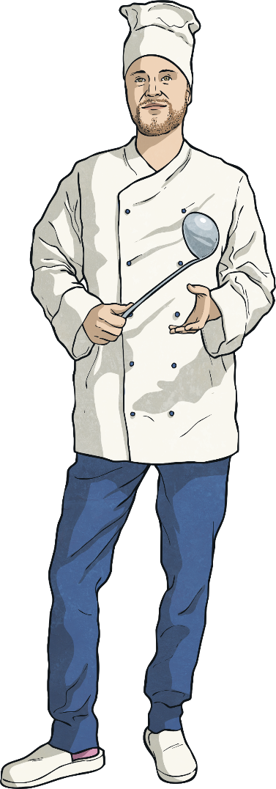
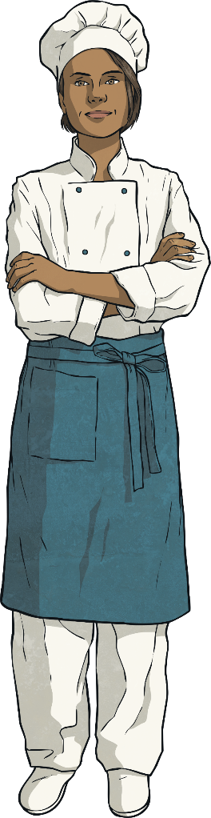
Who is Responsible?
Everyone is responsible for their own personal hygiene and food hygiene practices.
Getting into good habits is really important in order to lessen the risk of cross-contamination and food poisoning.
People who work in the food industry are subject to food regulations and standards to ensure food safety.

