Slide 1
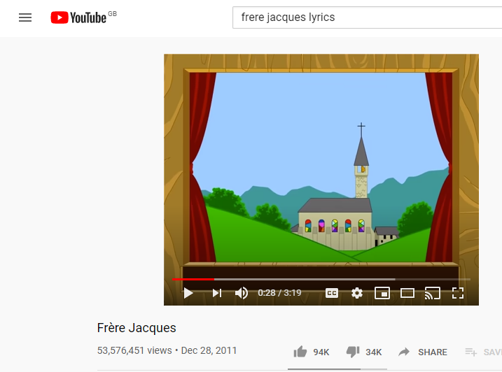
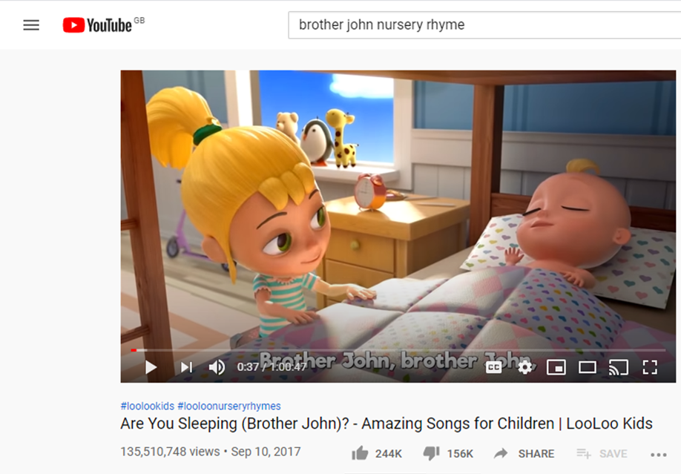
Song lyrics + repetition, rhyme, rhythm, alliteration and theme
Listen to the song
https://www.youtube.com/watch?v=BC6rvbxdywg
https://www.youtube.com/watch?v=en9ZkOo2rRA
Identify the words and phrases that justify the meaning of the song.

