Slide 1

Ifield School
Stage 3 Advanced Challenge
Mathematics
Independent Learning Booklet
Name………………………….
Class………………
Topic
Pythagoras Theorem
Trigonometry
Enlargement
Reflection
Rotation
Translation

Slide 2
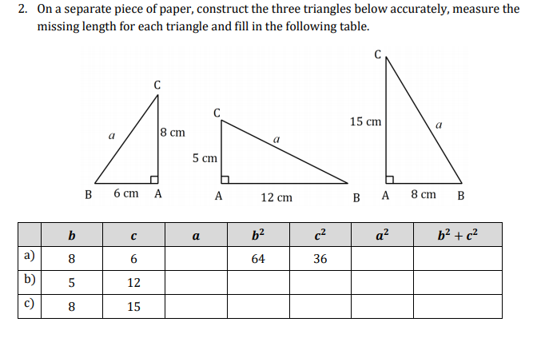
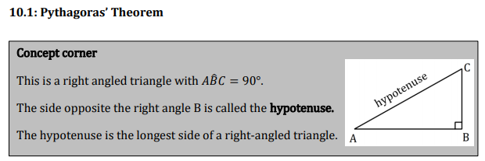
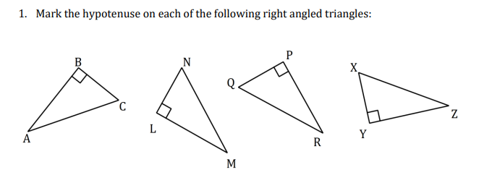
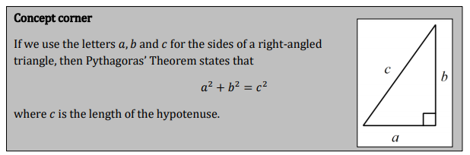

Slide 3
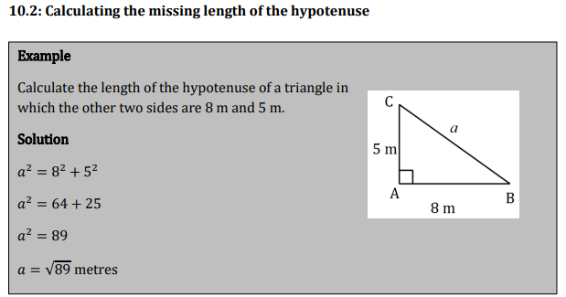
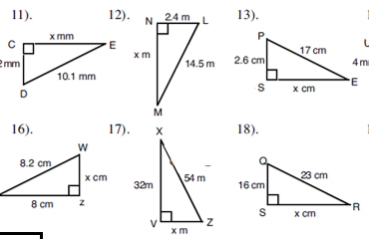
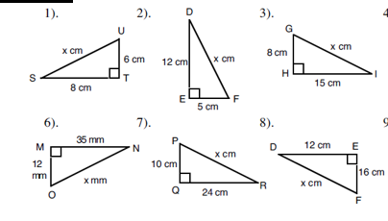
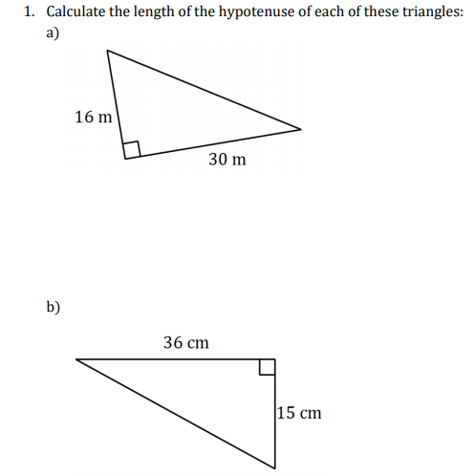

Slide 4













































$$5$$
$$7$$
$$3$$
$$9$$
?
$$5$$
$$1$$
$$2$$
$$2$$
$$4$$
$$2$$
$$\sqrt{29}$$
?
?
$$\sqrt{53}$$
$$\sqrt{77}$$
$$\sqrt{8}$$
?
?
$$3$$
$$4$$
$$2$$
$$9$$
?
$$10$$
$$7$$
$$\sqrt{125}$$
$$3$$
$$4$$
$$10$$
$$\sqrt{32}$$
?
?
$$\sqrt{32}$$
$$6$$
$$\sqrt{91}$$
$$\sqrt{32}$$
?
?
$$5$$
$$8$$
$$10$$
?
$$7$$
$$6$$
$$\sqrt{61}$$
$$6$$
$$1$$
$$3$$
$$3$$
?
$$\sqrt{44}$$
?
$$\sqrt{73}$$
$$12$$
?
?
$$\sqrt{27}$$
$$5$$
$$\sqrt{48}$$

Slide 5
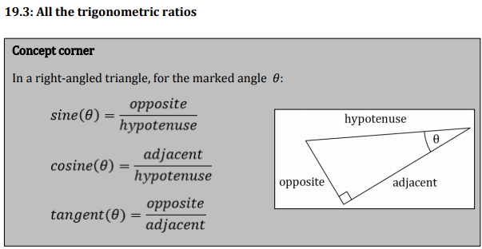
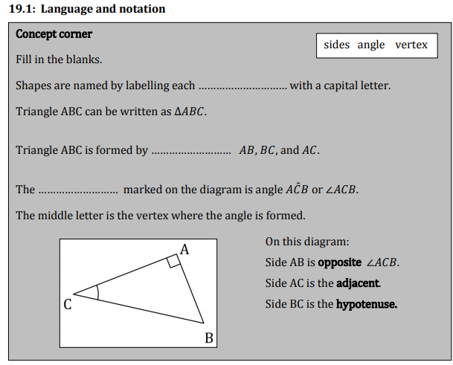
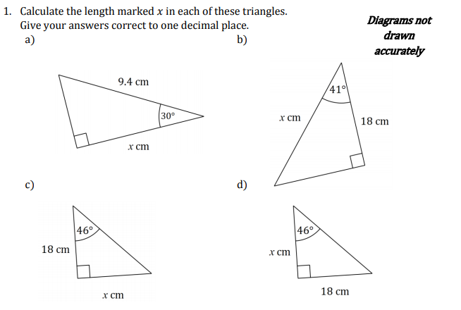
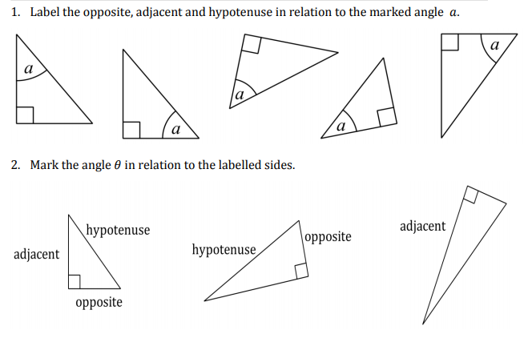

Slide 6
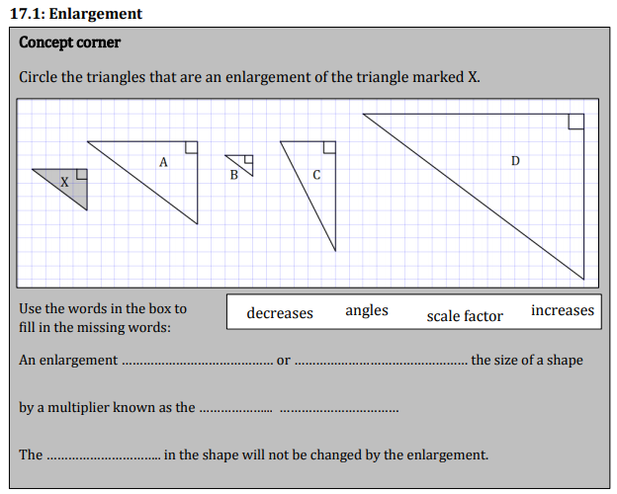
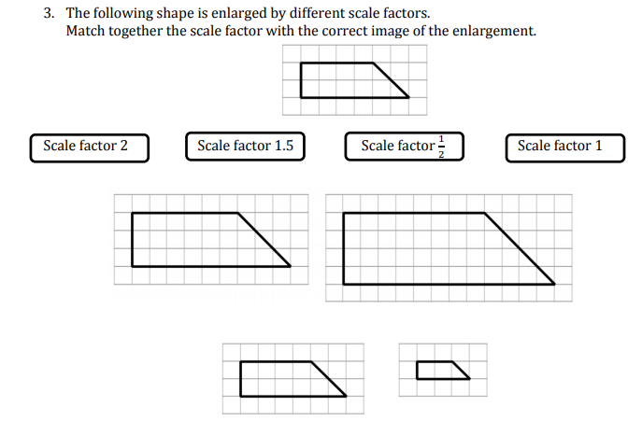
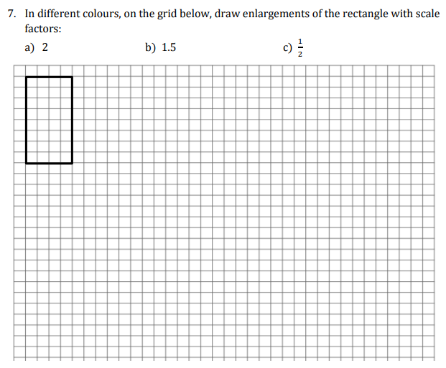
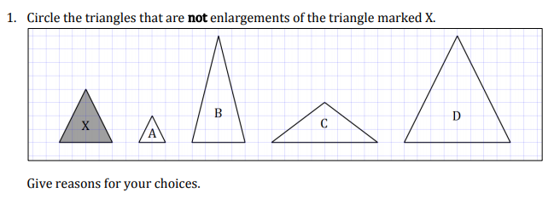

Slide 7
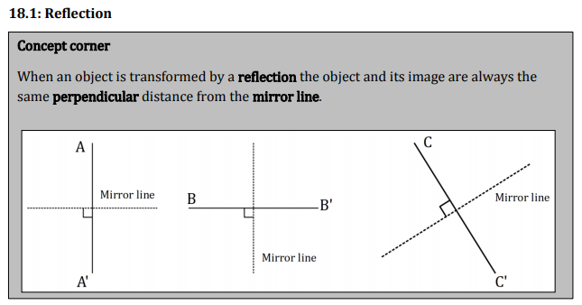
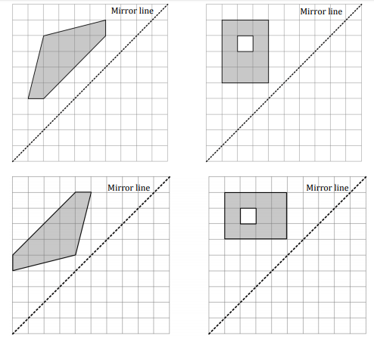
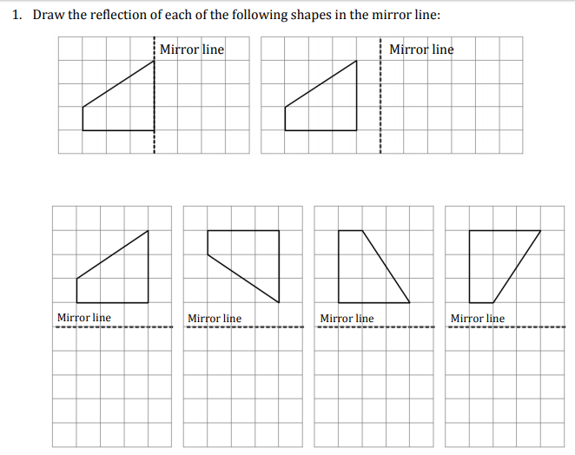
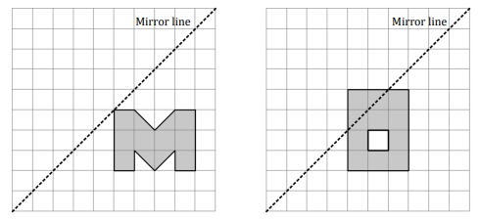

Slide 8
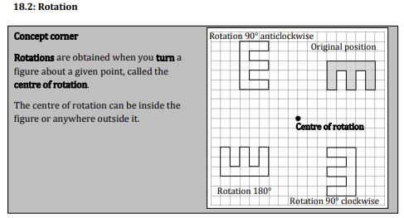
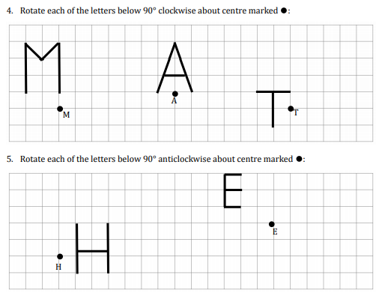
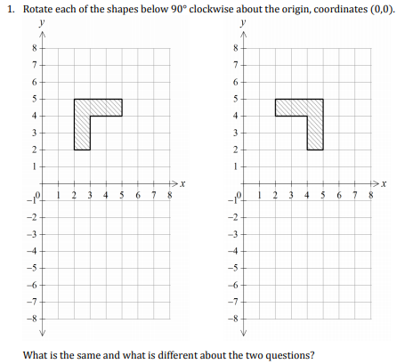
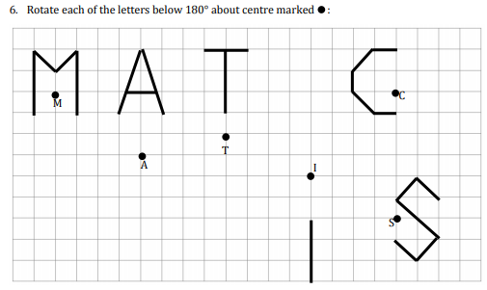

Slide 9
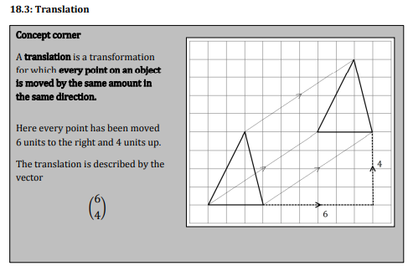
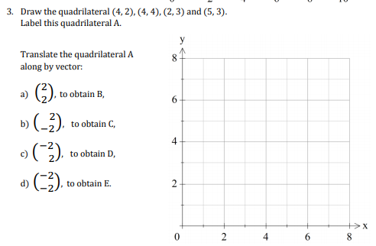
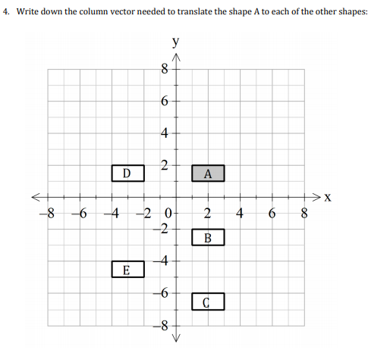
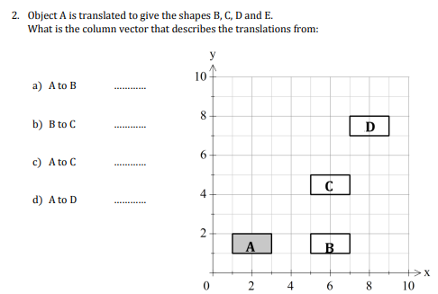

Slide 10
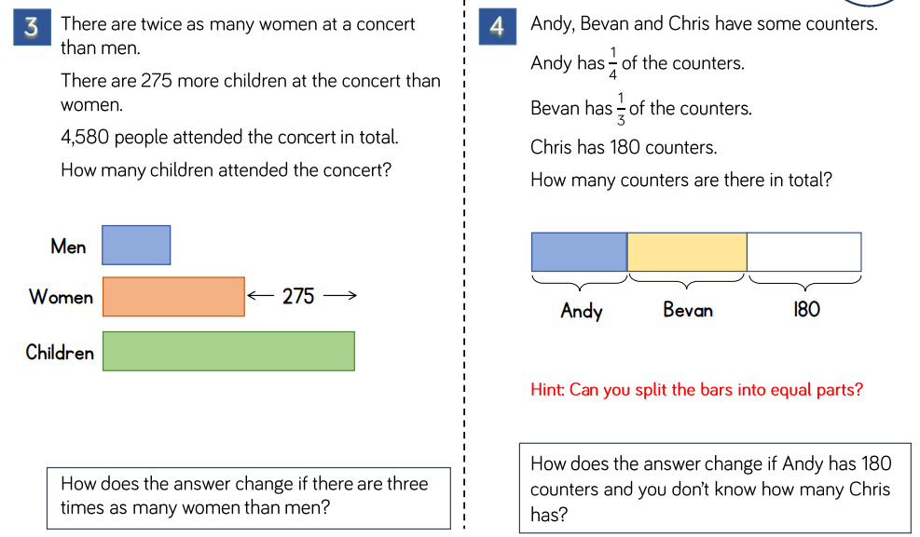
Problem Solving Questions

Slide 11
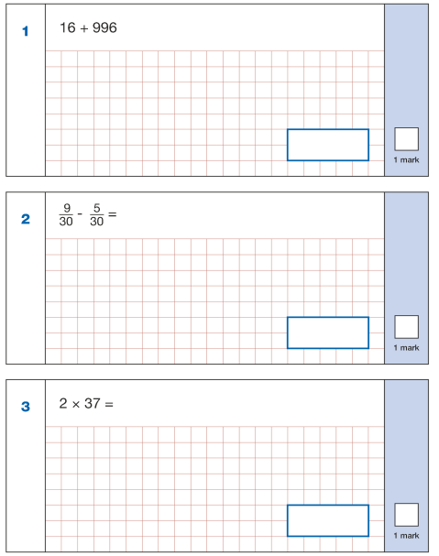
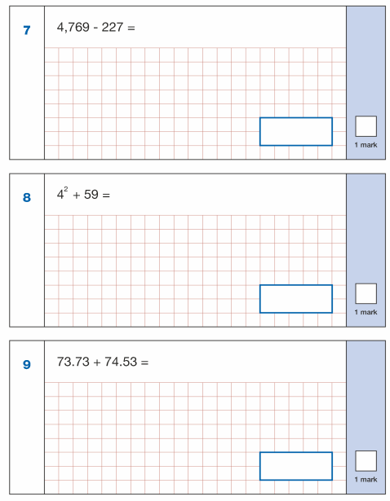
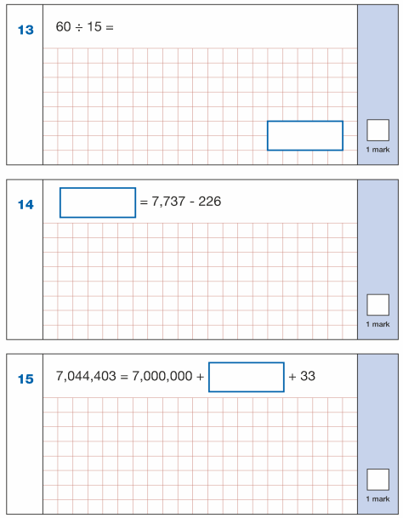
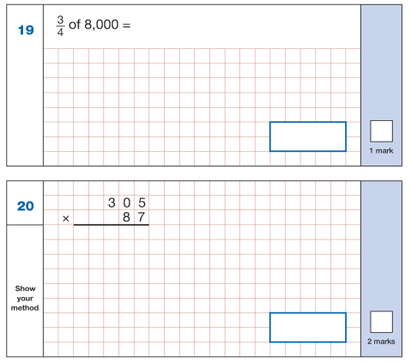
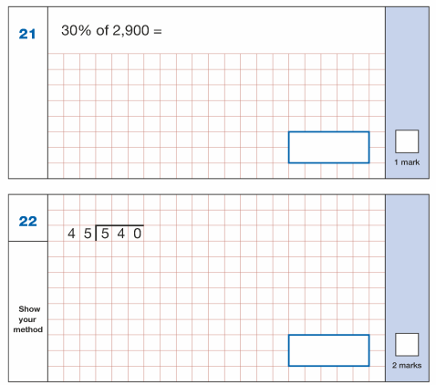
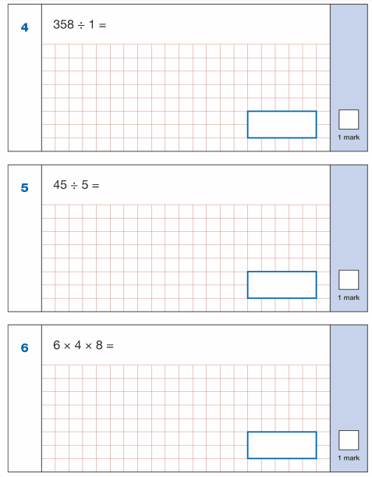
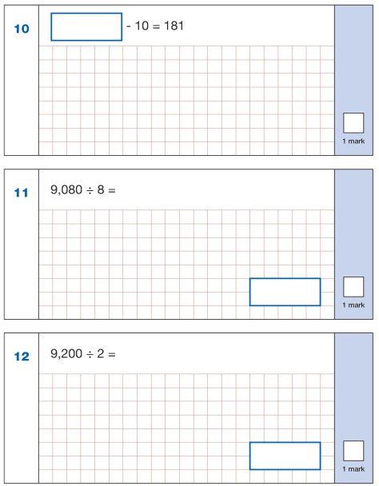
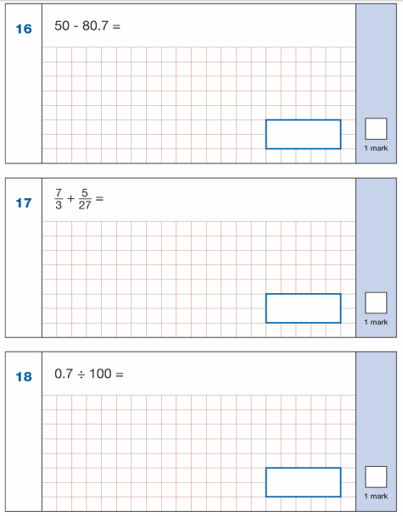
Arithmetic Practice

Slide 12


