Slide 2
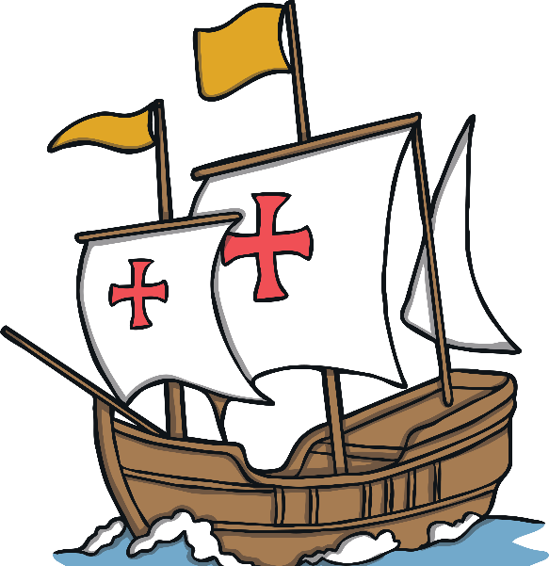
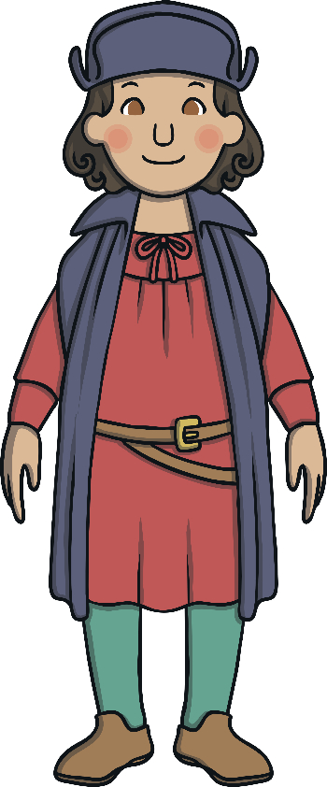
Aim
To know about Christopher Columbus
Success Criteria
To know who Christopher Columbus was.
To know what Christopher Columbus was famous for.

Slide 3
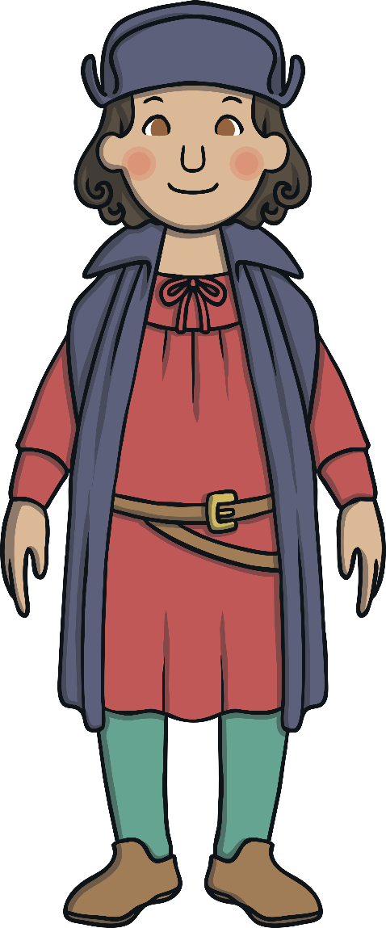
Who was Christopher Columbus?
Christopher Columbus was a famous explorer
In 14 92 Christopher Columbus sailed from
Europe to America.
He sailed across the Atlantic ocean, not
knowing where they would land!

Slide 4
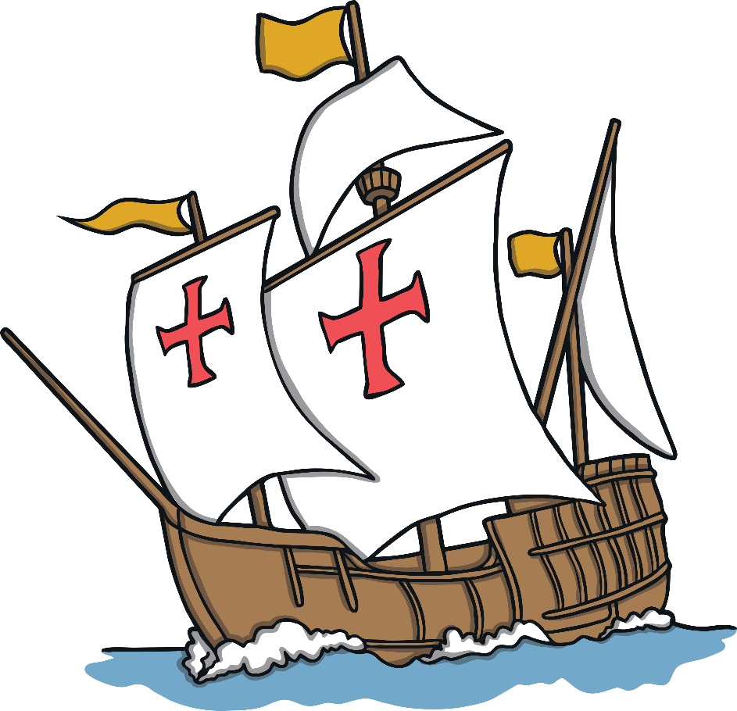
Who Did Christopher Columbus Do?
It is important to note that Christopher Columbus did not discover America, but he started regular contact between Europe and America.
Vikings had landed in America 500 years before
(Christopher Columbus did not know this.)

Slide 5
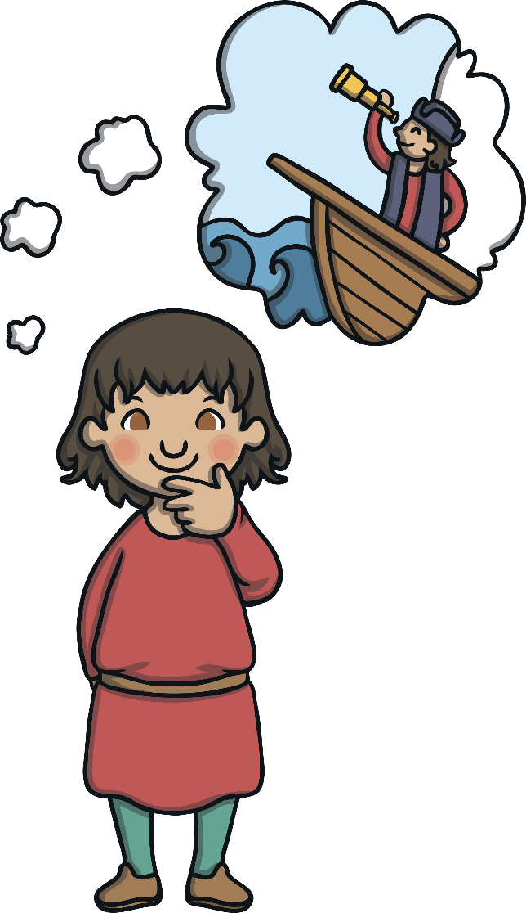
Christopher Columbus’ Early Life
Christopher Columbus was born in 1451 in Italy.
This time period was called the Renaissance.
Lots of people were building new
ships to explore new lands.
His father was a wool merchant.
Christopher Columbus’ first trip on the
sea was when he was 13 years old.

Slide 6
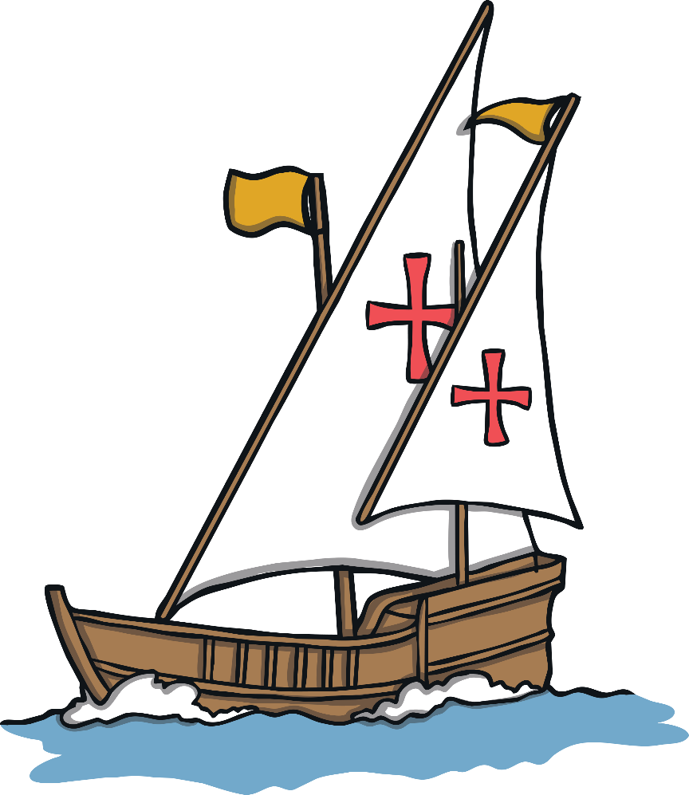
Christopher Columbus’ Life
Christopher Columbus learned to sail in a wooden ship with sails.
He learnt to find the way at sea by using the stars and the sun.
He went to live in Portugal and he sold maps with his brothers.
He had a dream to travel west and go to China.

Slide 7
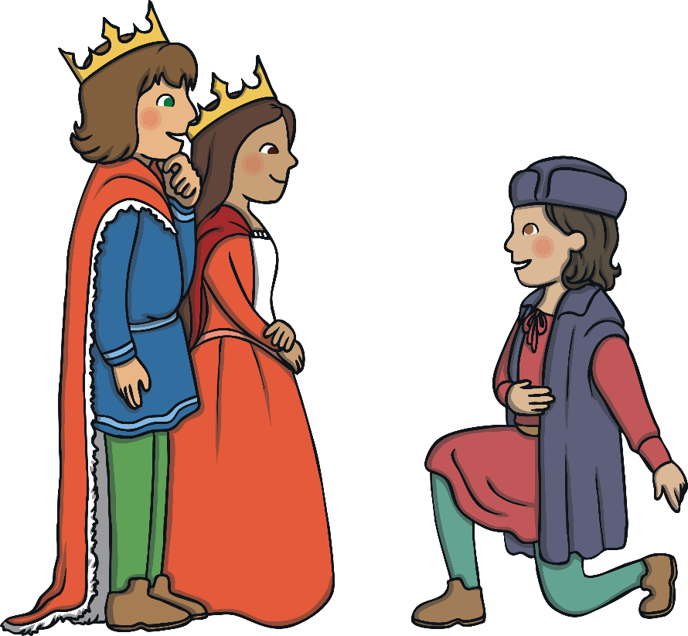
Setting Sail
To follow his dream he need money so the King and Queen
of Spain gave him money to buy ships.
He set sail on 3rd August 1492 with three ships.
The people on the ships took it in
turns to do the work.
Everyone had to sleep on the deck.

Slide 8
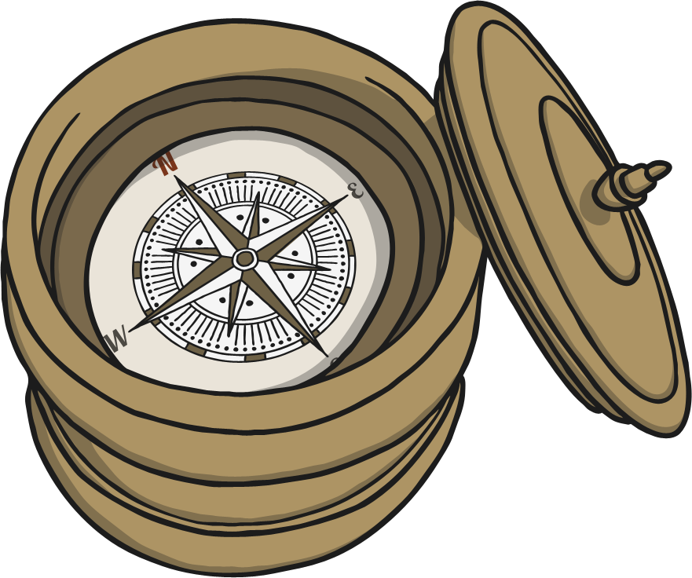
Setting Sail
Christopher Columbus used a compass to help him find his way.
The trip took them longer than expected and they got a bit scared.
They could find no land, all they could see was sea.
They were running out of food and water.
After 36 days one man spotted an
island, it was in the Bahamas.

Slide 9
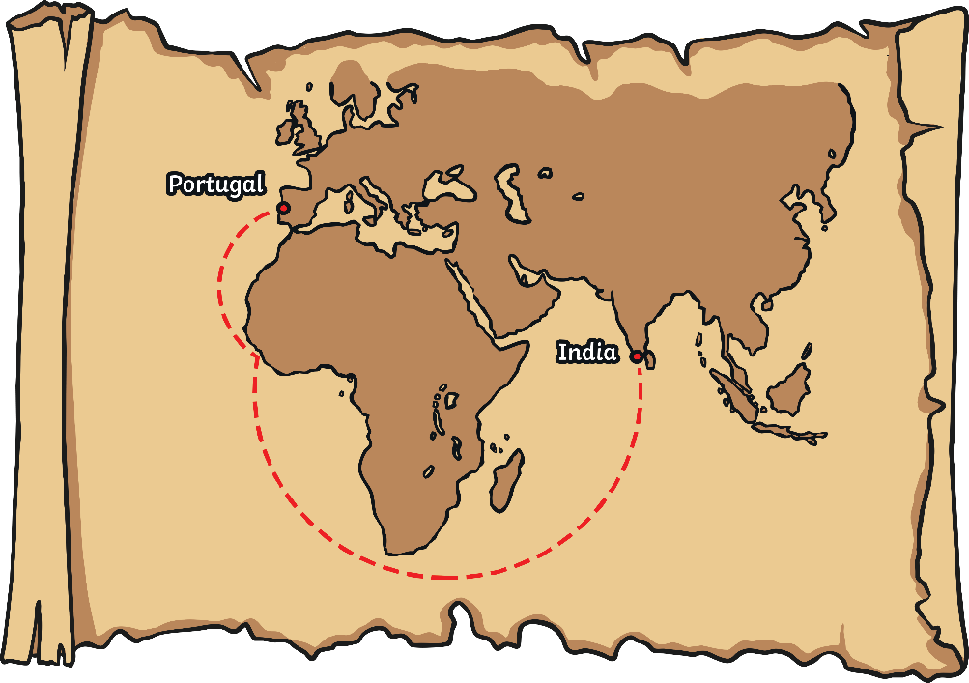
Christopher Columbus’ Discoveries
Christopher Columbus sailed onto Cuba and discovered new lands. They called it The New World.
Native Americans lived on the islands but Christopher Columbus called them Indians because he thought he had landed in ‘the Indies’.

Slide 10
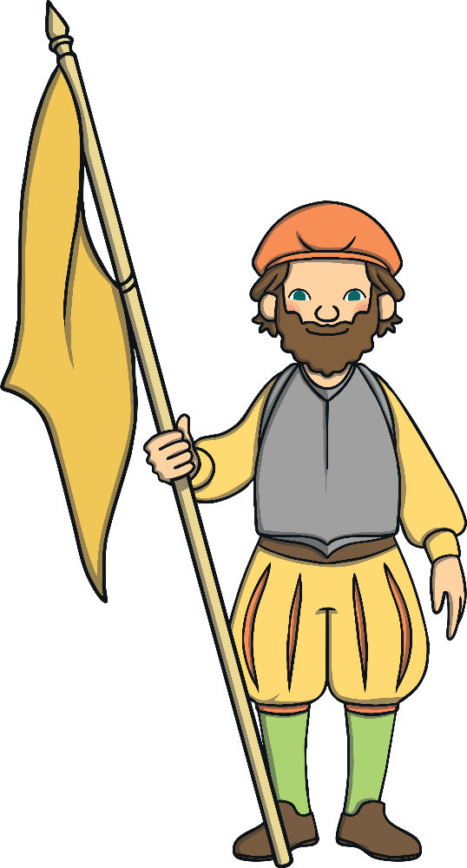
Christopher Columbus’ Big Problem!
In Christmas night of 1492, on of his ships hit a reef and it damaged the ship beyond repair.
He took the other two ships home,
leaving 40 men behind.
He took some Native Americans home with him.
He went back to collect his other men but
they were dead when he got there!

Slide 11
What Happened to Christopher Columbus?
Christopher Columbus sailed to America
in 1502 for the fourth time, still hoping
he would get to China.
Instead he ended up in Central America.
His ships had holes in them so he had
to wait a whole year to sail home.
When he got home he was very ill
and he died in 1506.

Slide 12
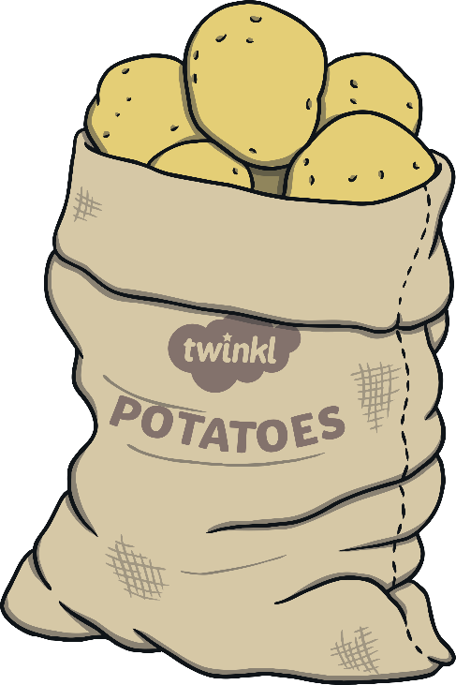
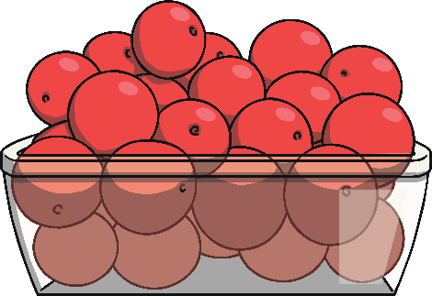
Interesting Facts
Christopher Columbus’ biggest ship was less than 23m long.
Before Christopher Columbus had been to America no one
had ever tried a tomato or potato.
The sailors ate stew made from salt, meat and bones.

Slide 13

Task
Create a poster advertising a leaving party for
Christopher Columbus’ trip to America.
Things you might want to include:
Text Here
Text Here
Text Here
Poster
Text Here
Text Here
Text Here

Slide 14
Plenary
What was Christopher Columbus famous for?
It was his dream to travel to which country?
What vegetable did Christopher
Columbusbring back from America?

