Slide 2




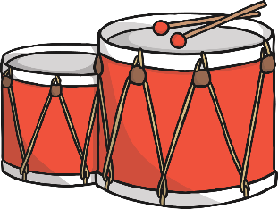

Click the music notes for clues
I am big
I am round
I am hit with a stick
What am I ?
?
Drums

Slide 3
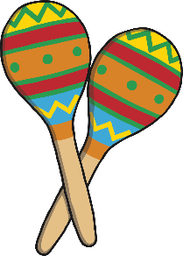
Click the music notes for clues
I am a pair
I am shaken
I am colourful
What am I ?
?
Maracas

Slide 4
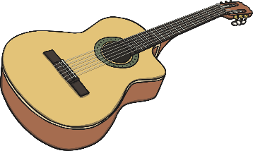
Click the music notes for clues
I am strummed
I am played with two hands
I am an instrument with strings
What am I ?
?
Guitar

Slide 5
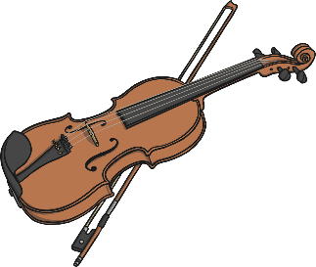
Click the music notes for clues
I am played on the shoulder
I am an instrument with strings
I am played with two hands
What am I ?
?
Violin

Slide 6
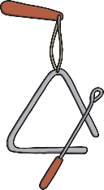
Click the music notes for clues
I am made of metal
I am small
I am hit with a metal stick
What am I ?
?
Triangle

Slide 7
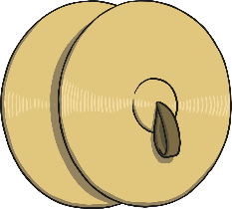
Click the music notes for clues
I am round
I am hit together
I am very loud
What am I ?
?
Cymbals

Slide 8
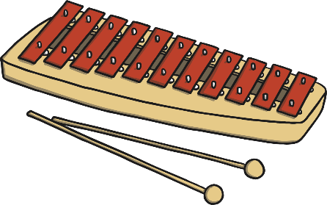
Click the music notes for clues
I am hit
I am made from metal
I am flat
What am I ?
?
Glockenspiel

Slide 9
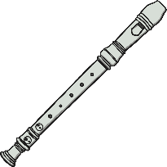
Click the music notes for clues
I am blown
I am played with two hands
I am thin
What am I ?
?
Recorder

Slide 10
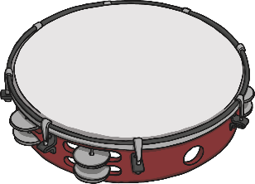
Click the music notes for clues
I am shaken
I am hit
I am round
What am I ?
?
Tambourine

Slide 11
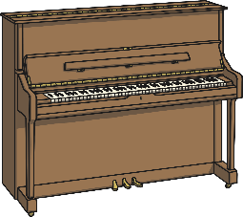
Click the music notes for clues
I am played sitting down
I am played with two hands
I am very big
What am I ?
?
Piano

