Slide 1

L1-2 Functional Engish - writing
May 2020. Kindly contributed by Trisha Childs, The Sheffield College.
Search for Trisha on www.skillsworkshop.org
Please refer to the download page for this resource on skillsworkshop for detailed curriculum links and related resources. https://www.skillsworkshop.org/resources/write_an_article_about_captain_tom
You can also find this presentation online (Google Slides). The related writing task is available as a Google document, a PDF and a MS Word document.
For full use of hyperlinks and other features, this presentation should be run in full screen mode.
Reformed Functional English curriculum links include:
L1.23 Write text of an appropriate level of detail and of appropriate length (including where this is specified) to meet the needs of purpose and audience
L1.24 Use format, structure and language appropriate for audience and purpose
L1.25 Write consistently and accurately in complex sentences, using paragraphs where appropriate
L2.24 Write text of an appropriate level of detail and of appropriate length (including where this is specified) to meet the needs of purpose and audience
L2.25 Organise writing for different purposes using appropriate format and structure (e.g. standard templates, paragraphs, bullet points, tables)
L2.27 Use different language and register (e.g. persuasive techniques, supporting evidence, specialist words), suited to audience and purpose
L2.28 Construct complex sentences consistently and accurately, using paragraphs where appropriate
Notes:
May 2020. Kindly contributed to www.skillsworkshop.org by Trisha Childs, Sheffield College.
1

Slide 2
Captain Tom
WrITING TASK
Level 1 & 2
Notes:
To use these slides properly - & so the website links work - view using full screen mode (click the slideshow icon bottom right)
May 2020. Kindly contributed to www.skillsworkshop.org by Trisha Childs, Sheffield College.

Slide 3
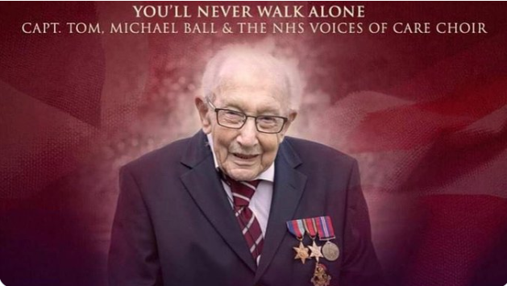
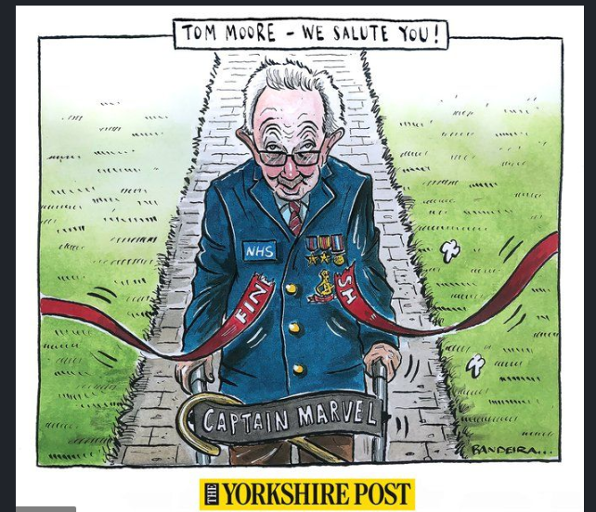

Captain Tom
Your writing challenge is all about Captain Tom.
You may have heard of him - or not - but it’s easy to find out!
YOU DO NOT NEED TO GIVE MONEY - THIS IS FOR INFO ONLY.
Click through the slides
£32,796,350
Notes:
May 2020. Kindly contributed to www.skillsworkshop.org by Trisha Childs, Sheffield College.

Slide 4
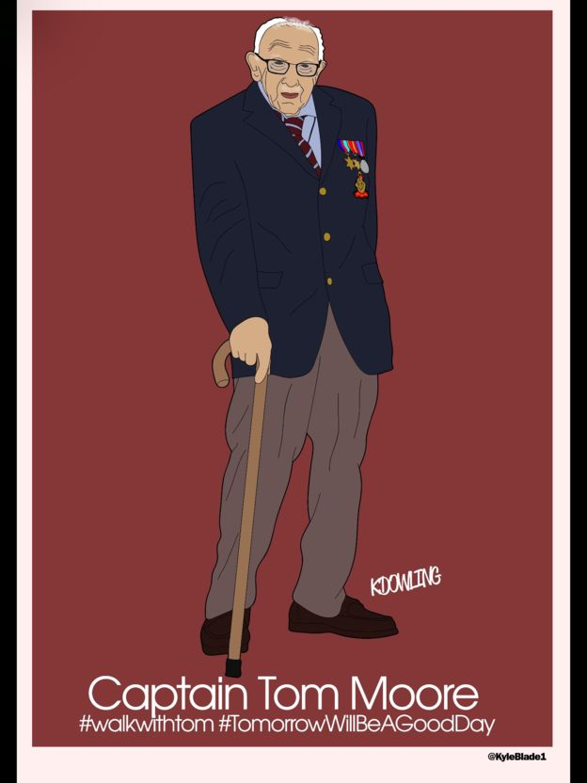
As seen in a BBC news article on the website
17 April 2020 https://www.bbc.co.uk/news/uk-52316856
Kyle Dowling, from Sheffield, was inspired to draw his own cartoon of Captain Tom by the sense of patriotism he feels he has stirred.
"This hero has fought for our country and is now fighting again for our country by raising millions for our health service," he says. "He's a true gent and really does put the great into Great Britain."
For Kyle, Captain Tom's assurance that "the clouds will go away" is a great comfort during the lockdown.
"It's helped me smile and think… it's not forever. Tomorrow is just another step towards it being over."
Notes:
May 2020. Kindly contributed to www.skillsworkshop.org by Trisha Childs, Sheffield College.

Slide 5


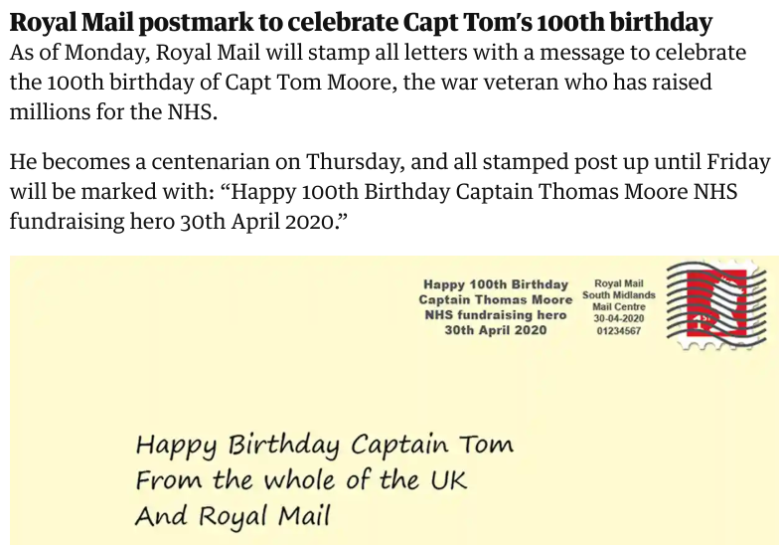


Click on the images to find out more
Suddenly, Captain Tom is a media sensation and has captured the hearts and attention of the world.
WHY ?
inspirational
a multi million pound fundraiser
an officer from World War 2 - he was 100 years old on 30 April 2020
£32,796,350
Notes:
May 2020. Kindly contributed to www.skillsworkshop.org by Trisha Childs, Sheffield College.

Slide 6
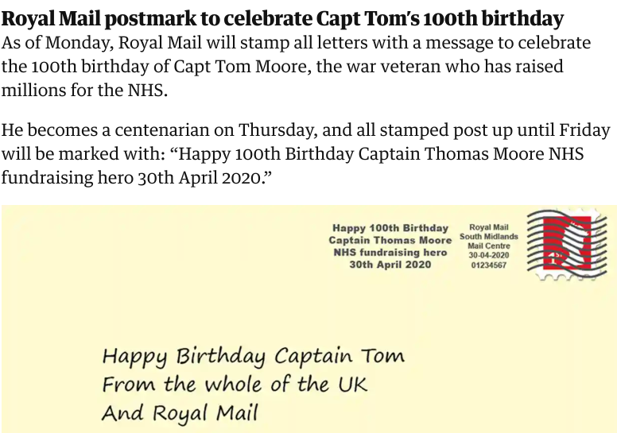
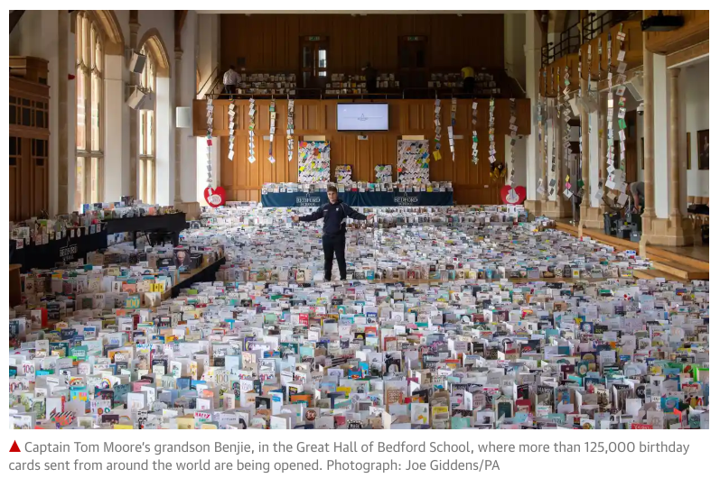

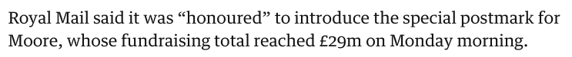
Celebrating 100th birthday
Notes:
May 2020. Kindly contributed to www.skillsworkshop.org by Trisha Childs, Sheffield College.

Slide 7
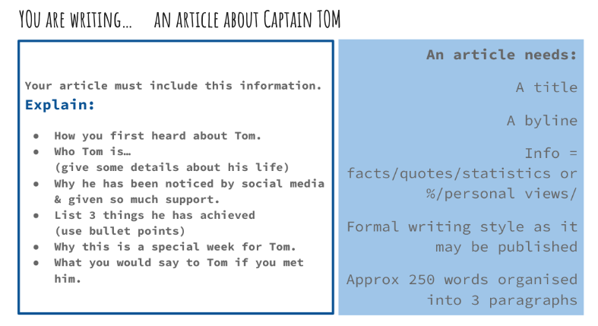
Include all expected ‘good’ language features: rule of 3, alliteration, various sentence types, hyperbole or effective vocabulary, SPaG etc.
Notes:
May 2020. Kindly contributed to www.skillsworkshop.org by Trisha Childs, Sheffield College.

Slide 8
The example article on the next slide may help you.
Write your article in the template provided in the Google or Word document.
Check your spelling, punctuation and grammar (SPaG).
Remember, you will get lots of extra marks if SPaG is good!
I look forward to reading your work!
Notes:
May 2020. Kindly contributed to www.skillsworkshop.org by Trisha Childs, Sheffield College.

Slide 9
An example to help you
Checked!
A title 
A byline 
Information (facts, quotes, statistics, personal views) 
Formal style 
Language features (hyperbole, emotive language, alliteration, rule of three) 
Used bullet points 
About 250 words grouped into paragraphs 
Simple, compound and complex sentences 
Spelling and grammar 
Punctuation (commas, apostrophes, dashes, speech marks, etc.) 
Tremendous Tom Turns 100
Like many folk, across the UK and beyond, I have been captivated by the inspirational, humble and kind Captain Tom. His fundraising hopes for a mere £1000 have skyrocketed into millions!
Born in Keighley, Yorkshire, Tom served in WW11 and proudly wore his medals as he carried out his walking challenge to raise money for the NHS. Now a grandfather, his simple, but effective plan was to raise £1000 by walking 100 laps of his family’s Bristol garden before his 100th birthday.
During the ‘lockdown’ Tom’s careful, swaying steps – supported by his walker – showed his gentle determination and positive outlook that ‘tomorrow will be a better day’.
An outpouring of support and affection for Tom and his fundraising challenge has exploded across the media. So far, he has raised an incredible 29 million pounds – and his 100th birthday is still 3 days away! In response to him and his charitable actions, Captain Tom has gathered more achievements; in just a few weeks, Tom has:
been given a ‘Pride of Britain’ award
collaborated with singer Michael Ball on the song, ‘You’ll Never Walk Alone’
become the only person ever to be at No.1 in the charts on their 100th birthday
been given a special postmark by the Royal Mail for EVERY letter posted this week
This Thursday Tom reaches his 100th birthday. Much of the world will celebrate with him. Me too!
“I wish you a very happy birthday and send heartfelt thanks for everything you do!”
Notes:
May 2020. Kindly contributed to www.skillsworkshop.org by Trisha Childs, Sheffield College.

