Slide 1
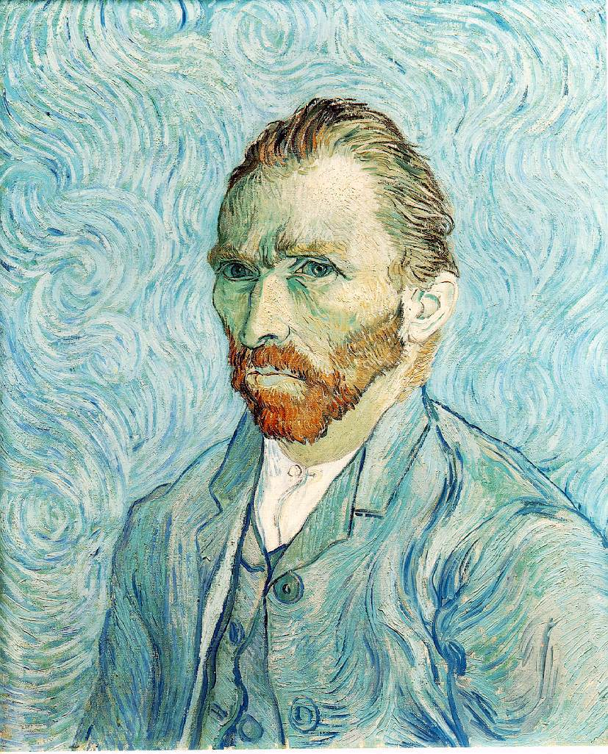
Vincent Van Gogh ‘Self Portrait’ 1889

Slide 2
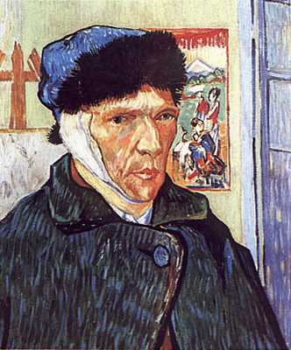
Vincent Van Gogh ‘Self Portrait with Bandaged Ear’ 1889

Slide 3
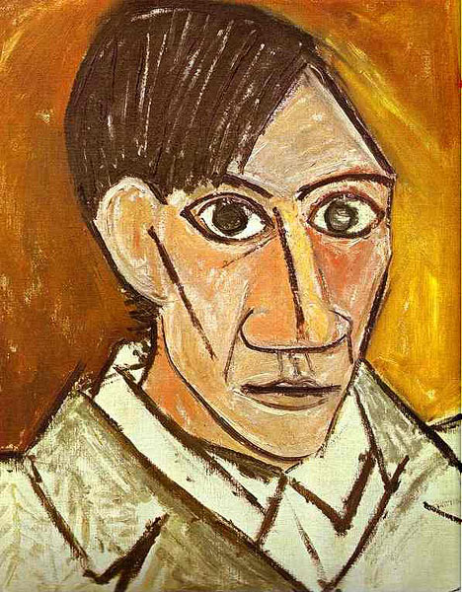
Pablo Picasso ‘Self Portrait’ oil on canvas 1907

Slide 4
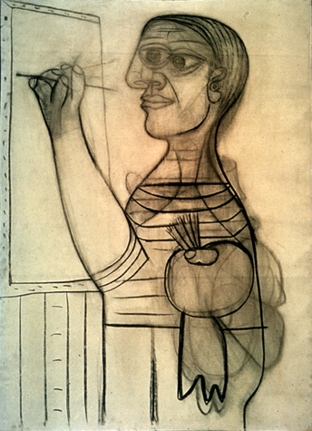
Pablo Picasso self portrait in charcoal

Slide 5
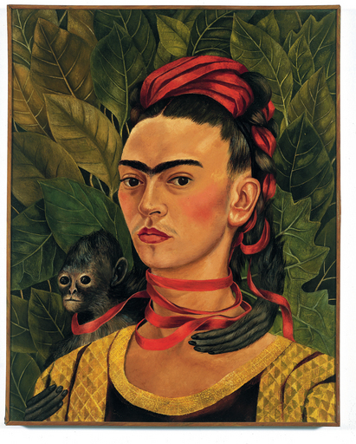
Frida Kahlo ‘Self Portrait with Monkey’ 1940

Slide 6
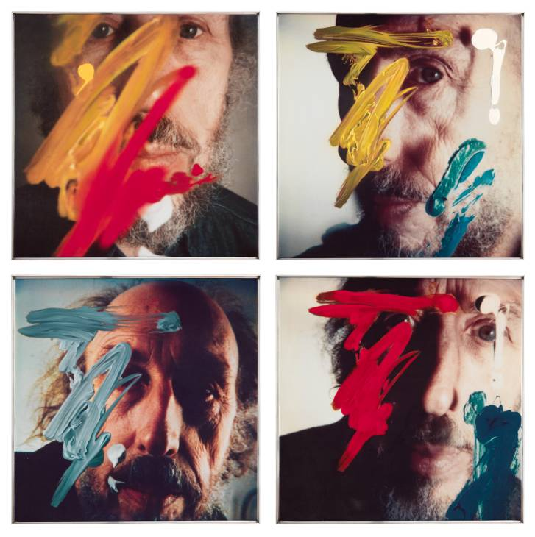
Richard Hamilton, ‘Four Self Portraits’ Polaroid photos and paint 1990

Slide 7
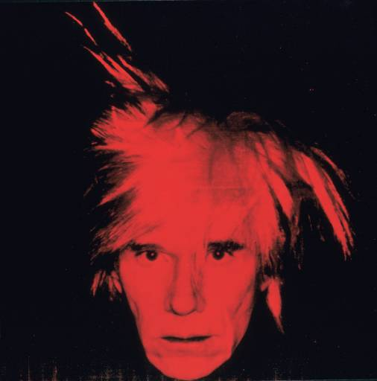
Andy Warhol ‘Self-Portrait’ screenprint 1986

Slide 8
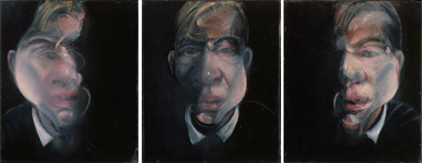
Francis Bacon ‘Three Studies for a Self-Portrait’ oil on canvas, 1979

Slide 9
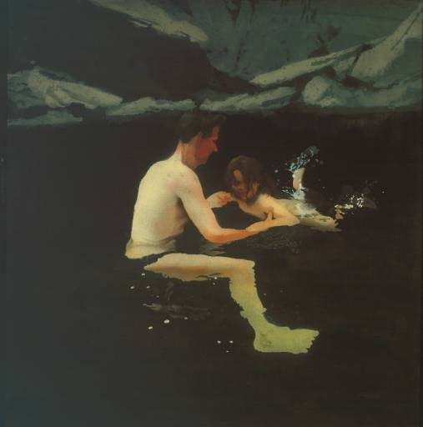
Micheal Andrews ‘Melanie and Me Swimming’ oil on canvas, 1978-9

Slide 10
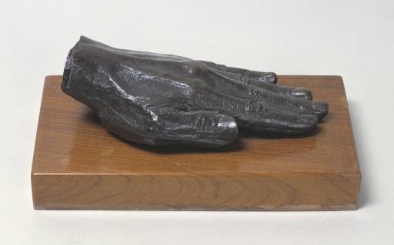
Barbara Hepworth ‘The Artist’s Hand’ bronze, 1967

Slide 11
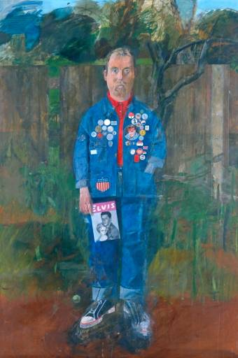
Peter Blake, ‘Self Portrait with Badges’ oil on board, 1961

Slide 12
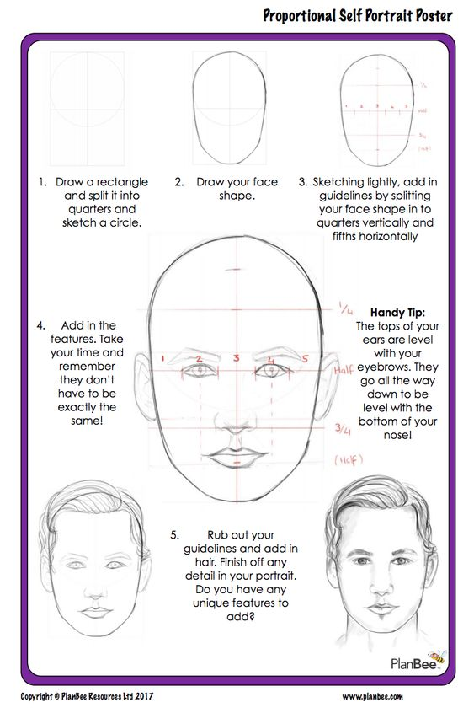
Portrait Guidelines

Slide 13
Tasks
Task 1
Look at the different pieces of art and choose two to discuss and compare. Think about
Why do you like these pieces of work?
What has the artist used to create the work?
Does the art reveal anything about their personality?
What colours and shapes can you see?
Is there anything in the background?
Task 2
Look at the self portrait by Peter Blake. What do you think he likes collecting? What does he enjoy reading? You can draw your self portrait and add images of your hobbies and what you enjoy doing in the background. Try and add details of your personality for example if you enjoy listening to music you could be wearing headphones or if your hobby is swimming you could draw the beach in the background.
Draw your own self portrait using a mirror and the portrait guidelines to help you draw the facial features. Add colour and collage.
Add drawings that describe your personality and hobbies. You may need to use the internet or magazines to help you.

Slide 14
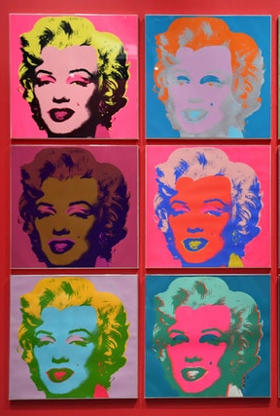
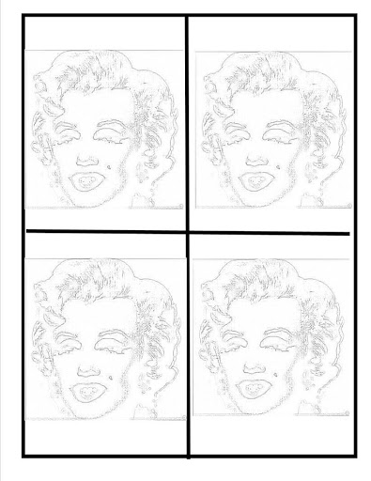
Task 3
Draw your self portrait and photocopy 3 times if possible. Add different colours to your portrait inspired by Andy Warhol’s portraits of the famous actress Marilyn Monroe.
‘no title’ Andy Warhol, 1967, screenprint on paper

Slide 15
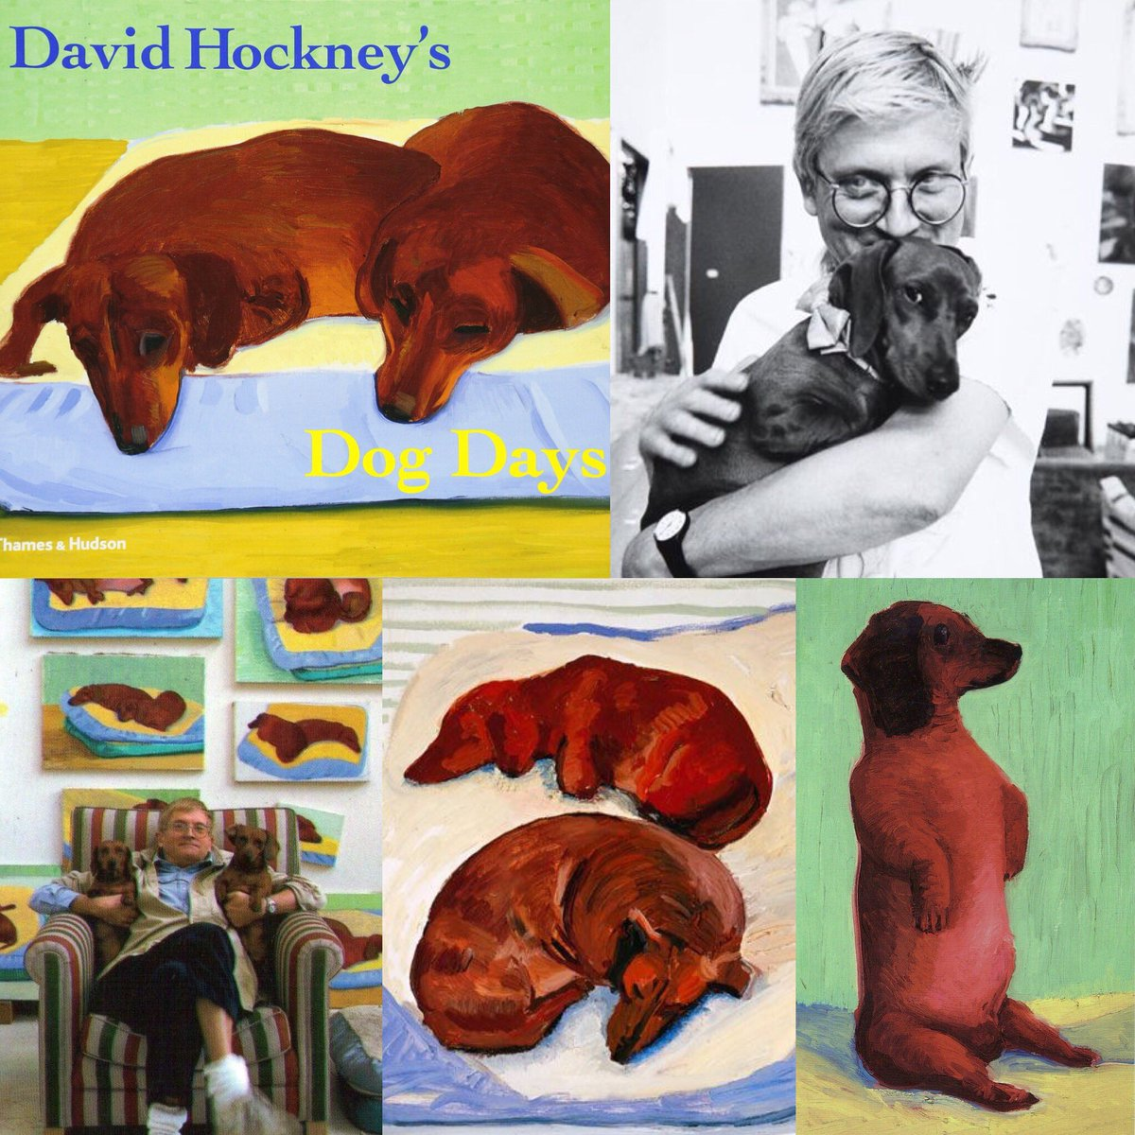
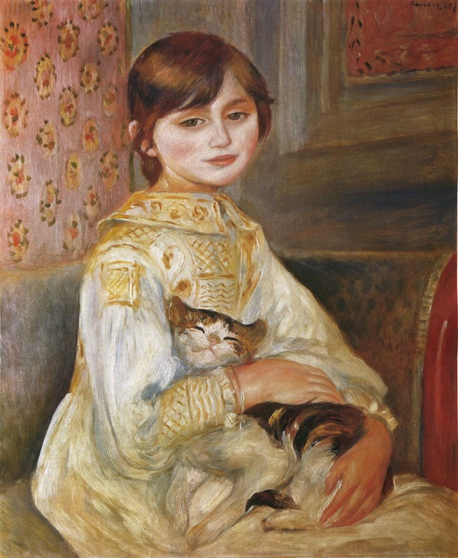
Task 4
Look at Frida Kahlo ‘Self Portrait with Monkey’ 1940. Draw your self portrait including your favourite animal. If you have any pets you could draw them from life at home and include them in your painting.
David Hockney and paintings of his dogs 1994 - 1995
‘Julie Manet with Cat’ Renoir 1887

