Slide 1
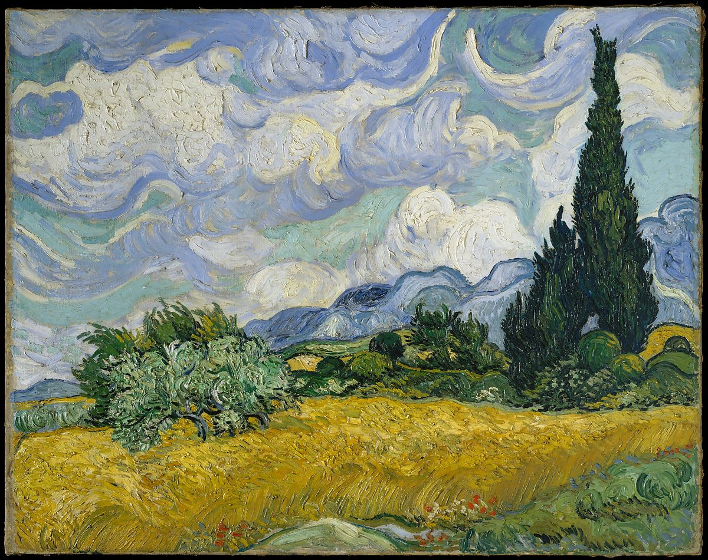
Term 5 Home Learning Pack Part 2 – Nature
‘Wheat Field with Cypresses’
1889
Vincent Van Gogh

Slide 2
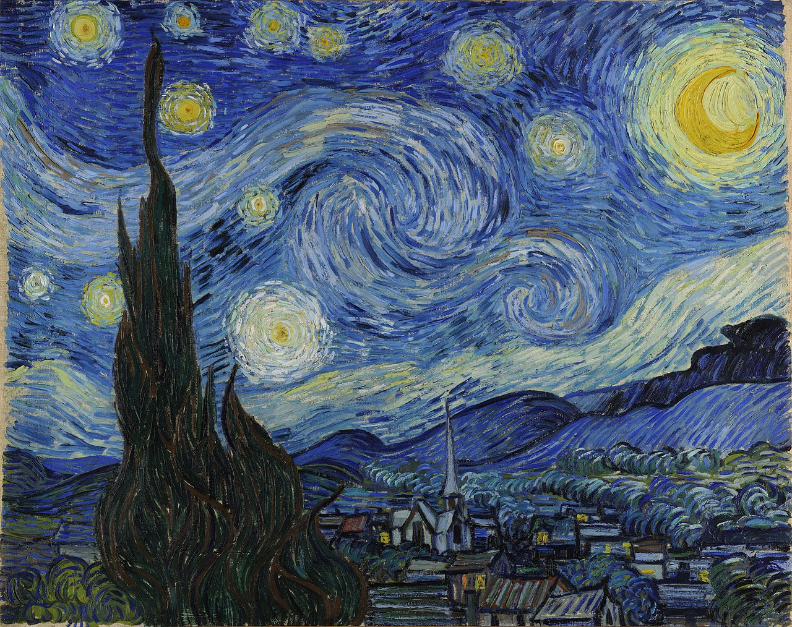
‘The Starry Night’
1889
Vincent Van Gogh

Slide 3
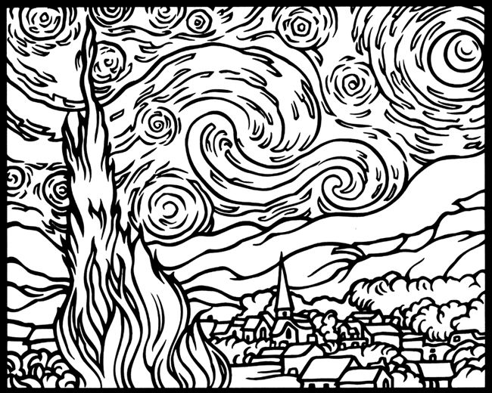

Slide 4
Task 4/Week 4
Look at the work of Vincent Van Gogh. He has painted the landscape and focused on the shapes of the clouds in the sky. Do you like the colours he has used? Van Gogh has painted a field in the day time and a town in the night time. Notice the dashes he has painted to create the clouds and the stars in the sky.
Draw the view of the sky from your garden or window. Try and choose a cloudy day. Use small dashes to add colour and swirls to show how the clouds are moving.
You can use the black and white copy to help you, but if you can, try and draw the clouds yourself.
The link below takes you to the Van Gogh Museum if you would like to see any more of his work.
https://www.vangoghmuseum.nl/en

Slide 5
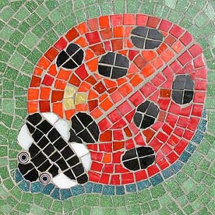
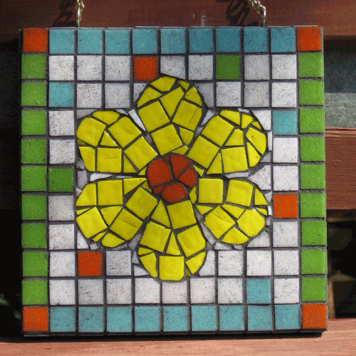
Task 5 – Mosaic in the Garden

Slide 6
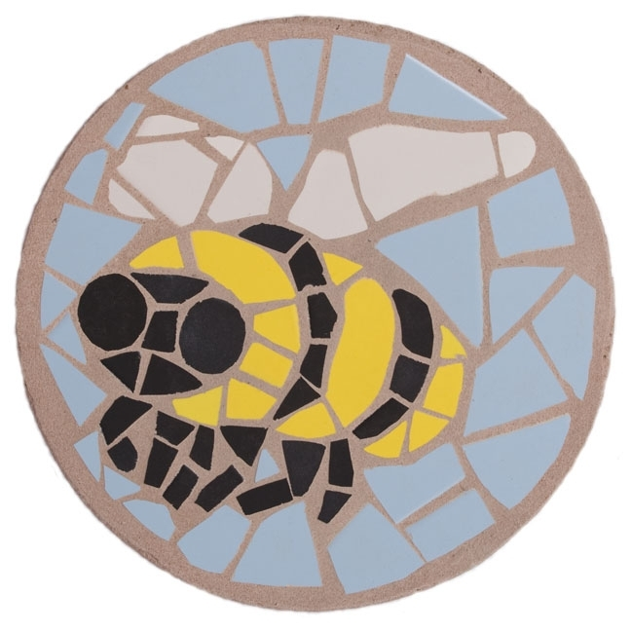
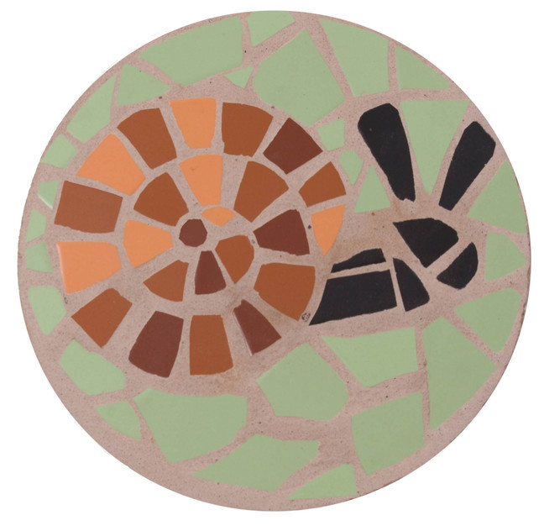

Slide 7
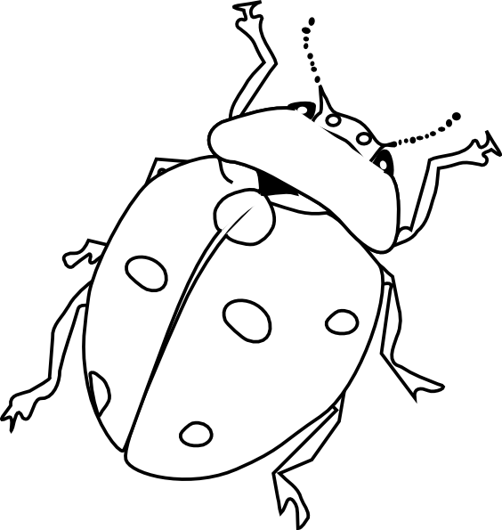

Slide 8
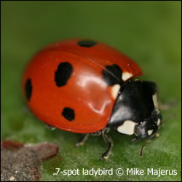
Ladybird

Slide 9
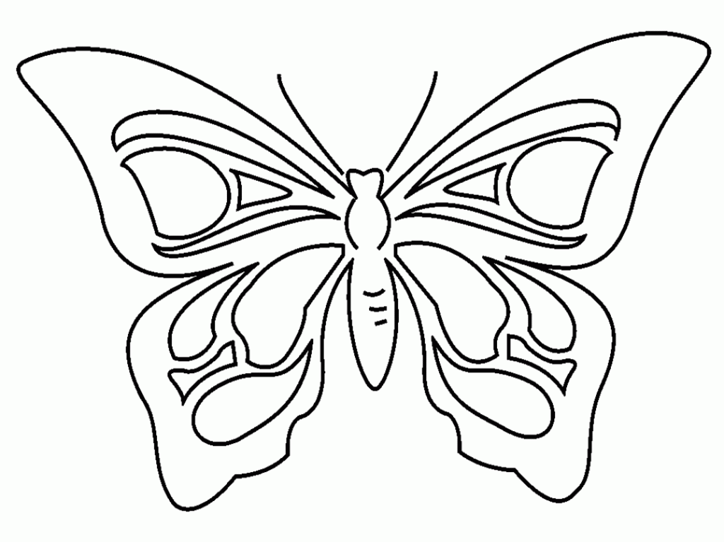

Slide 10
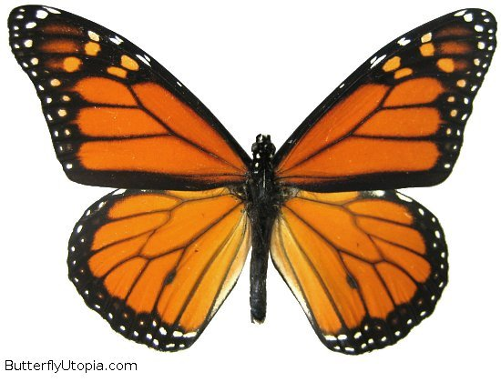
Butterfly

Slide 11
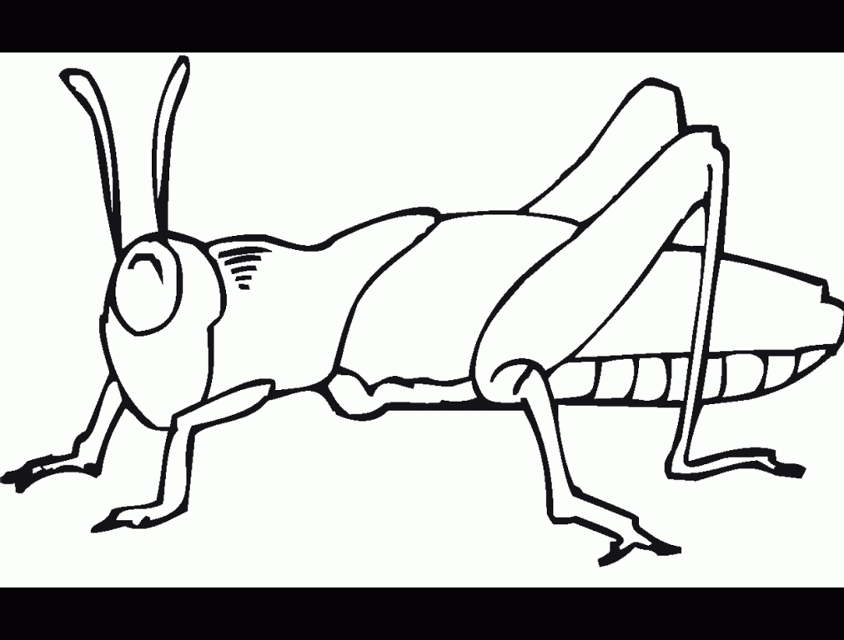

Slide 12
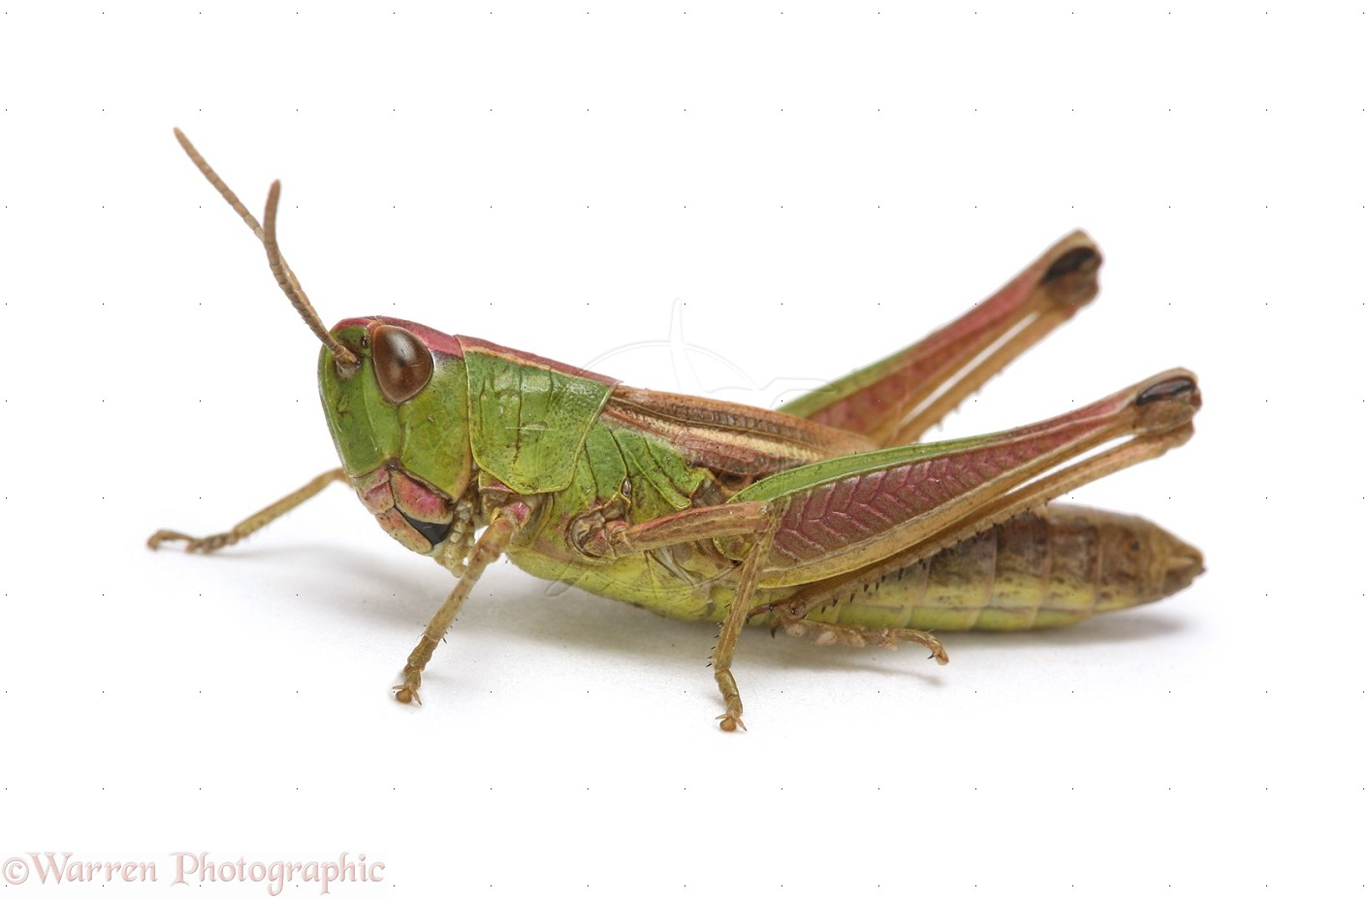
grasshopper

Slide 13
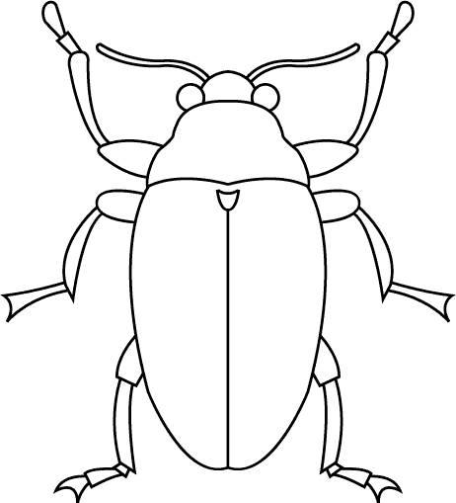

Slide 14
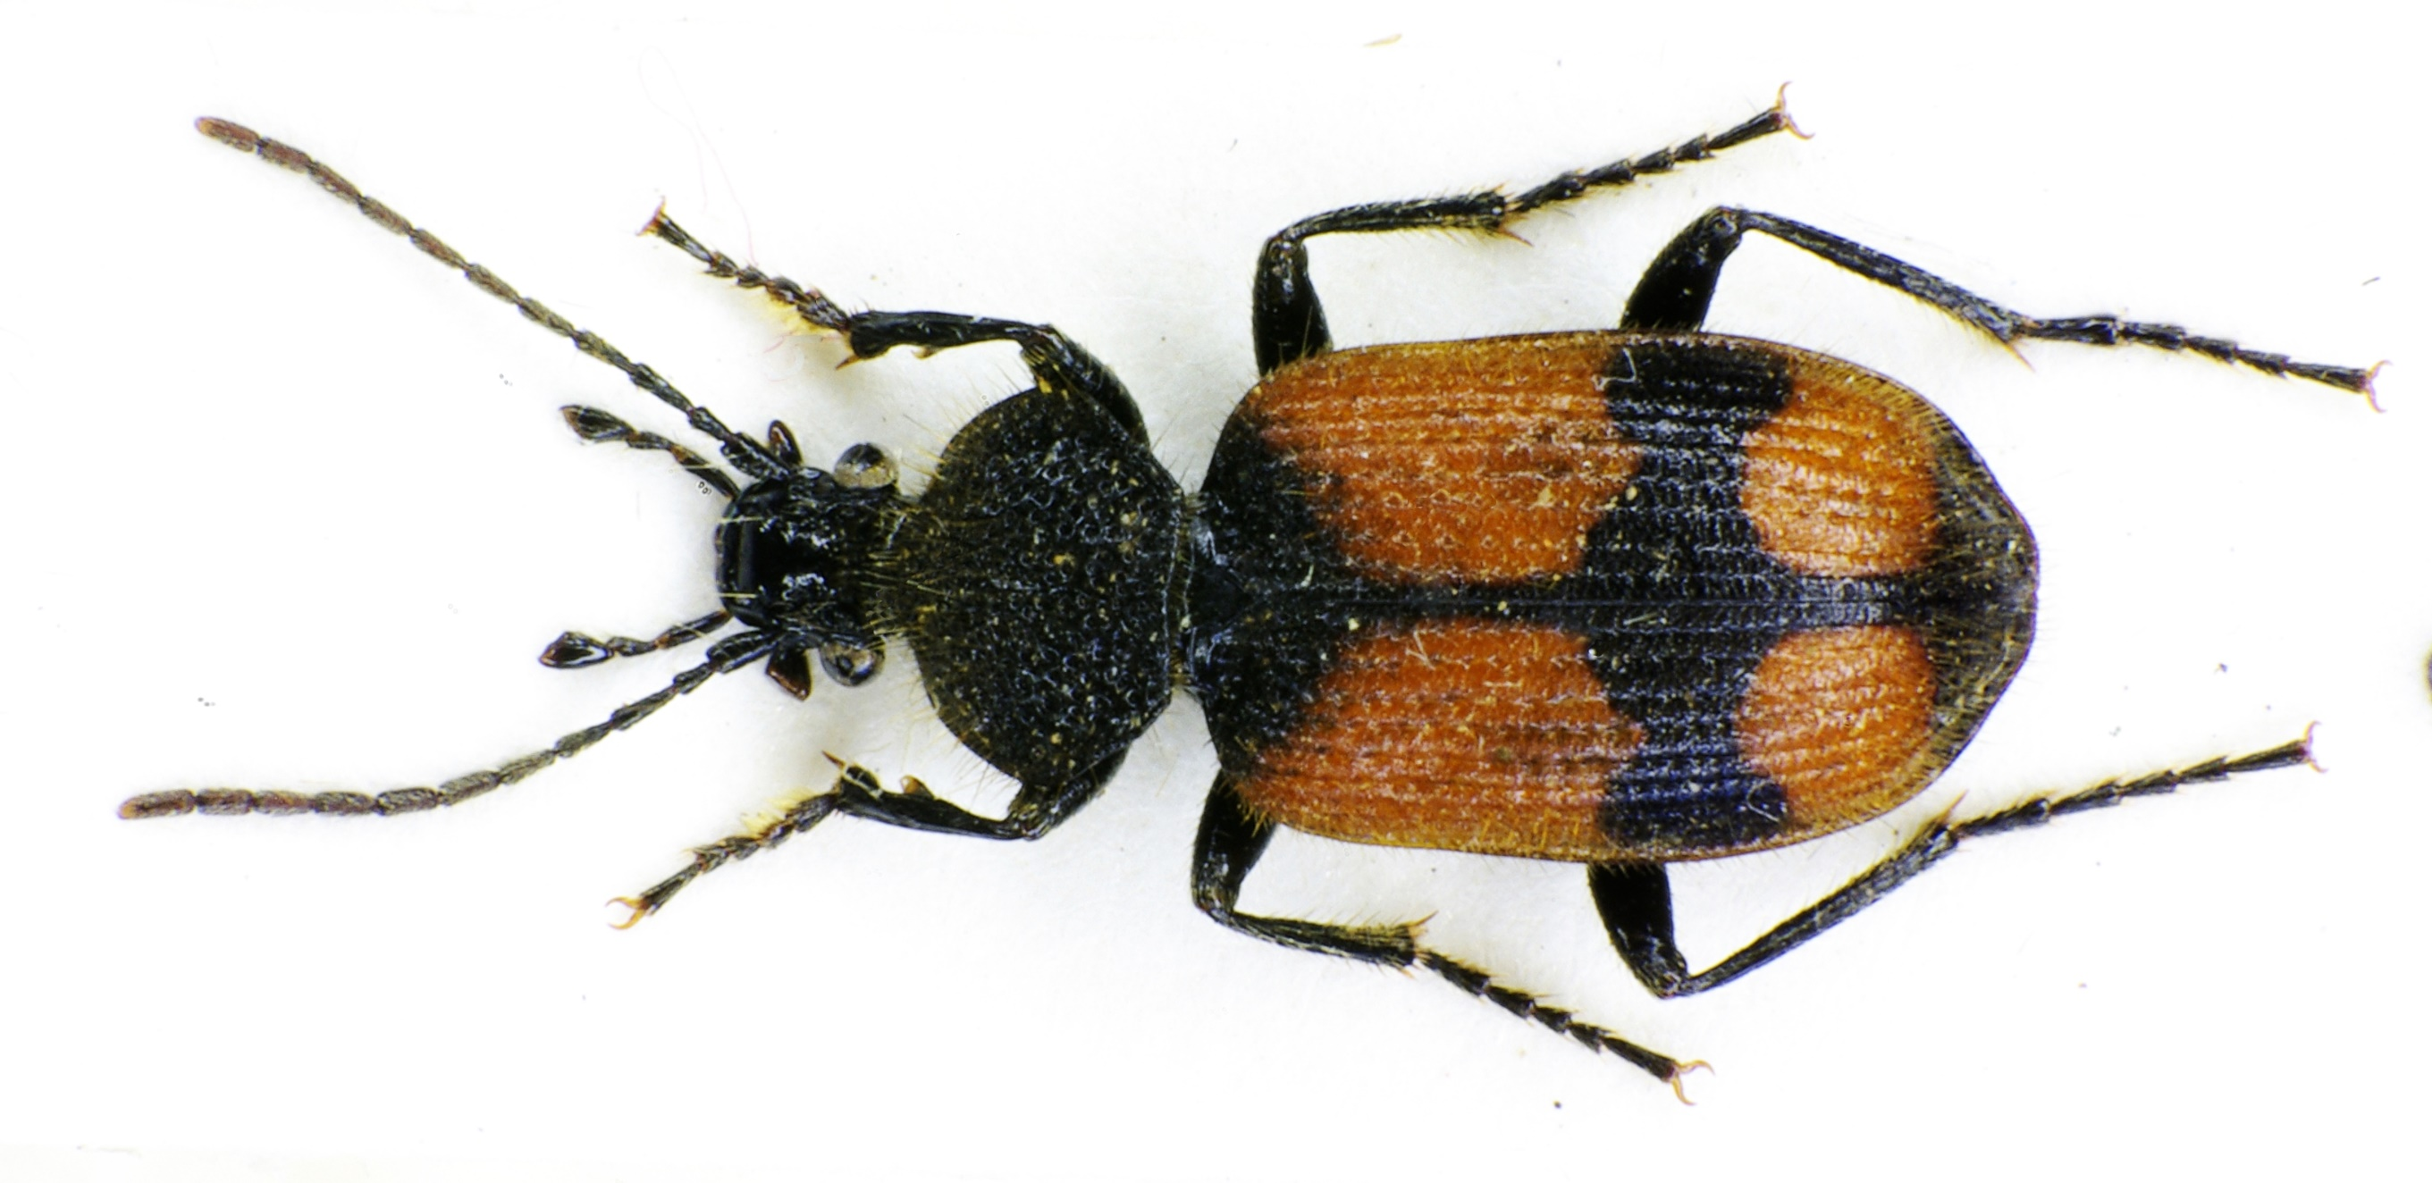
beetle

Slide 15
Task 5/Week 5
Look at the different insects. Draw insects in the garden, if you have a magnify glass you may want to use it to help you draw the insects.
Draw your insect large on your paper. Cut up coloured paper into 1cm squares and use them to create a mosaic of your insects.
You can use the pictures of insects to help you if you can’t use a garden.

Slide 16
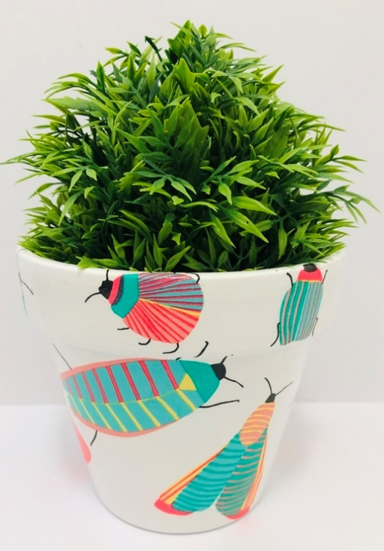
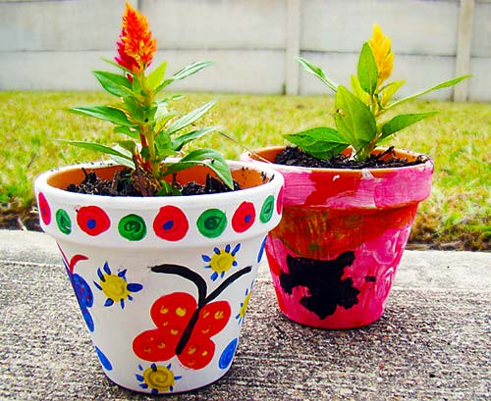
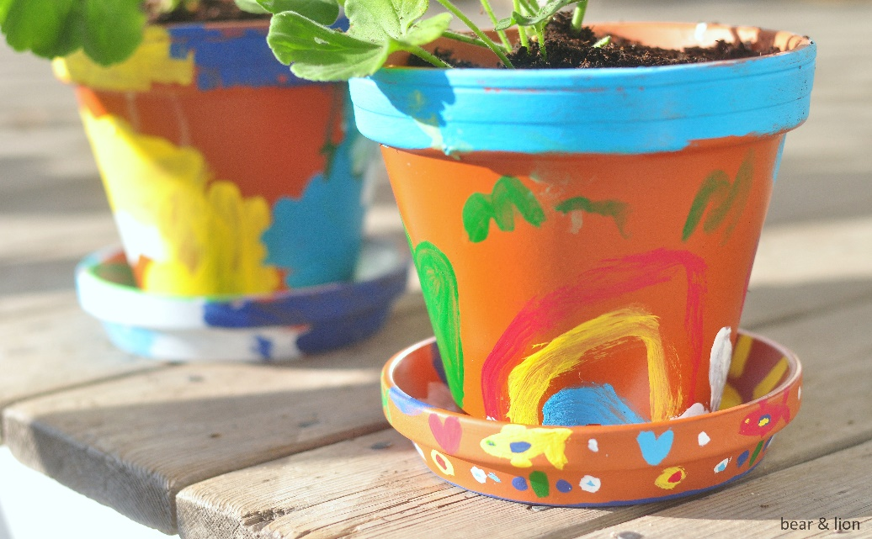
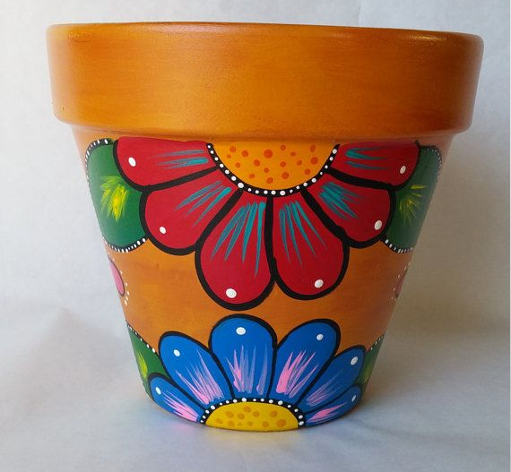
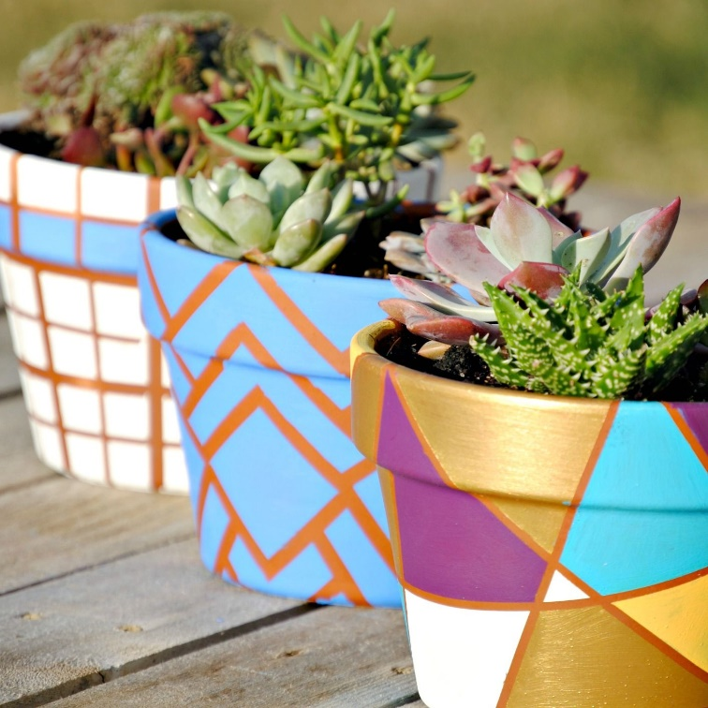
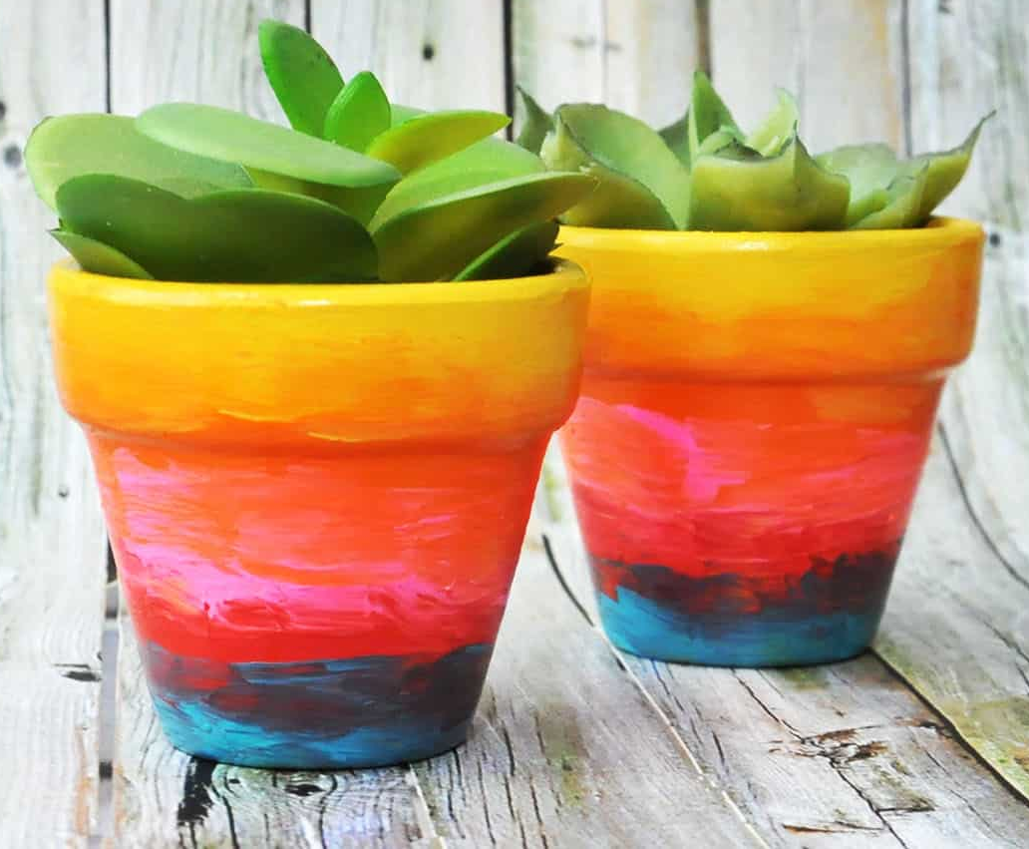
Task 6/Week 6 - Design a Flower Pot.

Slide 17
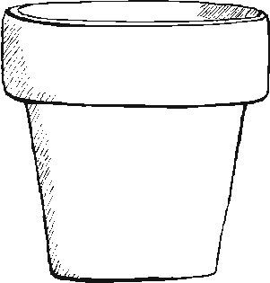

Slide 18
Task 6/Week 6
Design a flower pot inspired by the garden. You can use the template to draw a design and if you have paints and a flower pot try and transfer your design onto the pot.
If you want to paint shapes, you can use masking tape to make straight lines.
You may want to wait for the paint to dry and then paint a second layer.

