Slide 1
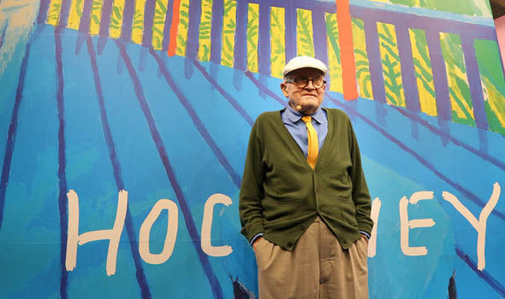
David Hockney 1937

Slide 2
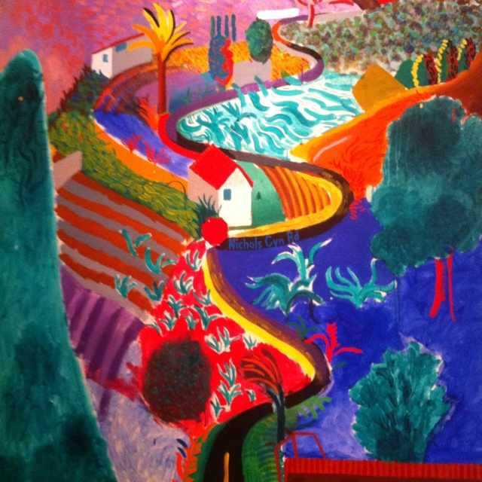
David Hockney
A Bigger Grand Canyon (1998)
After photographing the Grand Canyon in 1982 and harbouring a long desire to work with the subject, Hockney set out on a road trip from LA to Sante Fe to contemplate the vast landscapes of the West, thus, resulting in the creation of A Bigger Grand Canyon. Despite its notably difficult scale, Hockney applied his exceptional artistic skills to the painting. Having struggled with the composition of a single view when using photography — ‘such a tunnel to me’ — Hockney’s research methods led him to form collages of the Grand Canyon based on the cubist idea he derived from George Braque and Pablo Picasso. ‘Then you realise time and space are the same thing.’
www.theculturetrip.com

Slide 3
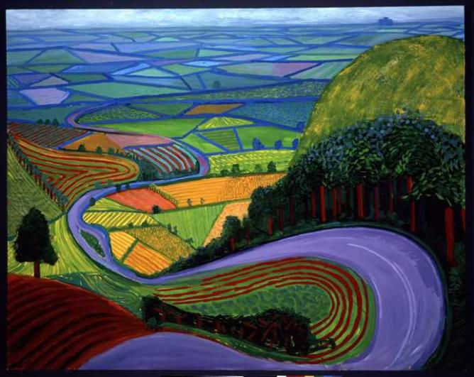
David Hockney ‘A Bigger Picture’ (2012)
Over fifty years after graduating from the Royal College of Arts, Hockney returned to his artistic home with the solo exhibition A Bigger Picture. Hockney took a chance on ‘could I produce something good?’ when approached by the Royal Academy as most of the featured works didn’t yet exist. The upbeat mood of the show delivered one single genre of landscape from his native Yorkshire, containing over 150 works including bright oil paintings, multi-canvas vistas, watercolours, charcoal sketches, more than fifty powerful drawings — created using the iPad and printed on to paper — and nine to eighteen screen video works captured using high-definition cameras. The model used by Hockney took a fresh approach to displaying his landscape works, and he found the Royal Academy the prime gallery for such a grand project.‘What could be better than a large gallery, smack in the middle of London.’
www.theculturetrip.com

Slide 4
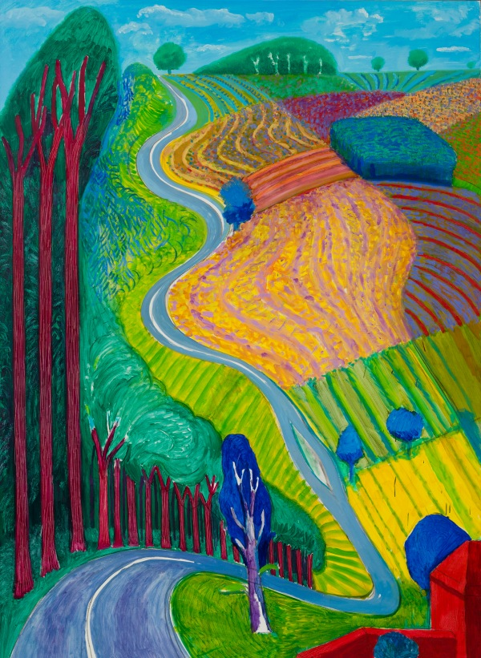
David Hockney ‘Garrowby Hill’ 1998

Slide 5
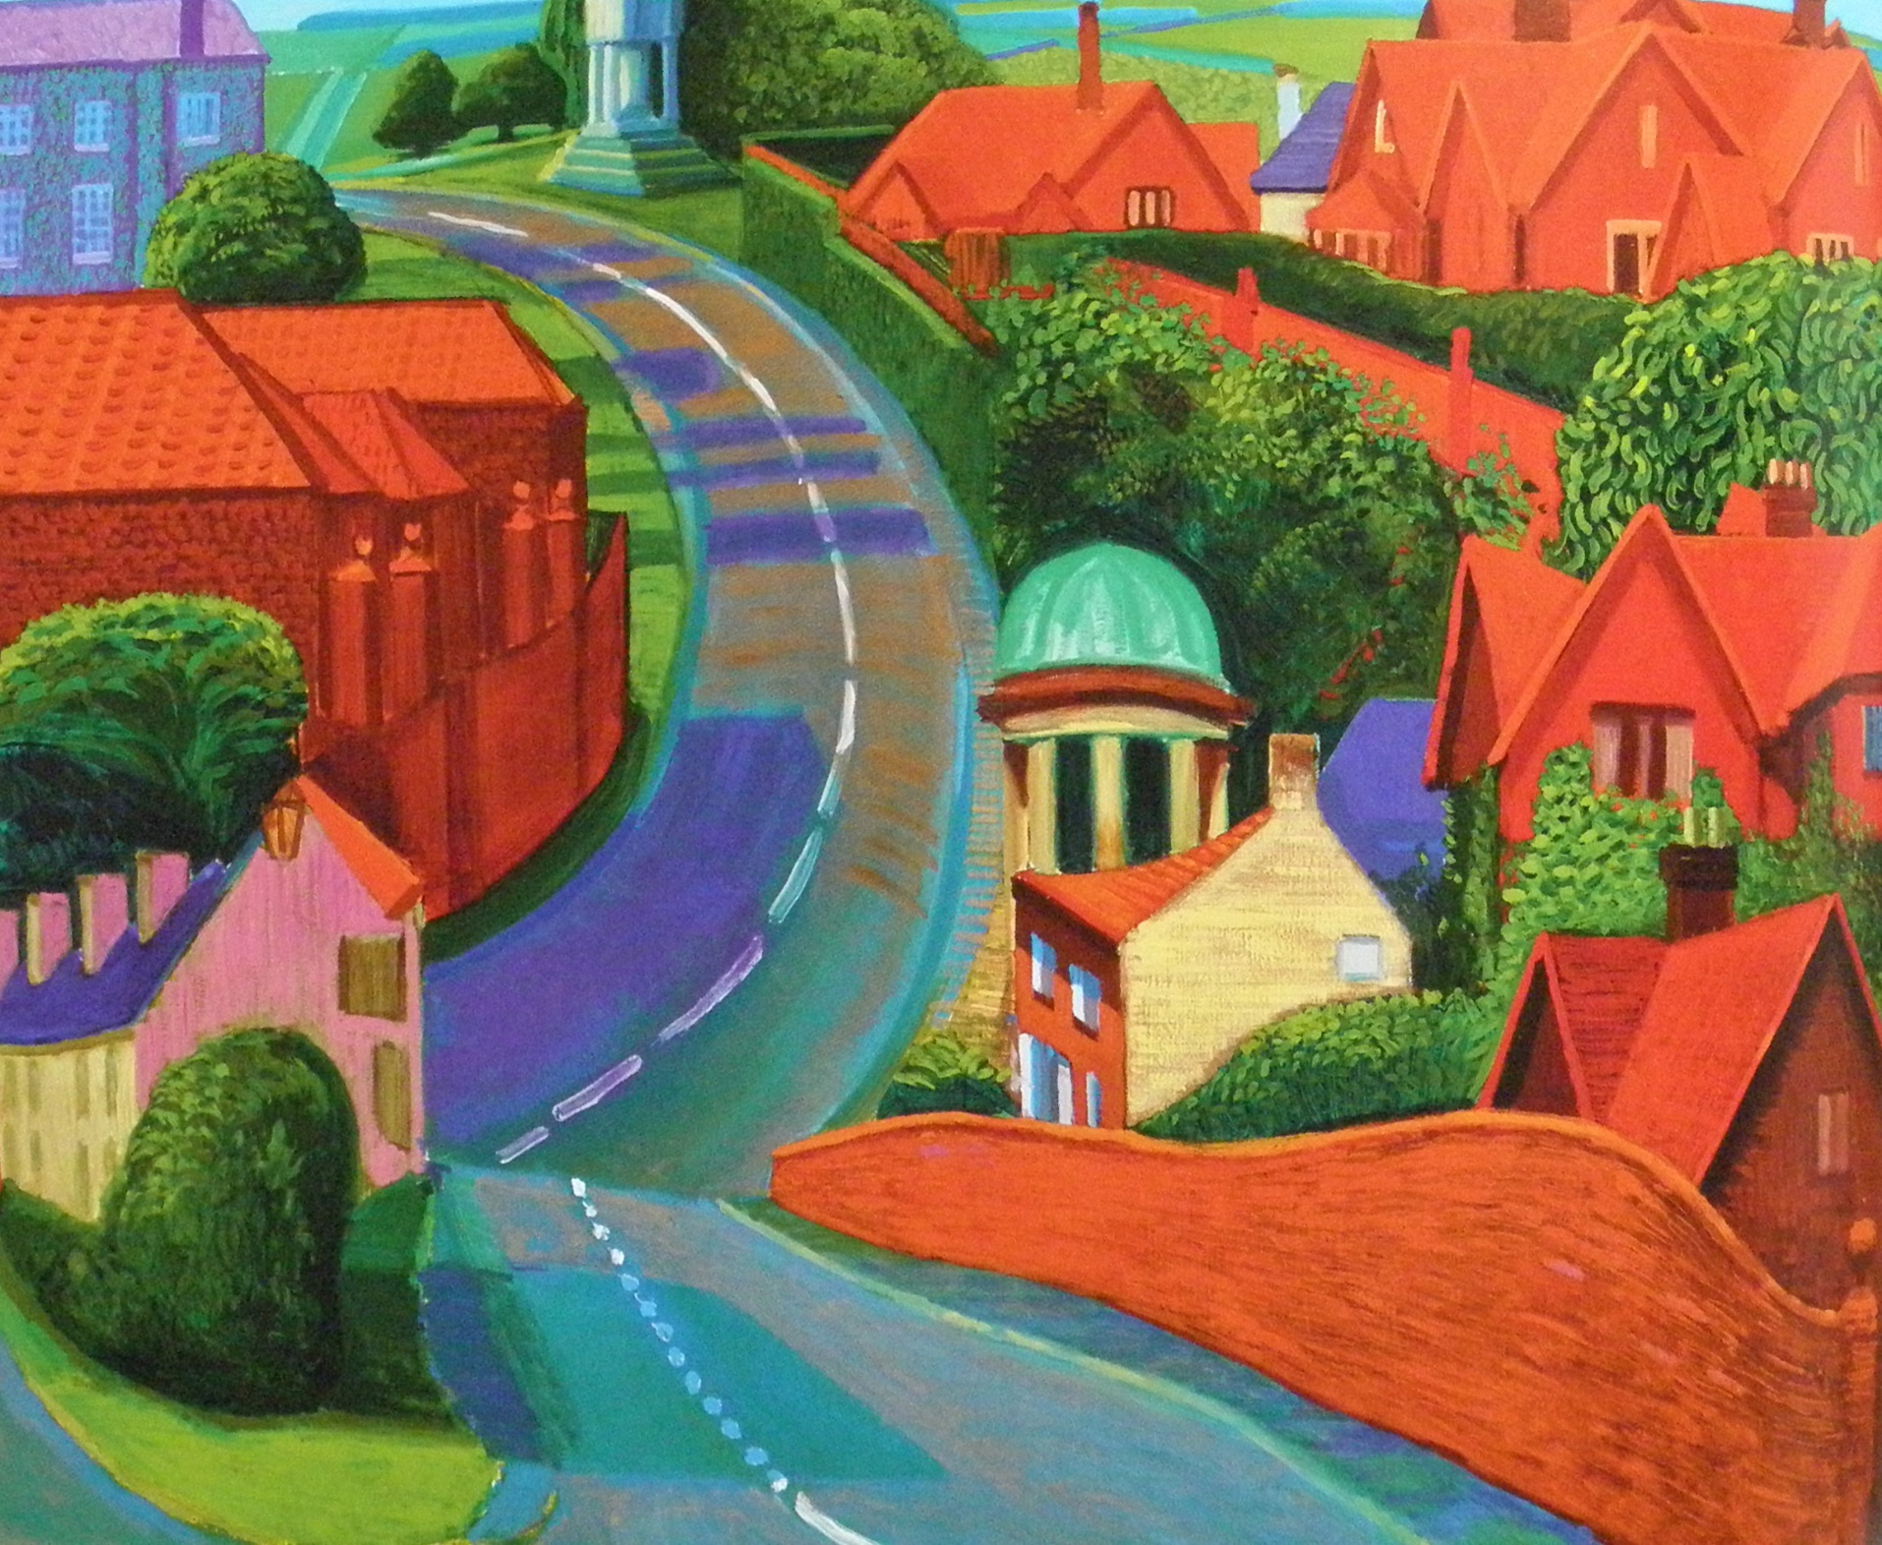
David Hockney "The Road to York through Siedmere." 1997

Slide 6
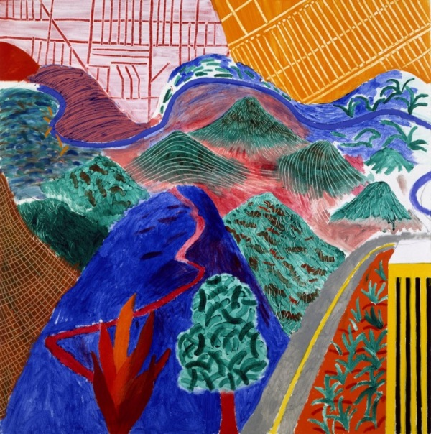
​David Hockney Outpost Drive, Hollywood 1980,Acrylic on canvas, 60 x 60"

Slide 7
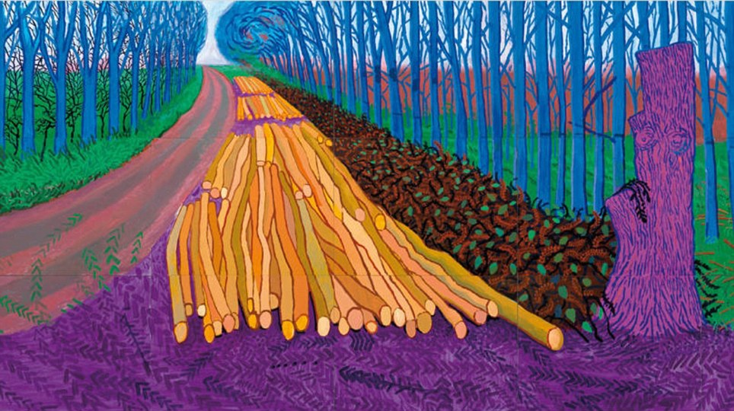
David Hockney ‘Winter Timber’ 2009

Slide 8
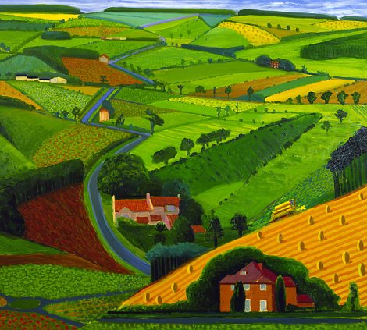
David Hockney ‘The Road Across the Wolds’ 1997

Slide 9
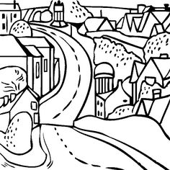

Slide 10
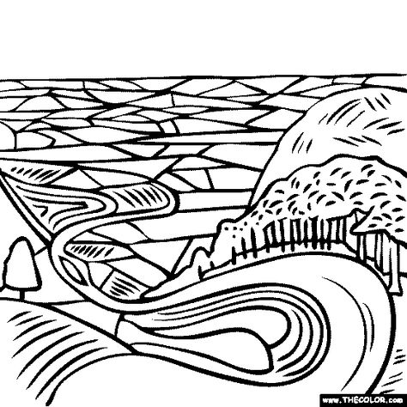

Slide 11
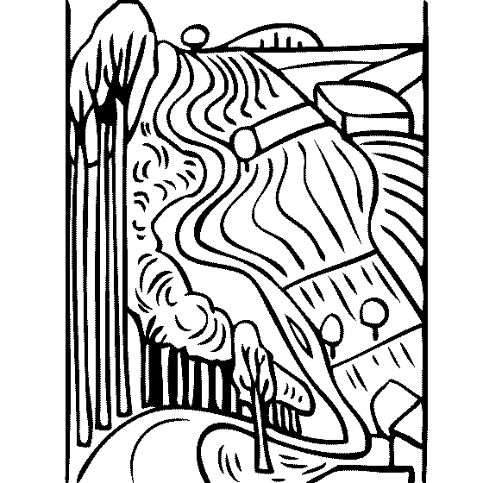

Slide 12
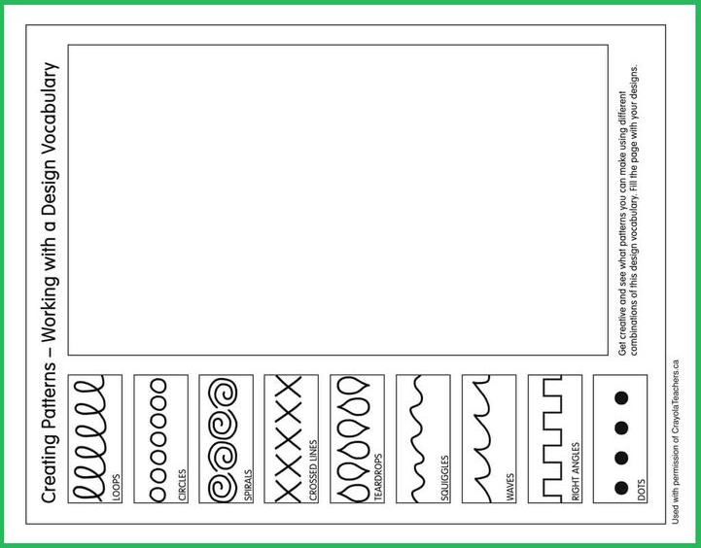

Slide 13
Term 5 Home Learning Pack – Nature
Task 1/Week 1 – Hockney Landscapes. A View From Your Window.
Look at the work of David Hockney and discuss the colours, patterns and shapes that he has used in his landscape paintings. Which one do you like? Why?
Draw the view from your window. Try and include a foreground (things close to you) and a background (things in the distance). Use bright colours and patterns in your view. They don’t have to be realistic, they can reflect how you are feeling and your favourite colours. Hockney didn’t use realistic colours in his painting. See if you can spot some.
Practise drawing patterns using the worksheet to help you. Add some patterns to your drawing. See if you can spot any of the patterns in Hockney’s paintings.
https://www.royalacademy.org.uk/article/exhibition-on-screen-documentary-david-hockney
You may want to watch these documentaries based on the work of David Hockney.

Slide 14
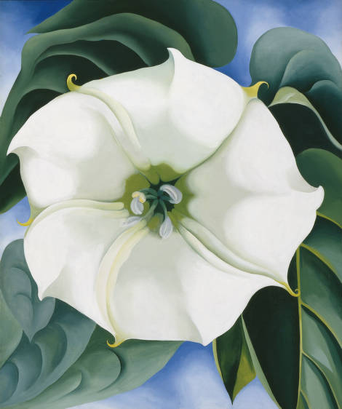
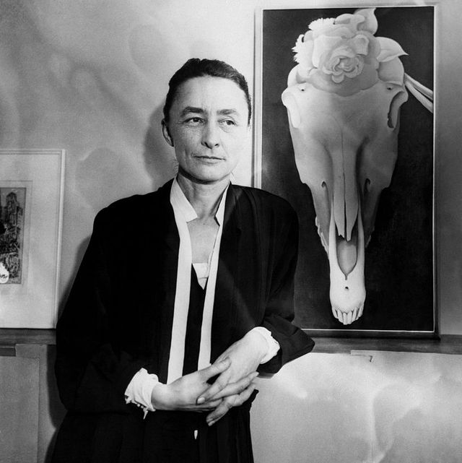
Task 2/Week 2 Georgia O’Keefe – Flowers.
Georgia O’Keefe
1887 - 1986
‘Jimson Weed’
Oil on canvas
1932

Slide 15
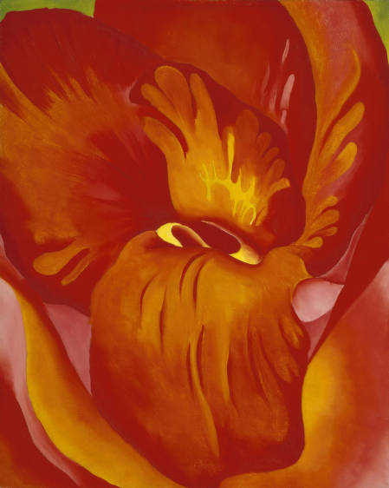
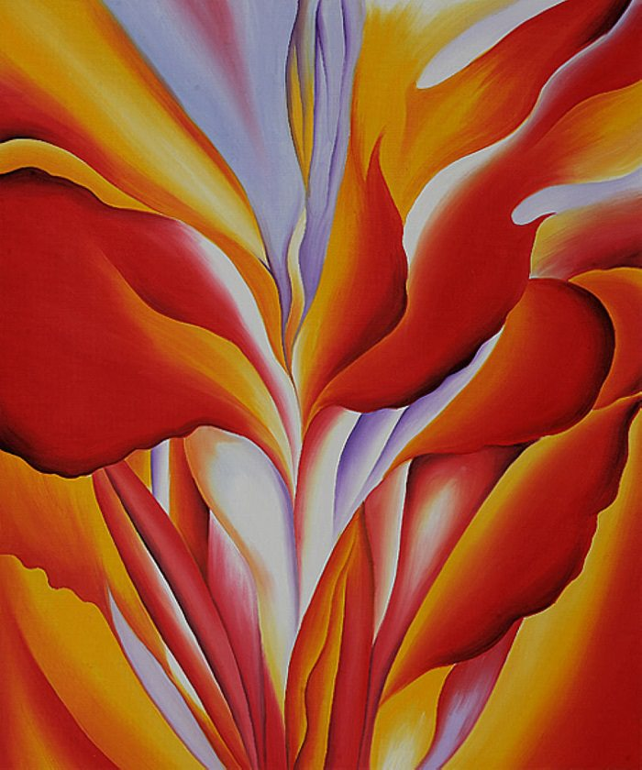
Red Canna, 1924 by Georgia O'Keeffe
‘Canna Red and Orange’ Oil on canvas 1926

Slide 16
Task 2/Week 2
Look at the flower paintings by Georgia O’Keefe. Notice how she has drawn the flowers very large.
Draw a flower and use the whole page. This will be a close up version of the flower so you can add detail including the centre of the flower and any shapes or patterns.
Add colour to your flower using pencils or paints.
If you would like to read more about Georgia O’Keefe click the link below
https://www.twinkl.co.uk/resource/t2-a-163-georgia-okeeffe-information-powerpoint

Slide 17
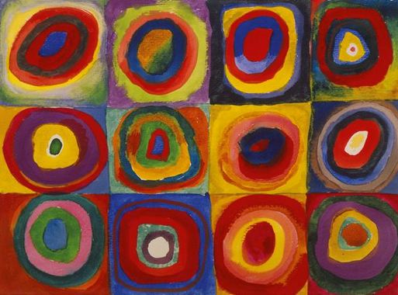
Task 3/Week3 Kandinsky Flowers
Kandinsky "Colour Study. Squares with Concentric Circles". 1913

Slide 18
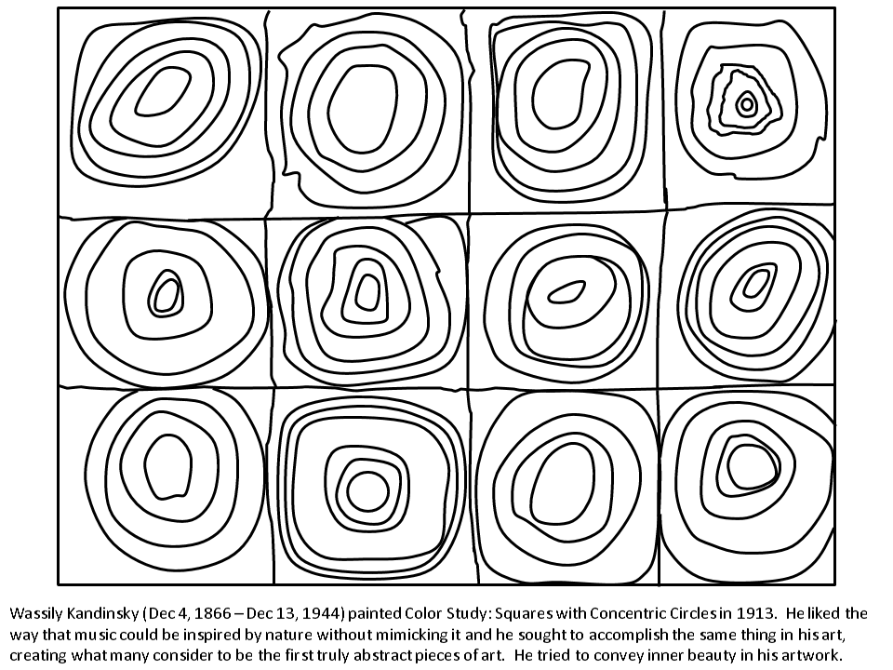

Slide 19
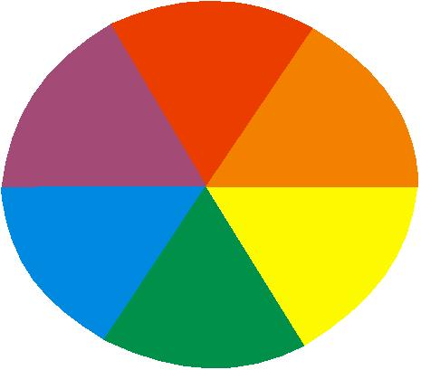
Task 3/Week 3
Create Kandinsky flowers inspired by his circle painting.
Paint a rainbow background and add drawings of round flowers. You can use the black and white circles to help you.
Try and use at least 10 different colours.
You can try and mix your own colours. Remember you could use complimentary colours.
Complimentary colours sit opposite each other on the colour
wheel.
Red and green
Orange and blue
Purple and yellow.
Try and use these colours together when you are painting
your round flowers.

