Slide 2
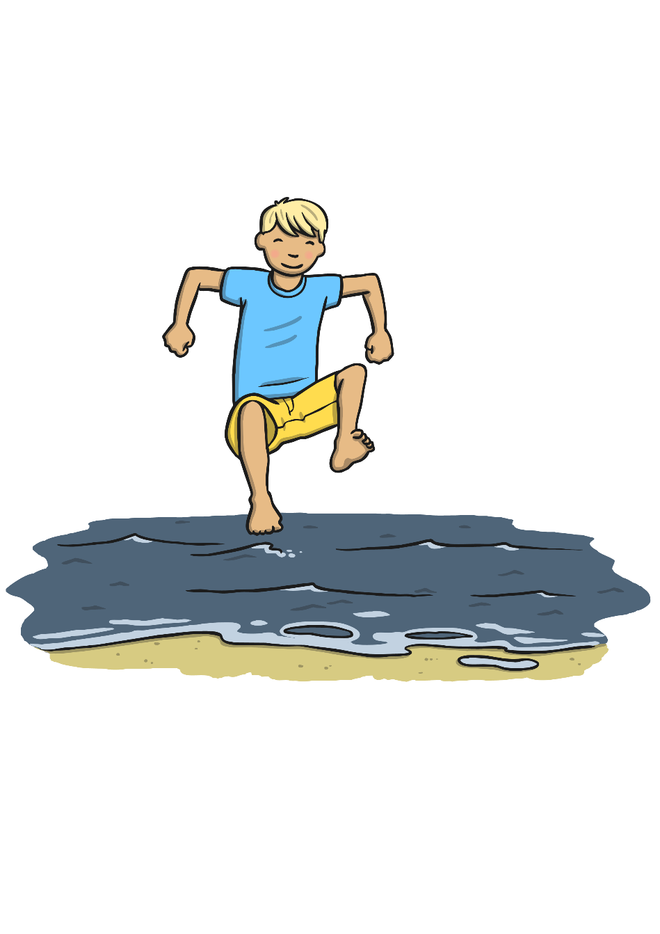
We’re going for a paddle.
We’re going for a big splash.
A wave comes along,
And back we dash.

Slide 3

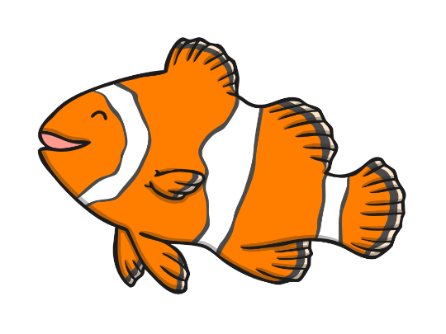
Fishes in the water.
Fishes in the sea.
We all jump up with a 1, 2, 3!

