Slide 2
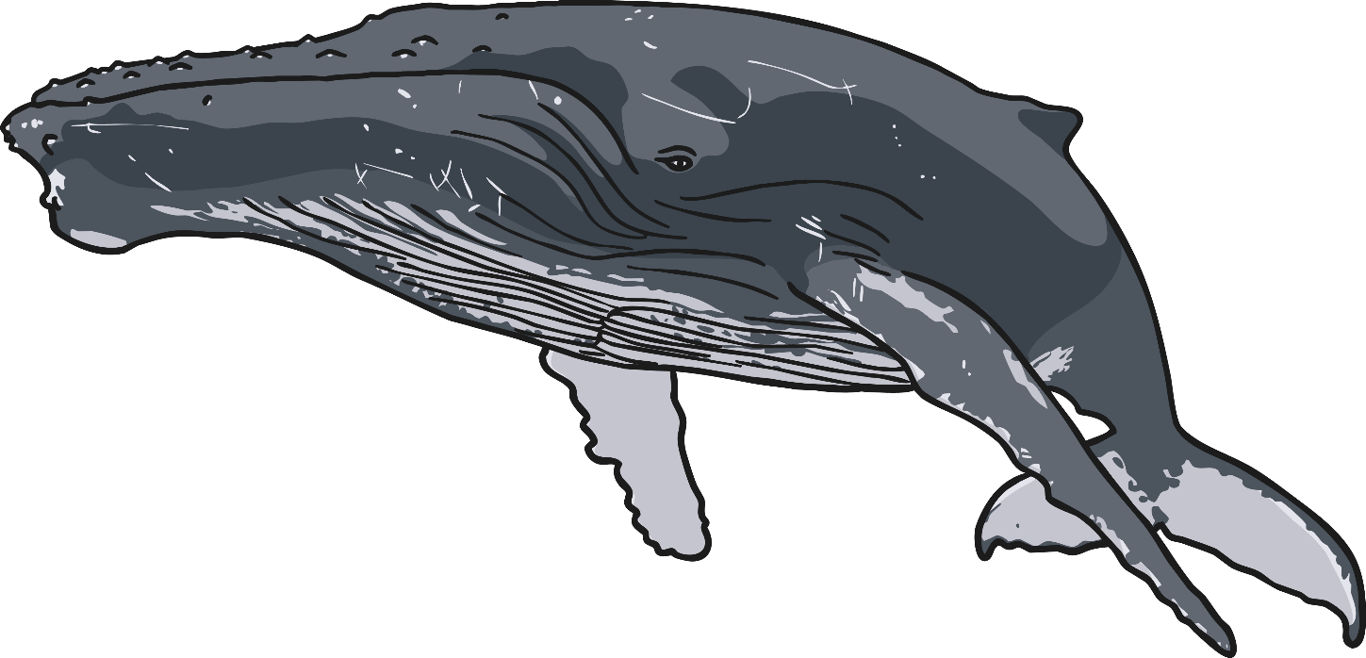
Down in the ocean where nobody goes,
There’s a humpback whale washing his clothes.
With a rub-a-dub here and a rub-a-dub there,
That’s the way he washes his clothes.

Slide 3
A Boogie, a woogie, a boogie woogie woogie woogie.
A Boogie, a woogie, a boogie woogie woogie woogie.
A Boogie, a woogie, a boogie woogie woogie woogie.
That’s the way he washes his clothes.

Slide 4
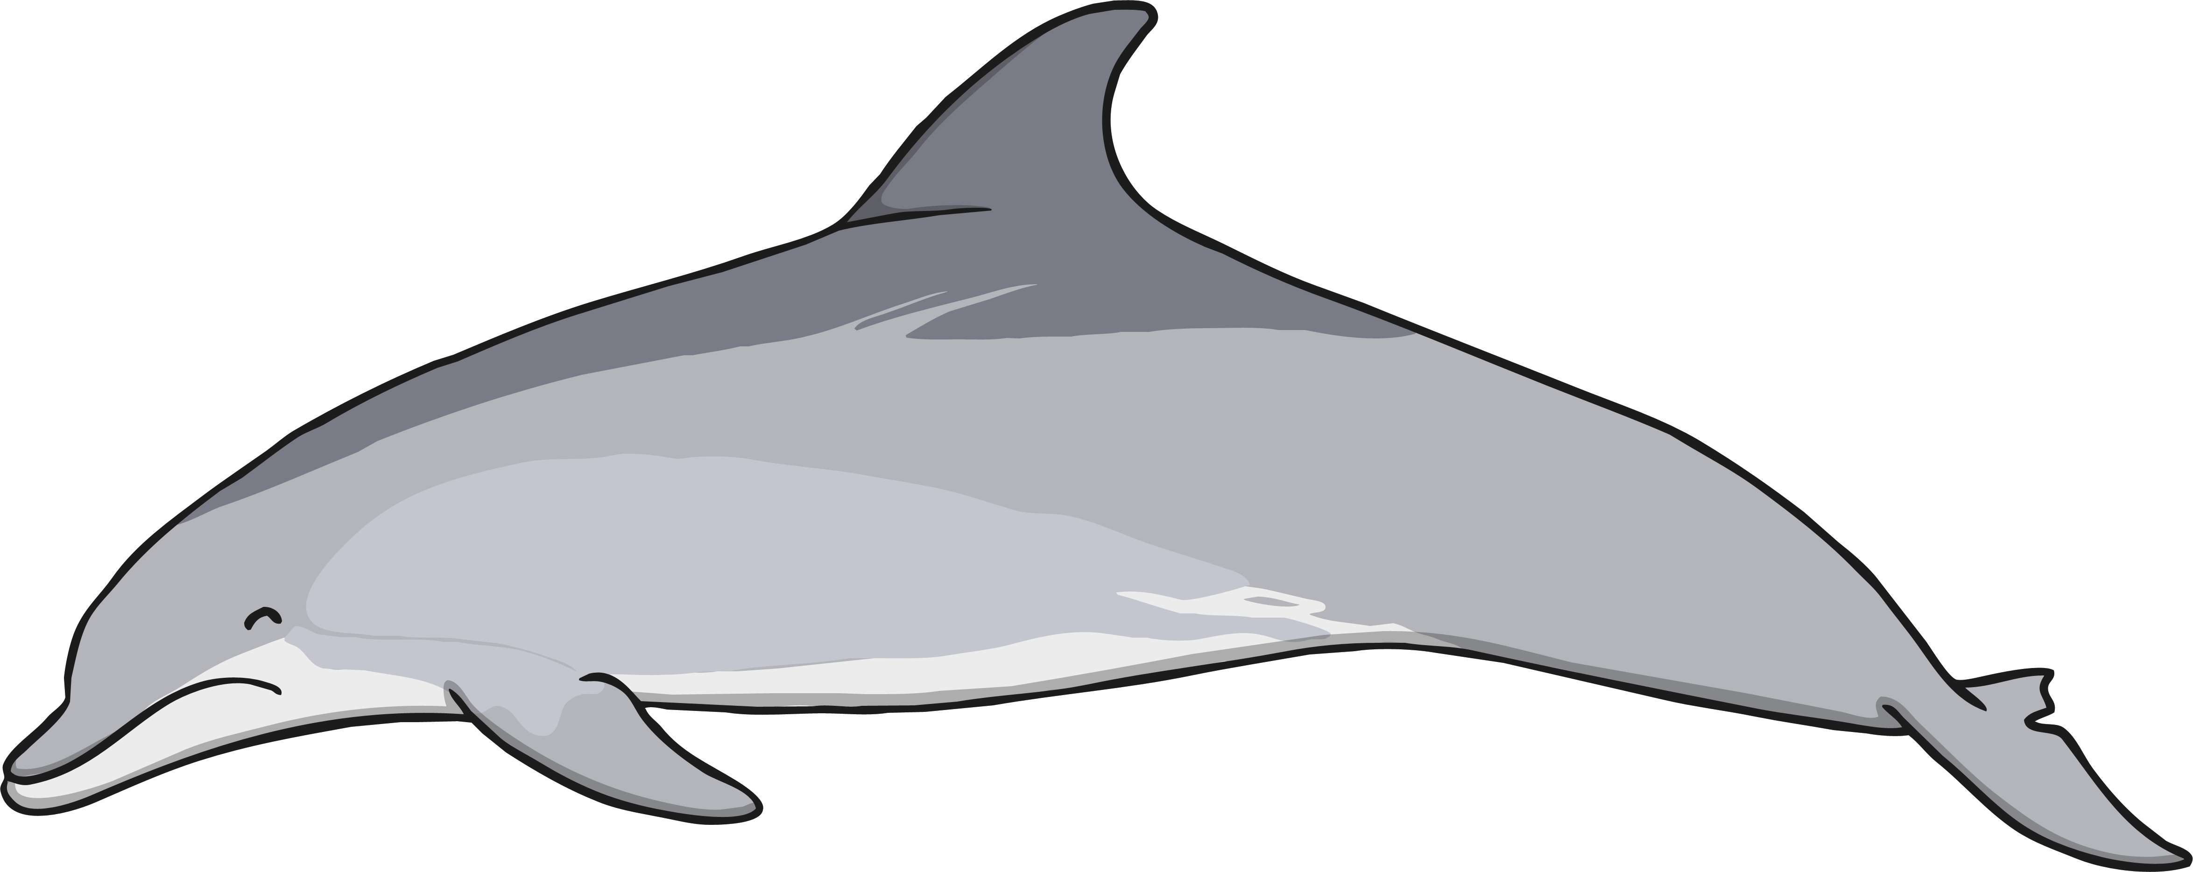
Down in the ocean where nobody goes,
There’s a bottlenose dolphin washing his clothes.
With a rub-a-dub here and a rub-a-dub there,
That’s the way he washes his clothes.

Slide 5
A Boogie, a woogie, a boogie woogie woogie woogie.
A Boogie, a woogie, a boogie woogie woogie woogie.
A Boogie, a woogie, a boogie woogie woogie woogie.
That’s the way he washes his clothes.

Slide 6
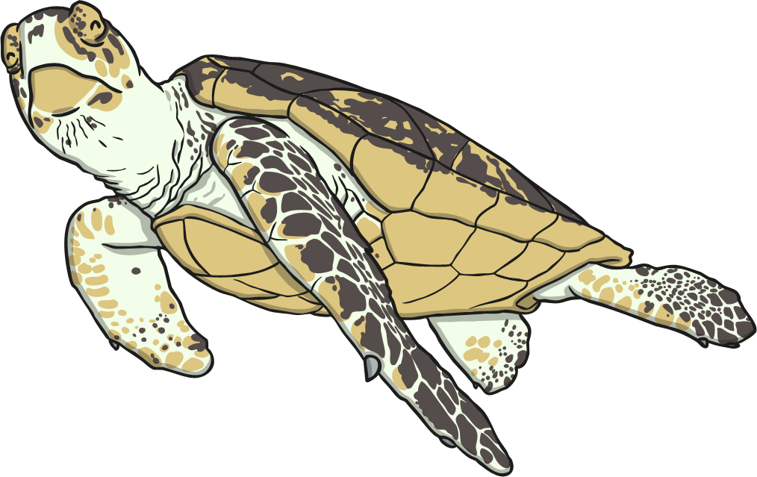
Down in the ocean where nobody goes,
There’s a loggerhead turtle washing his clothes.
With a rub-a-dub here and a rub-a-dub there,
That’s the way he washes his clothes.

Slide 7
A Boogie, a woogie, a boogie woogie woogie woogie.
A Boogie, a woogie, a boogie woogie woogie woogie.
A Boogie, a woogie, a boogie woogie woogie woogie.
That’s the way he washes his clothes.

Slide 8
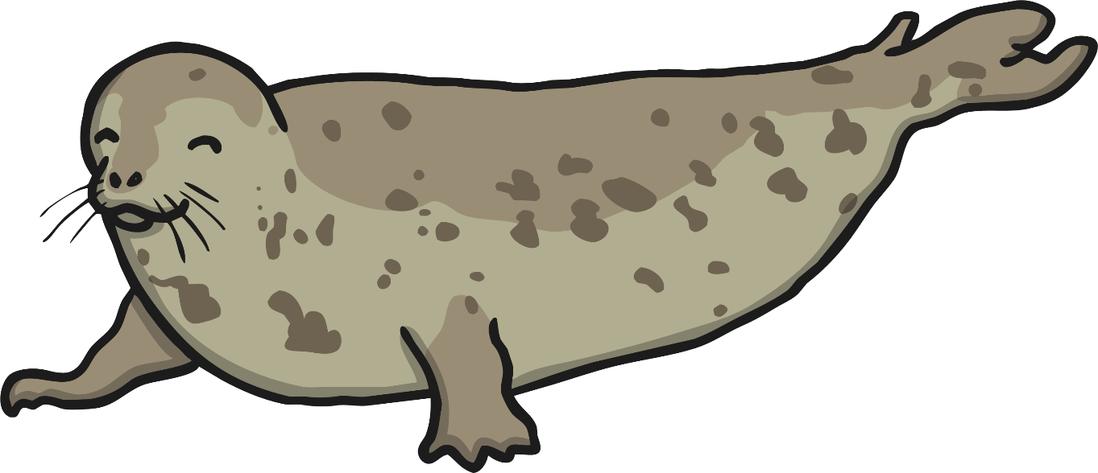
Down in the ocean where nobody goes,
There’s an elephant seal washing his clothes.
With a rub-a-dub here and a rub-a-dub there,
That’s the way he washes his clothes.

Slide 9
A Boogie, a woogie, a boogie woogie woogie woogie.
A Boogie, a woogie, a boogie woogie woogie woogie.
A Boogie, a woogie, a boogie woogie woogie woogie.
That’s the way he washes his clothes.

