Slide 2
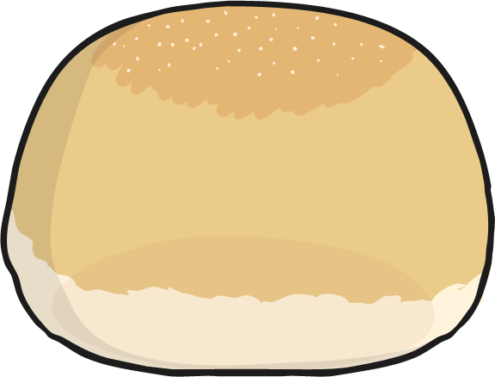
Fisherman, he caught 1.
He caught fishes with a bun.
With a hook, line, flick the wrists, cast it out to sea.
Catching fishes for my tea.

Slide 3

Fisherman, he caught 2.
He caught fishes with a shoe.
With a hook, line, flick the wrists, cast it out to sea.
Catching fishes for my tea.

Slide 4

Fisherman, he caught 3.
He caught fishes with a bee.
With a hook, line, flick the wrists, cast it out to sea.
Catching fishes for my tea.

Slide 5
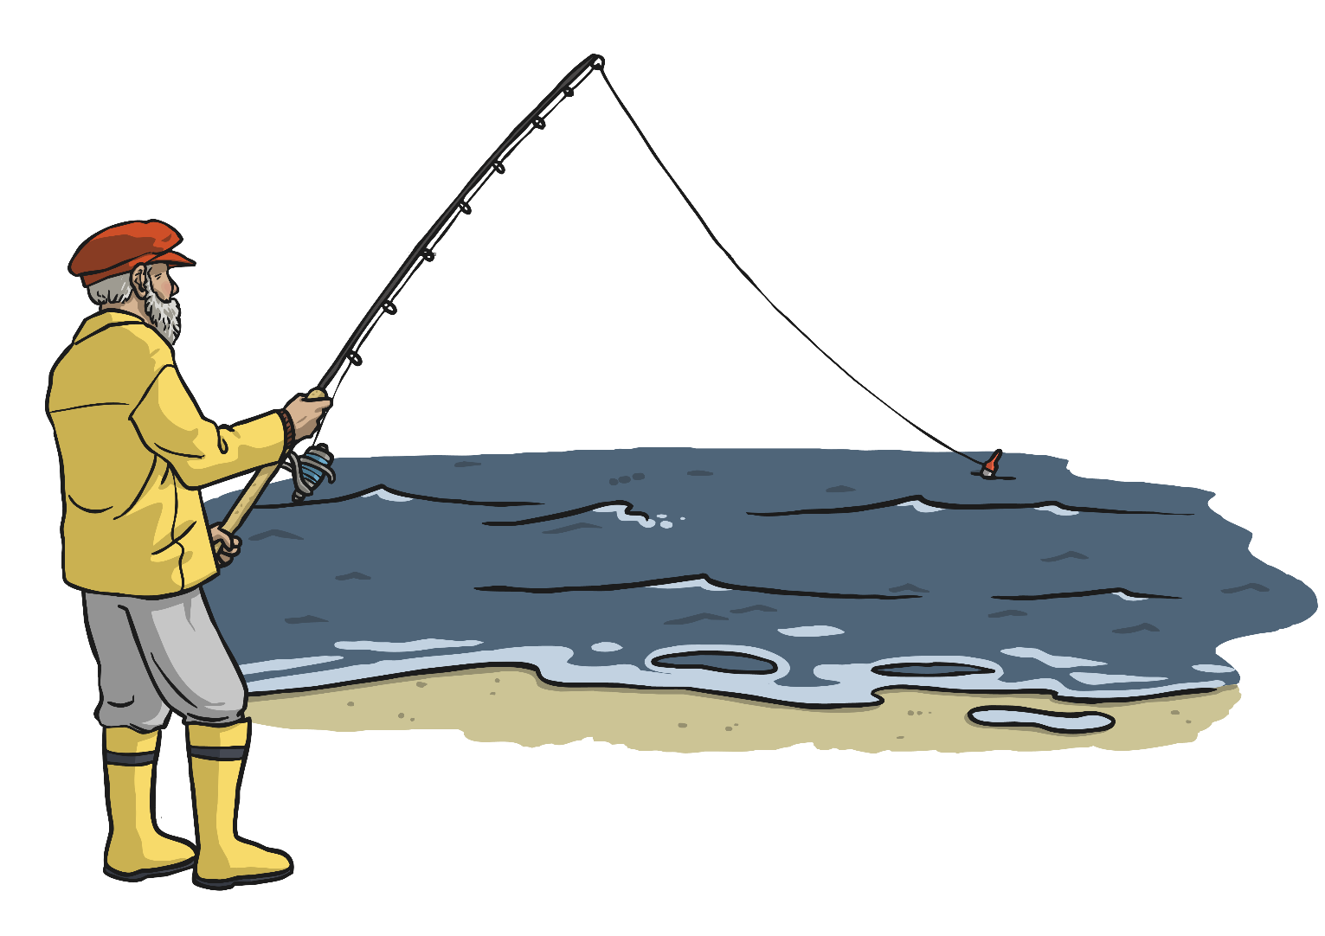
Fisherman, he caught 4.
He caught fishes from the shore.
With a hook, line, flick the wrists, cast it out to sea.
Catching fishes for my tea.

Slide 6

Fisherman, he caught 5.
He caught fishes on a dive.
With a hook, line, flick the wrists, cast it out to sea.
Catching fishes for my tea.

Slide 7
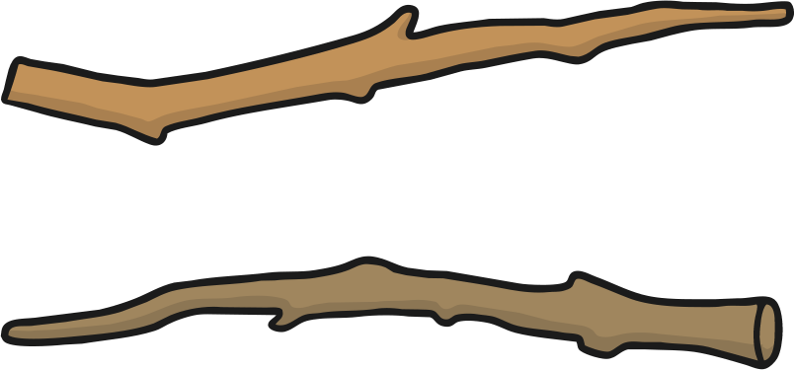
Fisherman, he caught 6.
He caught fishes with some sticks.
With a hook, line, flick the wrists, cast it out to sea.
Catching fishes for my tea.

Slide 8
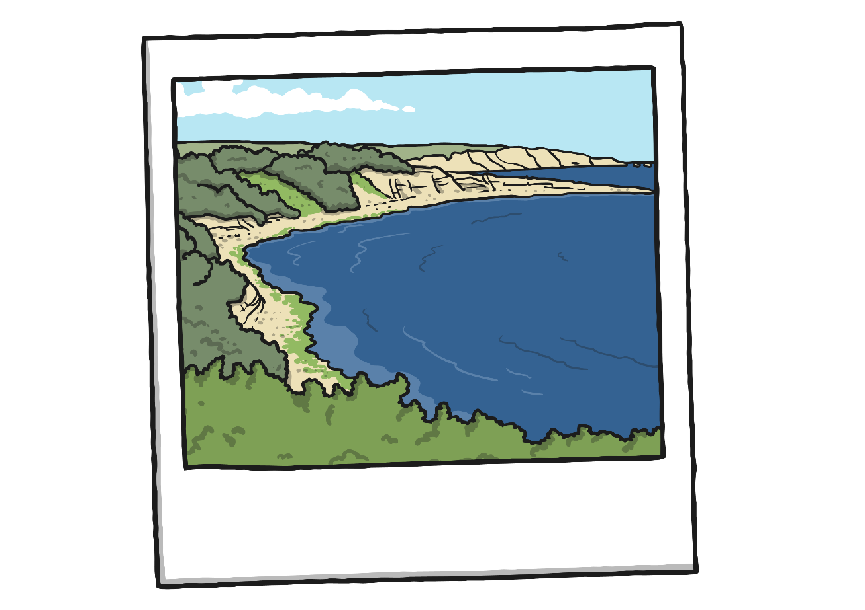
Fisherman, he caught 7.
He caught fishes down in Devon.
With a hook, line, flick the wrists, cast it out to sea.
Catching fishes for my tea.

Slide 9
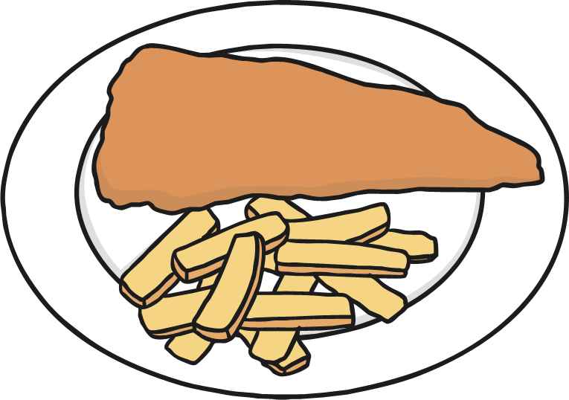
Fisherman, he caught 8.
He caught fishes for his plate.
With a hook, line, flick the wrists, cast it out to sea.
Catching fishes for my tea.

Slide 10
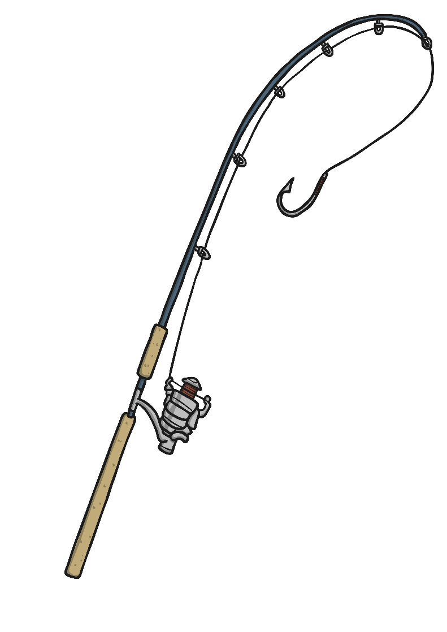
Fisherman, he caught 9.
He caught fishes on his line.
With a hook, line, flick the wrists, cast it out to sea.
Catching fishes for my tea.

Slide 11
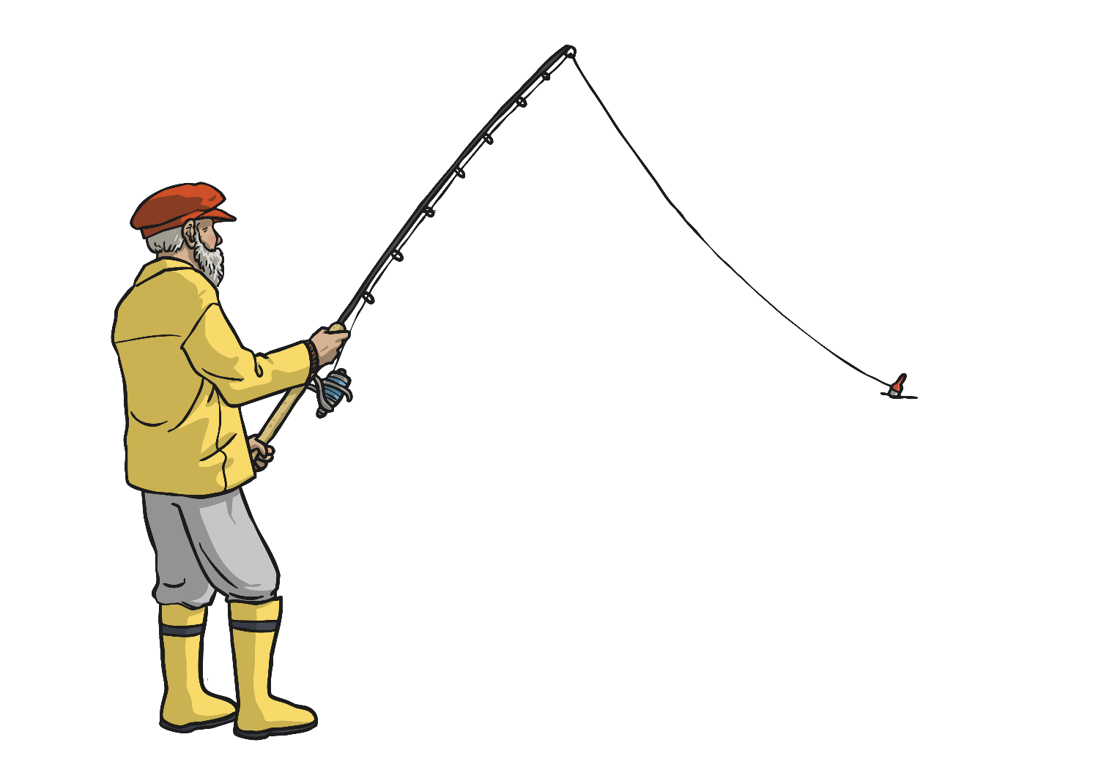
Fisherman, he caught 10.
He caught fishes once again.
With a hook, line, flick the wrists, cast it out to sea.
Catching fishes for my tea.

