Slide 2

One, two, three, four, five,
Once I caught a fish alive.

Slide 3

Six, seven, eight, nine, ten,
Then I let it go again.

Slide 4
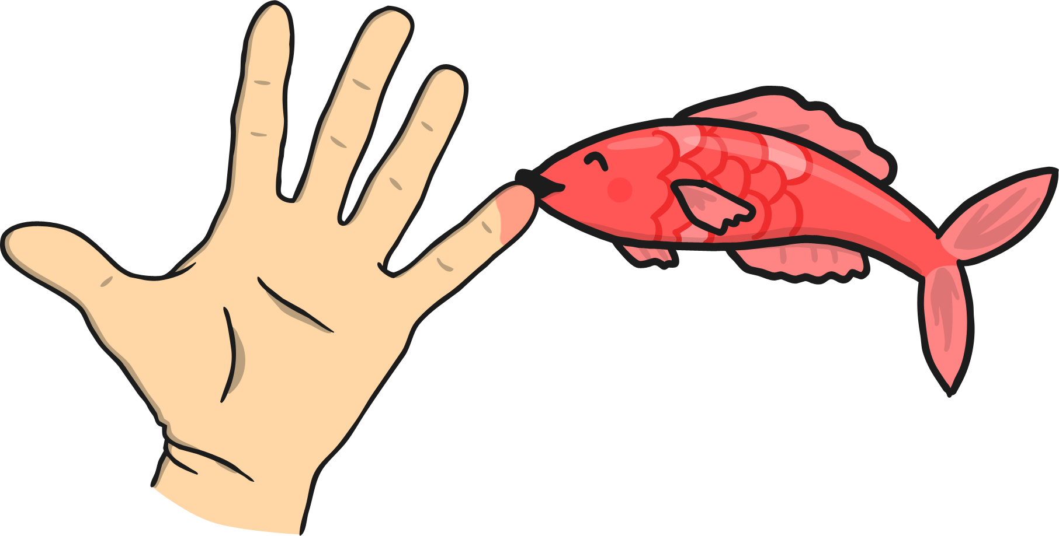
Why did you let it go?
Because it bit my finger so.

Slide 5

Which finger did it bite?
The little finger on the right.

