Slide 2
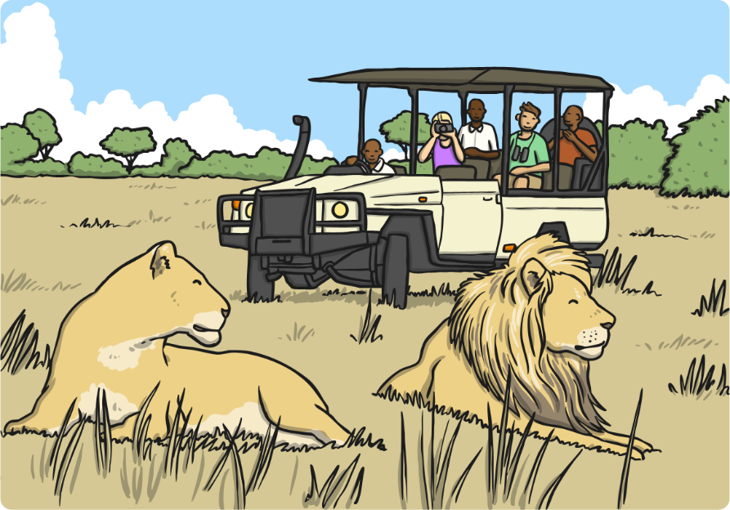
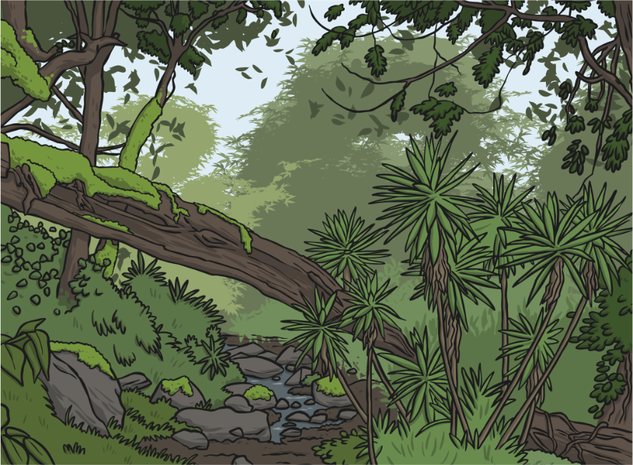
Amazing Africa
Africa is an amazing place. It is made up of a lot of countries that form the second largest continent in the world.
The northern half of the continent is mainly desert.
The southern half is mostly made up of jungle, rainforest and plains.

Slide 3
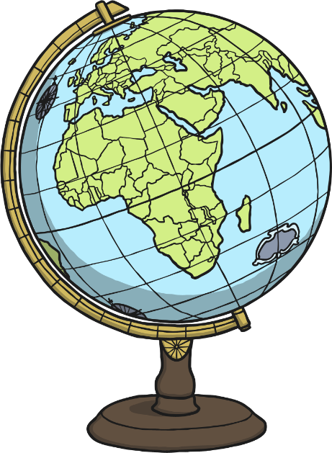
Fascinating Facts
Some of the countries in Africa include: Algeria, Egypt, Ethiopia, Ghana, Kenya, Madagascar, Morocco, Nigeria, Uganda and Zimbabwe.
There are over 1000 languages spoken in Africa.
The Sahara, in northern Africa, is the largest desert in the world.
The longest river in the world, the Nile, is in Africa.
Africa is the hottest continent in the world.

Slide 4
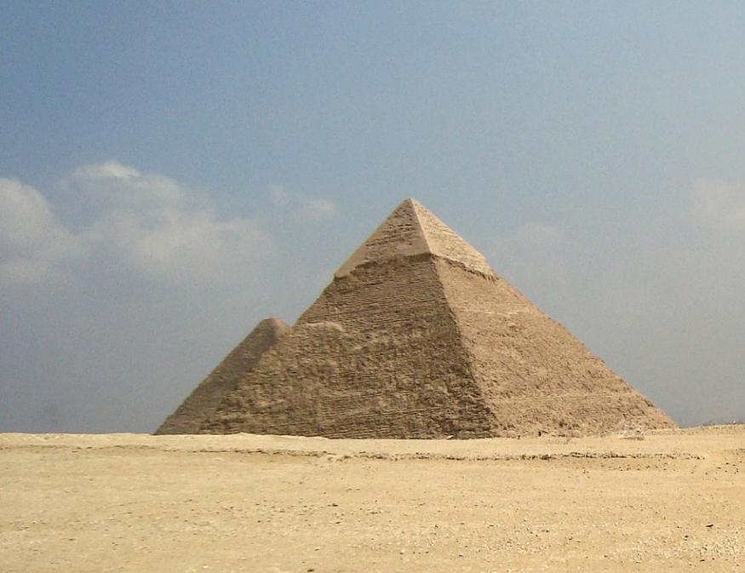
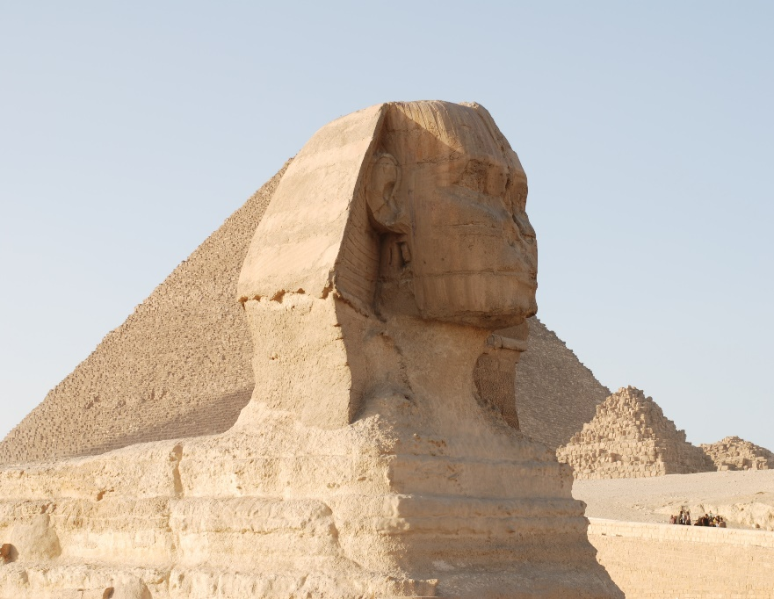
Landmarks
There are many famous landmarks in Africa.
The Egyptian pyramids and Sphinx
These are in Egypt and were built over 4000 years ago.
Photo courtesy of wilhelmja (@flickr.com) - granted under creative commons licence - attribution

Slide 5
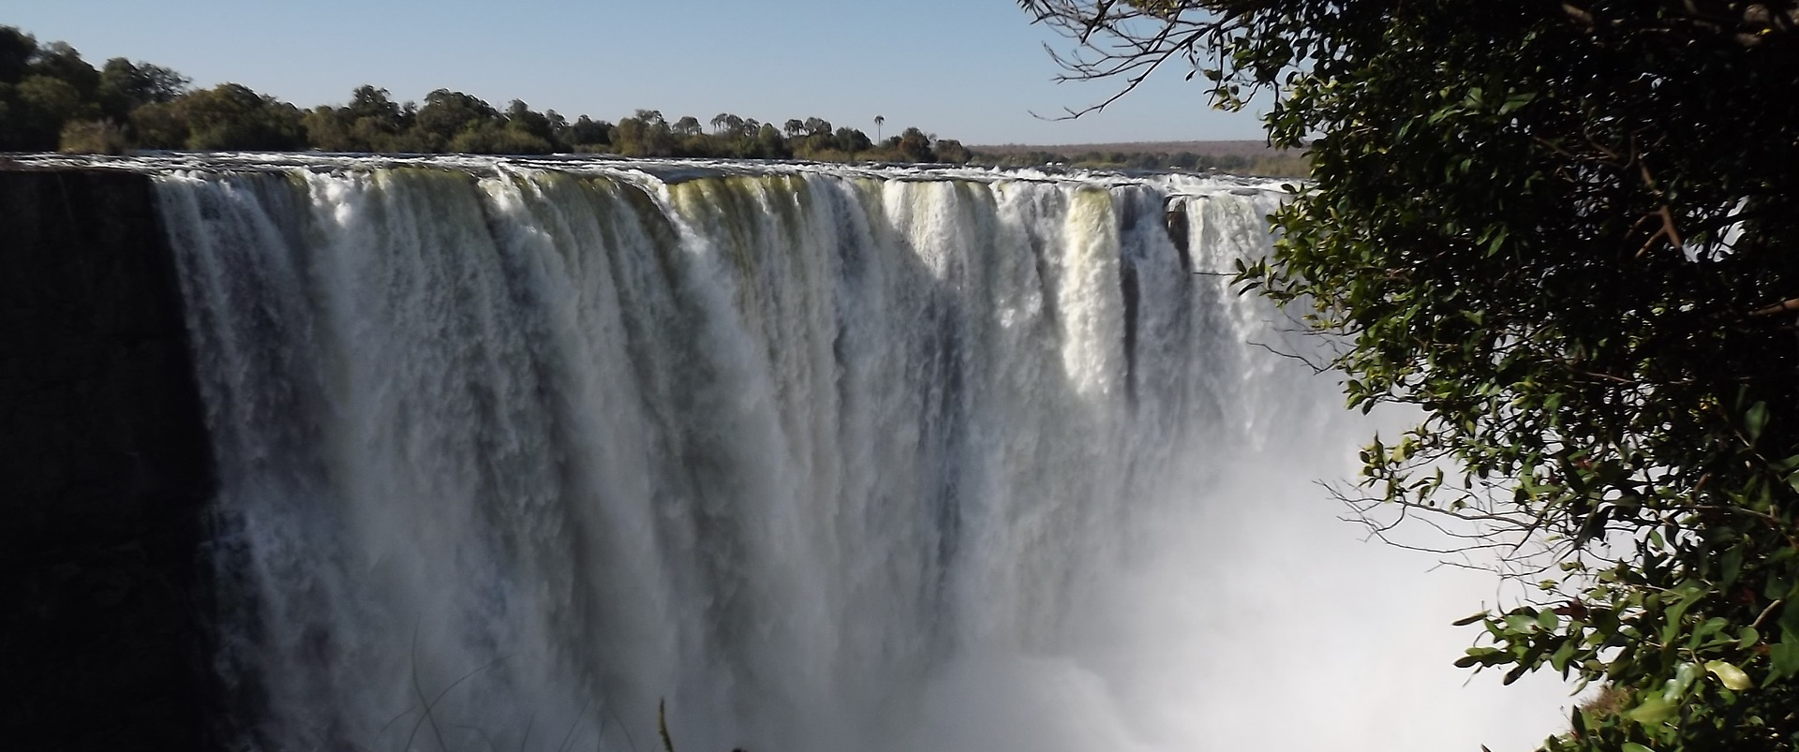
Landmarks
Victoria Falls
These amazing waterfalls are found between 2 countries: Zambia and Zimbabwe.

Slide 6
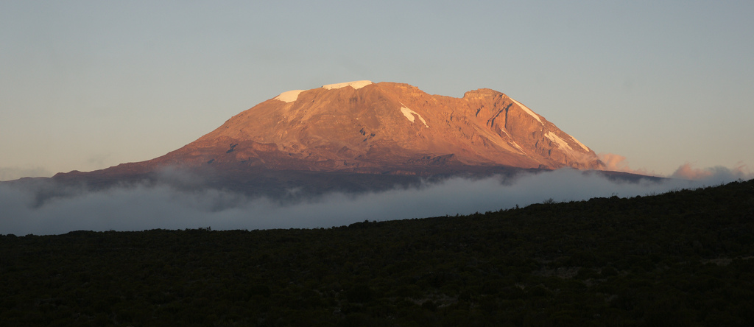
Landmarks
Mount Kilimanjaro
This very tall mountain is in Tanzania. It is the highest mountain in Africa and stands at 5895 metres above sea level. Many people have enjoyed climbing it.
Photo courtesy mitchpa1984 (@flickr.com) - granted under creative commons licence - attribution

Slide 7
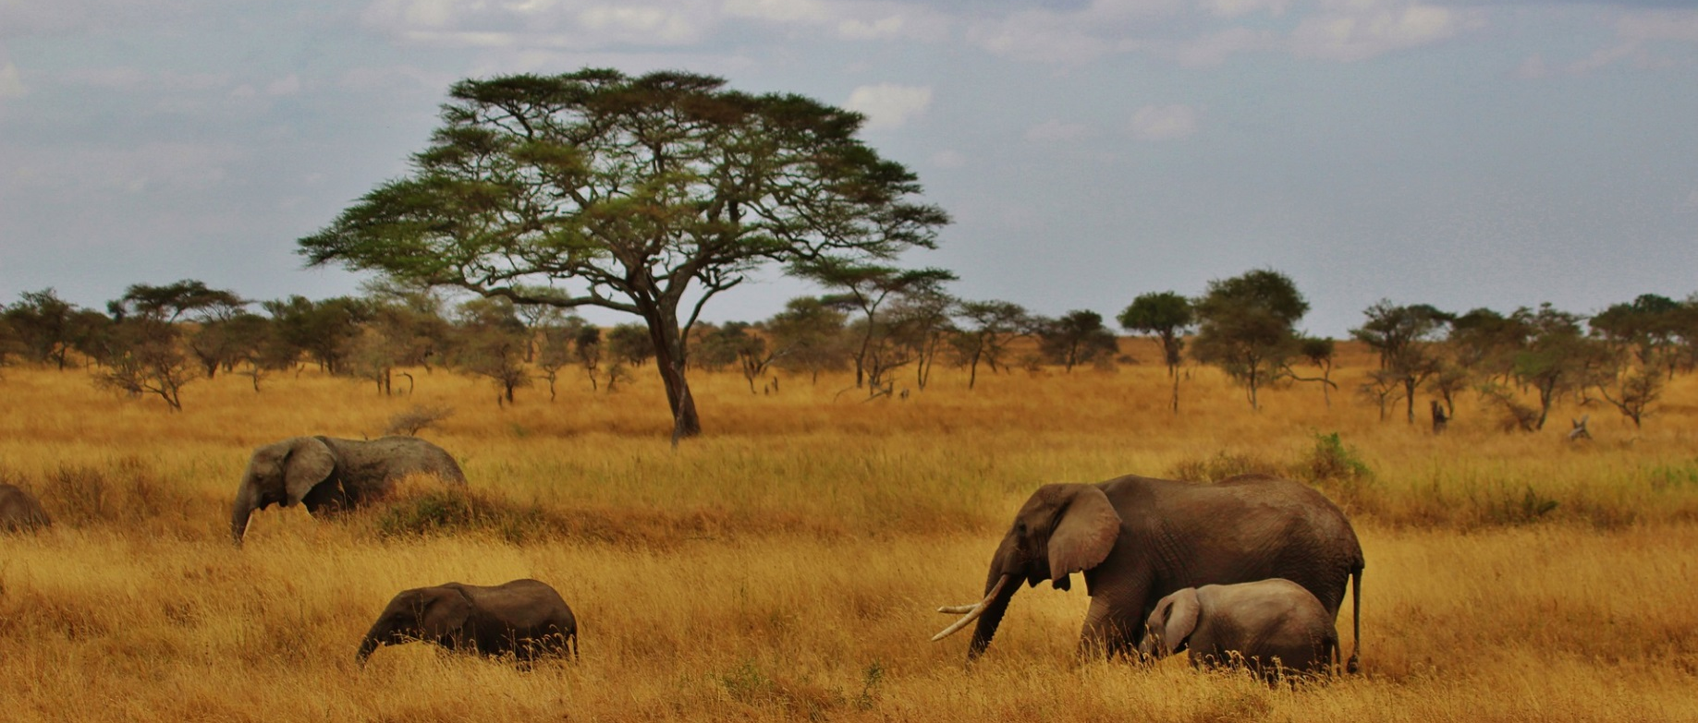
Landmarks
Serengeti National Park, Tanzania
Lots of people visit this beautiful park each year. It very big and is home to millions of animals, including lions, zebras, elephants and giraffes.

Slide 8
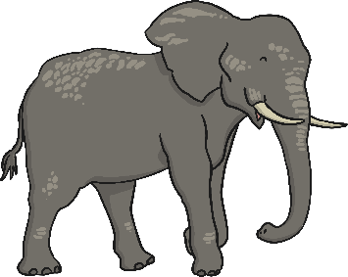
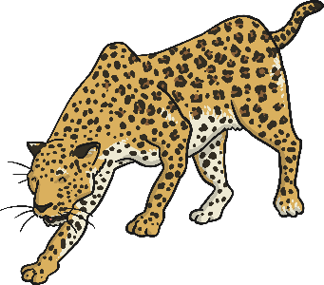
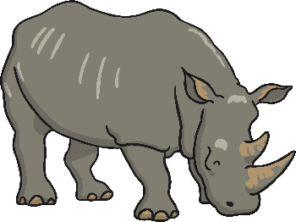
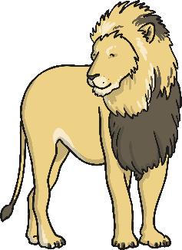
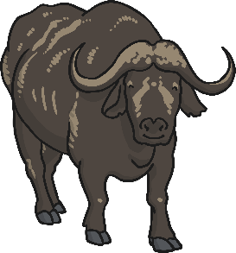
Africa’s Animals
Africa is well known for its wonderful animals. It is one of the few places you can see them in their natural habitat.
People often go to Africa to see the Big 5:
elephant
leopard
rhino
buffalo
lion

Slide 9
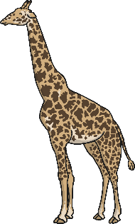
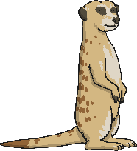
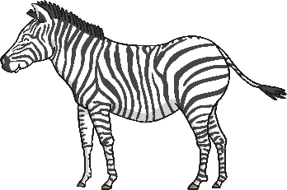
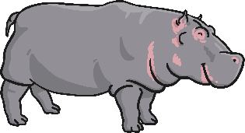
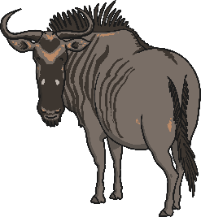
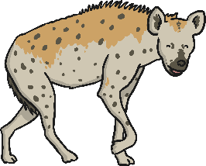
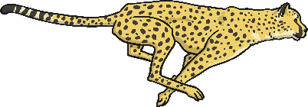
African Safari
Lots of people like to go on safari in Africa. On safari you can see lots of animals in their natural homes. Some of the animals that might be seen on safari include:
giraffe
hippopotamus
meerkat
zebra
wildebeest
cheetah
hyena

Slide 10
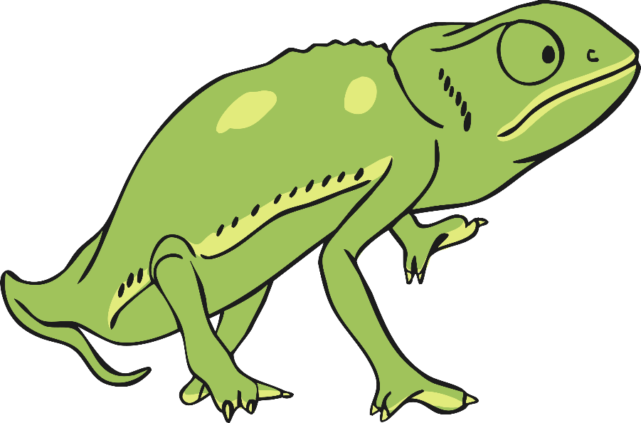
Animal Facts
There are over 2600 different types of bird that live in Africa.
4 out of 5 of the fastest animals in the world can be found in Africa:
The cheetah, which can reach speeds of 70mph.
The wildebeest, Thomson’s gazelle and lion - all of which can reach
speeds of 50 mph.
Some animals live in African jungles and some live in the desert.
Africa is also home to gorillas, Nile crocodiles
and the world’s largest chameleons.

