Slide 1






Guidance for Video/Audio in PowerPoints
1. Open the folder and copy all the files.
2. Paste the copied files into a new folder.
3. Open the PowerPoint file, enable editing and enter presentation mode (start the slide show).
Please note the embedded audio may not be compatible with early versions of PowerPoint.
You may wish to delete this slide before beginning the presentation.

Slide 3
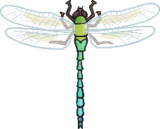

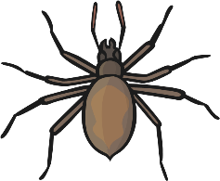



Choose a minibeast video to watch
plenary

Slide 4
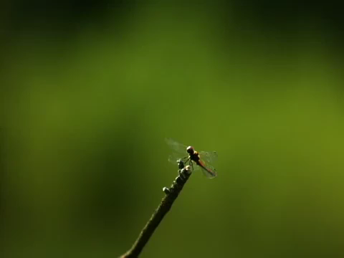
Dragonfly

Slide 5
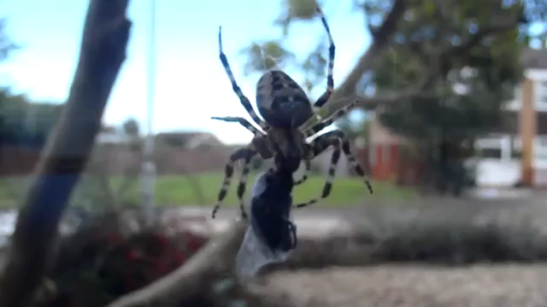
Spider

Slide 6
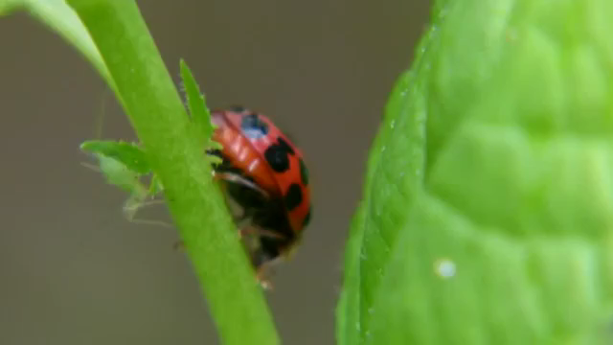
Ladybird

Slide 7
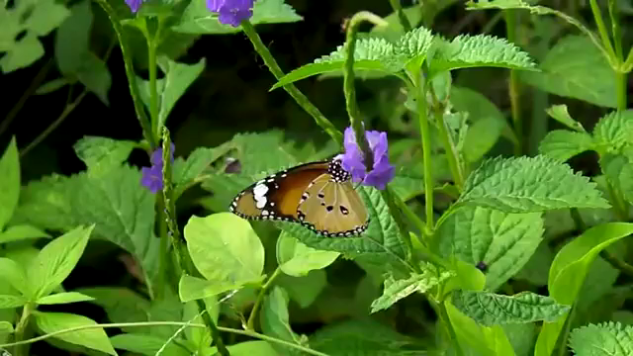
Butterfly

Slide 8

Snail

Slide 9
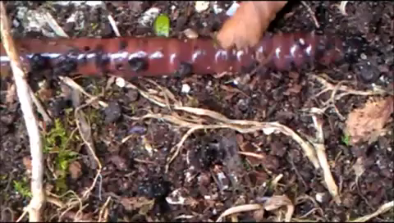
Worm

Slide 10
Did all the minibeasts have legs?
If so, how many?
Could all of the minibeasts fly?
Name all six minibeasts.
What was your favourite minibeast and why?

