Slide 1



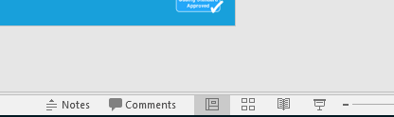


Guidance for Video/Audio in PowerPoints
1. Open the folder and copy all the files.
2. Paste the copied files into a new folder.
3. Open the PowerPoint file, enable editing and enter presentation mode (start the slide show). Go to slide 3 and the backing track will start automatically.
Please note the embedded audio may not be compatible with early versions of PowerPoint.
You may wish to delete this slide before beginning the presentation.

Slide 2


Slide 3



This is way we clean the ship,
Clean the ship, clean the ship.
This is way we clean the ship,
We’re off on an adventure!
(Add actions as though sweeping and scrubbing a ship)

Slide 4


Then we go sailing on the sea,
On the sea, on the sea.
Then we go sailing on the sea,
We’re off on an adventure!
(Add actions as though bobbing up and down on a boat or use hands to create a wave action)

Slide 5

This is way the parrots fly,
Parrots fly, parrots fly.
This is way the parrots fly,
We’re off on an adventure!
(Add actions as of a parrot flying by flapping arms like wings)

Slide 6
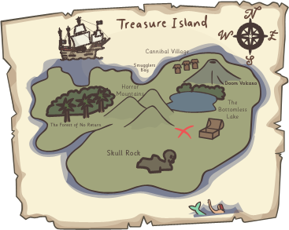
This is way we use the map,
Use the map, use the map.
This is way we use the map,
We’re off on an adventure!
(Add actions as though unrolling and looking at a map)

Slide 7
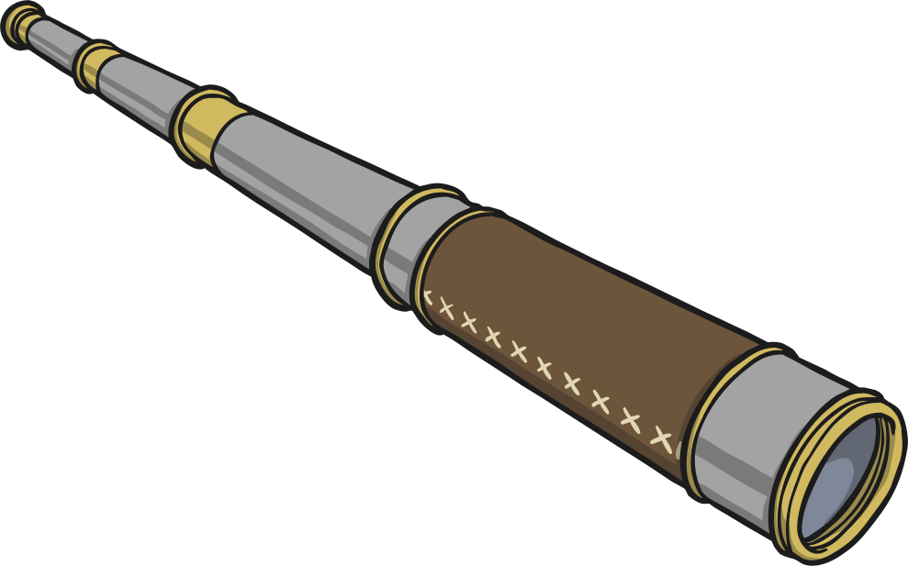
Then we can use our telescopes,
Telescopes, telescopes.
Then we can use our telescopes,
We’re off on an adventure!
(Add actions as though looking through a telescope)

Slide 8

On the island, X marks the spot,
Marks the spot, marks the spot.
On the island, X marks the spot,
We’re off on an adventure!
(Add actions to make an X using arms)
X

Slide 9

Then we dug up a treasure chest,
Treasure chest, treasure chest.
Then we dug up a treasure chest,
We’ve been on an adventure!
(Add actions as though digging up a treasure chest or cheering)

Slide 10


