Slide 2
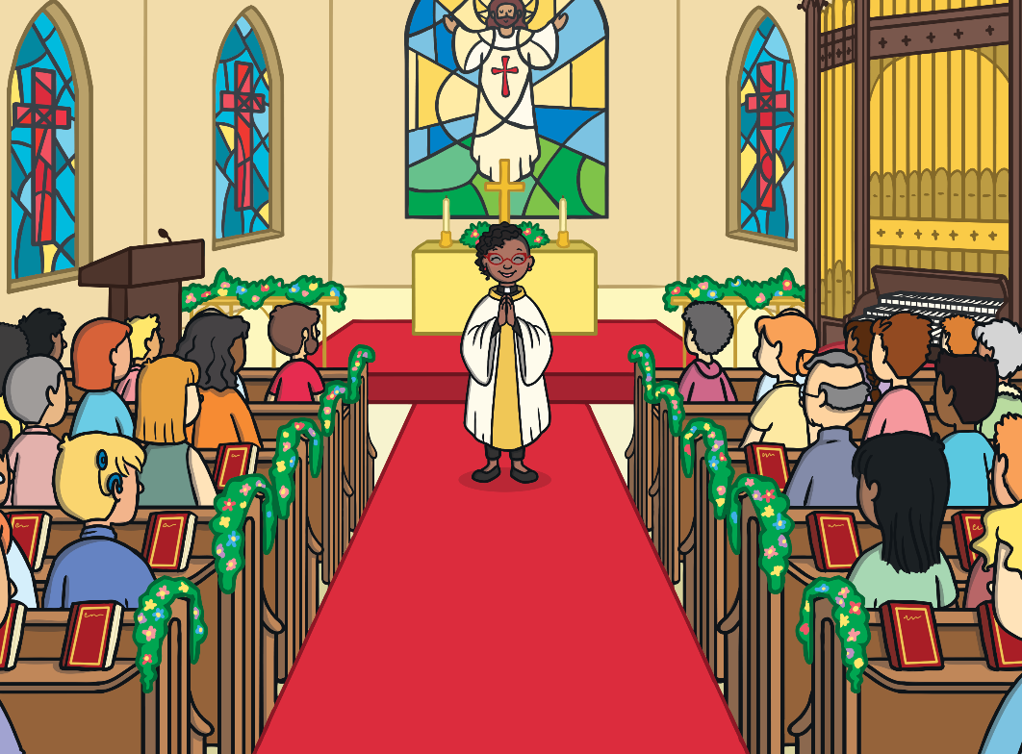
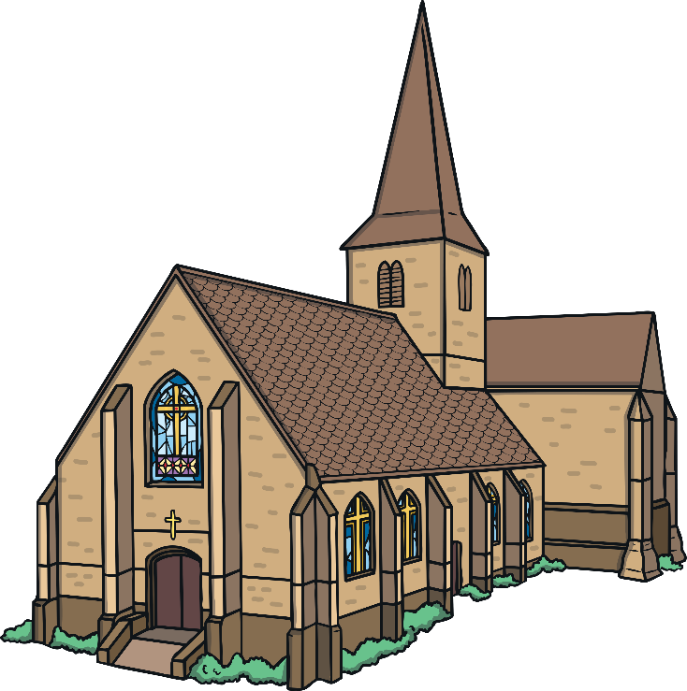
Why Do People Go to Church?
Christians attend church for many different reasons. It is a nice, quiet place where people can go to pray and worship God.
Have you ever been to a church? What was it like?

Slide 3
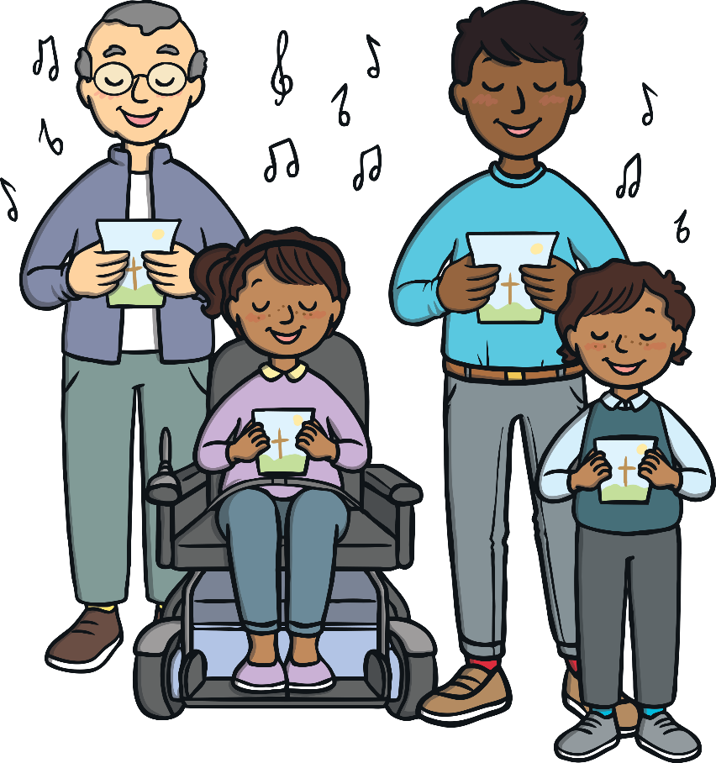
Hymns and Music
Christians like to sing hymns in church. Hymns are special songs all about God. There are hymn books in church, which help people to remember the words as they sing.
Many churches also have an organ. The person who plays the organ is called an organist, they play music to accompany the hymns.
Have you ever sung a hymn or a special song?

Slide 4


Weddings and Christenings
Weddings and christenings can take place in a church.
Have you ever been to a wedding or christening?
What was it like?

Slide 5
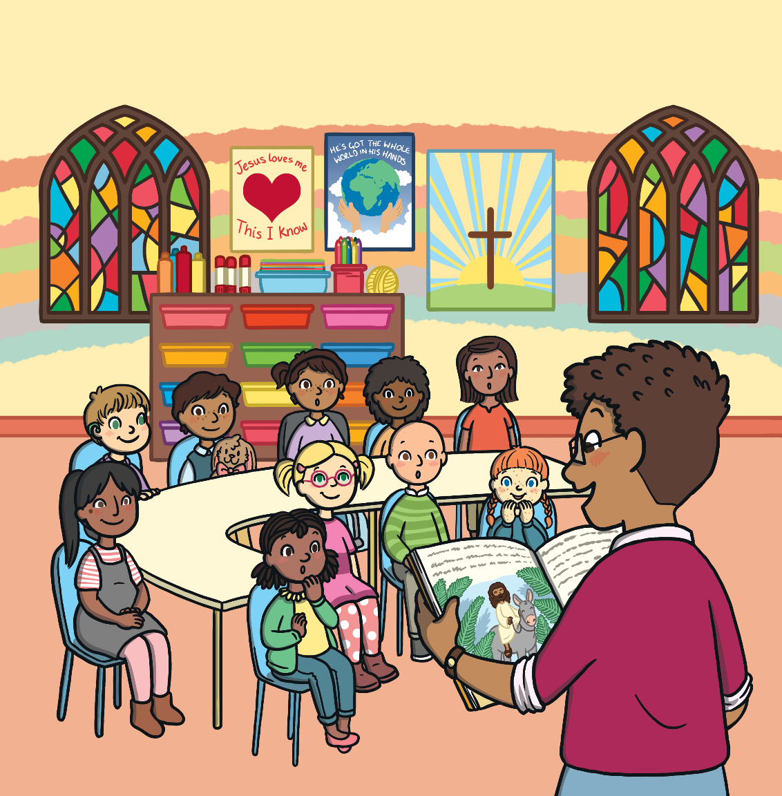
Sunday School
Children can attend Sunday school at church. They learn stories about Jesus and God and often can take part in fun activities, such as crafts, painting and outdoor games.
Have you ever been to Sunday school? What activities did you do?

Slide 6


The Bible
You will find a special book called the Bible inside a church. The Bible contains lots of stories about Jesus and God.
Do you know any stories about Jesus?

Slide 7

Stained-Glass Windows
Churches sometimes have beautiful, colourful stained-glass windows. They often have stories or symbols from the Bible on them.
Why do you think this window has a picture of a cross and daffodil on it?

Slide 8

Font
When baby’s are christened in a church, they are baptised in a font. The vicar puts special holy water on to the baby’s head in the shape of a cross.

Slide 9

Holy Cross
Churches have lots of holy crosses inside them. This is because Christians believe that Jesus died on a cross.

Slide 10

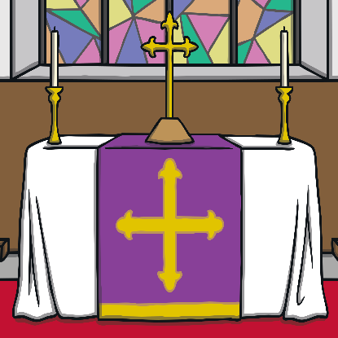

What Else Might You see inside a Church?
Pew
Pews are where people sit in church.
Altar
This is a special table used in church services.
Lectern
This a special stand that the Reverend might read the Bible from.

Slide 11

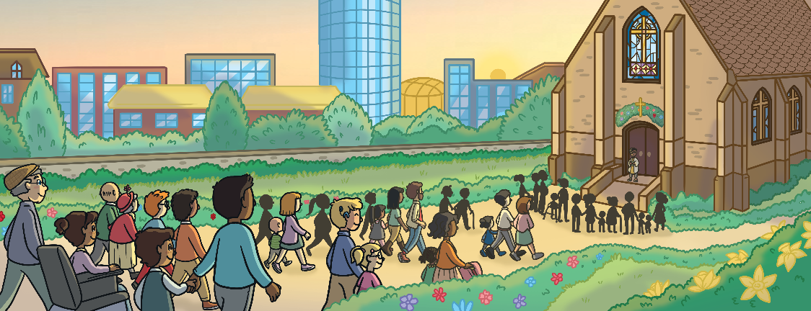
Who Might You Meet inside Church?
A vicar, priest, minister or reverend is the person who works for the church, carrying out church services and events.
A Sunday school teacher tells the children stories from the Bible and helps them with fun activities.
A church can be a good place to make new friends.

Slide 12
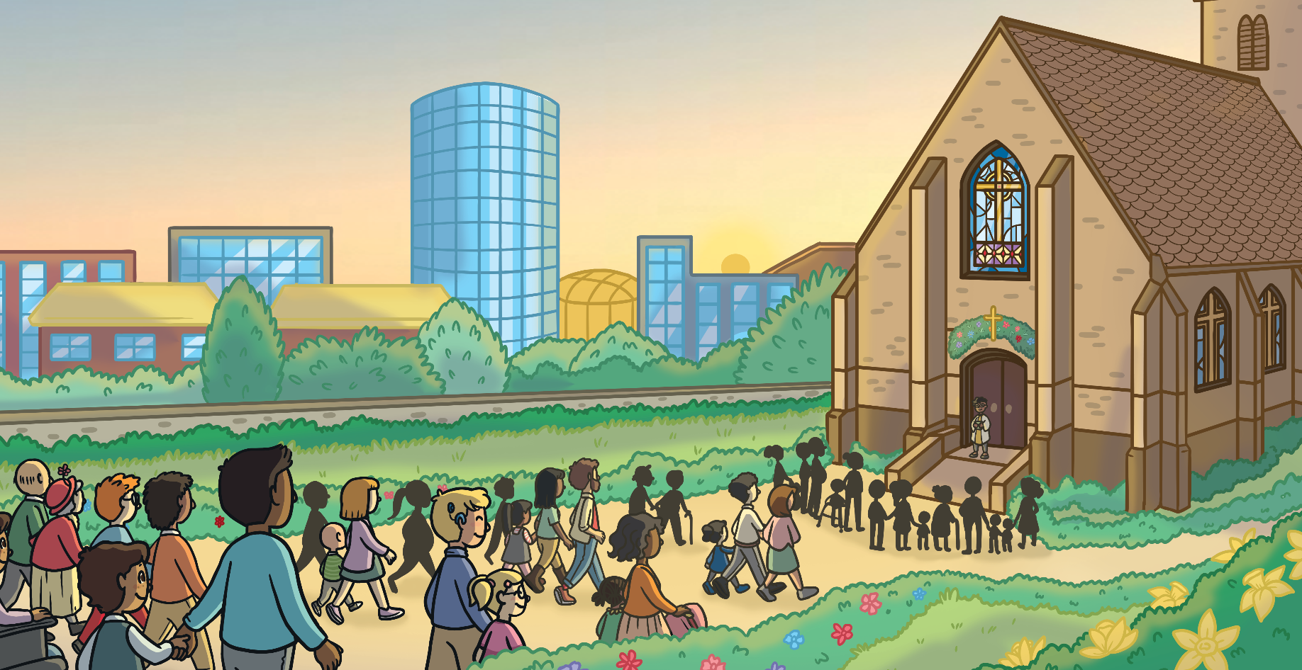
What Did You Learn?
Can you tell and adult one thing that you have learnt about churches today?

