Slide 1



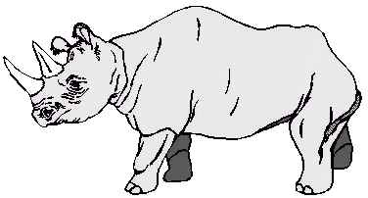


Continue the patterns

Slide 2






Slide 3


Slide 4
Laminate and chop

Slide 5
Laminate and chop

