Slide 1
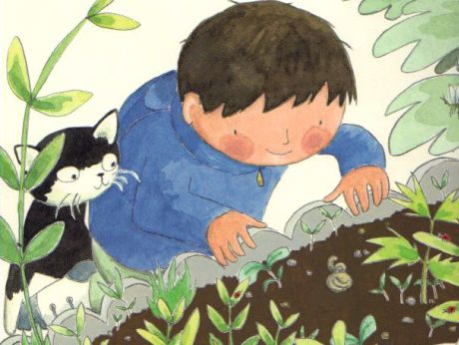
Hello! I’ve been digging for more worms with Gran. Can you help me find the long ones?
Tell me which worm is longer!

Slide 2


Slide 3
Use the cubes to measure the worms.

